Slide 1

Mole Doctor
Frédèrick Franck
Junior Data Scientist @BeCode

Slide 2
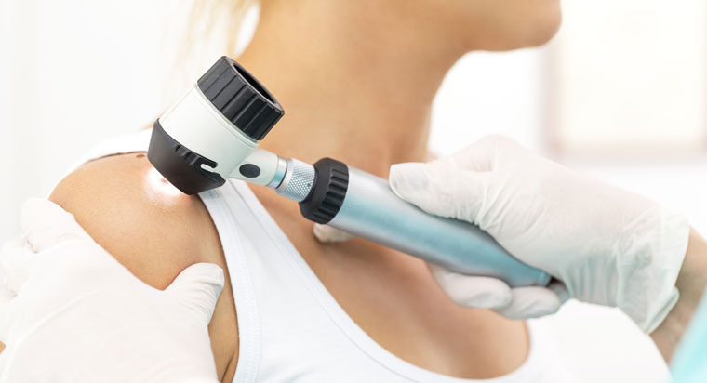
Mole Classification
Time intensive
Individual checks
Doctors needed
Better solution ?

Slide 3


Solution
Classification AI
Deep learning Computer Vision Model trained on real data
Available Online
People can upload their own pictures at home whenever they want
Scalable
Can be improved with extra features based on the clients needs

Slide 4


Classification AI
Transferred Learning
Using a pretrained model will speed up the process
Classification
Instead of benign/malignant we classify the moles into 7 classes so we can advise the clients better
Real Data
Using real data allows us to get the best results
Up sampling
Because we use real data some of the classes are underrepresented and we have to up sample the data to prevent biased outcomes
Docker
To create an easy to use app we deploy using docker so it can run on any platform
Heroku
As our final deployment we have chosen for the Heroku platform as it uses docker , is easy to use and allows free apps such as this one

Slide 5
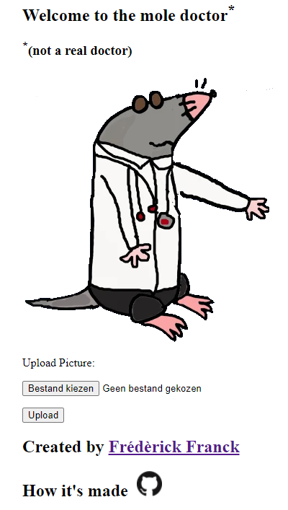
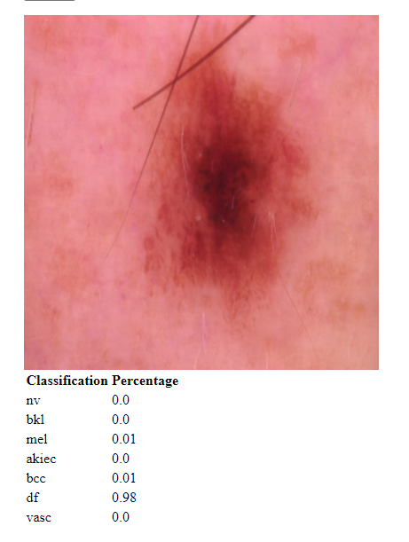
DEMO
https://mole-doctor.herokuapp.com/

Slide 6
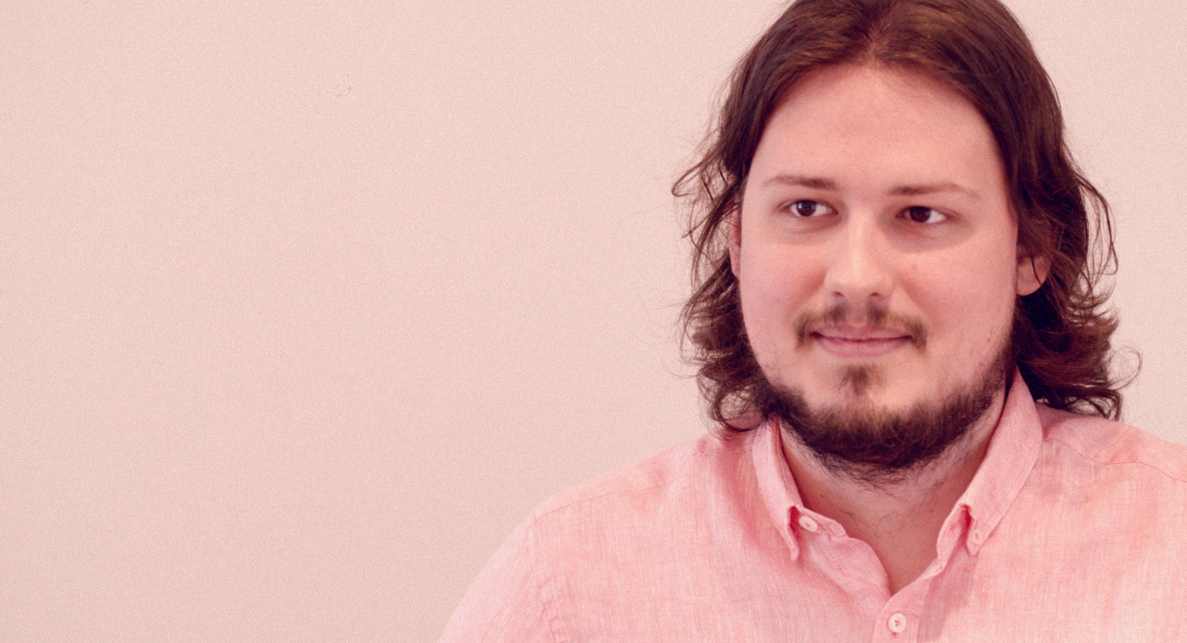


THANK YOU!
Frédèrick Franck
https://www.linkedin.com/in/frédèrick-franck/

