Slide 1
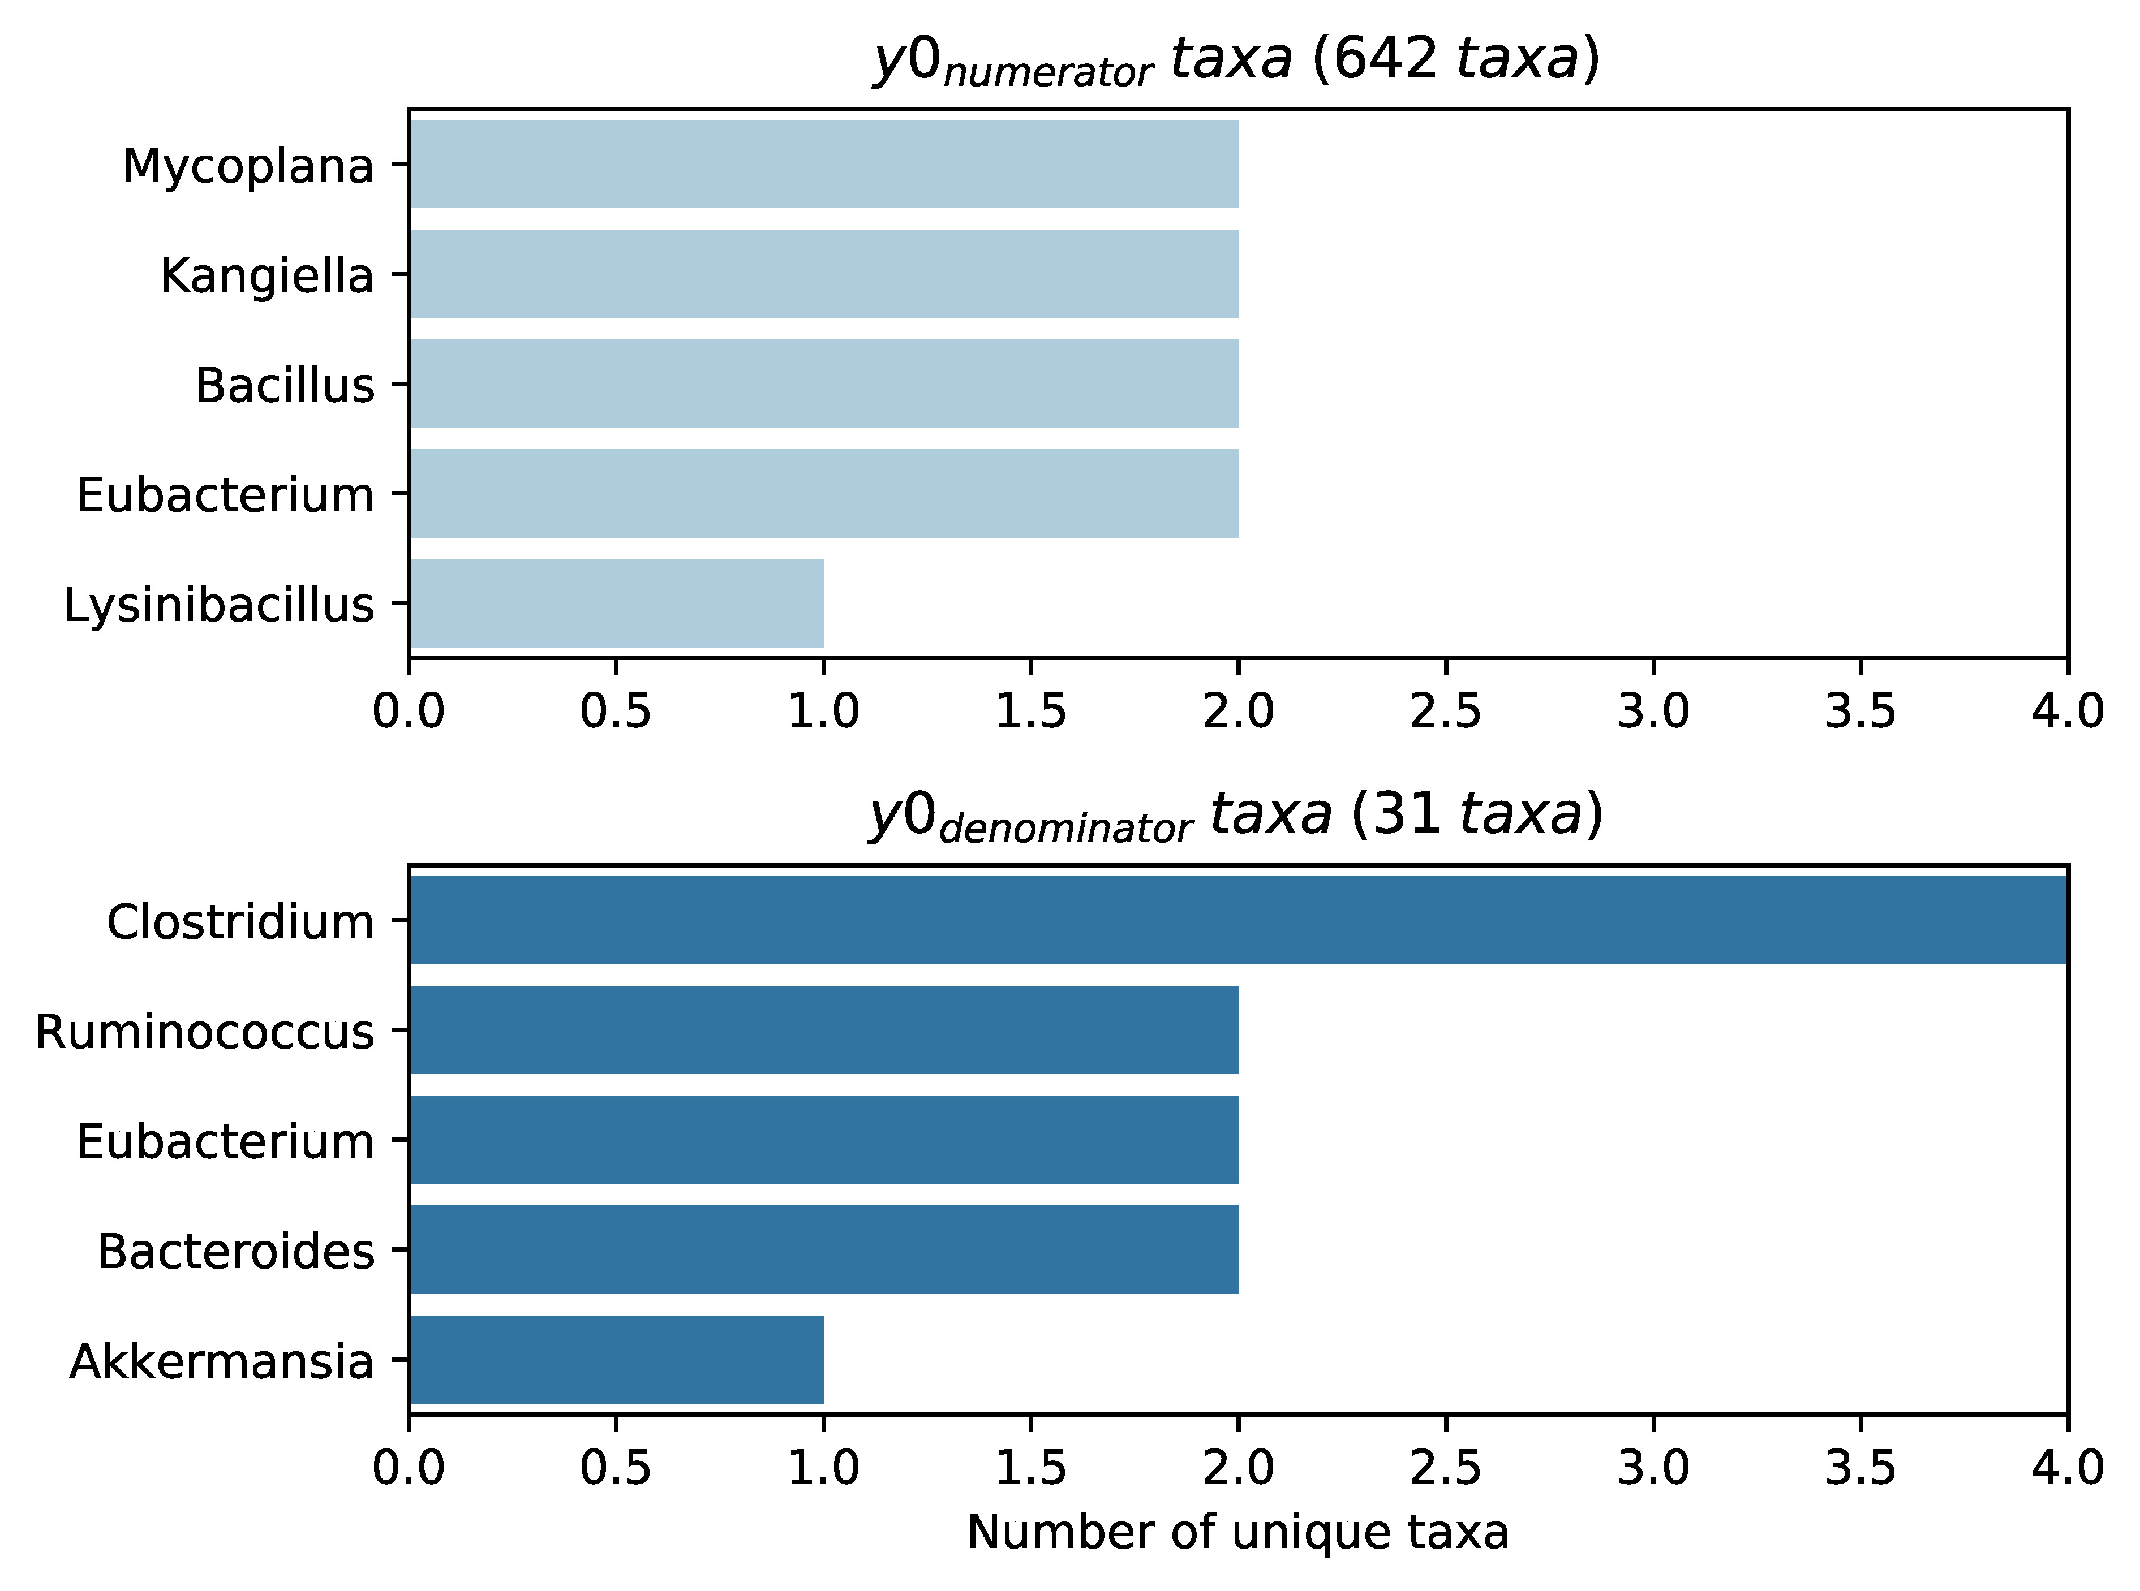
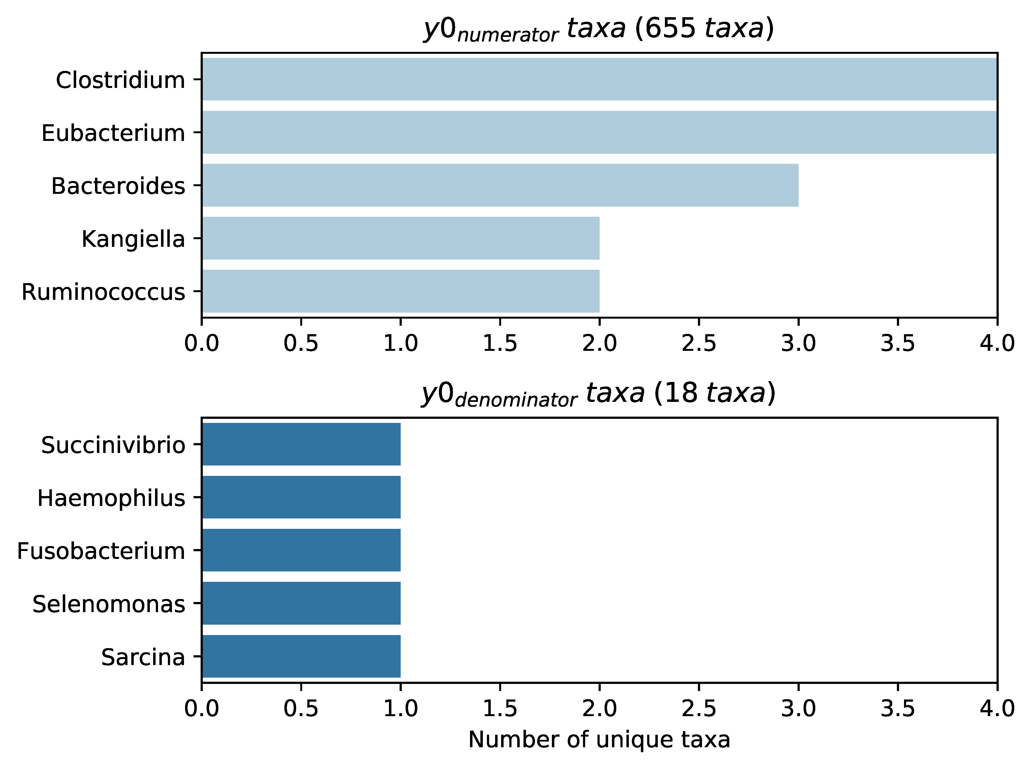


Age $≤$ 2 years old
Age $>$ 2 years old

