Slide 1


Sectoral H₂ competitiveness
Sectoral H₂ technology investments
Total green H₂ demand
Green H₂ cost
Sectoral green H₂ demands
R

Slide 2
Technology learning
Subsidies
Sectoral H₂ competitiveness
Sectoral H₂ technology investments
Total green H₂ demand
Green H₂ cost
Sectoral green H₂ demands
R
Carbon Tax
R
Technology acceptance

Slide 3
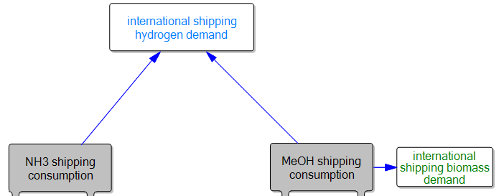
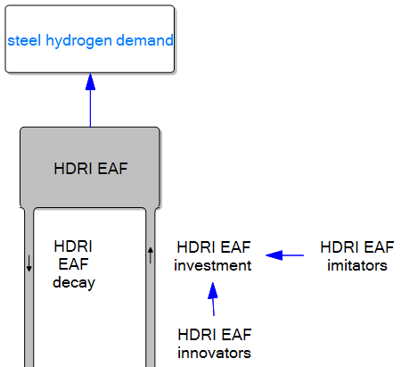
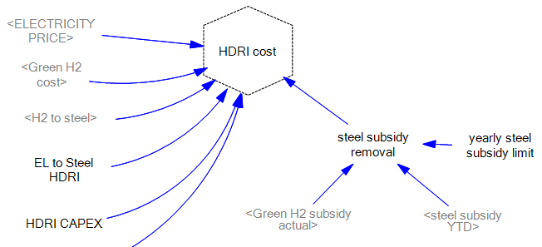
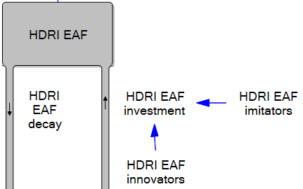
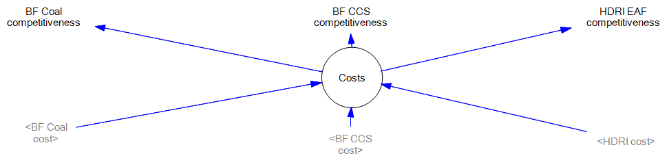

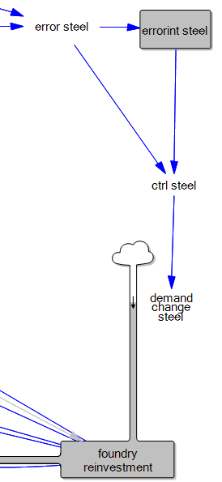


Slide 4
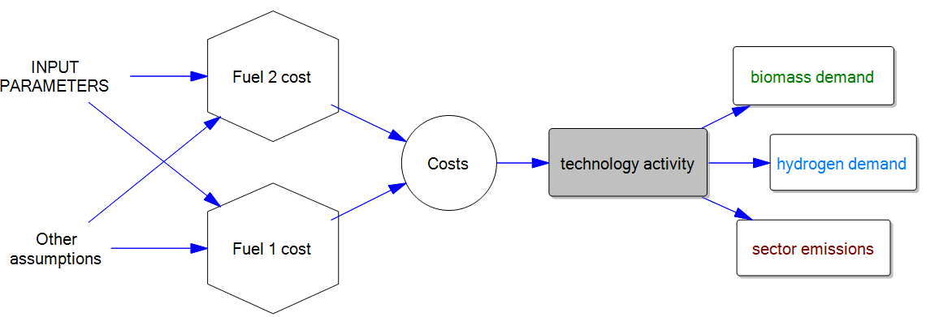

Slide 5
Hydrogen Production

