Slide 1


Sectoral H₂ competitiveness
Sectoral H₂ technology investments
Total green H₂ demand
Green H₂ cost
Sectoral green H₂ demands
R

Slide 2
Sectoral H₂ competitiveness
Sectoral H₂ technology investments
Total green H₂ demand
Green H₂ cost
Sectoral green H₂ demands
+
R

Slide 3
Technology learning
Subsidies
Sectoral H₂ competitiveness
Sectoral H₂ technology investments
Total green H₂ demand
Green H₂ cost
Sectoral green H₂ demands
R
Carbon Tax
R
Technology acceptance

Slide 4
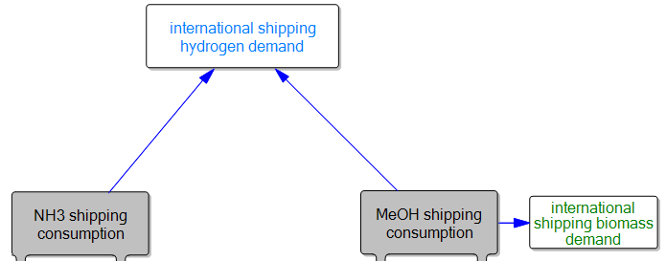
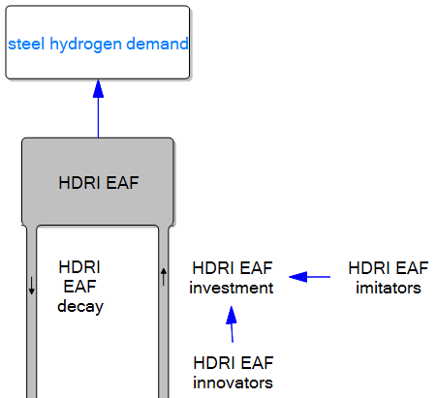
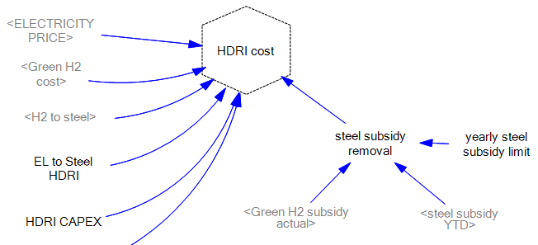
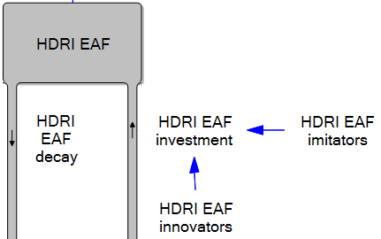
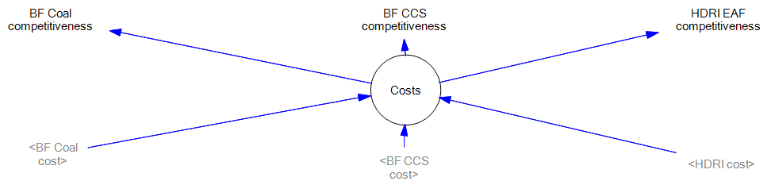

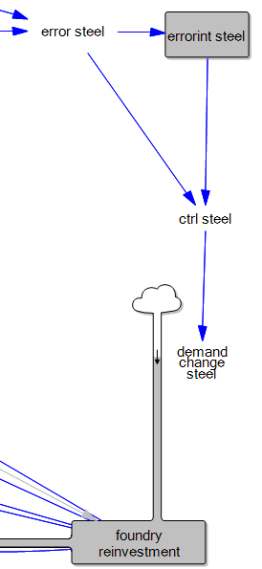


Slide 5
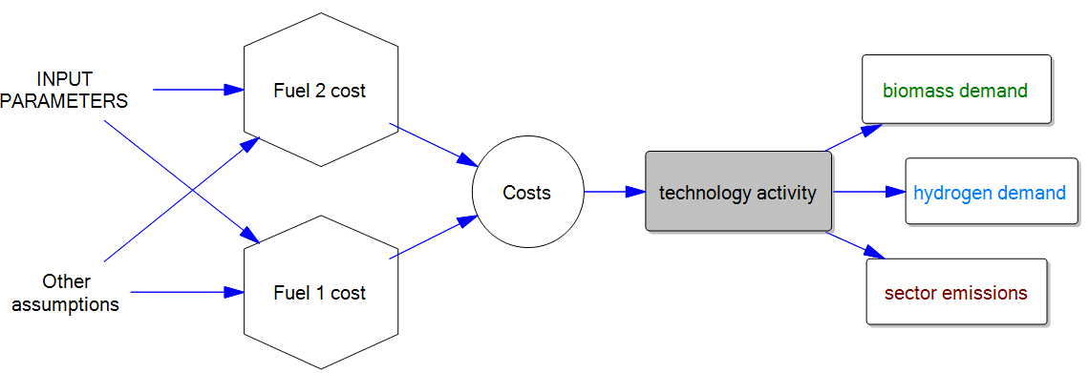

Slide 6
Hydrogen Production

