Slide 1
Nanoparticle toxicity
Jérôme Neirynck, Frederik Van Eecke & Robin Vrielynck
prof. dr. Ewald Janssens & prof. dr. Kristiaan Temst
Advanced Topics in Clusters, Macromolecules & Nanoparticles (G0S94A)
Master of Physics
Faculty of Science – Department of Physics and Astronomy

Slide 2
Outline
J. Neirynck, F. Van Eecke & R. Vrielynck
Introduction: What is toxicity?
Parameters influencing toxicity
Ways of entry & translocation

Slide 3
What is nanotoxicity?
J. Neirynck, F. Van Eecke & R. Vrielynck
= study of toxicity of nanomaterials
Inert materials become highly active at nanodimensions
Intended to determine whether or to what these properties pose a threat
Their most attractive properties make them also potentially toxic.
Introduction Framework Techniques & Results Summary

Slide 4
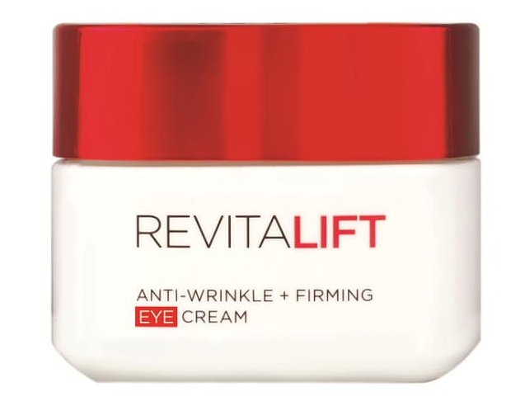

Nanoparticles in real life
J. Neirynck, F. Van Eecke & R. Vrielynck
Consumer products
Nanoparticle-baised cometics
Nanocomposite parts
Introduction Framework Techniques & Results Summary

Slide 5
Properties of nanoscale materials
J. Neirynck, F. Van Eecke & R. Vrielynck
Their most attractive properties make them also potentially toxic.
Higher reactivity
Higher surface to mass ratio
Higher permeation
Properties of matter change at nanosize:
Colour
Chemical reactivity
Introduction Framework Techniques & Results Summary

Slide 6
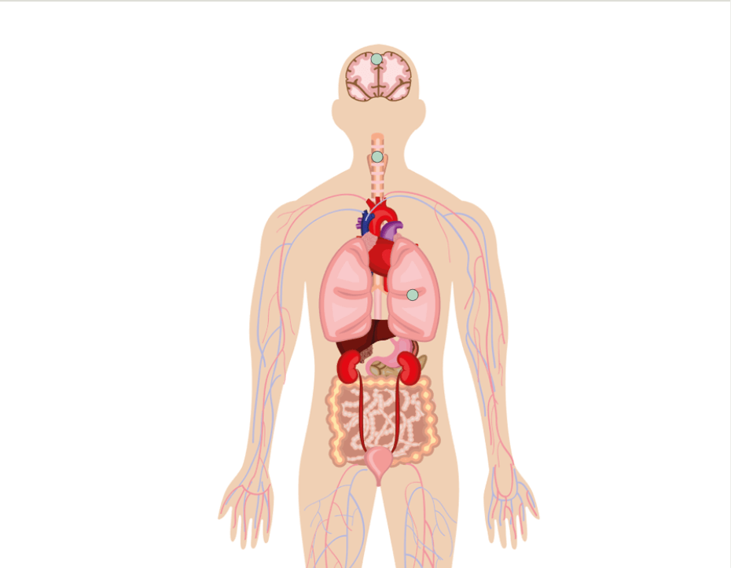
Exposure to nanoscale materials
J. Neirynck, F. Van Eecke & R. Vrielynck
Inhalation
Oral ingestion
Skin contact
Introduction Framework Techniques & Results Summary

Slide 7
Tests for toxicity
J. Neirynck, F. Van Eecke & R. Vrielynck
Measurement parameters:
duration & route
of exposure
dosage & composition
of test material
reference material need to be provided to compare
what biological environment is used?
Response of biological environment to the nanoparticles can extremely vary!
Introduction Framework Techniques & Results Summary

Slide 8
Areas studied for nanotoxicity
Characterization
In Vitro Toxicity
In Vivo Toxicity
Predictive Modeling

Slide 9
Areas studied for nanotoxicity
Area 1: Nanoparticle characterization
Nanoparticles are first assessed in the as-synthesized form after dispersion in the appropriate aqueous media.
Determination of:
Concentration
Composition
Size
Surface area
Morphology
charge
Introduction Framework Techniques & Results Summary
Notes:
FOR COMPOSITION AND CONCENTRATION: dispersice X-ray analysis (EDS), atomic absorption spectroscopy (AAS)
FOR SIZE AND SURFACE AREA:
SIZE AND MORPHOLOGYl: AFM , SEM and TEM.

Slide 10
Areas studied for nanotoxicity
Area 2: In Vitro toxicity
Study influence on subcellular, cellular and whole tissue.
Determination of:
A relatively simple model that reveals a general mechanism of toxicity can be a basis for further assessment.
“elementary toxicity”: the ability of a compound to cause death as a consequence of damage to basic cellular functions.
Experimental observation:
“The data obtained from basal toxicity studies have been found to be in good correlation with acute toxicity in animals and humans”

Slide 11
Areas studied for nanotoxicity
Area 3: In Vivo
= Test results from In Vitro experiments
Test for effects on:
immune system response
Translocation to other areas after uptake
Area 4: Toxicokinetic modeling
describes the absorption, distribution, metabolism and elimination of xenobiotics (foreign materials) within an organism, as a function of dose and time.

Slide 12
Genotoxicity
J. Neirynck, F. Van Eecke & R. Vrielynck
Study of physical and chemical agents that can damage the genetic materials of cells
DNA damage, which can lead to cancer
Inherting changes in DNA from one generation to next
Introduction Framework Techniques & Results Summary
Notes:
In vivo – in vitro – ex vivo

Slide 13
DNA mutations
J. Neirynck, F. Van Eecke & R. Vrielynck
Ideal: DNA sequence do not change, except during reproduction
Reality: DNA damage due to cell process & toxic chemicals
robust repair mechanism
DNA is repaired incorrectly
mutations
no or minor effect
life-threatening effects
when occured in wrong place
Introduction Framework Techniques & Results Summary
Notes:
In vivo – in vitro – ex vivo

Slide 14
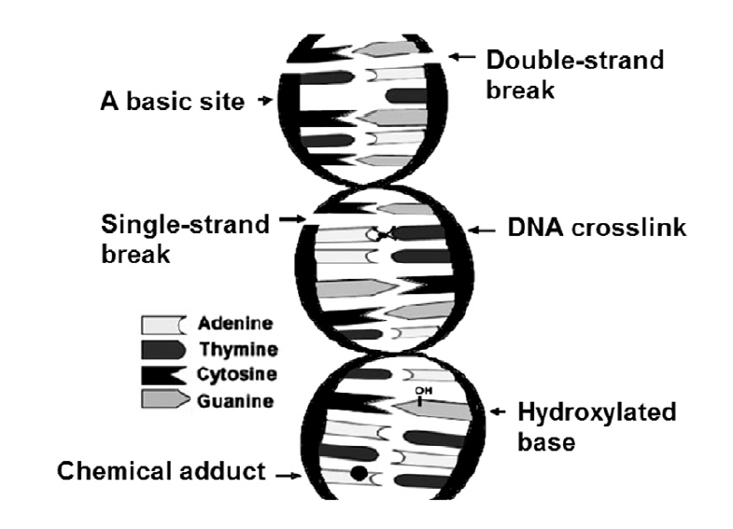
DNA mutations
J. Neirynck, F. Van Eecke & R. Vrielynck
Compounds do not correspond (4)
Structure of DNA string is broken (2)
Introduction Framework Techniques & Results Summary
Notes:
In vivo – in vitro – ex vivo

Slide 15
DNA mutations
J. Neirynck, F. Van Eecke & R. Vrielynck
Origin of DNA damage:
Ionizing radiation
Chemicals
Formation of reactive oxygen species
Introduction Framework Techniques & Results Summary
Notes:
In vivo – in vitro – ex vivo

Slide 16
Detection of genetic alterations
J. Neirynck, F. Van Eecke & R. Vrielynck
Introduction Framework Techniques & Results Summary
Notes:
In vivo – in vitro – ex vivo

Slide 17
Parameters influcencing toxicity

Slide 18
Dose dependence
J. Neirynck, F. Van Eecke & R. Vrielynck
Not dependent on mass dose
Surface is reactive, so small particles at a low mass dose can be as toxic al larger particles with a higer mass dose
Surface dose is what makes influences the toxicity
Introduction Framework Techniques & Results Summary

Slide 19
Concentration dependence
Large concentration --> aggregation of particles
Larger particles, less surface AND white bloodcells can macrophage the aggregates
Large concentration results in less toxicity

Slide 20
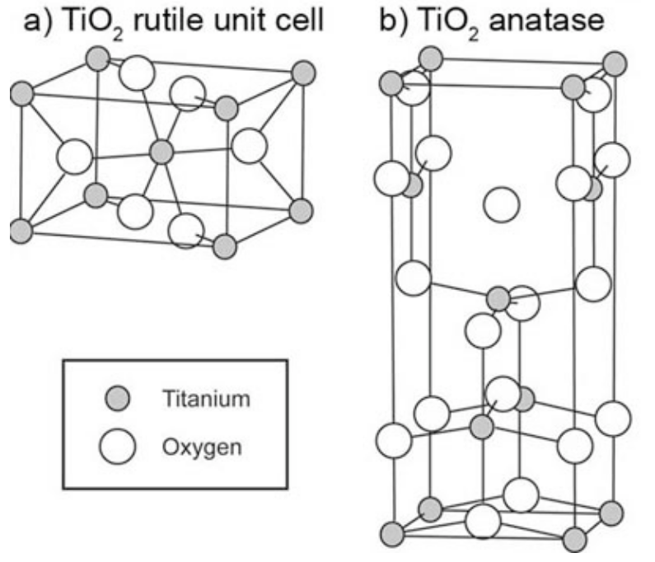
Crystaline structure
Even for the same substance, a different crystaline structure may influence the toxicity
TiO₂ has for instance two different structrures, of which one is toxic, and the other one is nontoxic

Slide 21
Aspect ratio
Long fibers are more toxic than short ones
Stay longer in the body (81% after 60 days)
Carbon nanotubes can be very toxic

Slide 22
Carbon nanotubes toxicity

Slide 23
Adaptation to nanoparticles
When first exposed to low doses of toxic nanoparticles for a period of time, there is not such a heavy reaction to a high dose
Habituation to the nanoparticles
White bloodcells fight more effectively against the nanoparticles

Slide 24
Nanofood
J. Neirynck, F. Van Eecke & R. Vrielynck
PACKING
Active packing
constantly provides certain feature
e.g. stop oxygen from spoiling food
antimicrobial films in beer bottles
Smart packing
reacts to changes in environment
e.g. presence of pathogens that can produce diseases
Future of packing
reflecting heat ox ice cream boxes
self healing packing
milk carton that changes colour
Source: AZoNano. (2006). Nanofood Defined and The Use Of Nanotechnology In Packaging, Producing and Growing Foods Now and Into The Future, https://www.azonano.com/article.aspx?ArticleID=1786
Introduction Framework Techniques & Results Summary

Slide 25
Nanofood
J. Neirynck, F. Van Eecke & R. Vrielynck
FOOD PROCESSING
FARMING
Nanoparticles & nanocapsules
change taste, alter properties
e.g. tuna oil (omega 3) in bread
avoid unpleasant taste
Nanosensors
nutrient levels, water concentration, pests,…
AGRICULTURE
Nanochips
tracking, information about vaccines
ANIMALS
Source: AZoNano. (2006). Nanofood Defined and The Use Of Nanotechnology In Packaging, Producing and Growing Foods Now and Into The Future, https://www.azonano.com/article.aspx?ArticleID=1786
Introduction Framework Techniques & Results Summary

