Slide 1
Nanoparticle toxicity
Jérôme Neirynck, Frederik Van Eecke & Robin Vrielynck
prof. dr. Ewald Janssens & prof. dr. Kristiaan Temst
Advanced Topics in Clusters, Macromolecules & Nanoparticles (G0S94A)
Master of Physics
Faculty of Science – Department of Physics and Astronomy

Slide 2
Outline
J. Neirynck, F. Van Eecke & R. Vrielynck
Introduction: What is toxicity?
Parameters influencing toxicity
Exposure of nanoparticles
Testing nanotoxicity
Areas studied for nanotoxicity
Application: Genotoxicity
Application: CNT toxicity
Modelling of nanotoxity
Nanofood
Conclusion

Slide 3
Outline
J. Neirynck, F. Van Eecke & R. Vrielynck
Introduction: What is toxicity?
Parameters influencing toxicity
Exposure of nanoparticles
Testing nanotoxicity
Areas studied for nanotoxicity
Application: Genotoxicity
Application: CNT toxicity
Modelling of nanotoxity
Nanofood
Conclusion

Slide 4
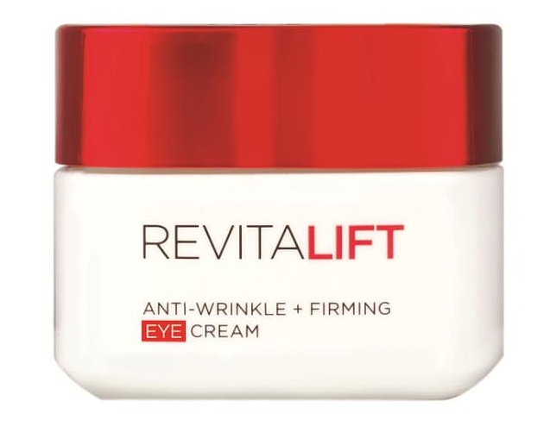

Nanoparticles in real life
J. Neirynck, F. Van Eecke & R. Vrielynck
Consumer products
Nanoparticle-baised cometics
Nanocomposite parts
Source: Bahadar, H., Maqbool, F., Niaz, K., & Abdollahi, M. (2016). Toxicity of Nanoparticles and an Overview of Current Experimental Models. Iranian biomedical journal, 20(1), 1–11. doi:10.7508/ibj.2016.01.001
Introduction Framework Techniques & Results Summary

Slide 5
What is nanotoxicity?
J. Neirynck, F. Van Eecke & R. Vrielynck
= study of toxicity of nanomaterials
Inert materials become highly active at nanodimensions
Intended to determine whether or to what these properties pose a threat
Their most attractive properties make them also potentially toxic.
Source: Bahadar, H., Maqbool, F., Niaz, K., & Abdollahi, M. (2016). Toxicity of Nanoparticles and an Overview of Current Experimental Models. Iranian biomedical journal, 20(1), 1–11. doi:10.7508/ibj.2016.01.001
Introduction Framework Techniques & Results Summary

Slide 6
Properties of nanoscale materials
J. Neirynck, F. Van Eecke & R. Vrielynck
Their most attractive properties make them also potentially toxic.
Higher reactivity
Higher surface to mass ratio
Higher permeation
Properties of matter change at nanosize:
Colour
Chemical reactivity
Source: Bahadar, H., Maqbool, F., Niaz, K., & Abdollahi, M. (2016). Toxicity of Nanoparticles and an Overview of Current Experimental Models. Iranian biomedical journal, 20(1), 1–11. doi:10.7508/ibj.2016.01.001
Introduction Framework Techniques & Results Summary

Slide 7
Silver nanoparticles
J. Neirynck, F. Van Eecke & R. Vrielynck
Macro: anti-bacterial substance
Nano: detected in various organs of rats via inhalation
Toxicity depends on:
Cell viability
Reactive oxygen species
Dehydrogenase
Coating difference: peptide-coated VS citrate-coated
Dose
Conclusion: toxicity issue relate to experimental by using of standard protocols
Source: Bahadar, H., Maqbool, F., Niaz, K., & Abdollahi, M. (2016). Toxicity of Nanoparticles and an Overview of Current Experimental Models. Iranian biomedical journal, 20(1), 1–11. doi:10.7508/ibj.2016.01.001
Introduction Framework Techniques & Results Summary
Notes:
In vivo – in vitro – ex vivo

Slide 8
Zinc oxide nanoparticles
J. Neirynck, F. Van Eecke & R. Vrielynck
Applications: paint, UV detectors, gas sensors, sunscreens & personal care products
Studies have shown:
Cell death
Change cell morphology
DNA damage
Mitochondrial inactivity in kidney cells
Source: Bahadar, H., Maqbool, F., Niaz, K., & Abdollahi, M. (2016). Toxicity of Nanoparticles and an Overview of Current Experimental Models. Iranian biomedical journal, 20(1), 1–11. doi:10.7508/ibj.2016.01.001
Introduction Framework Techniques & Results Summary
Notes:
In vivo – in vitro – ex vivo

Slide 9
Outline
J. Neirynck, F. Van Eecke & R. Vrielynck
Introduction: What is toxicity?
Parameters influencing toxicity
Exposure of nanoparticles
Testing nanotoxicity
Areas studied for nanotoxicity
Application: Genotoxicity
Application: CNT toxicity
Modelling of nanotoxity
Nanofood
Conclusion

Slide 10
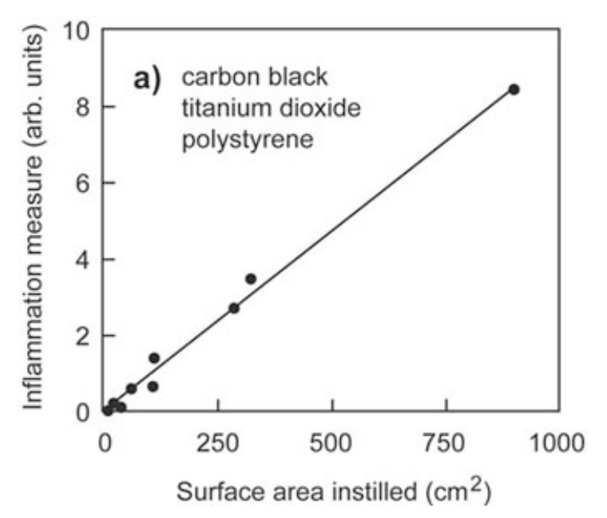
Dose dependence
J. Neirynck, F. Van Eecke & R. Vrielynck
Not dependent on mass dose
Surface is reactive, so small particles at a low mass dose can be as toxic as larger particles with a higher mass dose
Surface dose is what influences the toxicity
Source: Buzea, Cristina, Ivan I. Pacheco, and Kevin Robbie. "Nanomaterials and nanoparticles: sources and toxicity." Biointerphases 2.4 (2007): MR17-MR71.
Introduction Framework Techniques & Results Summary

Slide 11
Size dependence
J. Neirynck, F. Van Eecke & R. Vrielynck
Even at the same surface dose size of particles has an effect
Smaller particles have
prolonged retention
higher translocation
higher effect on the functioning of the macrophages
Source: Buzea, Cristina, Ivan I. Pacheco, and Kevin Robbie. "Nanomaterials and nanoparticles: sources and toxicity." Biointerphases 2.4 (2007): MR17-MR71.
Introduction Framework Techniques & Results Summary

Slide 12
Concentration dependence
J. Neirynck, F. Van Eecke & R. Vrielynck
Large concentration → aggregation of particles
Larger particles, less surface AND white bloodcells can macrophage the aggregates
Large concentration results in less toxicity
Source: Buzea, Cristina, Ivan I. Pacheco, and Kevin Robbie. "Nanomaterials and nanoparticles: sources and toxicity." Biointerphases 2.4 (2007): MR17-MR71.
Introduction Framework Techniques & Results Summary

Slide 13
Crystalline structure
J. Neirynck, F. Van Eecke & R. Vrielynck
Even for the same substance, a different crystalline structure may influence the toxicity
TiO₂ has for instance two different structures, of which one is toxic, and the other one is nontoxic
Source: Buzea, Cristina, Ivan I. Pacheco, and Kevin Robbie. "Nanomaterials and nanoparticles: sources and toxicity." Biointerphases 2.4 (2007): MR17-MR71.
Introduction Framework Techniques & Results Summary

Slide 14
Aspect ratio
J. Neirynck, F. Van Eecke & R. Vrielynck
Long fibers are more toxic than short ones
Stay longer in the body (81% after 60 days)
Can penetrate celmembrane
Carbon nanotubes can be toxic
Source: Buzea, Cristina, Ivan I. Pacheco, and Kevin Robbie. "Nanomaterials and nanoparticles: sources and toxicity." Biointerphases 2.4 (2007): MR17-MR71.
Introduction Framework Techniques & Results Summary

Slide 15
Adaptation to nanoparticles
J. Neirynck, F. Van Eecke & R. Vrielynck
When first exposed to low doses of toxic nanoparticles for a period of time, there is not such a heavy reaction to a high dose
Habituation to the nanoparticles
White bloodcells fight more effectively against the nanoparticles
Source: Buzea, Cristina, Ivan I. Pacheco, and Kevin Robbie. "Nanomaterials and nanoparticles: sources and toxicity." Biointerphases 2.4 (2007): MR17-MR71.
Introduction Framework Techniques & Results Summary

Slide 16
Outline
J. Neirynck, F. Van Eecke & R. Vrielynck
Introduction: What is toxicity?
Parameters influencing toxicity
Exposure of nanoparticles
Testing nanotoxicity
Areas studied for nanotoxicity
Application: Genotoxicity
Application: CNT toxicity
Modelling of nanotoxity
Nanofood
Conclusion

Slide 17
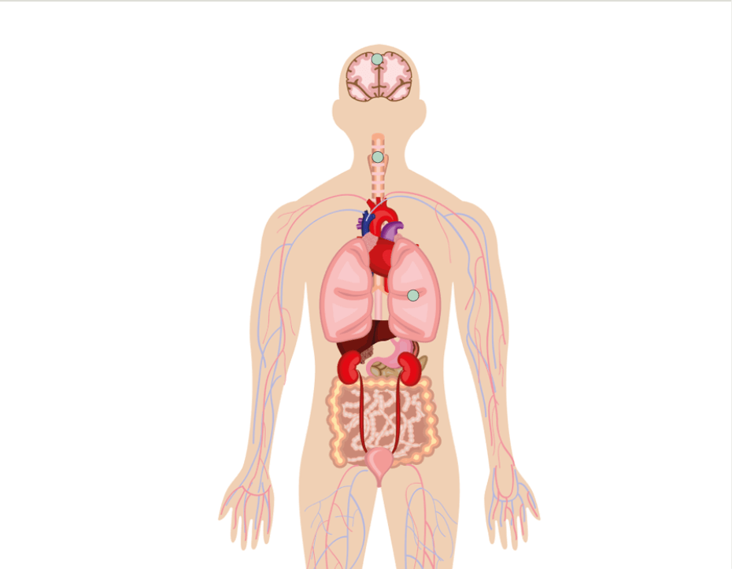
Exposure to nanoscale materials
J. Neirynck, F. Van Eecke & R. Vrielynck
Inhalation
Oral ingestion
Skin contact
Source: Armstead, A. L., & Li, B. (2016). Nanotoxicity: emerging concerns regarding nanomaterial safety and occupational hard metal (WC-Co) nanoparticle exposure. International journal of nanomedicine, 11, 6421–6433. doi:10.2147/IJN.S121238
Introduction Framework Techniques & Results Summary

Slide 18
Exposure to nanoscale materials
J. Neirynck, F. Van Eecke & R. Vrielynck
Inhalation
Oral ingestion
Skin contact
PRIMARY EFFECTS
SECONDARY EFFECTS
Toxicity
Oxidative stress
DNA damage
Inflammation
Tissue & organ deposition
Systematic inflammation
Altered functionality
EXTERNAL
Direct exposure
INTERNAL
Source: Armstead, A. L., & Li, B. (2016). Nanotoxicity: emerging concerns regarding nanomaterial safety and occupational hard metal (WC-Co) nanoparticle exposure. International journal of nanomedicine, 11, 6421–6433. doi:10.2147/IJN.S121238
Introduction Framework Techniques & Results Summary

Slide 19
Outline
J. Neirynck, F. Van Eecke & R. Vrielynck
Introduction: What is toxicity?
Parameters influencing toxicity
Exposure of nanoparticles
Testing nanotoxicity
Areas studied for nanotoxicity
Application: Genotoxicity
Application: CNT toxicity
Modelling of nanotoxity
Nanofood
Conclusion

Slide 20
Tests for toxicity
J. Neirynck, F. Van Eecke & R. Vrielynck
Measurement parameters:
duration & route
of exposure
dosage & composition
of test material
reference material need to be provided to compare
what biological environment is used?
Response of biological environment to the nanoparticles can extremely vary!
Source: Bahadar, H., Maqbool, F., Niaz, K., & Abdollahi, M. (2016). Toxicity of Nanoparticles and an Overview of Current Experimental Models. Iranian biomedical journal, 20(1), 1–11. doi:10.7508/ibj.2016.01.001
Introduction Framework Techniques & Results Summary

Slide 21
Outline
J. Neirynck, F. Van Eecke & R. Vrielynck
Introduction: What is toxicity?
Parameters influencing toxicity
Exposure of nanoparticles
Testing nanotoxicity
Areas studied for nanotoxicity
Application: Genotoxicity
Application: CNT toxicity
Modelling of nanotoxity
Nanofood
Conclusion

Slide 22
Areas studied for nanotoxicity
J. Neirynck, F. Van Eecke & R. Vrielynck
Characterization
In Vitro Toxicity
In Vivo Toxicity
Predictive Modeling
Source:
Introduction Framework Techniques & Results Summary

Slide 23
Areas studied for nanotoxicity
J. Neirynck, F. Van Eecke & R. Vrielynck
Area 1: Nanoparticle characterization
Nanoparticles are first assessed in the as-synthesized form after dispersion in the appropriate aqueous media.
Determination of:
Concentration
Composition
Size
Surface area
Morphology
charge
Source:
Introduction Framework Techniques & Results Summary

Slide 24
Areas studied for nanotoxicity
J. Neirynck, F. Van Eecke & R. Vrielynck
Area 2: In Vitro toxicity
Study influence on subcellular, cellular and whole tissue.
Determination of:
A relatively simple model that reveals a general mechanism of toxicity can be a basis for further assessment.
“elementary toxicity”: the ability of a compound to cause death as a consequence of damage to basic cellular functions.
Experimental observation:
“The data obtained from basal toxicity studies have been found to be in good correlation with acute toxicity in animals and humans”
Source:
Introduction Framework Techniques & Results Summary

Slide 25
Areas studied for nanotoxicity
J. Neirynck, F. Van Eecke & R. Vrielynck
Area 3: In Vivo
= Test results from In Vitro experiments
Test for effects on:
immune system response
Translocation to other areas after uptake
Area 4: Toxicokinetic modeling
describes the absorption, distribution, metabolism and elimination of xenobiotics (foreign materials) within an organism, as a function of dose and time.
Source:
Introduction Framework Techniques & Results Summary

Slide 26
Outline
J. Neirynck, F. Van Eecke & R. Vrielynck
Introduction: What is toxicity?
Parameters influencing toxicity
Exposure of nanoparticles
Testing nanotoxicity
Areas studied for nanotoxicity
Application: Genotoxicity
Application: CNT toxicity
Modelling of nanotoxity
Nanofood
Conclusion

Slide 27
Genotoxicity
J. Neirynck, F. Van Eecke & R. Vrielynck
Study of physical and chemical agents that can damage the genetic materials of cells
DNA damage, which can lead to cancer
Inherting changes in DNA from one generation to next
Source: Phillips D.H., Arlt V.M. (2009) Genotoxicity: damage to DNA and its consequences. In: Luch A. (eds) Molecular, Clinical and Environmental Toxicology. Experientia Supplementum, vol 99. Birkhäuser Basel
Introduction Framework Techniques & Results Summary
Notes:
In vivo – in vitro – ex vivo

Slide 28
DNA mutations
J. Neirynck, F. Van Eecke & R. Vrielynck
Ideal: DNA sequence do not change, except during reproduction
Reality: DNA damage due to cell process & toxic chemicals
robust repair mechanism
DNA is repaired incorrectly
mutations
no or minor effect
life-threatening effects
when occured in wrong place
Source: Phillips D.H., Arlt V.M. (2009) Genotoxicity: damage to DNA and its consequences. In: Luch A. (eds) Molecular, Clinical and Environmental Toxicology. Experientia Supplementum, vol 99. Birkhäuser Basel
Introduction Framework Techniques & Results Summary
Notes:
In vivo – in vitro – ex vivo

Slide 29
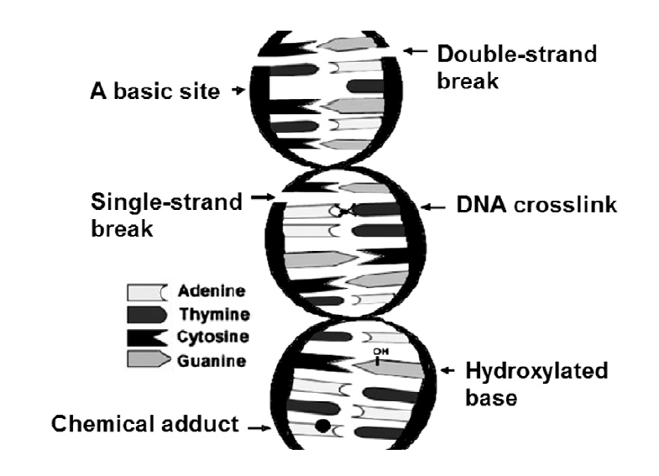
DNA mutations
J. Neirynck, F. Van Eecke & R. Vrielynck
Compounds do not correspond (4)
Structure of DNA string is broken (2)
Source: Phillips D.H., Arlt V.M. (2009) Genotoxicity: damage to DNA and its consequences. In: Luch A. (eds) Molecular, Clinical and Environmental Toxicology. Experientia Supplementum, vol 99. Birkhäuser Basel
Introduction Framework Techniques & Results Summary
Notes:
In vivo – in vitro – ex vivo

Slide 30
DNA mutations
J. Neirynck, F. Van Eecke & R. Vrielynck
Origin of DNA damage:
Ionizing radiation
Chemicals
Formation of reactive oxygen species
Source: Phillips D.H., Arlt V.M. (2009) Genotoxicity: damage to DNA and its consequences. In: Luch A. (eds) Molecular, Clinical and Environmental Toxicology. Experientia Supplementum, vol 99. Birkhäuser Basel
Introduction Framework Techniques & Results Summary
Notes:
In vivo – in vitro – ex vivo

Slide 31
Outline
J. Neirynck, F. Van Eecke & R. Vrielynck
Introduction: What is toxicity?
Parameters influencing toxicity
Exposure of nanoparticles
Testing nanotoxicity
Areas studied for nanotoxicity
Application: Genotoxicity
Application: CNT toxicity
Modelling of nanotoxity
Nanofood
Conclusion

Slide 32
Contradicting results for CNT toxicity
J. Neirynck, F. Van Eecke & R. Vrielynck
Lam et al., 2004
Dose dependent lesions: inflammation, fibrosis and necrosis
Foreign-body reactions
More lymphocytes
Warheit et al., 2004
Non-dose dependent lesions
No prolonged inflamation in the lungs
Source: Lam, Chiu-wing, et al. "A review of carbon nanotube toxicity and assessment of potential occupational and environmental health risks." Critical reviews in toxicology 36.3 (2006): 189-217.
Introduction Framework Techniques & Results Summary

Slide 33
Reason for differences
J. Neirynck, F. Van Eecke & R. Vrielynck
Different way of preparing samples → different diffusion in the lungs
Different fabrication method of CNTs gives different "purity"
In the Warheit et al. experiment lots of the bolus didn't reach the alveolar region
Source: Lam, Chiu-wing, et al. "A review of carbon nanotube toxicity and assessment of potential occupational and environmental health risks." Critical reviews in toxicology 36.3 (2006): 189-217.
Introduction Framework Techniques & Results Summary

Slide 34
CNT toxicity
J. Neirynck, F. Van Eecke & R. Vrielynck
Overview
Impurities
Long fiber macro phagocytosis
Oxidative potential
Source: Lam, Chiu-wing, et al. "A review of carbon nanotube toxicity and assessment of potential occupational and environmental health risks." Critical reviews in toxicology 36.3 (2006): 189-217.
Introduction Framework Techniques & Results Summary

Slide 35
Impurities
J. Neirynck, F. Van Eecke & R. Vrielynck
Encased in carbon shell → no interaction with cells
During ultrasonication (toxic) impurities can be released
Source: Lam, Chiu-wing, et al. "A review of carbon nanotube toxicity and assessment of potential occupational and environmental health risks." Critical reviews in toxicology 36.3 (2006): 189-217.
Introduction Framework Techniques & Results Summary

Slide 36
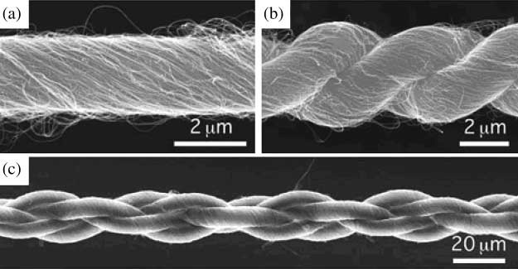
Long fibers
J. Neirynck, F. Van Eecke & R. Vrielynck
CNTs bundel into ropes due to van der Waals forces
Makes long asbestos fibers
Penetrate cell membrane
Source: Lam, Chiu-wing, et al. "A review of carbon nanotube toxicity and assessment of potential occupational and environmental health risks." Critical reviews in toxicology 36.3 (2006): 189-217.
Introduction Framework Techniques & Results Summary

Slide 37
Oxidative stress
J. Neirynck, F. Van Eecke & R. Vrielynck
CNTs can be good conductors
Shifting electrons between cells
Oxidation and reduction
Source: Lam, Chiu-wing, et al. "A review of carbon nanotube toxicity and assessment of potential occupational and environmental health risks." Critical reviews in toxicology 36.3 (2006): 189-217.
Introduction Framework Techniques & Results Summary

Slide 38
Outline
J. Neirynck, F. Van Eecke & R. Vrielynck
Introduction: What is toxicity?
Parameters influencing toxicity
Exposure of nanoparticles
Testing nanotoxicity
Areas studied for nanotoxicity
Application: Genotoxicity
Application: CNT toxicity
Modelling of nanotoxity
Nanofood
Conclusion

Slide 39
In silico models to predict BBB permeation of nanoparticles
J. Neirynck, F. Van Eecke & R. Vrielynck
The mechanism for different NP’s at the BBB is a fundamental parameter to asses and predict their nanotoxic potential for the CNS.
Why in silico models, support in:
Data mining of large databases.
Network analysis.
Molecular dynamics (MD) simulations for the so-called ADMET.
Regulatory demand for advancing the use of alternative non-animal testsystems.
Source:
Introduction Framework Techniques & Results Summary

Slide 40
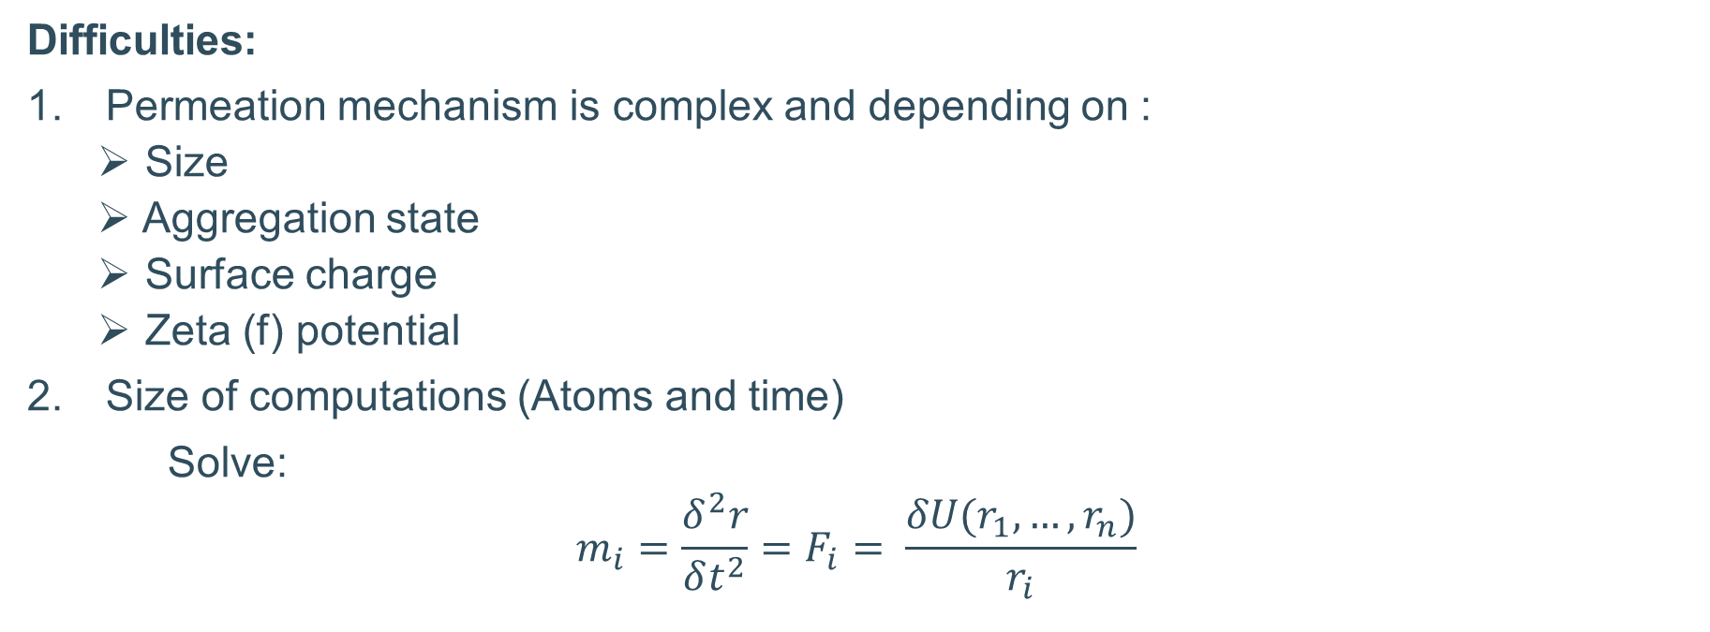
Main issue: Permeation of NP through a lipid membrane
J. Neirynck, F. Van Eecke & R. Vrielynck
Difficulties:
Permeation mechanism is complex and depending on :
Size
Aggregation state
Surface charge
Zeta (f) potential
Size of computations (Atoms and time)
Solve:
$$m_{i}=\frac{δ^{2}r}{δt^{2}}=F_{i}= \frac{δU(r_{1},…,r_{n})}{r_{i}}$$
Source:
Introduction Framework Techniques & Results Summary

Slide 41
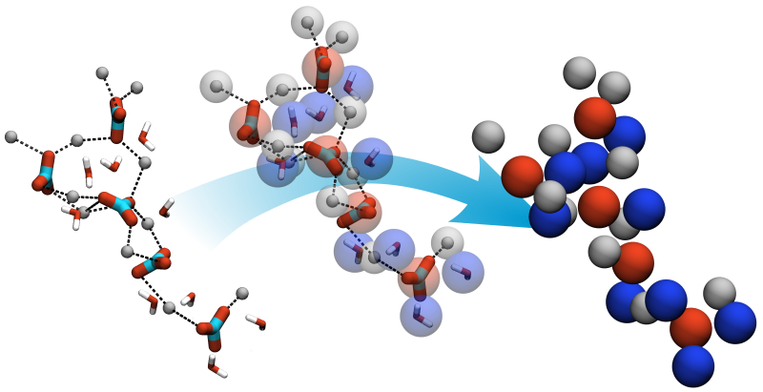
Coarse-grained MD models
J. Neirynck, F. Van Eecke & R. Vrielynck
Model for simplified representation.
using ‘‘pseudoatoms” for the representations of the NP and membrane geometries
Source:
Introduction Framework Techniques & Results Summary

Slide 42
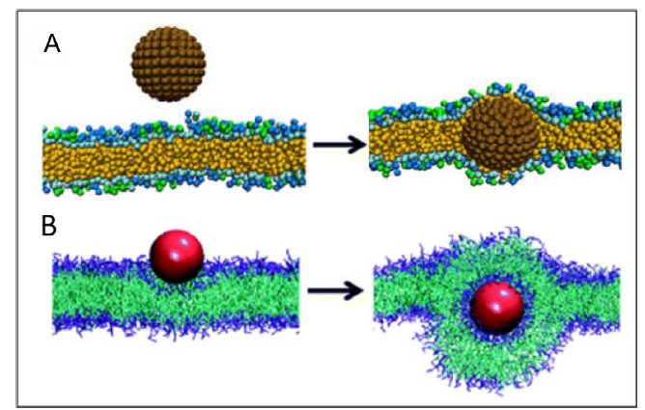
Results from model using dissipative particles
J. Neirynck, F. Van Eecke & R. Vrielynck
Some very small or very hydrophobic NPs may just pass the BBB.
Hydrophobic NP insert lipid bilayer spontaneously
Source:
Introduction Framework Techniques & Results Summary

Slide 43
Future opportunities
J. Neirynck, F. Van Eecke & R. Vrielynck
“A more intensive effort towards the development of predictive toxicity models is urgently needed.”
Problems:
The development of predictive models, particularly computational models, requires large amounts of high quality data
do not include a detailed description of the tested materials, measure different endpoints
Source:
Introduction Framework Techniques & Results Summary

Slide 44
The road to succes
J. Neirynck, F. Van Eecke & R. Vrielynck
There must be greater standardization at all stages of the toxicity studies, data collected in the same manner are needed.
studies should be designed in ways that specifically and systematically evaluate the role of physico-chemical properties in MNM behavior.
Systematic testing of variations on a NP property (e.g., charge, size, surface properties, etc.) are needed to identify how physicochemical properties influence biological activity.
an open system for storing and sharing information is needed.
Source:
Introduction Framework Techniques & Results Summary

Slide 45
Outline
J. Neirynck, F. Van Eecke & R. Vrielynck
Introduction: What is toxicity?
Parameters influencing toxicity
Exposure of nanoparticles
Testing nanotoxicity
Areas studied for nanotoxicity
Application: Genotoxicity
Application: CNT toxicity
Modelling of nanotoxity
Nanofood
Conclusion

Slide 46
Nanofood
J. Neirynck, F. Van Eecke & R. Vrielynck
PACKING
Active packing
constantly provides certain feature
e.g. stop oxygen from spoiling food
antimicrobial films in beer bottles
Smart packing
reacts to changes in environment
e.g. presence of pathogens that can produce diseases
Future of packing
reflecting heat ox ice cream boxes
self healing packing
milk carton that changes colour
Source: AZoNano. (2006). Nanofood Defined and The Use Of Nanotechnology In Packaging, Producing and Growing Foods Now and Into The Future, https://www.azonano.com/article.aspx?ArticleID=1786
Introduction Framework Techniques & Results Summary

Slide 47
Nanofood
J. Neirynck, F. Van Eecke & R. Vrielynck
FOOD PROCESSING
FARMING
Nanoparticles & nanocapsules
change taste, alter properties
e.g. tuna oil (omega 3) in bread
avoid unpleasant taste
Nanosensors
nutrient levels, water concentration, pests,…
AGRICULTURE
Nanochips
tracking, information about vaccines
ANIMALS
Source: AZoNano. (2006). Nanofood Defined and The Use Of Nanotechnology In Packaging, Producing and Growing Foods Now and Into The Future, https://www.azonano.com/article.aspx?ArticleID=1786
Introduction Framework Techniques & Results Summary

Slide 48
Outline
J. Neirynck, F. Van Eecke & R. Vrielynck
Introduction: What is toxicity?
Parameters influencing toxicity
Exposure of nanoparticles
Testing nanotoxicity
Areas studied for nanotoxicity
Application: Genotoxicity
Application: CNT toxicity
Modelling of nanotoxity
Nanofood
Conclusion

Slide 49
Conclusion
J. Neirynck, F. Van Eecke & R. Vrielynck
NANOTECHNOLOGY
BENEFITS & APPLICATIONS
NANOTOXICITY
Important tools at molecular level
Diseases
Genotoxicity
CNT toxicity
Source: Buzea, C., Pacheco, I.I. & Robbie, K. Biointerphases (2007) 2: MR17. https://doi.org/10.1116/1.2815690
Introduction Framework Techniques & Results Summary

Slide 50
Conclusion
J. Neirynck, F. Van Eecke & R. Vrielynck
RESEARCH ON NANOTOXICITY
emperical evaluation
Relation nanoparticle properties & toxicity
Kinetics & biochemical interactions within orgaisms
Nanoparticle aging
Surface modifications
Environment effects
Translocation pathways
Short- & long-term toxicity
Interaction effect on toxicity?
MULTIDISCIPLINARY APPROACH
Source: Buzea, C., Pacheco, I.I. & Robbie, K. Biointerphases (2007) 2: MR17. https://doi.org/10.1116/1.2815690
Introduction Framework Techniques & Results Summary

Slide 51
References
J. Neirynck, F. Van Eecke & R. Vrielynck
Bahadar, H., Maqbool, F., Niaz, K., & Abdollahi, M. (2016). Toxicity of Nanoparticles and an Overview of Current Experimental Models. Iranian biomedical journal, 20(1), 1–11. doi:10.7508/ibj.2016.01.001
Buzea, Cristina, Ivan I. Pacheco, and Kevin Robbie. "Nanomaterials and nanoparticles: sources and toxicity." Biointerphases 2.4 (2007): MR17-MR71.
Armstead, A. L., & Li, B. (2016). Nanotoxicity: emerging concerns regarding nanomaterial safety and occupational hard metal (WC-Co) nanoparticle exposure. International journal of nanomedicine, 11, 6421–6433. doi:10.2147/IJN.S121238
Phillips D.H., Arlt V.M. (2009) Genotoxicity: damage to DNA and its consequences. In: Luch A. (eds) Molecular, Clinical and Environmental Toxicology. Experientia Supplementum, vol 99. Birkhäuser Basel
Lam, Chiu-wing, et al. "A review of carbon nanotube toxicity and assessment of potential occupational and environmental health risks." Critical reviews in toxicology 36.3 (2006): 189-217.
Buzea, C., Pacheco, I.I. & Robbie, K. Biointerphases (2007) 2: MR17. https://doi.org/10.1116/1.2815690
AZoNano. (2006). Nanofood Defined and The Use Of Nanotechnology In Packaging, Producing and Growing Foods Now and Into The Future, https://www.azonano.com/article.aspx?ArticleID=1786
Introduction Framework Techniques & Results Summary

