Slide 1
Nanoparticle toxicity
Jérôme Neirynck, Frederik Van Eecke & Robin Vrielynck
prof. dr. Ewald Janssens & prof. dr. Kristiaan Temst
Advanced Topics in Clusters, Macromolecules & Nanoparticles (G0S94A)
Master of Physics
Faculty of Science – Department of Physics and Astronomy

Slide 2
Outline
J. Neirynck, F. Van Eecke & R. Vrielynck
Introduction: What is toxicity?
Parameters influencing toxicity
Ways of entry & translocation

Slide 3
What is nanotoxicity?
J. Neirynck, F. Van Eecke & R. Vrielynck
= study of toxicity of nanomaterials
Inert materials become highly active at nanodimensions
Intended to determine whether or to what these properties pose a threat
Their most attractive properties make them also potentially toxic.
Introduction Framework Techniques & Results Summary

Slide 4
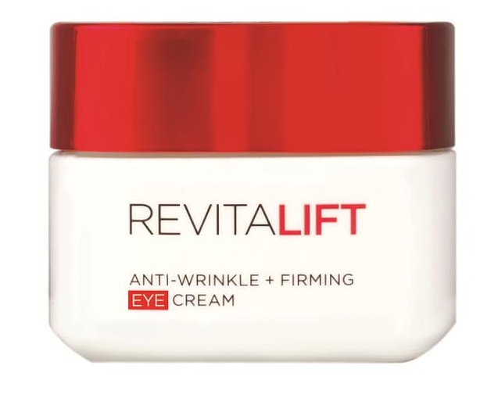

Nanoparticles in real life
J. Neirynck, F. Van Eecke & R. Vrielynck
Consumer products
Nanoparticle-baised cometics
Nanocomposite parts
Introduction Framework Techniques & Results Summary

Slide 5
Properties of nanoscale materials
J. Neirynck, F. Van Eecke & R. Vrielynck
Their most attractive properties make them also potentially toxic.
Higher reactivity
Higher surface to mass ratio
Higher permeation
Introduction Framework Techniques & Results Summary

Slide 6
Exposure to nanoscale materials
J. Neirynck, F. Van Eecke & R. Vrielynck
SHORT-TERM ROUTES
LONG-TERM ROUTES
Inhalation
Skin contact
Oral ingestion
Biodegradation issues
Introduction Framework Techniques & Results Summary

Slide 7
Tests for toxicity
J. Neirynck, F. Van Eecke & R. Vrielynck
Measurement parameters:
duration & route
of exposure
dosage & composition
of test material
reference material need to be provided to compare
what biological environment is used?
Response of biological environment to the nanoparticles can extremely vary!
Introduction Framework Techniques & Results Summary

Slide 8
Genotoxicity
J. Neirynck, F. Van Eecke & R. Vrielynck
Describes the ability of a chemical test agent to induce DNA damage
Introduction Framework Techniques & Results Summary
Notes:
In vivo – in vitro – ex vivo

