Slide 1
Nanoparticle toxicity
Jérôme Neirynck, Frederik Van Eecke & Robin Vrielynck
prof. dr. Ewald Janssens & prof. dr. Kristiaan Temst
Advanced Topics in Clusters, Macromolecules & Nanoparticles (G0S94A)
Master of Physics
Faculty of Science – Department of Physics and Astronomy

Slide 2
Outline
J. Neirynck, F. Van Eecke & R. Vrielynck
Introduction: What is toxicity?
Parameters influencing toxicity
Ways of entry & translocation

Slide 3
What is nanotoxicity?
J. Neirynck, F. Van Eecke & R. Vrielynck
= study of toxicity of nanomaterials
Inert materials become highly active at nanodimensions
Intended to determine whether or to what these properties pose a threat
Their most attractive properties make them also potentially toxic.
Introduction Framework Techniques & Results Summary

Slide 4
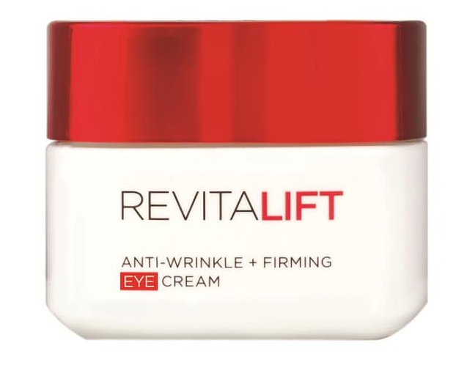

Nanoparticles in real life
J. Neirynck, F. Van Eecke & R. Vrielynck
Consumer products
Nanoparticle-baised cometics
Nanocomposite parts
Introduction Framework Techniques & Results Summary

Slide 5
Properties of nanoscale materials
J. Neirynck, F. Van Eecke & R. Vrielynck
Their most attractive properties make them also potentially toxic.
Higher reactivity
Higher surface to mass ratio
Higher permeation
Properties of matter change at nanosize:
Colour
Chemical reactivity
Introduction Framework Techniques & Results Summary

Slide 6
Nanofood
J. Neirynck, F. Van Eecke & R. Vrielynck
https://www.azonano.com/article.aspx?ArticleID=1786
PACKING
Active packing
Provide certain feature
e.g. stop oxygen
Smart packing
Introduction Framework Techniques & Results Summary

Slide 7
Exposure to nanoscale materials
J. Neirynck, F. Van Eecke & R. Vrielynck
SHORT-TERM ROUTES
Inhalation
Skin contact
Oral ingestion
Biodegradation issues
Introduction Framework Techniques & Results Summary

Slide 8
Tests for toxicity
J. Neirynck, F. Van Eecke & R. Vrielynck
Measurement parameters:
duration & route
of exposure
dosage & composition
of test material
reference material need to be provided to compare
what biological environment is used?
Response of biological environment to the nanoparticles can extremely vary!
Introduction Framework Techniques & Results Summary

Slide 9
Genotoxicity
J. Neirynck, F. Van Eecke & R. Vrielynck
Describes the ability of a chemical test agent to induce DNA damage
Introduction Framework Techniques & Results Summary
Notes:
In vivo – in vitro – ex vivo

Slide 10
Parameters influcencing toxicity

Slide 11
Dose dependence
J. Neirynck, F. Van Eecke & R. Vrielynck
Not dependent on mass dose
Surface is reactive, so small particles at a low mass dose can be as toxic al larger particles with a higer mass dose
Surface dose is what makes influences the toxicity
Introduction Framework Techniques & Results Summary

Slide 12
Concentration dependence
Large concentration --> aggregation of particles
Larger particles, less surface AND white bloodcells can macrophage the aggregates
Large concentration results in less toxicity

Slide 13
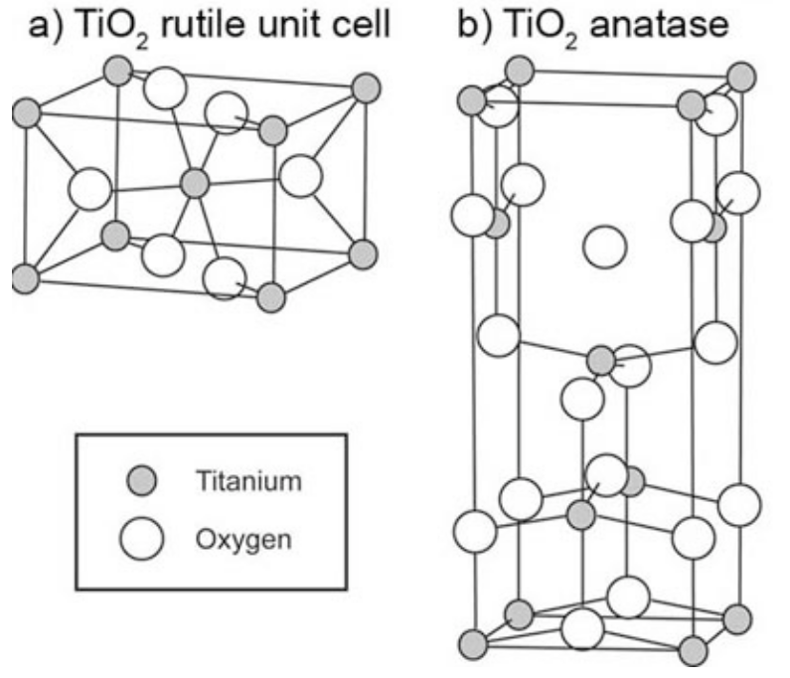
Crystaline structure
Even for the same substance, a different crystaline structure may influence the toxicity
TiO₂ has for instance two different structrures, of which one is toxic, and the other one is nontoxic

Slide 14
Aspect ratio
Long fibers are more toxic than short ones
Stay longer in the body (81% after 60 days)
Carbon nanotubes can be very toxic

Slide 15
Carbon nanotubes toxicity

Slide 16
Adaptation to nanoparticles
When first exposed to low doses of toxic nanoparticles for a period of time, there is not such a heavy reaction to a high dose
Habituation to the nanoparticles
White bloodcells fight more effectively against the nanoparticles

