Slide 1

Vister

Slide 2


Introduction
Vister
Introduction
Overview
Today we would like to show you, what we have accomplished – and not accomplished.
Testing Types
Activation Test
Showcase scenarios of when Vister will be ideal to use in an experiment.
Motion Tracker Test
Guides
Let you guys try it out while we observe. Mainly to get some data for our thesis but also to see where we can make small adjustment.
Future work

Slide 3






Overview
Vister
Introduction
Can it run on Windows?
Overview
Testing Types
Activation Test
Motion Tracker Test
Linux
Guides
Windows
OpenCV
Future work

Slide 4


Overview
Vister
Introduction
Overview
Ubuntu
Linux Mint
Testing Types
The most used OS for Linux
Built upon Ubuntu 20.4
Activation Test
Motion Tracker Test
Easier for IT-services / find solution on the internet
Created to feel like Windows
Steep learning curve
95% everything that can be done on Ubuntu can be done here
Guides
Future work
1. Get an extra harddrive for your PC with Linux installed
2. Get a small laptop running Linux
External flash drives won’t work

Slide 5
Overview
Vister
Vister 1.0 has a Terminal Interface
Introduction
What about the GUI?
Overview
Testing Types
Activation Test
Motion Tracker Test
The short answer for now is that there will be no GUI
Implementation of Vister.
Guides
The good news is that the Terminal Interface have everything needed. The experience is just not that fluid and smooth
Future work

Slide 6
Testing Types
Vister
We wished that we could give you every testing types you wanted
Introduction
Overview
Drop Test
Spring Test
Testing Types
Brick Test
Activation Test
Motion Tracker Test
Rollercoaster Test
Guides
Future work
Lap Counter Test
Cannon Test

Slide 7
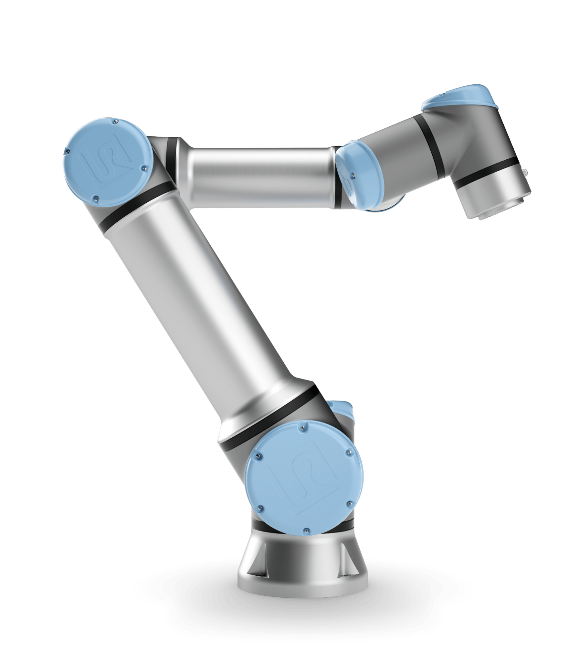
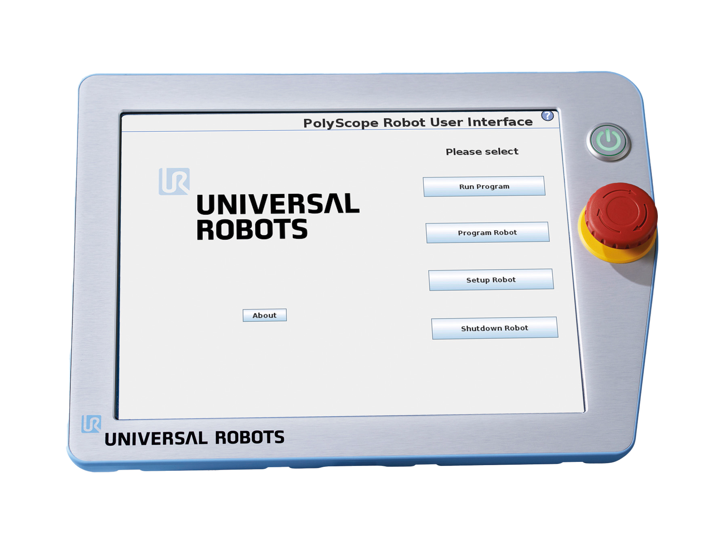
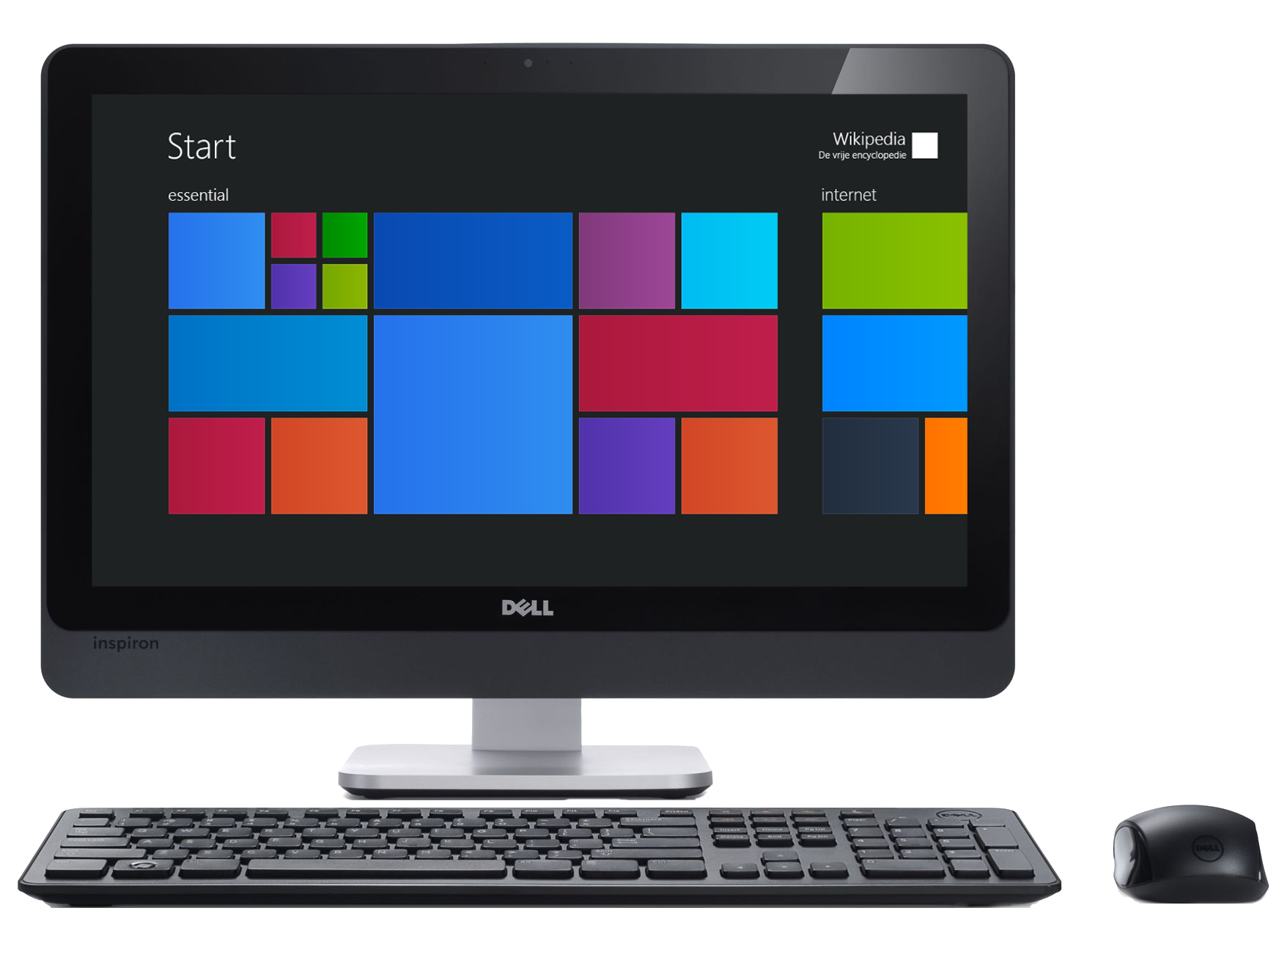
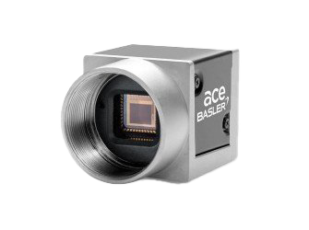
Testing Types
Vister
Activation Test
The “Activation Test” was inspired by the “spring experiment”
Home_waypoint … Home_waypoint
DO[0] = HIGH
Introduction
Overview
Testing Types
Activation Test
Motion Tracker Test
Guides
Future work
A Full video with lap counter written in the corner
A CSV file with bounding box values
A CSV file from the UR with data like: Force, Speed, Position

Slide 8
Testing Types
Vister
Motion Tracker Test
The “Motion Tracker Test” was inspired by the “Train experiment”
Set Hue_low Hue_high
Saturation_low
Saturation_high Value_low Value_high
Introduction
Overview
Testing Types
Activation Test
Motion Tracker Test
Guides
Future work
A Full video with lap counter written in the corner
A CSV file with lap time duration

Slide 9
Guides
Vister
Introduction
We know learning something new can be tedious. Therefor we have created the following PDF guides to help you guys get a good start
Overview
Testing Types
Activation Test
Motion Tracker Test
Guides
Future work

Slide 10
Future Work
Vister
The time is short…
Introduction
Overview
Firstly, the improvements will primarily be based on today's evaluation
Testing Types
The code will be cleaned, commented and docstring. So, it will be easier to further develop
Activation Test
Motion Tracker Test
Guides
The code will be cleaned, commented and docstring. So, it will be easier to further develop
Future Work

