Slide 1
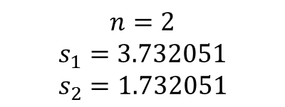

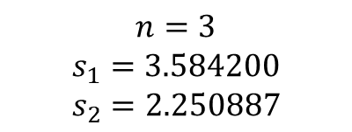
$$n=1$$
$$s_{1}=4$$
$$s_{2}=0$$
$$n=2$$
$$s_{1}=3.732051$$
$$s_{2}=1.732051$$
$$n=3$$
$$s_{1}=3.584200$$
$$s_{2}=2.250887$$

