Slide 1
Spatial Autocorrelation and Spatial Regression
Elisabeth Root
Department of Geography

Slide 2
A few good books…
Bivand, R., E.J. Pebesma and V. Gomez-Rubio. Applied Spatial Data Analysis with R. New York: Springer.
Ward, M.D. and K.S. Gleditsch (2008). Spatial Regression Models. Thousand Oaks, CA: Sage.

Slide 3
First, a note on spatial data
Point data
Accuracy of location is very important
Area/lattice data
Data reported for some regular or irregular areal unit
2 key components of spatial data:
Attribute data
Spatial data

Slide 4
Tobler’s First Law of Geography
“All places are related but nearby places are more related than distant places”
Spatial autocorrelation is the formal property that measures the degree to which near and distant things are related
Statistical test of match between locational similarity and attribute similarity
Positive, negative or zero relationship

Slide 5
Spatial regression
Steps in determining the extent of spatial autocorrelation in your data and running a spatial regression:
Choose a neighborhood criterion
Which areas are linked?
Assign weights to the areas that are linked
Create a spatial weights matrix
Run statistical test to examine spatial autocorrelation
Run a OLS regression
Determine what type of spatial regression to run
Run a spatial regression
Apply weights matrix

Slide 6
Let’s start with spatial autocorrelation

Slide 7
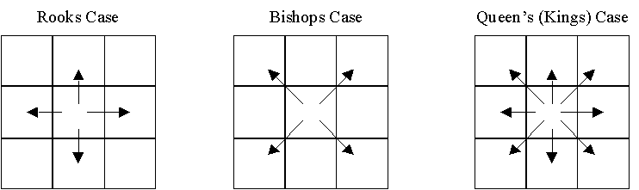
Spatial weights matrices
Neighborhoods can be defined in a number of ways
Contiguity (common boundary)
What is a “shared” boundary?
Distance (distance band, K-nearest neighbors)
How many “neighbors” to include, what distance do we use?
General weights (social distance, distance decay)

Slide 8
Step 1: Choose a neighborhood criterion
Importing shapefiles into R and constructing neighborhood sets

Slide 9
R libraries we’ll use
SET YOUR CRAN MIRROR
> install.packages(“ctv”)
> library(“ctv”)
> install.views(“Spatial”)
> library(maptools)
> library(rgdal)
> library(spdep)
You only need to do this
once on your computer

Slide 10
Importing a shapefile
> library(maptools)
> getinfo.shape("C:/Users/ERoot/Desktop/R/sids2.shp")
Shapefile type: Polygon, (5), # of Shapes: 100
> sids<-readShapePoly ("C:/Users/ERoot/Desktop/R/sids2.shp")
> class(sids)
[1] "SpatialPolygonsDataFrame"
attr(,"package")

Slide 11
Importing a shapefile (2)
> library(rgdal)
> sids<-readOGR dsn="C:/Users/ERoot/Desktop/R",layer="sids2")
OGR data source with driver: ESRI Shapefile
Source: "C:/Users/Elisabeth Root/Desktop/Quant/R/shapefiles", layer: "sids2"
with 100 features and 18 fields
Feature type: wkbPolygon with 2 dimensions
> class(sids)
[1] "SpatialPolygonsDataFrame"
attr(,"package")
[1] "sp"

Slide 12
Projecting a shapefile
If the shapefile has no .prj file associated with it, you need to assign a coordinate system
> proj4string(sids)<-CRS("+proj=longlat ellps=WGS84")
We can then transform the map into any projection
> sids_NAD<-spTransform(sids, CRS("+init=epsg:3358"))
> sids_SP<-spTransform(sids, CRS("+init=ESRI:102719"))
For a list of applicable CRS codes:
http://www.spatialreference.org/ref/
Stick with the epsg and esri codes
Notes:
http://en.wikipedia.org/wiki/European_Petroleum_Survey_Group

Slide 13
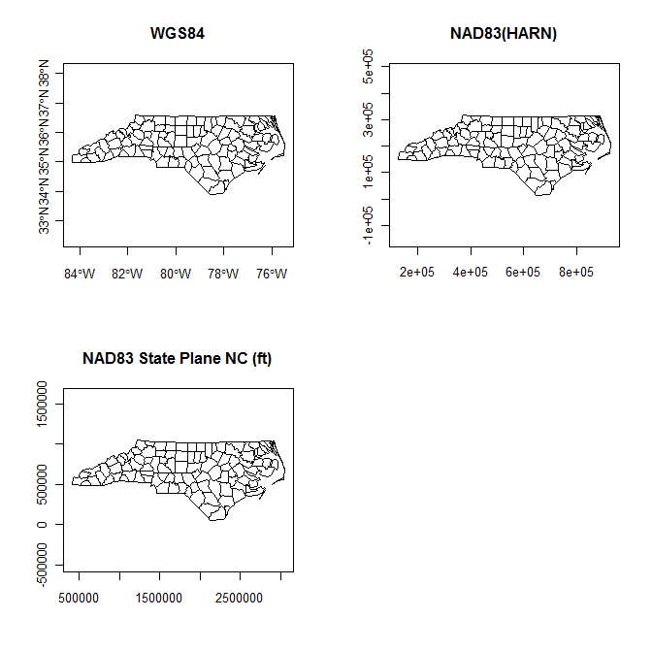

Slide 14
Contiguity based neighbors
Areas sharing any boundary point (QUEEN) are taken as neighbors, using the poly2nb function, which accepts a SpatialPolygonsDataFrame
> library(spdep)
> sids_nbq<-poly2nb(sids)
If contiguity is defined as areas sharing more than one boundary point (ROOK), the queen= argument is set to FALSE
> sids_nbr<-poly2nb(sids, queen=FALSE)
> coords<-coordinates(sids)
> plot(sids)
> plot(sids_nbq, coords, add=T)

Slide 15
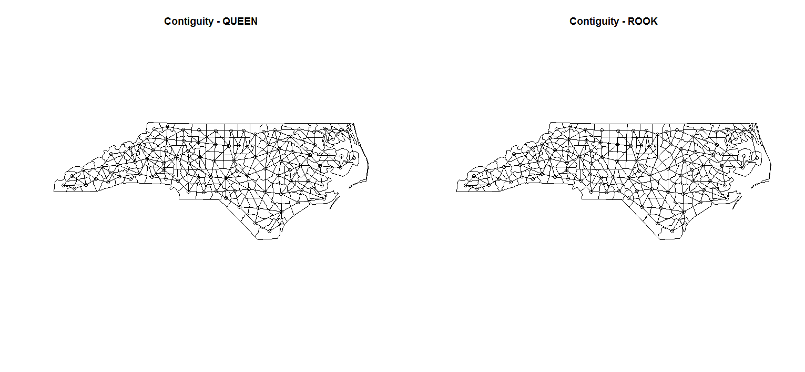
Queen
Rook

Slide 16
Distance based neighbors k nearest neighbors
Can also choose the k nearest points as neighbors
> coords<-coordinates(sids_SP)
> IDs<-row.names(as(sids_SP, "data.frame"))
> sids_kn1<-knn2nb(knearneigh(coords, k=1), row.names=IDs)
> sids_kn2<-knn2nb(knearneigh(coords, k=2), row.names=IDs)
> sids_kn4<-knn2nb(knearneigh(coords, k=4), row.names=IDs)
> plot(sids_SP)
> plot(sids_kn2, coords, add=T)
k=2
k=1
k=3

Slide 17
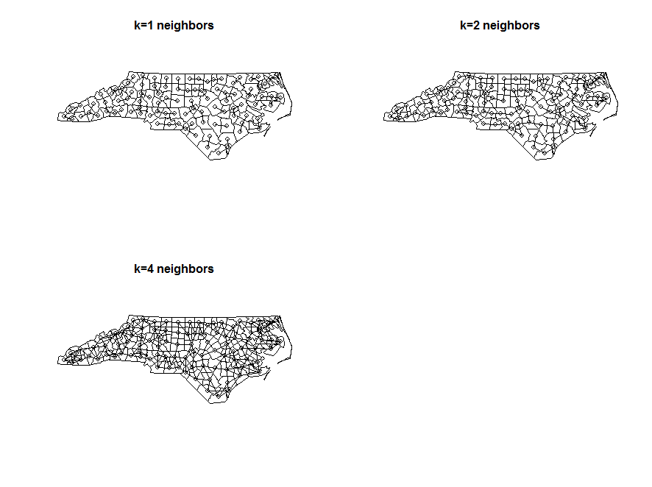
k=1
k=2
k=4

Slide 18
Distance based neighbors Specified distance
Can also assign neighbors based on a specified distance
> dist<-unlist(nbdists(sids_kn1, coords))
> summary(dist)
Min. 1st Qu. Median Mean 3rd Qu. Max.
40100 89770 97640 96290 107200 134600
> max_k1<-max(dist)
> sids_kd1<-dnearneigh(coords, d1=0, d2=0.75*max_k1, row.names=IDs)
> sids_kd2<-dnearneigh(coords, d1=0, d2=1*max_k1, row.names=IDs)
> sids_kd3<-dnearneigh(coords, d1=0, d2=1.5*max_k1, row.names=IDs)
OR by raw distance
> sids_ran1<-dnearneigh(coords, d1=0, d2=134600, row.names=IDs)

Slide 19
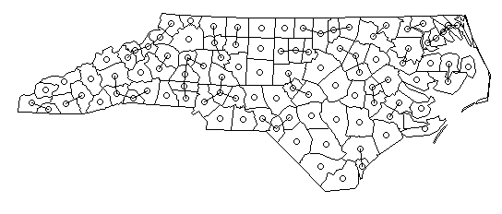

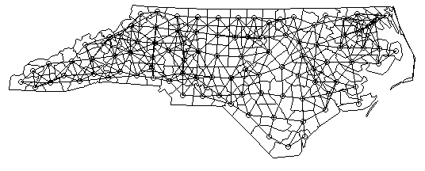
dist=0.75*max_k1
(k=1)
dist=1*max_k1=134600
dist=1.5*max_k1
dist=1*max_k1
dist=1.5*max_k1

Slide 20
Step 2: Assign weights to the areas that are linked
Creating spatial weights matrices using neighborhood lists

Slide 21
Spatial weights matrices
Once our list of neighbors has been created, we assign spatial weights to each relationship
Can be binary or variable
Even when the values are binary 0/1, the issue of what to do with no-neighbor observations arises
Binary weighting will, for a target feature, assign a value of 1 to neighboring features and 0 to all other features
Used with fixed distance, k nearest neighbors, and contiguity

Slide 22
Row-standardized weights matrix
> sids_nbq_w<- nb2listw(sids_nbq)
> sids_nbq_w
Characteristics of weights list:
Neighbour list object:
Number of regions: 100
Number of nonzero links: 490
Percentage nonzero weights: 4.9
Average number of links: 4.9
Weights style: W
Weights constants summary:
n nn S0 S1 S2
W 100 10000 100 44.65023 410.4746
Row standardization is used to create proportional weights in cases where features have an unequal number of neighbors
Divide each neighbor weight for a feature by the sum of all neighbor weights
Obs i has 3 neighbors, each has a weight of 1/3
Obs j has 2 neighbors, each has a weight of 1/2
Use is you want comparable spatial parameters across different data sets with different connectivity structures

Slide 23
Binary weights
> sids_nbq_wb<-nb2listw(sids_nbq, style="B")
> sids_nbq_wb
Characteristics of weights list:
Neighbour list object:
Number of regions: 100
Number of nonzero links: 490
Percentage nonzero weights: 4.9
Average number of links: 4.9
Weights style: B
Weights constants summary:
n nn S0 S1 S2
B 100 10000 490 980 10696
Row-standardised weights increase the influence of links from observations with few neighbours
Binary weights vary the influence of observations
Those with many neighbours are up-weighted compared to those with few

Slide 24
Binary vs. row-standardized
A binary weights matrix looks like:
A row-standardized matrix it looks like:
0 | 1 | 0 | 0
0 | 0 | 1 | 1
1 | 1 | 0 | 0
0 | 1 | 1 | 1
0 | 1 | 0 | 0
0 | 0 | .5 | .5
.5 | .5 | 0 | 0
0 | .33 | .33 | .33

Slide 25
Regions with no neighbors
If you ever get the following error:
Error in nb2listw(filename): Empty neighbor sets found
You have some regions that have NO neighbors
This is most likely an artifact of your GIS data (digitizing errors, slivers, etc), which you should fix in a GIS
Also could have “true” islands (e.g., Hawaii, San Juans in WA)
May want to use k nearest neighbors
Or add zero.policy=T to the nb2listw call
> sids_nbq_w<-nb2listw(sids_nbq, zero.policy=T)

Slide 26
Step 3: Examine spatial autocorrelation
Using spatial weights matrices, run statistical tests of spatial autocorrelation

Slide 27
Spatial autocorrelation
Test for the presence of spatial autocorrelation
Global
Moran’s I
Geary’s C
Local (LISA – Local Indicators of Spatial Autocorrelation)
Local Moran’s I and Getis G_{i}*
We’ll just focus on the “industry standard” – Moran’s I

Slide 28
Moran’s I in R
> moran.test(sids_NAD$SIDR79, listw=sids_nbq_w, alternative=“two.sided”)
Moran's I test under randomisation
data: sids_NAD$SIDR79
weights: sids_nbq_w
Moran I statistic standard deviate = 2.3625, p-value = 0.009075
alternative hypothesis: greater
sample estimates:
Moran I statistic Expectation Variance
0.142750392 -0.010101010 0.004185853
“two.sided” → H_{A}: I ≠ I₀
“greater” → H_{A}: I > I₀
Notes:
results reported here are actually for the default = “greater”

Slide 29
Moran’s I in R
> moran.test(sids_NAD$SIDR79, listw=sids_nbq_wb)
Moran's I test under randomisation
data: sids_NAD$SIDR79
weights: sids_nbq_wb
Moran I statistic standard deviate = 1.9633, p-value = 0.02480
alternative hypothesis: greater
sample estimates:
Moran I statistic Expectation Variance
0.110520684 -0.010101010 0.003774597

Slide 30
Moving on to spatial regression
Modeling data in R

Slide 31
Spatial autocorrelation in residuals Spatial error model
Incorporates spatial effects through error term
Where:
If there is no spatial correlation between the errors, then λ = 0

Slide 32
Spatial autocorrelation in DV Spatial lag model
Incorporates spatial effects by including a spatially lagged dependent variable as an additional predictor
Where:
If there is no spatial dependence, and y does no depend on neighboring y values, ρ = 0

Slide 33
Spatial Regression in R Example: Housing Prices in Boston
CRIM | per capita crime rate by town
ZN | proportion of residential land zoned for lots over 25,000 ft²
INDUS | proportion of non-retail business acres per town
CHAS | Charles River dummy variable (=1 if tract bounds river; 0 otherwise)
NOX | Nitrogen oxide concentration (parts per 10 million)
RM | average number of rooms per dwelling
AGE | proportion of owner-occupied units built prior to 1940
DIS | weighted distances to five Boston employment centres
RAD | index of accessibility to radial highways
TAX | full-value property-tax rate per $10,000
PTRATIO | pupil-teacher ratio by town
B | 1000(Bk - 0.63)² where Bk is the proportion of blacks by town
LSTAT | % lower status of the population
MEDV | Median value of owner-occupied homes in $1000's

Slide 34
Spatial Regression in R
Read in boston.shp
Define neighbors (k nearest w/point data)
Create weights matrix
Moran’s test of DV, Moran scatterplot
Run OLS regression
Check residuals for spatial dependence
Determine which SR model to use w/LM tests
Run spatial regression model

Slide 35
Define neighbors and create weights matrix
> boston<-readOGR(dsn="F:/R/shapefiles",layer="boston")
> class(boston)
> boston$LOGMEDV<-log(boston$CMEDV)
> coords<-coordinates(boston)
> IDs<-row.names(as(boston, "data.frame"))
> bost_kd1<-dnearneigh(coords, d1=0, d2=3.973, row.names=IDs)
> plot(boston)
> plot(bost_kd1, coords, add=T)
> bost_kd1_w<- nb2listw(bost_kd1)

Slide 36
Moran’s I on the DV
> moran.test(boston$LOGMEDV, listw=bost_kd1_w)
Moran's I test under randomisation
data: boston$LOGMEDV
weights: bost_kd1_w
Moran I statistic standard deviate = 24.5658, p-value < 2.2e-16
alternative hypothesis: greater
sample estimates:
Moran I statistic Expectation Variance
0.3273430100 -0.0019801980 0.0001797138

Slide 37
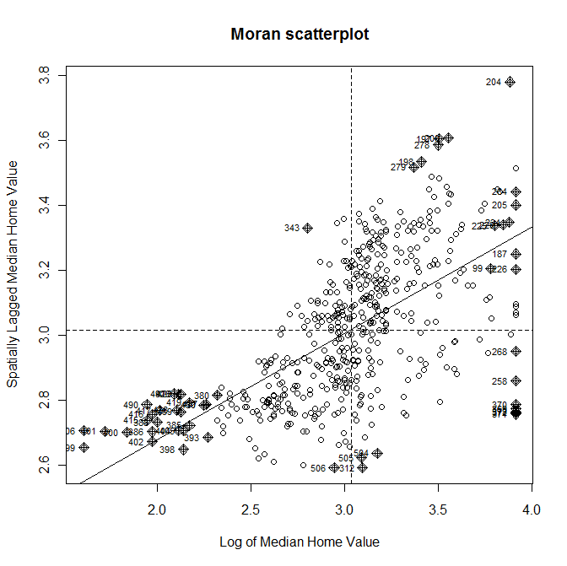
Moran Plot for the DV
> moran.plot(boston$LOGMEDV, bost_kd1_w, labels=as.character(boston$ID))

Slide 38
OLS Regression
bostlm<-lm(LOGMEDV~RM + LSTAT + CRIM + ZN + CHAS + DIS, data=boston)
Residuals:
Min 1Q Median 3Q Max
-0.71552 -0.11248 -0.02159 0.10678 0.93024
Coefficients:
Estimate Std. Error t value Pr(>|t|)
(Intercept) 2.8718878 0.1316376 21.817 < 2e-16 ***
RM 0.1153095 0.0172813 6.672 6.70e-11 ***
LSTAT -0.0345160 0.0019665 -17.552 < 2e-16 ***
CRIM -0.0115726 0.0012476 -9.276 < 2e-16 ***
ZN 0.0019330 0.0005512 3.507 0.000494 ***
CHAS 0.1342672 0.0370521 3.624 0.000320 ***
DIS -0.0302262 0.0066230 -4.564 6.33e-06 ***
---
Residual standard error: 0.2081 on 499 degrees of freedom
Multiple R-squared: 0.7433, Adjusted R-squared: 0.7402
F-statistic: 240.8 on 6 and 499 DF, p-value: < 2.2e-16

Slide 39
Checking residuals for spatial autocorrelation
> boston$lmresid<-residuals(bostlm)
> lm.morantest(bostlm, bost_kd1_w)
Global Moran's I for regression residuals
Moran I statistic standard deviate = 5.8542, p-value = 2.396e-09
alternative hypothesis: greater
sample estimates:
Observed Moran's I Expectation Variance
0.0700808323 -0.0054856590 0.0001666168

Slide 40
Determining the type of dependence
> lm.LMtests(bostlm, bost_kd1_w, test="all")
Lagrange multiplier diagnostics for spatial dependence
LMerr = 26.1243, df = 1, p-value = 3.201e-07
LMlag = 46.7233, df = 1, p-value = 8.175e-12
RLMerr = 5.0497, df = 1, p-value = 0.02463
RLMlag = 25.6486, df = 1, p-value = 4.096e-07
SARMA = 51.773, df = 2, p-value = 5.723e-12
Robust tests used to find a proper alternative
Only use robust forms when BOTH LMErr and LMLag are significant
Notes:
There are 6 tests performed to assess the spatial dependence of the model.
First, Moran’s I is .07, but highly significant (p<0.0001), indicating strong spatial autocorrelation in the residuals.
There are also 5 LM tests:
The LM test for a missing spatially lagged DV (LMlag)
The LM test for error dependence (LMerr)
The robust LM error, which tests for error dependence in the possible presence of a missing lagged dependent variable
The robust LM lag, which tests for
The SARMA test, which tests for both lag and error (not particularly useful because it’s high if either SL or SE is present)
We see that both simple LM tests are significant, indicating the presence of spatial dependence
The robust tests help us understand what type of spatial dependence may be at work…both are significant, but the lag measures is more so.
This tells us we should run a spatial lag model.

Slide 41
One more diagnostic…
> install.packages(“lmtest”)
> library(lmtest)
> bptest(bostlm)
studentized Breusch-Pagan test
data: bostlm
BP = 70.9173, df = 6, p-value = 2.651e-13
Indicates errors are heteroskedastic
Not surprising since we have spatial dependence

Slide 42
Running a spatial lag model
> bostlag<-lagsarlm(LOGMEDV~RM + LSTAT + CRIM + ZN + CHAS + DIS, data=boston, bost_kd1_w)
Type: lag
Coefficients: (asymptotic standard errors)
Estimate Std. Error z value Pr(>|z|)
(Intercept) 1.94228260 0.19267675 10.0805 < 2.2e-16
RM 0.10158292 0.01655116 6.1375 8.382e-10
LSTAT -0.03227679 0.00192717 -16.7483 < 2.2e-16
CRIM -0.01033127 0.00120283 -8.5891 < 2.2e-16
ZN 0.00166558 0.00052968 3.1445 0.001664
CHAS 0.07238573 0.03608725 2.0059 0.044872
DIS -0.04285133 0.00655158 -6.5406 6.127e-11
Rho: 0.34416, LR test value:37.426, p-value:9.4936e-10
Asymptotic standard error: 0.051967
z-value: 6.6226, p-value: 3.5291e-11
Wald statistic: 43.859, p-value: 3.5291e-11
Log likelihood: 98.51632 for lag model
ML residual variance (sigma squared): 0.03944, (sigma: 0.1986)
AIC: -179.03, (AIC for lm: -143.61)
Notes:
Rho reflects the spatial dependence inherent in our sample data, measuring the average influence on observations by their neighboring observations. It has a positive effect and is highly significant.
AIC is lower that linear model, indicating a better model fit.
However, the LR test value (likelihood ratio) is still significant, indicating that the introduction of the spatial lag term improved model fit, it didn’t make the spatial effects go away.

Slide 43
A few more diagnostics
LM test for residual autocorrelation
test value: 1.9852, p-value: 0.15884
> bptest.sarlm(bostlag)
studentized Breusch-Pagan test
data:
BP = 60.0237, df = 6, p-value = 4.451e-11
LM test suggests there is no more spatial autocorrelation in the data
BP test indicates remaining heteroskedasticity in the residuals
Most likely due to misspecification

Slide 44
Running a spatial error model
> bosterr<-errorsarlm(LOGMEDV~RM + LSTAT + CRIM + ZN + CHAS + DIS, data=boston, listw=bost_kd1_w)
Type: error
Coefficients: (asymptotic standard errors)
Estimate Std. Error z value Pr(>|z|)
(Intercept) 2.96330332 0.13381870 22.1442 < 2.2e-16
RM 0.09816980 0.01700824 5.7719 7.838e-09
LSTAT -0.03413153 0.00194289 -17.5674 < 2.2e-16
CRIM -0.01055839 0.00125282 -8.4277 < 2.2e-16
ZN 0.00200686 0.00062018 3.2359 0.001212
CHAS 0.06527760 0.03766168 1.7333 0.083049
DIS -0.02780598 0.01064794 -2.6114 0.009017
Lambda: 0.59085, LR test value: 24.766, p-value: 6.4731e-07
Asymptotic standard error: 0.086787
z-value: 6.8081, p-value: 9.8916e-12
Wald statistic: 46.35, p-value: 9.8918e-12
Log likelihood: 92.18617 for error model
ML residual variance (sigma squared): 0.03989, (sigma: 0.19972)
AIC: -166.37, (AIC for lm: -143.61)

