Slide 1
Bootstrap
Toby Dussek
16-17 January 2017

Slide 2
Welcome
Wifi
Facilities

Slide 3
Course Times
9:30 start
11:00 coffee break
12:30 lunch break
3:00 tea break
4:30 end

Slide 4
Introductions
What do you currently know
What do you want from this course

Slide 5
Bootstrap Overview

Slide 6
Timeline of CSS

Slide 7
Mobile First
There are more than 1 billion mobile users worldwide
More than 25 percent of web users access it on a mobile only
More than 90 percent of all people on earth have a mobile phone
More than 50 percent own a smartphone
More than 50 percent of mobile phone users use mobile device as their primary Internet source
More than 70 percent of tablet owners purchase things online from their tablets each week
In 2016 mobiles and tablets overtook desktop internet usage

Slide 8
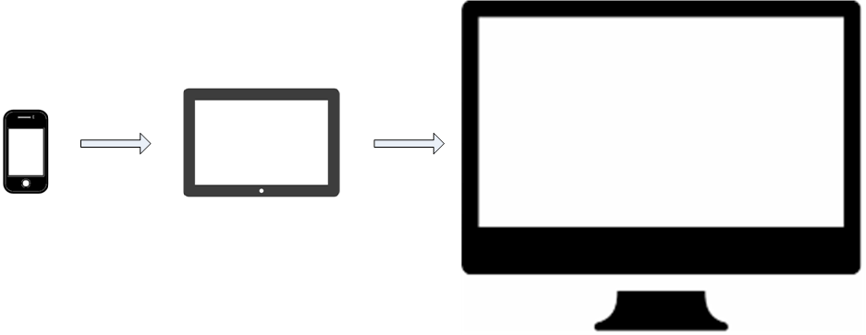
Progressive Enhancement

Slide 9
Graceful Degradation

Slide 10
Responsive Design
Designing and building web content to properly render on all the devices regardless of device size browser screen size, orientation etc.

Slide 11
Setting the viewport
<meta name="viewport" content="width=device-width, initial-scale=1">

Slide 12
media queries
<link rel="stylesheet" media="print" href="print.css">
<link rel="stylesheet" media="(max-width: 800px)" href="max800.css">
<link rel="stylesheet" media="(max-width: 320px)" href="max320.css">
<link rel="stylesheet" media="(orientation: portrait)" href="prt.css">
<link rel="stylesheet" media="(orientation: landscape)" href="lnd. css">

Slide 13
Responsive Design Patterns
Fluid design
This is the most popular and easiest option for responsive design
In this pattern larger screen multiple columns layout renders as a single column in a smaller screen in absolutely same sequence
Column drop
The page gets rendered as a single column but the order of blocks is altered
So if a content block is visible first the block might be rendered as second or third on smaller screen
Layout shifter
The whole layout of the screen contents get altered,
You need to develop different page layouts for large, medium, and small screens

Slide 14
Some Navigation Patterns
Menu bar, Navigation/app bar
Links and Images
Tabs
HTML forms
Alerts and popups
Embedded audios and videos tend to have their own transport control

Slide 15
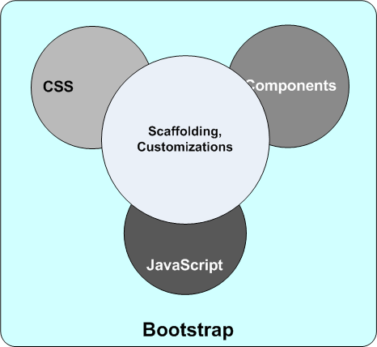
What Bootstrap includes

Slide 16
Bootstrap Default CSS
fundamental HTML element styles
global CSS classes
classes for advanced grid patterns
lots of enhanced and extended CSS classes

Slide 17
Example Tag Style
hr {
height: 0;
-webkit-box-sizing: content-box;
-moz-box-sizing: content-box;
box-sizing: content-box;
}

Slide 18
Example Class Style
.glyphicon {
position: relative;
top: 1px;
display: inline-block;
font-family: 'Glyphicons Halflings';
font-style: normal;
font-weight: normal;
line-height: 1;
-webkit-font-smoothing: antialiased;
-moz-osx-font-smoothing: grayscale;
}

Slide 19
Example Component
<ol class="breadcrumb">
<li><a href="#">Home</a></li>
<li><a href="#">The Store</a></li>
<li class="active">Offer Zone</li>
</ol>
.breadcrumb {
padding: 8px 15px; margin-bottom: 20px;
list-style: none; background-color: #f5f5f5;
border-radius: 4px;
}
.breadcrumb > li { display: inline-block; }
.breadcrumb > li + li:before {
padding: 0 5px; color: #ccc; content: "/\00a0";
}
.breadcrumb > .active { color: #777; }

Slide 20
Bootstrap JavaScript
Bootstrap framework comes with a number of ready-to-use JavaScript plugins
Popup windows, Tabs, Carousels or Tooltips etc.
Bootstrap JS plugins are built on top of jQuery
JS code you write for Bootstrap also based on jQuery
$('#profileTab li:eq(1) a').tab('show');

Slide 21
Bootstrap CSS
When you use Bootstrap CSS all the main HTML elements automatically become responsive
The built-in components are designed to be responsive
Bootstrap offers very easy ways to customize behaviour

Slide 22
Getting Started with Bootstrap
Download from
https://getbootstrap.com/getting-started/
Bootstrap (bootstrap-3.3.7-dist.zip) or source (bootstrap-3.3.7.zip)
Bootstrap CDN
<link rel="stylesheet" href="https://maxcdn.bootstrapcdn.com/bootstrap/3.3.7/css/bootstrap.min.css" />
Install with npm
npm install bootstrap@3
Can also install with Bower or Composer
NOTE: you will also need to download jQuery if you want to use the JavaScript features of Bootstrap

Slide 23
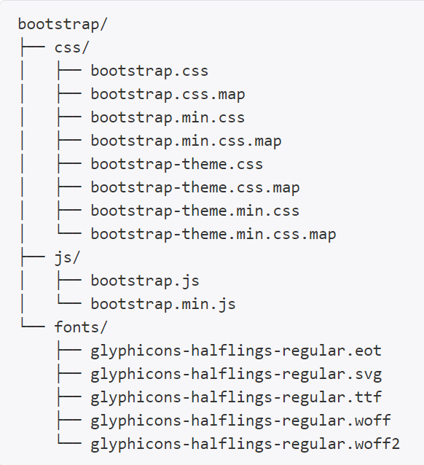
Precompiled Bootstrap

Slide 24
CSS pre-processors LESS and SASS
A CSS pre-processor is a program that takes some pre-processed code and convert them into CSS code that browsers understand
Makes CSS more dynamic, productive, efficient and organized

Slide 25
How to use Bootstrap
include all the CSS and JavaScript files in your HTML page

Slide 26
Exercise: Build a Starter Template

Slide 27
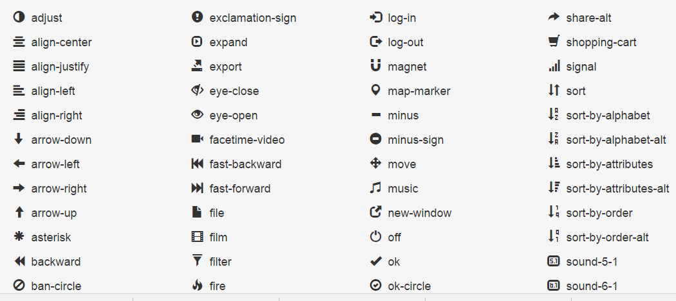
Bootstrap Icons
http://www.bootstrapicons.com/index.htm?version=3.0.2

Slide 28
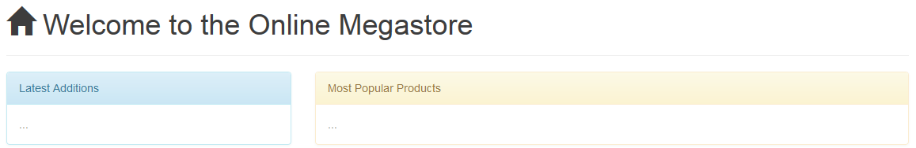
Exercise: Build some sample content
Also explore at different screen widths
And on different devices

Slide 29
Responsive Layouts with Bootstrap CSS

Slide 30
Basic HTML structure for Bootstrap
The head section
HTML file must be marked as HTML5 doctype
must include meta viewport tag
The body section
HTML must be positioned inside a div element with class attached
container or container-fluid

Slide 31
Container and Container-Fluid

Slide 32
Bootstrap Default Styles for HTML Elements
<h1>This is a Heading</h1>
To use the heading styles in any other elements use the .h1 CSS class

Slide 33
Responsive classes
xs .btn-xs | Extra small devices < 768px width For buttons font-size is 12px line-height is 1.5 padding is 1px 5px
sm .btn-sm | Small devices with width ≥ 768px and < 992px For buttons font-size is 12px line-height is 1.5 padding is 5px 10px
md .btn-md | (default) Medium size devices width ≥992px and <1200px
lg .btn-lg | Large devices with ≥1200px width For buttons font-size is 18px line-height is 1.33 padding is 10px 16px

Slide 34
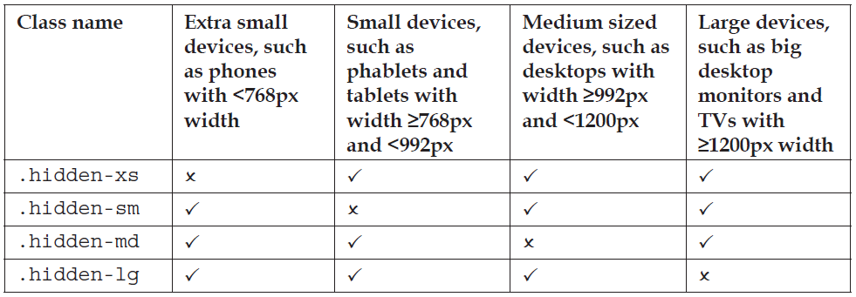
Controlling display of elements

Slide 35
Visible Only on Specific Device Size
Can display only on specific size of device
.visible-sm-block, .visible-sm-inline, .visible-sm-inline-block
.visible-md-block, .visible-md-inline, .visible-md-inline-block
.visible-lg-block, .visible-lg-inline, .visible-lg-inline-block
E.g.
<div class="visible-lg-block">This DIV will be displayed only in large devices, and will be hidden in all other devices.</div>
For HTML element to be shown in both medium and large devices (but not smaller devices) add .visible-md-block and .visible-lg-block

Slide 36
Rendering images
Most HTML elements are automatically responsive
For images you need to add a class manually
.img-responsive
The image captures the full width of its container element
The height of the image is scaled for its aspect ratio
This happens regardless of the actual size of the image
Bootstrap css for images
.img-responsive
{ display: block; max-width: 100%; height: auto; }
It is up to you to structure the parent element layout and size

Slide 37
Styling Images
Soft rounded corners
.img-rounded
Rendered as a circle or oval
.img-circle
Small outline border
.img-thumbnail
Can combine these for more effects

Slide 38
Exercise: Responsive Images

Slide 39
The grid system

Slide 40
Responsive Grid Layout
Bootstrap offers a grid system framework
Dynamically compatible with all devices and screens currently available
The screen is horizontally divided into a maximum of 12 columns

Slide 41
Setting Column Span
Class Names
.col-xs-* .col-sm-* .col-md-* .col-lg-*
(where * is a number 1-12)
E,g .col-xs-1 .col-sm-1 .col-md-1 .col-lg-1

Slide 42
Column Example
Display only the first two columns in smaller screens
<div class="row">
<div class="col-xs-6 col-sm-4 col-md-4 col-lg-4">
Column 1: col-xs-6 col-sm-4 col-md-4 col-lg-4
</div>
<div class="col-xs-6 col-sm-4 col-md-4 col-lg-4">
Column 2: col-xs-6 col-sm-4 col-md-4 col-lg-4
</div>
<div class="hidden-xs col-sm-4 col-md-4 col-lg-4">
Column 3: hidden-xs col-sm-4 col-md-4 col-lg-4
</div>
</div>

Slide 43
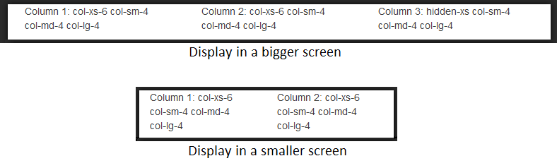
Column Result

Slide 44
Another Column Example
On smaller screens make all the columns vertical
On medium screens first two columns should consume more space
On large screens they should be equal
<div class="row">
<div class="col-xs-12 col-sm-5 col-md-5 col-lg-4">
Column 1: col-xs-12 col-sm-5 col-md-5 col-lg-4
</div>
<div class="col-xs-12 col-sm-5 col-md-5 col-lg-4">
Column 2: col-xs-12 col-sm-5 col-md-5 col-lg-4
</div>
<div class="col-xs-12 col-sm-2 col-md-2 col-lg-4">
Column 3: col-xs-12 col-sm-2 col-md-2 col-lg-4
</div>
</div>

Slide 45
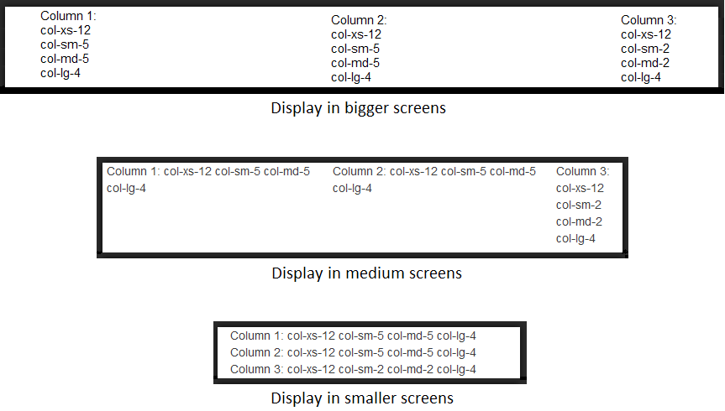
Example Result

Slide 46
Column Placeholder
To create a placeholder of one column width use .col-*-1 class
For two columns width use .col-*-2 class etc.
For a placeholder which consumes all 12 columns use .col-*-12 class
Where * is the corresponding device size you are targeting (xs, sm, md or lg)

Slide 47
Columns Must Add Up to 12
Total size of columns must always be 12
If it is less than 12 some space will be left unused
If it is more than 12 the last placeholder will be wrapped in the next line

Slide 48
Exercise: Responsive Columns

Slide 49
Data Entry Forms

Slide 50
Augmenting Forms
The .form-group class encapsulates multiple controls
The .control-label and .form-control classes style labels and form elements
For horizontal layout use .form-horizontal and place labels and controls as grid columns
The .control-group class will act as each row in the form
The .input-group class associates multiple controls adjacently
Create inline forms using .form-inline class
Disabled or readonly state
All the controls must have .form-control class added
Use .has-success, .has-warning, .has-error classes for validation states
Control size with .input-lg, .input-sm
Control the size of a group with .form-group-lg or .form-group-sm
For help texts use .help-block class
shows help text in a new line
Button Styles .btn-primary .btn-success .btn-warning .btn-info .btn-danger and .btn-link

Slide 51
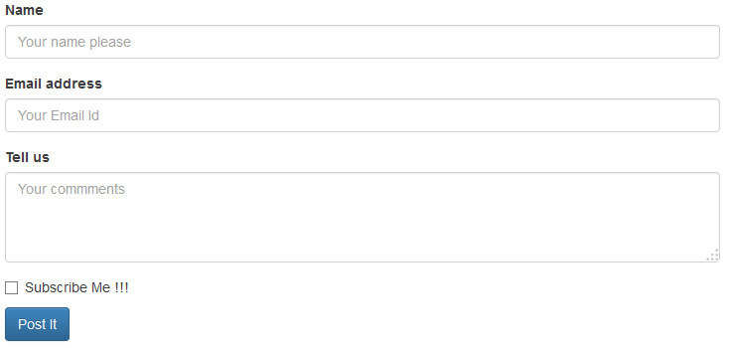
Simple Form

Slide 52
Horizontal form

Slide 53
Form With Icons

Slide 54
Utility Classes

Slide 55
Accessibility
Web content should follow Web Accessibility standards
Content must be compatible with screen readers and other Assistive Technologies (AT)
Use .sr-only and .sr-only-focusable classes
Ensures the content is not rendered but it will be read out by screen readers

Slide 56
Show Hide and Align
For showing or hiding use .show and .hide classes
For horizontal alignment use .pull-left and .pull-right

Slide 57
Foreground and Background Colour
Bootstrap provides five colour classes for foreground
.text-primary
.text-danger
.text-warning
.text-info
.text-success
Also five colour classes for background
.bg-primary
.bg-danger
.bg-warning
.bg-info
.bg-success

Slide 58
Tables
Create tables with <table> tag
Use .table class on the element
For borders around the tables and cells use .table-bordered
To display alternate coloured rows use .table-striped
To change colours of rows while hovering use .table-hover
To create responsive tables use .table-responsive
only effective on devices less than 768px
For larger devices there is no effect

Slide 59
Exercise: Encapsulate

Slide 60
Bootstrap Components

Slide 61
Page Header
<div class="page-header"><h1>Welcome</h1> </div>

Slide 62
Glyphicons
A library of monochromatic icons and symbols created with an emphasis on simplicity and easy orientation
To use Glyphicons in Bootstrap add a span element with the CSS class that for an icon
<span class="glyphicon glyphicon-home"></span>

Slide 63
Navigation Bar
<nav class="navbar navbar-default">
<div class="container-fluid">
<div class="navbar-header">
<button type="button" class="navbar-toggle collapsed" data-toggle="collapse" data-target="#the-menu">
<span class="icon-bar"></span>
<span class="icon-bar"></span>
<span class="icon-bar"></span>
</button> …

Slide 64
Responsive Navigation Bar
The navigation menu automatically transform into the hamburger on small screens

Slide 65
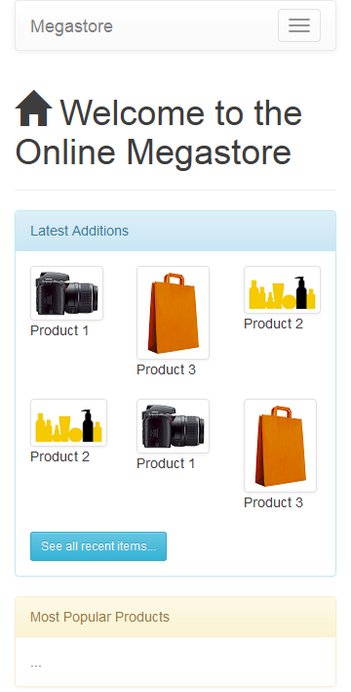
Navigation Bar Example

Slide 66
Fix NavBar to Top
Scrolling down the page makes the navigation bar disappears
Can fix it to the top
<nav class="navbar navbar-default navbar-fixed-top">
The actual body contents are overlaid by a fixed navigation bar
To rectify this add top padding to the body element

Slide 67
Right-Justified NavBar Members
<ul class="nav navbar-nav navbar-right">
<li><a href="#"><span class="glyphicon glyphicon-log-in">
</span>&nbsp;Sign In</a></li>
</ul>

Slide 68
Search Box (not shown on small screens)
Add a search box so users can search for products
<form class="navbar-form navbar-right visible-md-inline visible-lg-inline">
<div class="form-group" style="margin-top: 4px">
<label class="sr-only" for="keyword">Keyword</label>
<input type="text" class="form-control input-sm" id="keyword" placeholder="Enter Search keyword" />
</div>
</form>

Slide 69
NavBar Example

Slide 70
Badges
Badges are indicators such as count of items
<li><a href="#"><span class="glyphicon glyphicon-shopping-cart"></ span>&nbsp;My Cart <span class="badge">4</span></a></li>

Slide 71
Alerts
Alerts provide information to the user
E.g. showing the status of an operation
<div class="alert alert-info">You last visited us on ...</div>
.alert-info .alert-warning .alert-success or .alert-danger
Links inside alert require .alert-link in the anchor tag to ensure the links will be displayed in the contextual colour

Slide 72

Toolbars and button groups
For grouping buttons together use .btn-group class
Creates a group of buttons
Each of the buttons must have the .btn class
<div class="btn-group">
<button type="button" class="btn btn-success">Add</button>
<button type="button" class="btn btn-warning">Edit</button>
<button type="button" class="btn btn-danger">Delete</button>
</div>

Slide 73

Complex Tool Grouping

Slide 74
Panels
Segregate web content
Panels in Bootstrap have placeholders
.panel-heading .panel-body and .panel-footer
Five modes
.panel-info .panel-success .panel-primary .panel-warning and .panel-danger
Use .panel-title inside .panel-heading to retain pre-styled headings and display contextual colours of hyperlinks

Slide 75
Tables Within Panels
Bootstrap will merge all the paddings and borders to unify tables and panels

Slide 76
Wells
Wells are similar to panels but with less complexity
A group of logically related contents can be rendered in a well
<div class="well well-sm">
<form class="form-horizontal"> …

Slide 77
Example Well

Slide 78
Jumbotron
Optionally captures the whole viewport and renders the contents inside
Use to showcase some contents or in pages with important messages

Slide 79
Example Jumbotron

Slide 80
Breadcrumbs
Add .breadcrumb class to an OL element
All the LI elements inside it will be rendered as each breadcrumb stage
<ol class="breadcrumb">
<li><a href="#">Home</a></li> ...

Slide 81
Paginations
Two ways to show pagination

Slide 82
Code for Pagination
<!-- Pattern #1 -->
<nav>
<ul class="pagination">
<li><a href="#">&laquo;</a></li>
<li><a href="#">1</a></li>
<li><a href="#">2</a></li>
<li><a href="#">3</a></li>
<li><a href="#">4</a></li>
<li><a href="#">5</a></li>
<li><a href="#">6</a></li>
<li><a href="#">&raquo;</a></li>
</ul>
</nav>
<!-- Pattern #2 -->
<nav>
<ul class="pager">
<li><a href="#">&larr;&nbsp;Previous</a></li>
<li><a href="#">Next&nbsp;&rarr;</a></li>
</ul>
</nav>

Slide 83
Bootstrap JavaScript Add-ons

Slide 84
JavaScript Components (Add-ons)
Bootstrap JavaScript components are built on top of jQuery
https://jquery.com/
They use Custom data attributes
HTML specification says
Custom data attributes are intended to store custom data private to the page or application, for which there are no more appropriate attributes or elements

Slide 85
data-*
data-target
data-toggle
data-dismiss
data-spy
data-placement
data-content
data-container
data-animation
data-loading-text
data-complete-text
data-parent
data-slide
data-ride

Slide 86
Including Add-ons
bootstrap.min.js file includes all the JavaScript add-ons
Include in an HTML page to use any and all of the add-ons
To include only a few of the components create and use a subset of this file

Slide 87
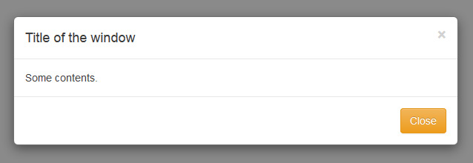
Modal Window

Slide 88
Modal Window sample code
<div class="modal" id="theModal" tabindex="-1">
<div class="modal-dialog">
<div class="modal-content">
<div class="modal-header">
<button type="button" class="close" data-dismiss="modal">…

Slide 89
Sample button to show modal window
<button type="button" class="btn btn-success btn-lg"
data-toggle="modal" data-target="#theModal">Open Modal</button>

Slide 90
data-toggle and data-target attributes
By putting modal as the data-toggle value we are informing Bootstrap that this button will invoke some modal window
Which modal window it should invoke is determined by data-target
data-dismiss says that it will close the current modal window

Slide 91
Opening Modal Window via code
Can open modal windows via JavaScript
HTML
<button type="button" class="btn btn-primary btn-lg" onclick="callMe()">Open Modal by Script</button>
Script
function callMe() {
$('#theModal').modal();
}

Slide 92
Modal Options
modal('show'): opens the modal dialog box
modal('hide'): closed the dialog
modal('toggle'): toggles the
modal(options): options include
keyboard (true/false)
show (true/false)
backdrop (static/true/false)

Slide 93
Exercise: Add modal window to web app

Slide 94
Modal Window Events
Modal windows support a few events to fire an action
E.g.
$('#logonBox').on('hidden.bs.modal', function (e) {
console.log('cancelled the Sign In operation');
})

Slide 95
Tabs
Create a UL element with .nav-tabs class

Slide 96
Pills
Replace .nav-tabs with .nav-pills

Slide 97
Exercise: Tabs or Pills to sign-up or sign-in

Slide 98
Collapse and Accordions
Collapse component shows and hides sections and subsections of web content

Slide 99
Exercise: using collapse and accordion

Slide 100
Tooltips and Popovers
Four options for data-placement
top, right, bottom, and left
You must initialize the tooltip functionality in the page where you want to use it
Unlike any other component Bootstrap does not initialize this component by default

Slide 101
Popovers
Popovers are more flexible and can contain html rendering

Slide 102
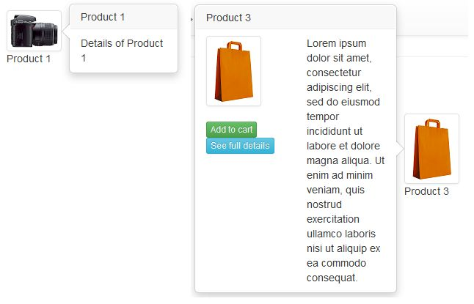

Slide 103
Dropdown
Drop-down can be used for example a menu, button, link, navigation bar etc.

Slide 104
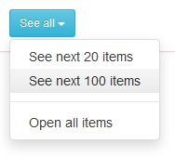
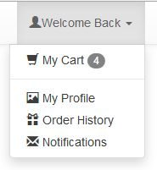

Slide 105
Alerts
The alert component also offers a JavaScript API

Slide 106
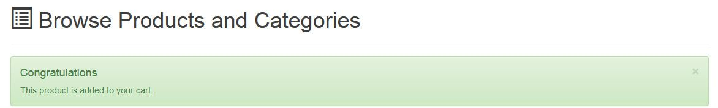
Example Alerts

Slide 107
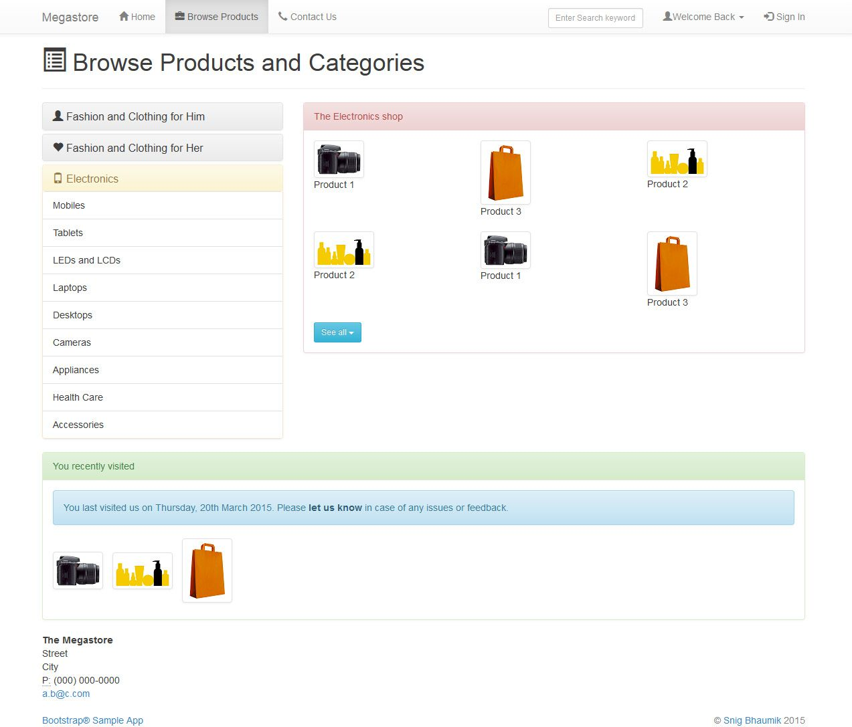
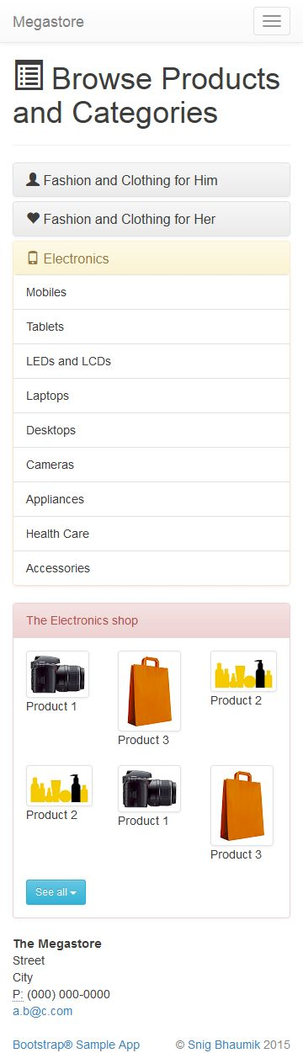

Slide 108
Carousels
Carousels are slideshow components
Carousel is also available via JavaScript APIs
The interval value defines the time in milliseconds for each slide
Pause as hover instructs Bootstrap to stay on the current slide until the mouse is moved out
The important parts of the carousel component are:
carousel-indicator: to open a particular slide in the set of slides
carousel-inner: actual contents of each of the slides
carousel-control: left and right arrows to navigate to previous or next

Slide 109
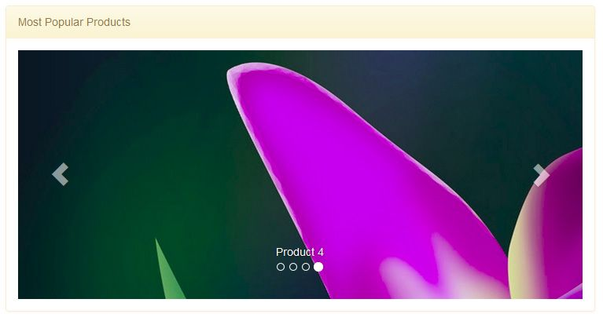

Slide 110
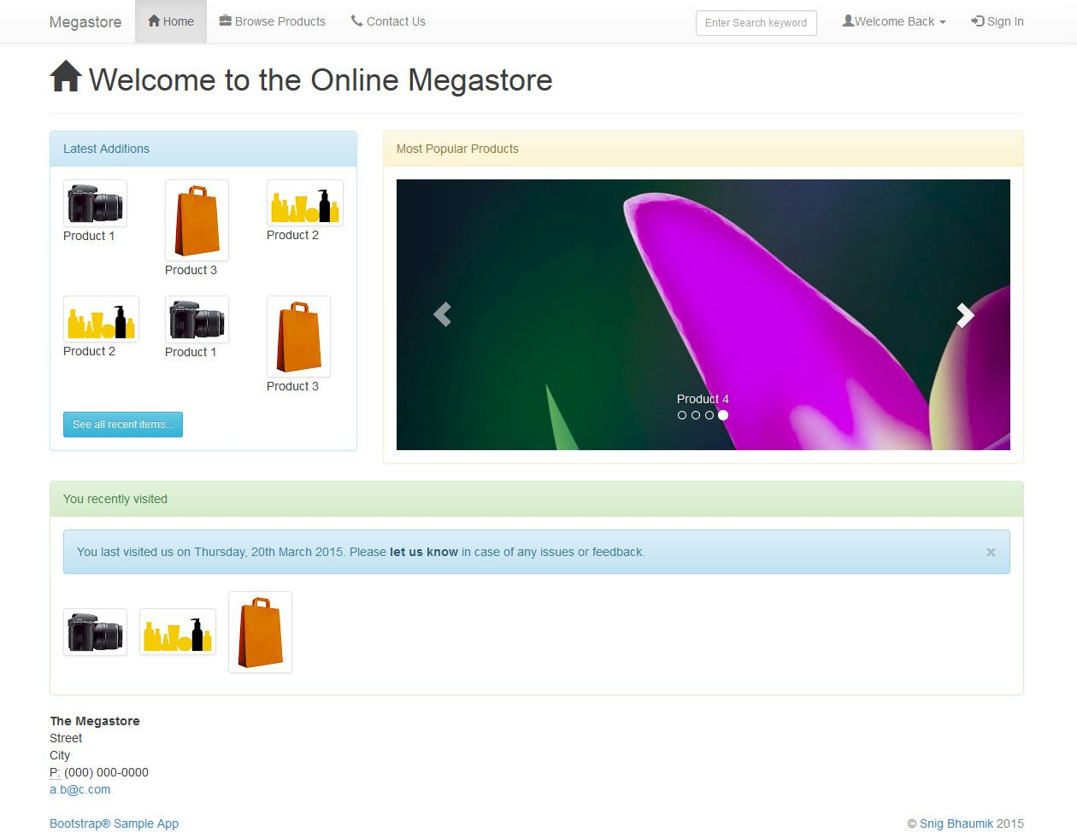
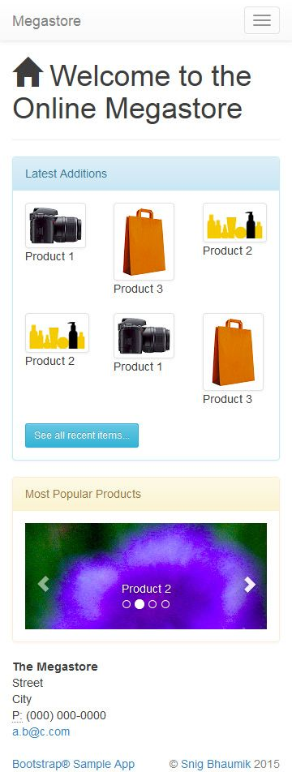

Slide 112
Disabling responsiveness
By default Bootstrap automatically adapts pages for screen sizes
To disable page responsiveness omit the viewport <meta> in the CSS docs
Override the width on the .container for each grid tier with a single width
E.g. width: 970px !important;
Be sure that this comes after the default Bootstrap CSS
If using navbars remove all navbar collapsing and expanding behaviour
For grid layouts use .col-xs-* classes in in place of the medium/large ones
the extra-small grid scales to all resolutions
Still need Respond.js for IE8

Slide 113
Browser and device support
Bootstrap is built to work best in the latest desktop and mobile browsers
Older browsers might display differently styled though fully functional renderings of certain components

Slide 114
Internet Explorer 8 and 9
Internet Explorer 8 and 9 are also supported
Some CSS3 properties and HTML5 elements are not fully supported
Internet Explorer 8 requires respond.js to enable media queries

Slide 115
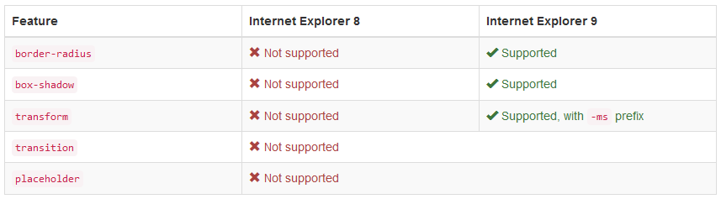
IE 8 and 9 Feature Table

Slide 116
Other IE issues
Internet Explorer 8 and box-sizing
IE8 does not fully support box-sizing: border-box; when combined with min-width, max-width, min-height, or max-height
For that reason as of v3.0.1 Bootstrap no longer uses max-width on .containers
Internet Explorer 8 and @font-face
IE8 has some issues with @font-face when combined with :before
Bootstrap uses that combination with its Glyphicons
If a page is cached and loaded without the mouse over the window then the page gets rendered before the font loads
Hovering over the page will show some of the icons and hovering over the remaining icons will show those as well
IE Compatibility modes
Bootstrap is not supported in old Internet Explorer compatibility modes
To be sure you're using the latest rendering mode for IE consider including the appropriate <meta> tag in your pages:
<meta http-equiv="X-UA-Compatible" content="IE=edge">

Slide 117
Accessibility
Bootstrap follows common web standards and can be used to create sites that are accessible to assistive Technologies
Skip navigation
If your navigation contains many links and comes before the main content in the DOM, add a Skip to main content link before the navigation
Using the .sr-only class will visually hide the skip link
The .sr-only-focusable class will ensure that the link becomes visible once focused

Slide 118
Colour contrast
Currently some of the default colour combinations have a low contrast ratio below the recommended ratio of 4.5:1
This can cause problems to users with low vision or who are colour blind
These default colours may need to be modified to increase their contrast and legibility

Slide 119
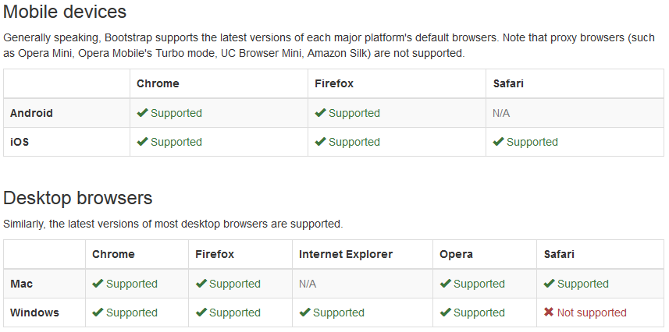
Latest Browser and Device Support

Slide 120
Compiling

Slide 121
Compiling CSS and JavaScript
Bootstrap uses Grunt for its build system with convenient methods for working with the framework
Download and install node.js
Install grunt-cli globally with npm install -g grunt-cli
Navigate to the root /bootstrap/ directory then run npm install
npm will automatically install the necessary local dependencies

Slide 122
Grunt commands
grunt dist (Just compile CSS and JavaScript)
Regenerates the /dist/ directory with compiled and minified CSS and JavaScript files
grunt watch (Watch)
Watches the Less source files and automatically recompiles them to CSS whenever you save a change
grunt test (Run tests)
Runs JSHint and runs the QUnit tests headlessly in PhantomJS
grunt docs (Build & test the docs assets)
Builds and tests CSS, JavaScrip, and other assets which are used when running the documentation locally via bundle exec jekyll serve
grunt (Build absolutely everything and run tests)
Compiles and minifies CSS and JavaScript, builds the documentation website, runs the HTML5 validator against the docs, regenerates the Customizer assets, and more

