Slide 1
ASM NGS Pre Conference NCBI Workshop Background Information - Part 1: Cloud Basics
Hosted by NCBI Pathogen Detection Team

Slide 2
Note to ASM-NGS Workshop participants. These slides are provided as background for you to review prior to the workshop. We will NOT cover them all during the actual workshop due to time constraints. If you have any questions before OR after, email us at: pd-help@ncbi.nlm.nih.gov For questions DURING the workshop we will provide more information on the day of the workshop.
ASM-NGS Workshop (Dec 7th, 9AM-1PM EDT)

Slide 3
I. Cloud basics II. NCBI in cloud III. Other tools IV. NCBI Pathogen Detection V. Background to the analysis section
Overview

Slide 4
I. Cloud Basics
Initial setup and projects
Spending, billing, budgets
Google compute engines
Cloud storage buckets

Slide 5
Initial Setup
Much of this will depend on whether you are running a personally administered account or an institutional account.
We’ll cover some basics for setting limits and warnings on spending as well as generating credential files for using certain APIs.
You can experiment with your own Google Cloud account by entering the necessary billing information and taking advantage of the free credits provided to you by Google.

Slide 6
Create a Project
There are multiple optional layers of resource hierarchy in Google Cloud but Project is the most basic.
Projects enable billing, managing permission for resources, adding and removing collaborators, and more.
A project is required to use Google Cloud resources.
We have already added each of you to a project to give you access to features, pay for the work you will do, and generally participate in this workshop.
we have already created a project for the workshop

Slide 7
Projects
You won’t be making a new project in this workshop but you will need to create one if you plan to use a personal GCP account in the future.
This guide in the GCP documentation should help you create and manage projects if you need to. https://cloud.google.com/resource-manager/docs/creating-managing-projects

Slide 8
Set Spending Alerts
Cost is a frequent concern when moving from local to cloud.
It is certainly possible to generate large bills when using cloud services from the major providers but there are quite a few trial credits and “free tier” services that allow for learning and experimenting with very low expense.
GCP billing has tools to set alerts for various spending levels either projected or actual costs spent to prevent surprises.
There is also a robust monitoring system to track spending

Slide 9
Billing
The Billing section of the console provides many views and tools to manage and track spending.
For institutional accounts some of these features may not be available to you.
The Billing Overview is a good place to start to talk about costs.

Slide 10
Billing Overview
The Overview page shows current and projected usage for the billing period.
For personal accounts like the one shown it also provides information about the remaining trial credit.
We can set some spending alerts by clicking Budgets & alerts on the menu.

Slide 11
Budgets & Alerts
From this page we can create a budget and use it to send us alerts at certain milestones or if we are spending at a faster monthly rate than previously.

Slide 12
Create a Budget
We can create a budget that tracks one or more of our Projects as well as one or more of the GCP services.
This can provide very granular tracking to optimize spending.
Or it can simply ensure you don’t spend too much money without being alerted.

Slide 13
Simple Budget Alert
A simple budget sets a target spending limit.
Then we can trigger alerts to email when certain thresholds are hit, for example 50% of the budget.

Slide 14
API Credentials
Sometimes API in GCP will need you to provide billing credentials in order to charge usage to your project.
This is going to come up later when installing the SRA Toolkit.
GCP handles this with a JSON file containing billing project information.

Slide 15
Get JSON Credentials for API
A description of how to make credentials needed for Google or AWS can be found here.
https://github.com/ncbi/sra-tools/wiki/04.-Cloud-Credentials
For this workshop we have created the necessary file for you and will show how to access the needed file in a demo.

Slide 16
Review
Projects are a fundamental part of GCP and we added you to one for this workshop.
Budgets allow you to track spending and set alerts to prevent unexpected expenses.
Applications may require credentials to bill your service account. For the SRA Toolkit this takes the form of a JSON file that can be downloaded from the GCP Console.

Slide 17
Additional Resources
GCP Intro Video https://www.youtube.com/watch?v=4D3X6Xl5c_Y
GCP Documentation Page https://cloud.google.com/docs
GCP Billing Documentation https://cloud.google.com/billing/docs/how-to
GCP Service Accounts https://cloud.google.com/iam/docs/creating-managing-service-accounts

Slide 18
Overview
What is Google’s Compute Engine?
Creating a new Compute Engine Virtual Machine.
- workshop participants will be doing these steps at the beginning
of the workshop

Slide 19
What is Compute Engine?
GCP Compute Engine provides on demand virtual machines.
These can be launched with basic operating systems or custom images.
Users can scale both the power of single machines or the number of VMs to fit their workflow.

Slide 20
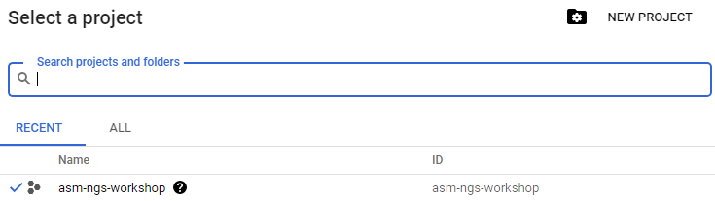
login to:
console.cloud.google.com
search and select for the asm-ngs-workshop

Slide 21
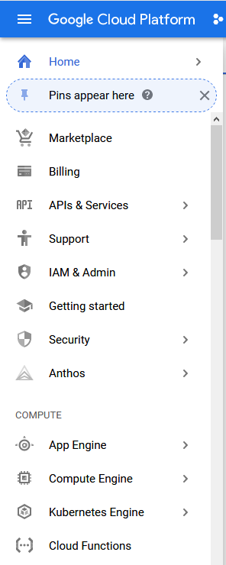
New Compute Engine
To create a Compute Engine VM start at the GCP
console
https://console.cloud.google.com/
click "Compute Engine" in the menu on the
left of the screen.

Slide 22
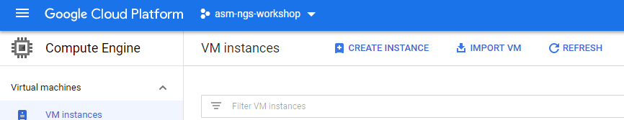
New Compute Engine
Click the Create Instance button in the center of the screen.

Slide 23
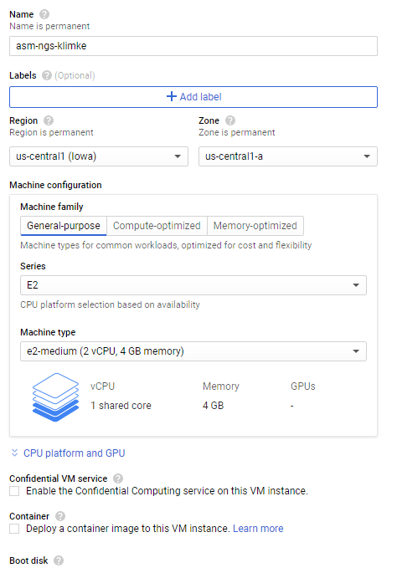
New Compute Engine
Select a permanent name for the instance - asm-ngs-$USER. Select a Region : us-cental1 (Iowa). Regions determine the location of the data center running the compute instance. NCBI archive data is typically available to any US region. Your own stored results or data may be limited in access to a smaller geographic area. We'll talk about this more when discussing buckets and storage.
More info on regions and zones here:
https://cloud.google.com/docs/overview#global_regional_and_zonal_resources

Slide 24
New Compute Engine
Select a Zone to run the instance in.
Zones are a further layer of localization.
For our workshop we should be able to avoid issues by picking a zone and region we will work in and staying consistent with that. More information about zones and regions can be found here.
https://cloud.google.com/compute/docs/regions-zones

Slide 25
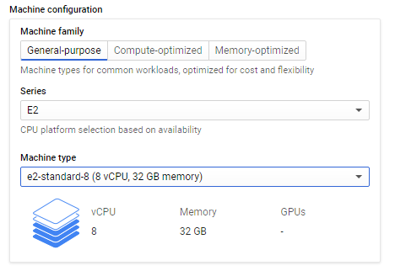
New Compute Engine
Select General-purpose E2 Series machine.
Select the e2-standard-8 Machine type from the Shared core list. This has access to 8 virtual cores and 32GB of memory.
Choosing the correct size of CPU can have a big impact on the expense of compute costs. For this example we will be using medium powered (and therefore medium cost per time) CPUs.
For tasks that will take more memory resources or are very compute intensive, a larger machine may be necessary and may also be less expensive because it will be able to finish the task substantially faster. Detailed pricing of the resources can be found here.
https://cloud.google.com/compute/all-pricing

Slide 26
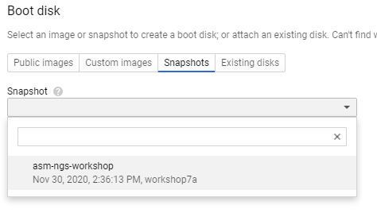
New Compute Engine
Select the asm-ngs-workshop snapshot
the date may be different depending on when we produce the latest snapshot

Slide 27
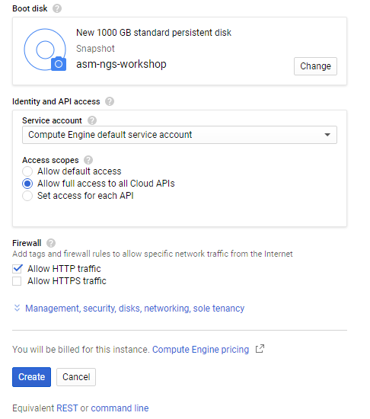
New Compute Engine
Select the asm-ngs-workshop snapshot
Allow full access to all Cloud APIs
Allow HTTP traffic (this opens port 80)
Click Create to begin launching the VM

Slide 28
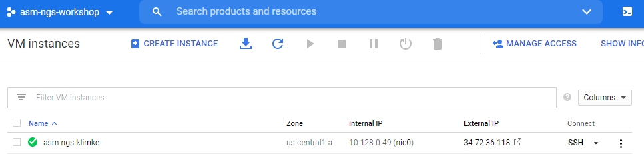
New Compute Engine
Once a green circle with a check appears next to your new instance, it is ready for you to connect to it.
There are multiple ways to connect to a GCP instance. You can use any ssh client you prefer to connect to the instance using an External IP.
To connect in a browser window find the Connect column menu for your instance and click the text SSH for your instance.

Slide 29
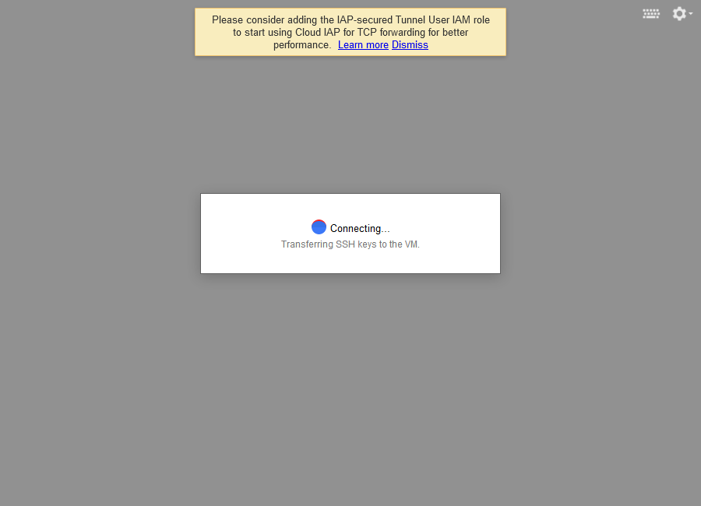
New Compute Engine
A new browser will open and begin connecting to your instance.
You may need to tell your browser to allow GCP to open new windows.
When we connect we will be presented with a command prompt for our compute instance.

Slide 30
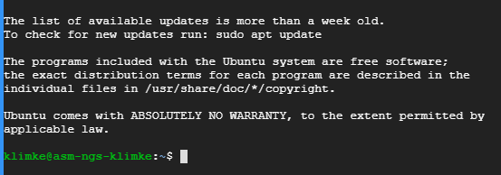
New Compute Engine
This VM will have very few programs installed. Frequent users of cloud services will typically go through the process of installing all the software they want on their instances and saving that as an image or container that can be launched from the Compute Engine.
For the purposes of this workshop we have done this for you

Slide 31
More information
Google Cloud Next Introduction to Virtual Machines video https://www.youtube.com/watch?v=3aNDcgoJ-_8
Google Docs for VM Instances https://cloud.google.com/compute/docs/instances

Slide 32
Storagae Bucket Overview
What are buckets?
Create a bucket.
Add and remove files.
we will be creating a bucket during the workshop, these slides are provided
as background information

Slide 33
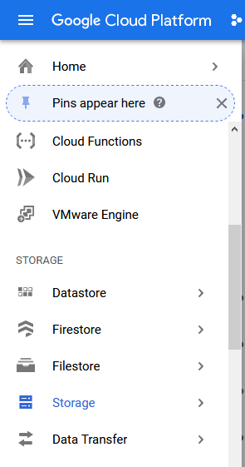
What is a Bucket?
Buckets are key part of working in the cloud.
They provide centralized stable storage that can be accessed by multiple VMs to do work.
There are several levels of storage for a bucket with frequency of use being the primary consideration.
Infrequently accessed data can be stored on nearline, cold storage, or archive buckets that will save money but be much slower to access.
Frequently used data buckets typically use the “Standard” storage class.
https://cloud.google.com/storage/docs/storage-classes

Slide 34
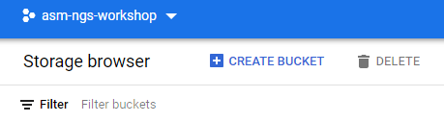
Create a Bucket
The Storage Browser will be helpful to see and manage our buckets.
It is also where we will create our new bucket from.
we will be creating a bucket during the workshop

Slide 35
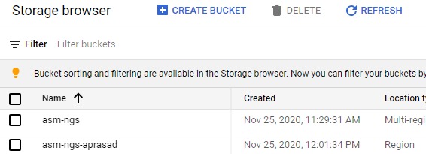
Create a Bucket
It is important to remember that bucket names must be globally unique as they all exist in a single namespace.
This allows any service or VM to point to specific buckets and objects within those buckets.
Bucket names can contain only lowercase letters, numbers, dashes, underscores, and dots. There are additional guidelines for bucket names available here.
https://cloud.google.com/storage/docs/naming-buckets
For this workshop please make sure all bucket you create begin with ‘asm-ngs-$USER’ and a unique name afterward that you can identify as your own bucket.

Slide 36
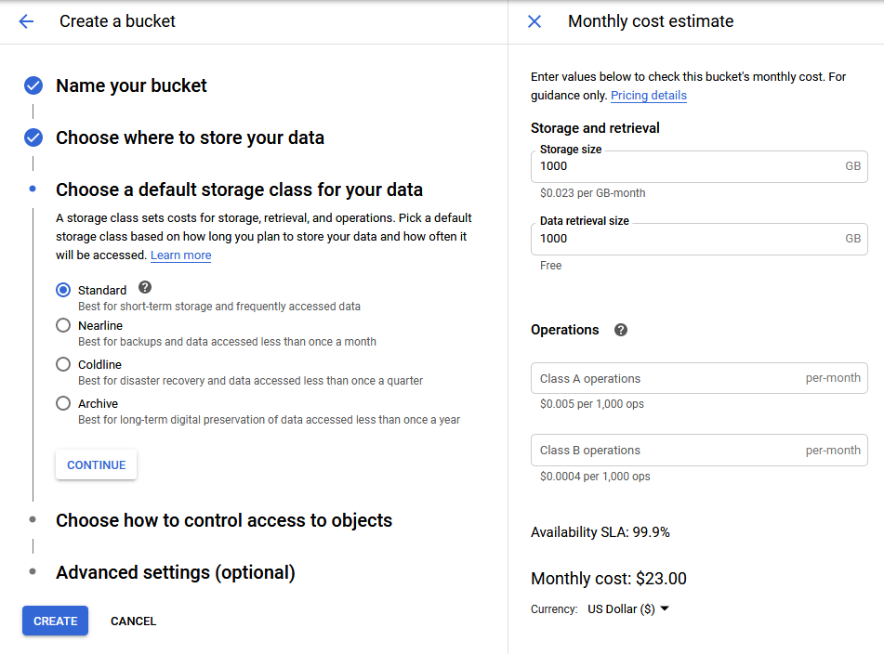
Create a Bucket
Storage Class has a large impact on bucket cost.
Standard is what we will use for this workshop and is the best choice for “working” storage.
The other classes are much cheaper for storage but add costs for access/retrieval.
You can use the cost estimation tool provided by GCP to understand how much expense is generated by your choices and usage.

Slide 37
Create a Bucket
Access control is a deep topic for bucket management. There are several sections devoted to access control of bucket objects on the GCP documentation.
https://cloud.google.com/storage/docs/access-control
The recommended default from Google is Uniform so we will use that in this workshop.
If you need to set object level access control using an Access Control List (ACL) then you will need to select Fine-grained when creating your bucket.
Click CREATE to make your new bucket.

Slide 38
Create a Bucket
Now we have a new bucket at GCP
But we have nothing in the bucket yet.
There are several methods for getting data into our bucket and we will look at the following methods:
Upload via console from current computer
Transfer via gsutil
Streaming from VM to bucket with gsutil

Slide 39
Save Files to Buckets
Transfers using the console can be a simple way to get files from your current computer into your GCP bucket.
From the bucket console page click UPLOAD FILES.
Use the browser window to find a file on your computer and click Open to transfer the file to the bucket.

Slide 40
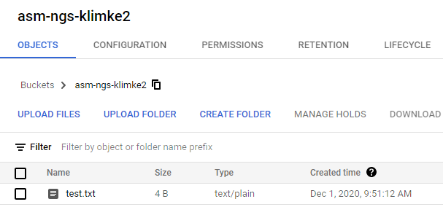
Save Files to Buckets
In the console for the bucket you will be able to see the files as well as the details about them.
You can also change bucket options like:
Lifecycle: move to different storage classes or delete once conditions are met
Retention policy: files can’t be altered or deleted for a minimum time period
You can add or change metadata on a file using the three dots on the right side of the table.

Slide 41
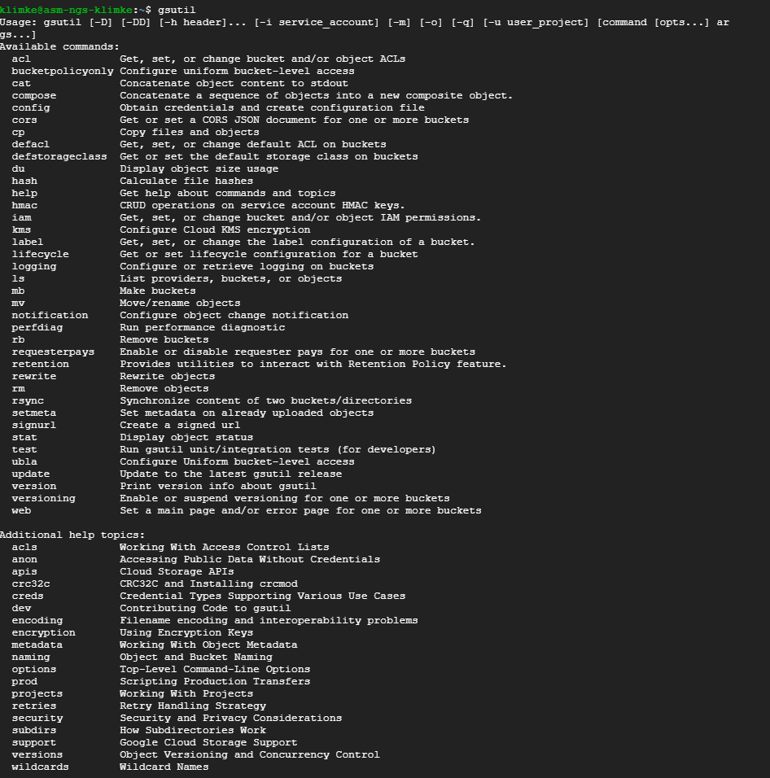
Save Files to Buckets
The program gsutil is included with the standard GCP images and is likely a good idea to include on any personal containers.
Allows command-line operation for common functions like:
Create or remove buckets
Remove or modify objects
Copy files to and from buckets
Modify policies

Slide 42
Save Files to Buckets
Gsutil can copy files using the cp function with a similar syntax to the unix cp program.
Accepts a cloud bucket location in either the source or destination portion of the command.
gsutil cp *fastq gs://asm-ngs-klimke

Slide 43
View Bucket Contents
The web console can be used to view the contents of your buckets, download them, edit metadata, and more.
Note the REFRESH button if you are monitoring transfers with the web interface.

Slide 44

View Bucket Contents
You can also list the contents of a bucket with gsutil.
gsutil ls gs://bucket
Like unix there are options for longer listings with more information as well as size in bytes or human readable formats.
Learn all the options by running the following help command:
gsutil help ls

Slide 45
Delete Files from Buckets
Gsutil and the GUI can also be used to delete files from a bucket.
Retention policy will be enforced and may prevent deleting files due to the policy.
There is no restore/recover feature for accidentally deleted files so be careful!
You can even delete every file an entire directory or bucket using the recursive (-r) option.

Slide 46
Mounting Buckets
Buckets can be mounted through a separate process using gcsfuse
This will make the bucket look similar to a directory in your filesystem
We will not do this for this particular workshop but is provided
as background info
https://github.com/GoogleCloudPlatform/gcsfuse/blob/master/docs/installing.md

Slide 47
Review
Buckets (Storage) are an integral part of working with large data sets or providing access to multiple VMs from a single storage location.
Costs of storage can represent a significant portion of cloud expenses if files are being stored for a long period of time.
Storage buckets can be managed through the GCP console or through the command line with gsutil.

Slide 48
Additional Resources
Google Cloud Next Best Practices video https://www.youtube.com/watch?v=mOHy6m8KzJk
Google docs for their Storage product https://cloud.google.com/compute/docs/disks
Documentation for gsutil https://cloud.google.com/storage/docs/gsutil

