Slide 1
ASM NGS Pre Conference NCBI Workshop Background Information - Part 3: Other tools
Hosted by NCBI Pathogen Detection Team

Slide 2
3. Other tools
SKESA
Readfinder
SAUTE
AMRFinderPlus
compat

Slide 3
SKESA: Strategic Kmer Extension for Scrupulous Assemblies
The difference between the strains could be as small as a handful of SNPs.
Most assemblers are optimized for the contig length and will make ‘risky’ connection.
Most experiments are conducted using Illumina machines.
Low-level contamination from a very similar strain is almost always present -- sequencing and/or sampling protocols may be the cause.
Souvorov et al., 2018. doi: 10.1186/s13059-018-1540-z

Slide 4
56 bio-samples with PacBio assembly and Illumina reads (used as validation set)
QUAST: quality assessment tool for genome assemblies, Bioinformatics, 2013 Apr 15.
Assembler | SKESA | SPADes | Megahit
Avg time (12 cores) | 362 s | 1,236 s | 283 s
Assembler | SKESA | SPADes | Megahit
Avg N50 | 200 Kbp | 175 Kbp | 157 Kbp
SKESA is fast because it is conservative
there will be more breaks in the assembly, but less mismatches overall
https://github.com/ncbi/SKESA

Slide 5
Readfinder
Efficient short nucleotide read filtering application.
Under development.
Efficient way to extract reads based on reference sequence(s).
https://github.com/morgulis/ReadFinder

Slide 6
SAUTE
Guided assembler
Efficient way to generate consensus alignments against reference sequences as well as generate
graph genomes
Graph genomes can be viewed with bandage
Undergoing development
not available yet

Slide 7
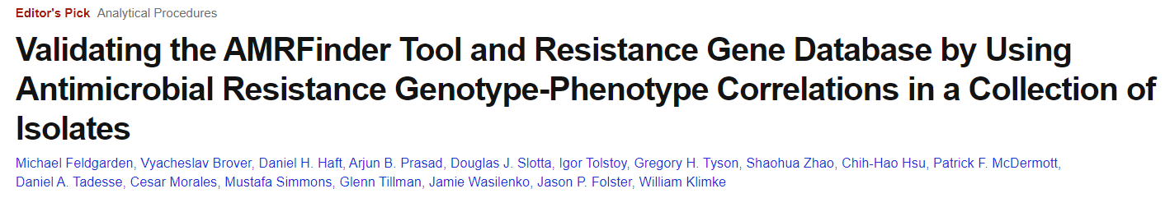
AMRFinderPlus
Updated version of AMRFinder
Can be run on assembled sequences with or without annotation (with annotation results in greater
specificity)
Includes point mutations contributing to resistance for several key organisms
Includes stress response (biocide, metal, acid, heat resistance) and virulence (most STECs)
https://github.com/ncbi/amr/wiki
Feldgarden et al., 2019. DOI: 10.1128/AAC.00483-19

Slide 8
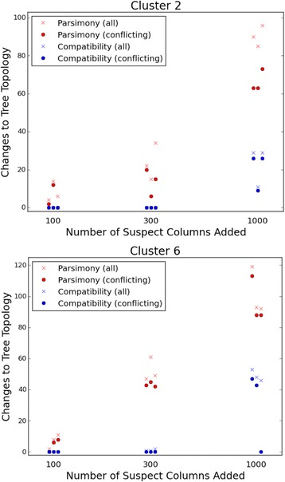
max compat
maximum compatibility algorithm
identifies maximum compatible characters for reconstruction of phylogeny
useful for closely related genomes
more robust to data errors
https://ftp.ncbi.nih.gov/pub/jcherry/compat/compat-0.8.3.tar.gz
Cherry, 2019. DOI: 10.1186/s12859-017-1520-4

Slide 9
Non-NCBI tools
dsub
samtools + pyfaidx
docker
mummer
parsnp
harvesttools

Slide 10
dsub
dsub is a command-line tool that makes it easy to submit and run batch scripts in the cloud.
The dsub user experience is modeled after traditional high-performance computing job schedulers like Grid Engine and Slurm. You write a script and then submit it to a job scheduler from a shell prompt on your local machine.
It can be exercised in local mode to allow rapid prototyping without incurring costs.
It uses the Google Cloud Life Sciences API for running tasks.
Requires storage buckets for input/output data files.
Can run docker images, or home built scripts.
https://github.com/DataBiosphere/dsub
https://cloud.google.com/life-sciences/docs/reference/rest

Slide 11
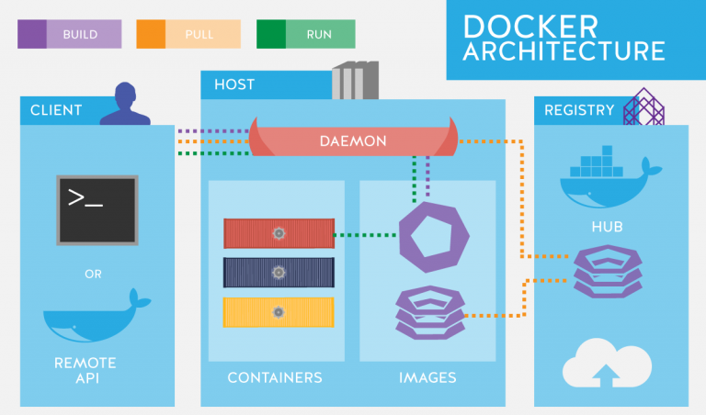
Docker
Dockerhttps://thingsolver.com/hello-docker/

Slide 12
Docker
Docker Engine is an open source containerization technology for building and containerizing your applications.
Docker Engine acts as a client-server application with:
A server with a long-running daemon process dockerd.
APIs which specify interfaces that programs can use to talk to and instruct the Docker daemon.
A command line interface (CLI) client docker.
Many Docker images already exist for life sciences tools
Anyone can create a Docker image (with account)
https://docs.docker.com/engine/

Slide 13
samtools
Samtools is a set of utilities that manipulate alignments in the BAM format. It imports from and exports to the SAM (Sequence Alignment/Map) format, does sorting, merging and indexing, and allows to retrieve reads in any regions swiftly.
https://en.wikipedia.org/wiki/SAM_(file_format)
https://en.wikipedia.org/wiki/Binary_Alignment_Map
http://samtools.sourceforge.net/
pyfaidx
Samtools provides a function “faidx” (FAsta InDeX), which creates a small flat index file “.fai” allowing for fast random access to any subsequence in the indexed FASTA file, while loading a minimal amount of the file in to memory. This python module implements pure Python classes for indexing, retrieval, and in-place modification of FASTA files using a samtools compatible index.
https://pypi.org/project/pyfaidx/

Slide 14
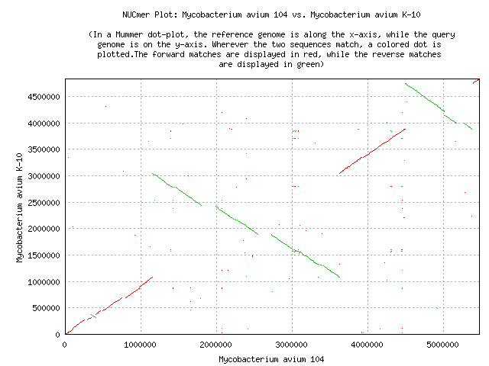
mummer
MUMmer is a versatile alignment tool for DNA and protein sequences.
Useful for pairwise comparisons
https://github.com/mummer4/mummer

Slide 15
parsnp
Parsnp was designed to align the core genome of hundreds to thousands of bacterial genomes within a few minutes to few hours. Input can be both draft assemblies and finished genomes, and output includes variant (SNP) calls, core genome phylogeny and multi-alignments. Parsnp leverages contextual information provided by multi-alignments surrounding SNP sites for filtration/cleaning, in addition to existing tools for recombination detection/filtration and phylogenetic reconstruction.
harvesttools
HarvestTools is a utility for creating and interfacing with Gingr files, which are efficient archives that the Harvest Suite uses to store reference-compressed multi-alignments, phylogenetic trees, filtered variants and annotations. Though designed for use with Parsnp and Gingr, HarvestTools can also be used for generic conversion between standard bioinformatics file formats.
https://harvest.readthedocs.io/en/v1.5.0/content/parsnp.html
https://harvest.readthedocs.io/en/v1.5.0/content/harvest-tools.html

Slide 16
Acknowledgements for NCBI + Other Tools
Richa Agarwala
Victor Ananiev
Azat Badretdin
Slava Brover
Joshua Cherry
Jinna Choi
Vyacheslav Chetvernin
Pavan Chilamakuri
Robert Cohen
Michael DiCuccio
Boris Fedorov
Mike Feldgarden
Lewis Geer
Renata Geer
Dan Haft
Lianyi Han
Avi Kimchi
Michel Kimelman
William Klimke
Alex Kotliarov
Valerii Lashmanov
Aleksandr Morgulis
Eyal Moses
Chris O'Sullivan
Arjun Prasad
Edward Rice
Kirill Rotmistrovskyy
Alejandro A. Schaffer
Nadya Serova
Stephen Sherry
Sergey Shiryev
Martin Shumway
Oleg Shutov
Douglas Slotta
Alexandre Souvorov
Tatiana Tatusova
Francoise Thibaud-Nissen
Igor Tolstoy Lukas Wagner
Hlavina Wratko
Chunlin Xiao
Alexander Zasypkin
Eugene Yaschenko Mingzhang Yang
David Lipman
James Ostell
Kim Pruitt
CDC
FDA/CFSAN
GenFS
USDA-FSIS
PHE/FERA
NHGRI
NIAID
WRAIR
Broad
Wadsworth/MDH
Vendors: PacBio, Illumina, Roche
pd-help@ncbi.nlm.nih.gov
This research was supported by the Intramural Research Program of the NIH, National Library of Medicine. http://www.ncbi.nlm.nih.gov
National Center for Biotechnology Information – National Library of Medicine – Bethesda MD 20892 USA

