Slide 1
ASM NGS Pre Conference NCBI Workshop Background Information - Part 5: Background to Analysis Projects
Hosted by NCBI Pathogen Detection Team

Slide 2
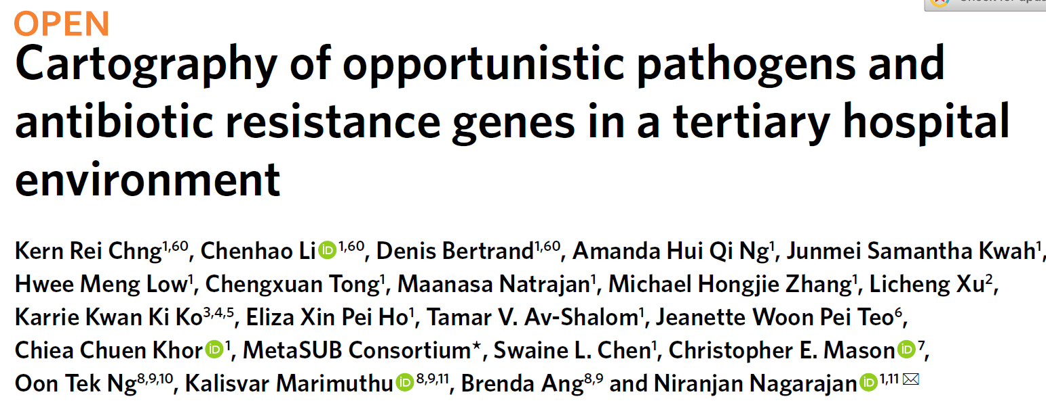
5. Background to the analysis section.
Using data from this paper:
https://pubmed.ncbi.nlm.nih.gov/32514171/
doi: 10.1038/s41591-020-0894-4

Slide 3
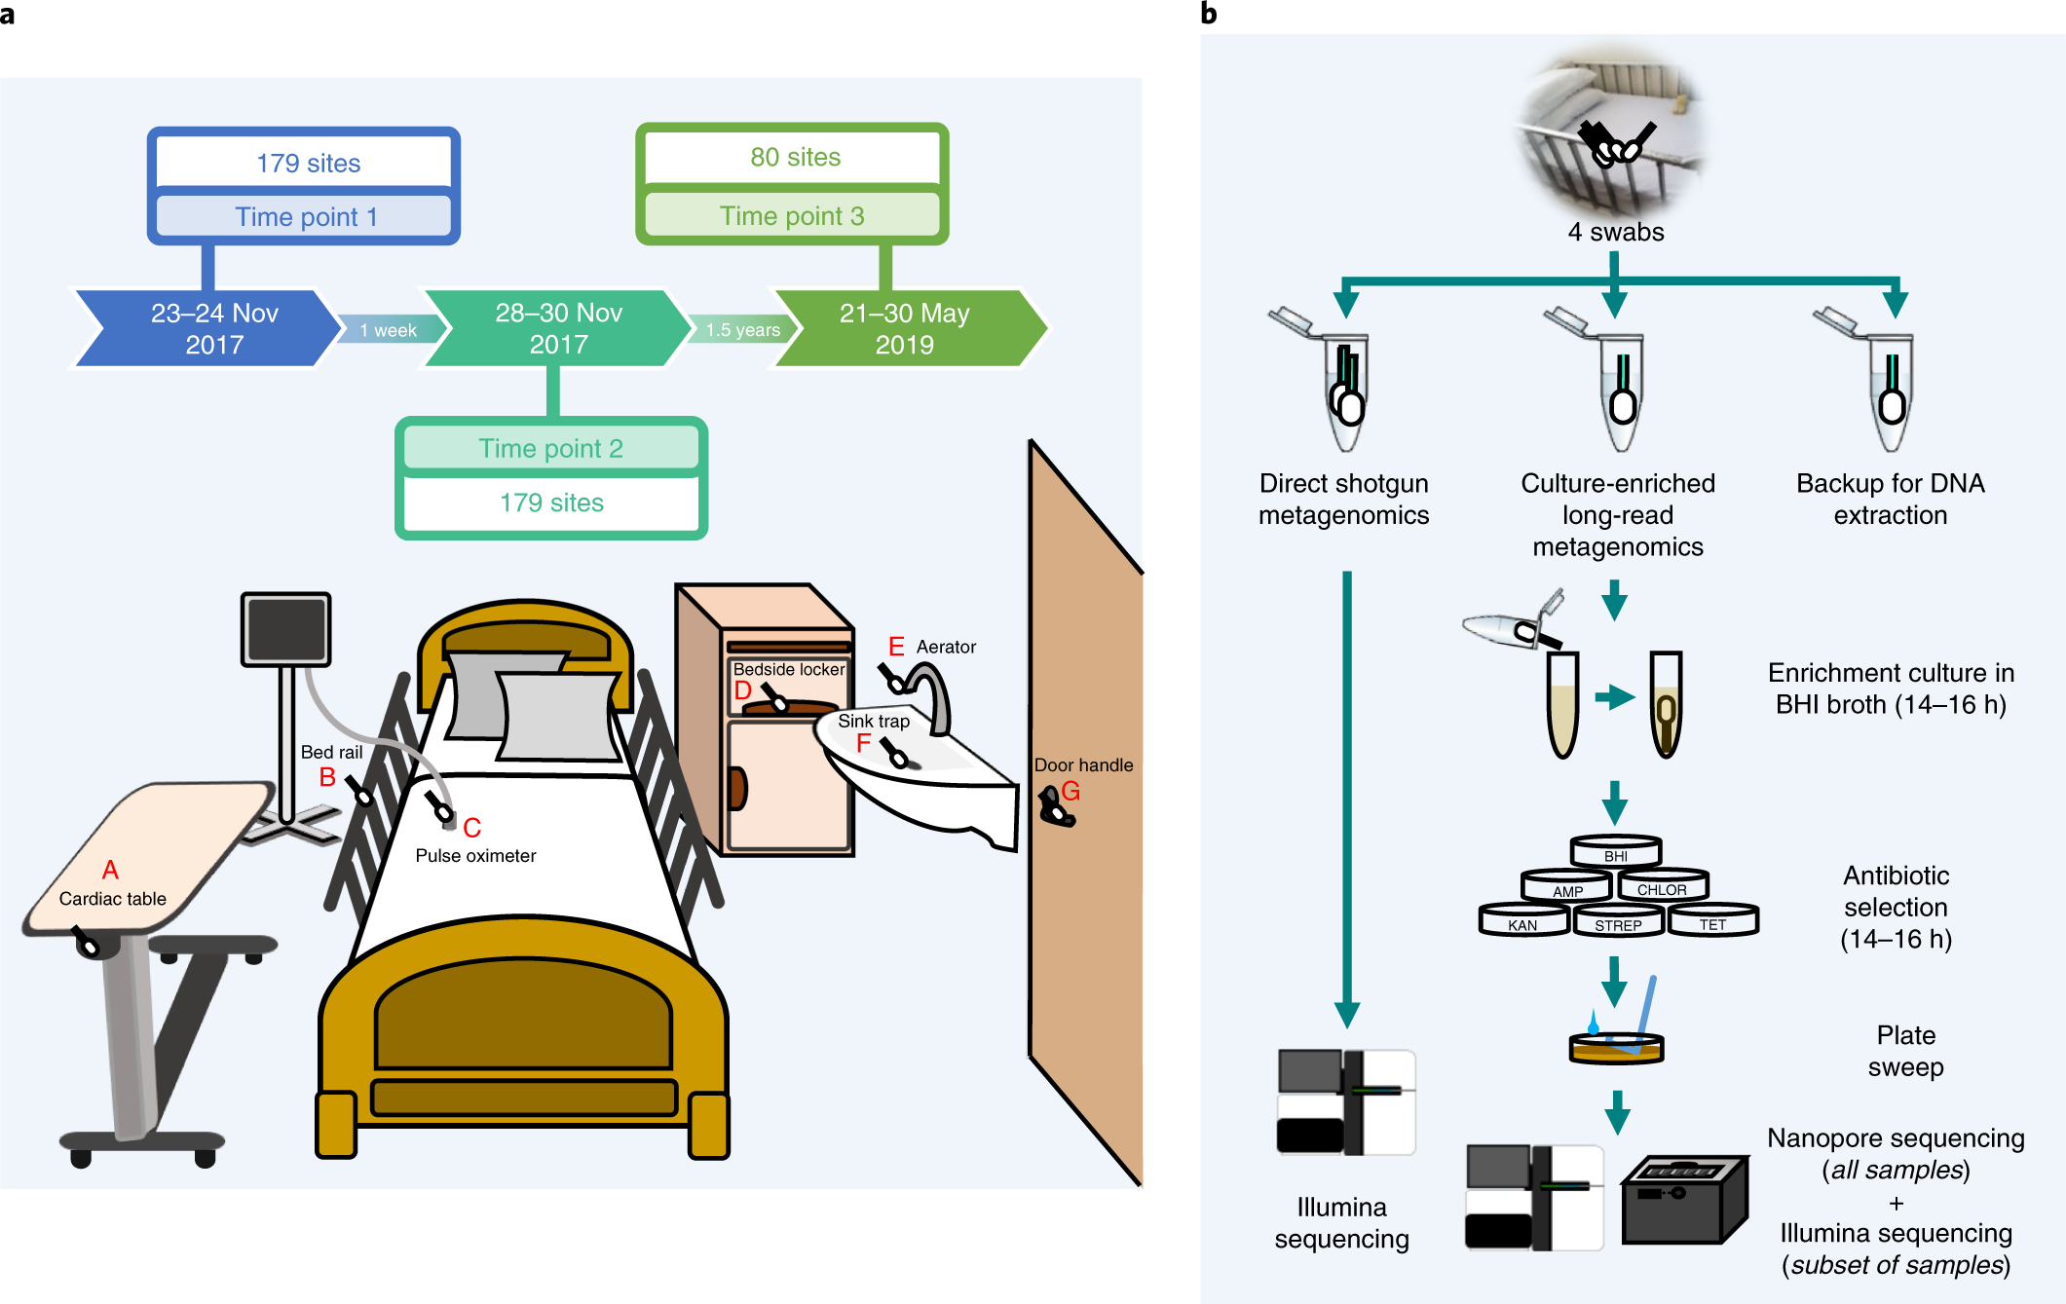
Sampling in a tertiary care hospital
multiple floors, wards, rooms,
sites samples
two time points one week apart,
deep metagenomics sequencing
with Illuumina
a subset of sites sampled a third
time a year later
did taxonomic and antibiotic
resistance gene analysis (ARG)
used ARG analysis to aid
enrichment culture for nanopore
sequencing
Figure 1. Overview of sampling sites and analysis workflow. Chng, et al. 2020

Slide 4
Background to the analysis section.
Using data from this paper:
From enrichment cultures did nanopore sequencing (all samples) and illumina (subset)
Nanopore-based metagenomic assemblies were high quality and could be assigned to specific taxa
Illumina assemblies were lower quality
Characterized plasmid sequences from assemblies and ARGs, and noted same plasmid in multiple environments.
Analyzed relationships between genomes using ANI and noted ARG and cluster stability over time
Noted some very clonally related isolates (Elizabethkingia) and more distally related (S. aureus) both
patient and environment and from a different study years earlier (also found antibiotic resistance was enriched),
and A. baumannii patient and environment and relationship to Kuwaiti isolates from a separate published study

Slide 5
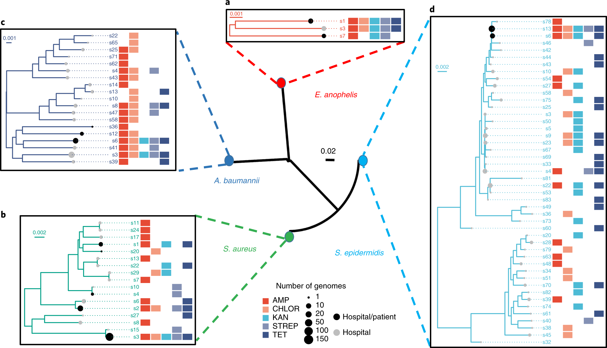
We will examine this cluster (part 2, see below)
leaf nodes reflect
clusters of related
genomes, not
individual isolate
genomes
Figure 5. Multispecies analysis of phylogenetic relationships between environmental
and patient genomes. Chng, et al. 2020

Slide 6
We will examine three areas
1. For the Acinetobacter isolates for which antibiotic susceptibility testing has
been done
a. assemble the Illumina data with SKESA
b. run AMRFinderPlus on the assemblies
c. compare the AST data from the paper to the ARGs from AMRFinder
2. For the Acinetobacter s6 cluster, compare to the Kuwaiti isolates
a. Use Pathogen Detection to examine and obtain Kuwaiti isolates genomes
b. Use metadata for the s6 cluster to pull out genomes from the s6 set
c. compare using MUMMER and parsnp

Slide 7
3. From a set of metagenomic samples
a. select interesting examples based on reported Resistome
b. from set of assembled plasmid, select interesting plasmids
c. pull out reads from a using b as reference and tool readfinder
d. assemble reads from c using b as reference using saute
e. compare assembled plasmid against reference plasmid
f. identify shared plasmids in different metagenomic samples

Slide 8
Acknowledgements
Richa Agarwala
Victor Ananiev
Azat Badretdin
Slava Brover
Joshua Cherry
Jinna Choi
Vyacheslav Chetvernin
Pavan Chilamakuri
Robert Cohen
Michael DiCuccio
Boris Fedorov
Mike Feldgarden
Lewis Geer
Renata Geer
Dan Haft
Lianyi Han
Avi Kimchi
Michel Kimelman
William Klimke
Alex Kotliarov
Valerii Lashmanov
Aleksandr Morgulis
Eyal Moses
Chris O'Sullivan
Arjun Prasad
Edward Rice
Kirill Rotmistrovskyy
Alejandro A. Schaffer
Nadya Serova
Stephen Sherry
Sergey Shiryev
Martin Shumway
Oleg Shutov
Douglas Slotta
Alexandre Souvorov
Tatiana Tatusova
Francoise Thibaud-Nissen
Igor Tolstoy Lukas Wagner
Hlavina Wratko
Chunlin Xiao
Alexander Zasypkin
Eugene Yaschenko Mingzhang Yang
David Lipman
James Ostell
Kim Pruitt
CDC
FDA/CFSAN
GenFS
USDA-FSIS
PHE/FERA
NHGRI
NIAID
WRAIR
Broad
Wadsworth/MDH
Vendors: PacBio, Illumina, Roche
pd-help@ncbi.nlm.nih.gov
This research was supported by the Intramural Research Program of the NIH, National Library of Medicine. http://www.ncbi.nlm.nih.gov
National Center for Biotechnology Information – National Library of Medicine – Bethesda MD 20892 USA

