Slide 1
Resource Management and Prioritization
Fredrik Johnsson
Olle Svensson

Slide 2
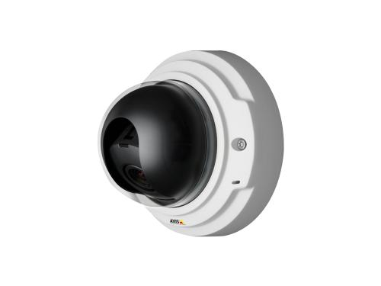
Axis Communications
Founded and based in Lund
Develops networked attached surveillance cameras

Slide 3

Background
Many applications contending for resources on an Axis surveillance camera, running Linux
Demands on frame-rate
A way to distribute resources and to adjust image quality in order to maintain framerate is needed.
Solution needs to be stable and flexible

Slide 4
Problem formulation.
Adjust an existing resource management framework according to specifications from Axis.
Test the framework by letting a streaming application contend for resources with load generators. The streaming application should also adjust its image quality in order to maintain framerate.

Slide 5
Resource Manager
Game Theoretic Resource Manager
Developed at the Department of Automatic Control
Consists of two concepts
  Virtual Platform
  Service Level

Slide 6
Matching Function
Feedback of the application performance
Deadline
Start
Execution time

abundant
perfect
scarce

Slide 7
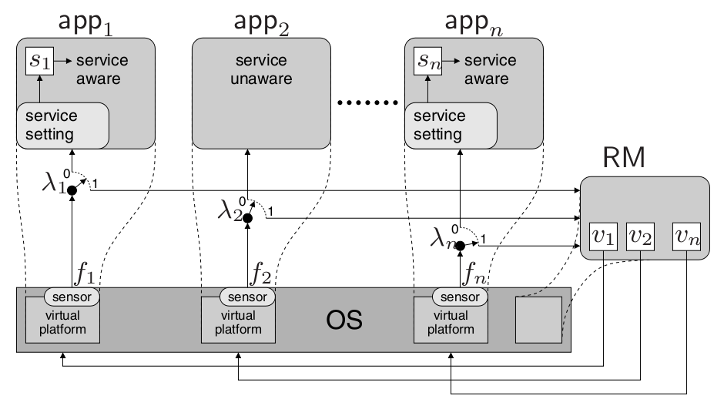
GTRM - Overview
Service Level is adjusted by the applications themselves
Virtual Platform is in our case the amount of CPU-time
λ – Determines how to distribute the adaptation between SL and VP

Slide 8
Resource Management Algorithm
The virtual platform for each application i is updated according to the formula:
where f_{i}(k) is calculated by app_{i} and sent to the RM socket.

Slide 9
Service Level adaptation
Quality of Service
Managed by the application
Monotonicity
Simple – independent adaptation
Advanced – coordinated adaptation
Introduce a Performance Multiplier

Slide 10
Adjustments
Embed Resource manager into systemd.
Use sockets instead of shared memory
Use service files instead of cgroups.
Use CPUShares instead of period/quota.

Slide 11
systemd
System and service management daemon.
First application that starts when Linux is booted.
Keeps track of processes using cgroups.
Natural choice for location of Resource manager.
Uses sockets for communication.

Slide 12
Socket Communication
Systemd uses epoll to watch several sockets for activity.
All messages are read and put into a prioritized queue that is popped later in the loop.
Socket adress is put into an environmental variable for the applications to read.
Using non blocking datagram sockets.

Slide 13
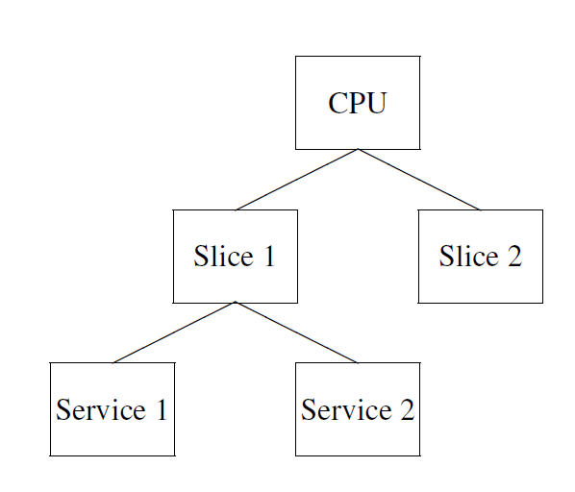
Service- And Slice Files
A virtual file tree is built as in the figure.
Service and slice files lies under slice files.
Services describes how systemd should treat an application.
Resources are inherited from parent according to CPUShares.
Resource manager varies CPUShares in order to distribute resources.

Slide 14
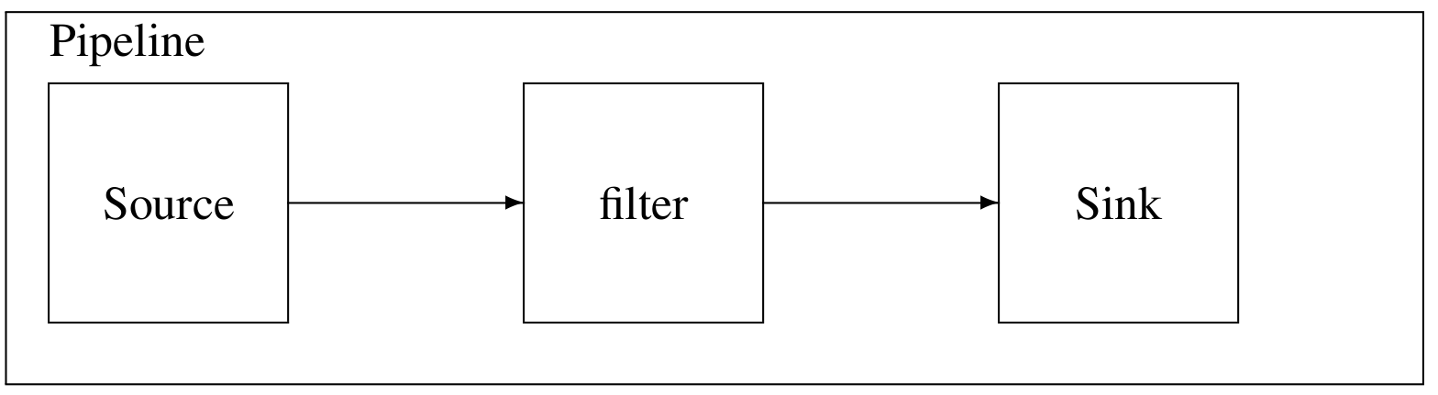
Image Quality Adaptation
Video processing is based on open source library, Gstreamer
Pipeline of elements pass buffers from source to sink
Insert identity element, attach dispatch function
Quality is adjusted by changing JPEG compression size

Slide 15
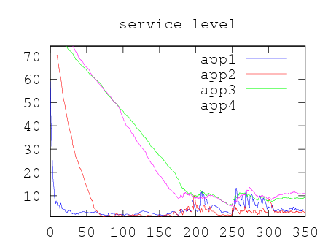
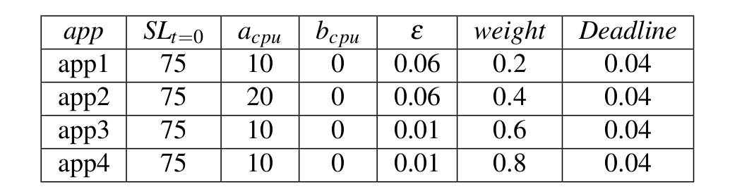
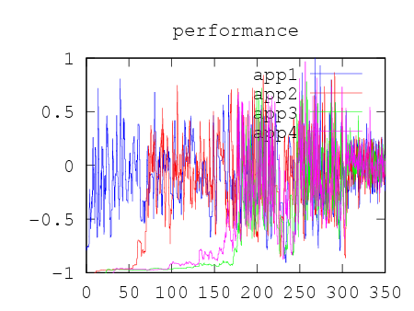
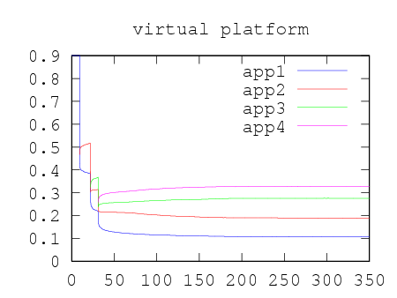
Result, Only Load Generators

Slide 16
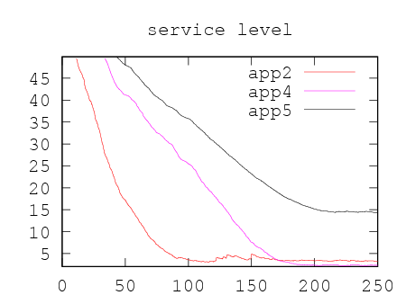
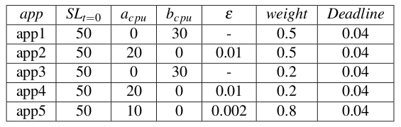
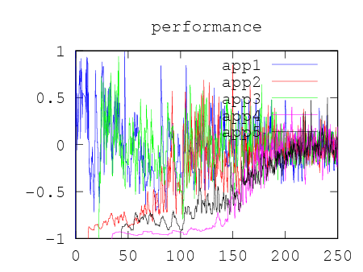
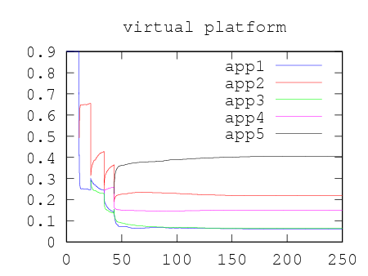
Result, Only Load Generators

Slide 17
Conclusions and Further Work
Integrating GTRM into systemd – SUCCESS
Implementing SL-adaptation of video quality – SUCCESS
Very rough prototype
Bring more applications to GTRM

Slide 18




Innovating for a
smarter, safer world.

