Slide 1
Digital Image Processing
Spatial Domain Filtering: Part I

Slide 2
Spatial Filtering
w(-1,-1) | w(-1,0) | w(-1,1)
w(0,-1) | w(0,0) | w(0,1)
w(1,-1) | w(1,0) | w(1,1)
Mask coefficients showing coordinate arrangement

Slide 3
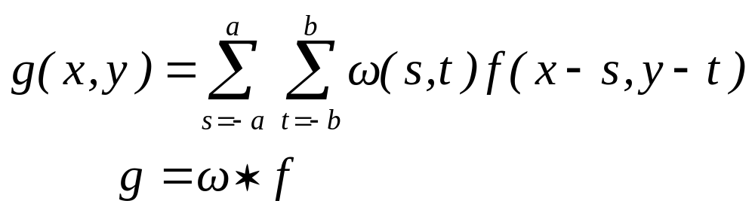
Convolution

Slide 4
Convolution
Convolution kernel, ω
Input Image, f
1 | -1 | -1
1 | 2 | -1
1 | 1 | 1
2 | 2 | 2 | 3
2 | 1 | 3 | 3
2 | 2 | 1 | 2
1 | 3 | 2 | 2
Rotate 180º
1
1
1
-1
2
1
-1
-1
1

Slide 5
Convolution
1
1
1
2
2
2
3
-1
2
1
2
1
3
3
-1
-1
1
2
2
1
2
1
3
2
2
1
1
1
-1
2
2
2
3
5
4
2
-1
2
1
3
3
Output Image, g
-2
1
2
2
1
2
1
3
2
2
Input Image, f

Slide 6
1
1
1
2
2
2
3
Convolution
-1
2
1
2
1
3
3
-1
-1
1
2
2
1
2
1
3
2
2
1
1
1
2
2
2
3
5
4
-2
4
2
2
1
3
3
Output Image, g
-2
-1
3
2
2
1
2
1
3
2
2
Input Image, f

Slide 7
Convolution
1
1
1
2
2
2
3
-1
2
1
2
1
3
3
-1
-1
1
2
2
1
2
1
3
2
2
1
1
1
2
2
2
3
5
4
4
-2
4
3
2
1
3
3
Output Image, g
-1
-3
3
2
2
1
2
1
3
2
2
Input Image, f

Slide 8
1
1
1
2
2
2
3
Convolution
-1
2
1
2
1
3
3
-1
-1
1
2
2
1
2
1
3
2
2
1
1
1
2
2
2
3
5
4
4
-2
-2
6
1
2
1
3
3
Output Image, g
-3
-3
1
2
2
1
2
1
3
2
2
Input Image, f

Slide 9
1
1
1
2
2
2
3
Convolution
-1
2
1
2
1
3
3
-1
-1
1
2
2
1
2
1
3
2
2
1
2
2
2
2
2
3
5
4
4
-2
Output Image, g
-1
4
1
2
1
3
3
9
-1
-2
2
2
2
1
2
1
3
2
2
Input Image, f

Slide 10
1
1
1
2
2
2
3
Convolution
-1
2
1
2
1
3
3
-1
-1
1
2
2
1
2
1
3
2
2
2
2
2
2
2
2
3
5
4
4
-2
Output Image, g
-2
2
2
1
3
3
3
9
6
-2
2
-2
2
1
1
2
1
3
2
2
Input Image, f

Slide 11
Convolution
5
4
4
-2
9
6
14
5
11
7
6
5
9
12
8
5
Final output Image, g

Slide 12
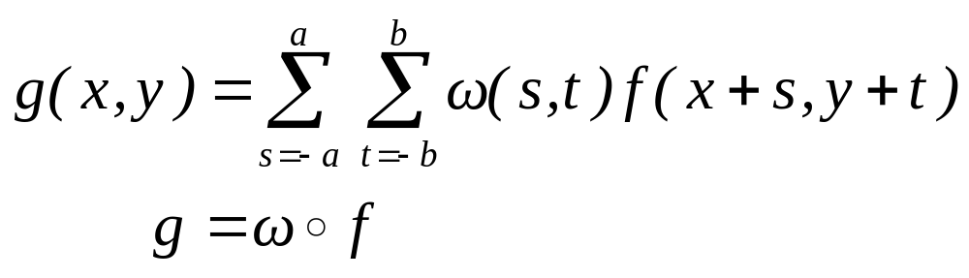
Correlation

Slide 13
Correlation
correlation kernel, ω
1 | -1 | -1
1 | 2 | -1
1 | 1 | 1
Input Image f
2 | 2 | 2 | 3
2 | 1 | 3 | 3
2 | 2 | 1 | 2
1 | 3 | 2 | 2
Don’t rotate use it directly

Slide 14
Correlation
1
-1
-1
2
2
2
3
1
2
-1
2
1
3
3
1
1
1
2
2
1
2
1
3
2
2
1
-1
-1
1
2
2
2
3
5
4
-2
1
2
1
3
3
2
1
output Image, g
2
2
1
2
1
3
2
2
Input Image, f

Slide 15
1
-1
-1
2
2
2
3
Correlation
1
2
-1
2
1
3
3
1
1
1
2
2
1
2
1
3
2
2
1
-1
-1
2
2
2
3
5
10
2
4
-2
2
1
3
3
2
1
3
output Image, g
2
2
1
2
1
3
2
2
Input Image, f

Slide 16
1
-1
-1
2
2
2
3
Correlation
1
2
-1
2
1
3
3
1
1
1
2
2
1
2
1
3
2
2
1
-1
-1
2
2
2
3
5
10
10
2
4
-3
2
1
3
3
1
3
3
output Image, g
2
2
1
2
1
3
2
2
Input Image, f

Slide 17
1
-1
-1
2
2
2
3
Correlation
1
2
-1
2
1
3
3
1
1
1
2
2
1
2
1
3
2
2
1
-1
-1
2
2
2
3
5
10
10
15
2
6
-1
2
1
3
3
3
3
1
output Image, g
2
2
1
2
1
3
2
2
Input Image, f

Slide 18
1
-1
-1
2
2
2
3
Correlation
1
2
-1
2
1
3
3
1
1
1
2
2
1
2
1
3
2
2
1
-2
-2
2
2
2
3
5
10
10
15
1
4
-1
2
1
3
3
3
output Image, g
1
2
2
2
2
1
2
1
3
2
2
Input Image, f

Slide 19
1
-1
-1
2
2
2
3
Correlation
1
2
-1
2
1
3
3
1
1
1
2
2
1
2
1
3
2
2
2
2
-2
2
-2
2
3
5
10
10
15
2
2
2
1
-3
3
3
3
4
output Image, g
2
2
1
2
2
2
1
1
3
2
2
Input Image, f

Slide 20
Correlation
5
10
10
15
3
4
6
11
7
11
4
9
-5
4
4
5
Final output Image, g

Slide 21
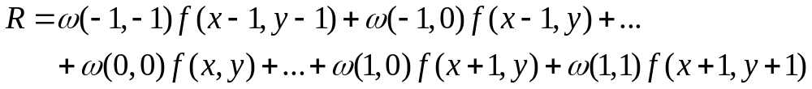
Linear Spatial Filtering

Slide 22
Smoothing Spatial Filters
Types of Smoothing Filters : linear and nonlinear
Smoothing Linear Filters : known as averaging filter or lowpass filters.

Slide 23
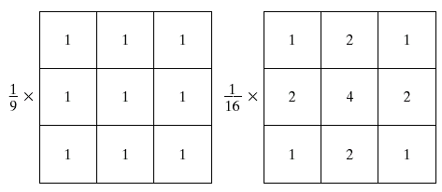
Smoothing Linear Filters
Box filter
Weighted average filter

Slide 24
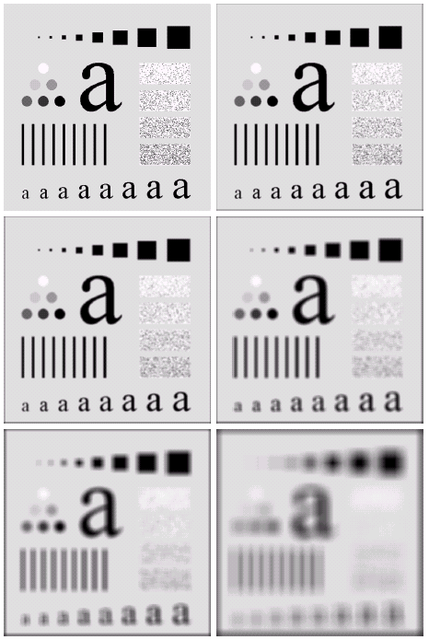
Smoothing Linear Filters
Original
3x3
5x5
9x9
15x15
35x35
© 2002 R. C. Gonzalez & R. E. Woods

Slide 25
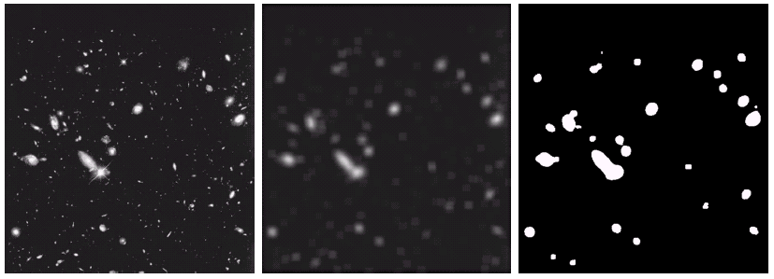
Smoothing Linear Filters
original
blurred
thresholded
© 2002 R. C. Gonzalez & R. E. Woods

Slide 26
Summary
We have looked at:
  What are spatial domain operations.
  What are convolution and correlation.
  What is smoothing linear filter
Next time we will continue our talk
about image enhancement in spatial
domain by focusing on statistical
terminology

