Slide 1

CAOaas
Creation and Annihilation Operators as a Service
Nano project during innovation week of PI21.37
Fredrik Wartenberg, Zenseact

Slide 2
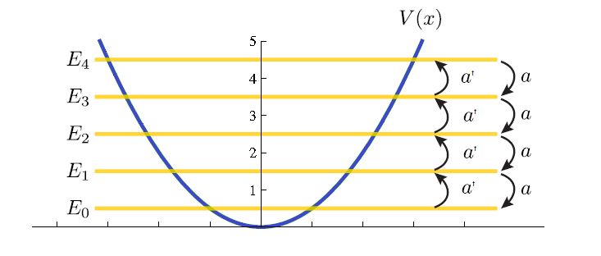

What are Creation and Annihilation Operators (CAO)?
Example Quantum Harmonic Oscillator
a^{ⴕ} creation operator moves state one energy level up (or creates a particle)
a annihilation operator moves state one energy level down (or annihilates a particle)
States
creation
annihilation
|3>
|2>
|1>
|0>
Mathematically operators do so by operating on the wave functions |n> for the energy states:

Slide 3
Operator algebra
Basic equations
Operators do not commute; order matters:
(1) a^{ⴕ}a |n> = a^{ⴕ} (a |n>) = a^{ⴕ} sqrt(n) |n-1> = sqrt(n) sqrt(n)|n> = n * |n>
(2) aa^{ⴕ} |n> = a (a^{ⴕ} |n>) = sqrt(n+1) a |n> = sqrt(n+1)sqrt(n+1)|n> = (n+1) |n>
Thus (2) – (1)
(aa^{ⴕ} - a^{ⴕ} a) |n> = n + 1 –n |n> = 1 |n>
Writing only the operators
aa^{ⴕ -} a^{ⴕ}a = 1 or [a, a^{ⴕ} ] = 1 or aa^{ⴕ} = a^{ⴕ}a + 1

Slide 4
Normal Order
For long terms of consecutive annihilation or creation operators, normal order is the way to organize operators.
Normal order implies that creation operators go first followed by annihilation operators.
Normal order: a^{ⴕ}a^{ⴕ}a^{ⴕ}aaa
Not Normal order: a^{ⴕ}a^{ⴕ}aa a^{ⴕ}
To go from not-normal order to normal order can be very tedious for long terms as operators do not commute:
aaa^{ⴕ} = aa^{ⴕ}a + a = a^{ⴕ}aa + a + a = a^{ⴕ^2}a + 2a

Slide 5
CAOaas
REST API to transform CAO operator expression to normal order
Simple, highly inefficient, implementation due to recursion:
FredrikWartenberg/annihilator-creator (github.com)
Service is live under http://vagrinder.asuscomm.com:1930/__docs__/

Slide 6
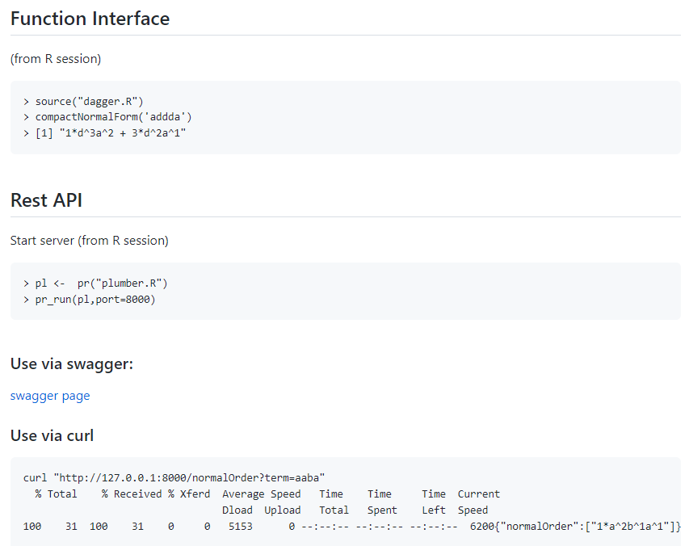
Usage
http://vagrinder.asuscomm.com:1930/__docs__/ (my be down)

Slide 7
Example
d = a^{ⴕ} (creation operator ‘a-dagger’)
a: annihilation operator
aa^{ⴕ}aa^{ⴕ}aa^{ⴕ}
adadad
1*d^3a^3 + 6*d^2a^2 + 7*d^1a^1 + 1*1^1
a^{ⴕ3}a³ + 6a^{ⴕ2}a² +7a^{ⴕ}a+ 1
Textbook input
API input
CAOaas Output
Output in Textbook notation

