Slide 1

CAOaas
Creation and Annihilation Operators as a Service
Nano project during innovation week of PI21.37
Fredrik Wartenberg, Zenseact

Slide 2
CAOaas
Creation and Annihilation Operators as a Service
Nano project during innovation week of PI21.37
Fredrik Wartenberg, Zenseact

Slide 3
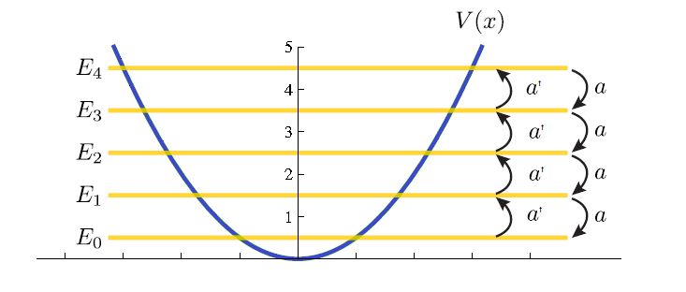
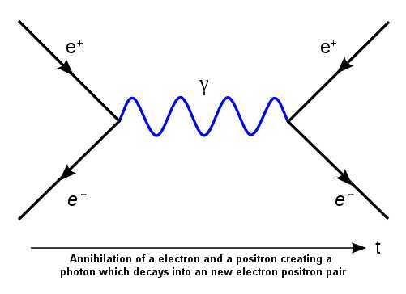

What are Creation and Annihilation Operators (CAO)?
creation operator a^{ⴕ} moves state one energy level up (or creates a particle)
annihilation operator a moves state one energy level down (or annihilates a particle)
Example Quantum Harmonic Oscillator
Example Quantum Field Theory
Energy States
annihilation
creation
|3>
annihilation
creation
|2>
|1>
|0>
Mathematically operators do so by operating on the wave functions |n> for the energy states:

Slide 4
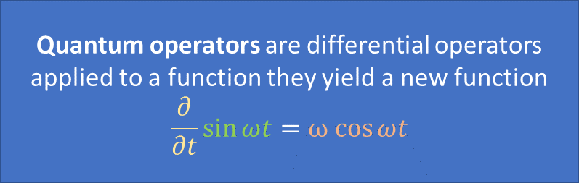
Operator algebra: [a, a^{ⴕ} ] = 1
Basic equations of CAO algebra
Quantum operators are differential operators
applied to a function they yield a new function
$$\frac{∂}{∂t}\sin{ωt}=ω cos{ωt}$$
operator a
function |n>
new function |n+1>
differential operator
function
new function
Operators do not commute; order matters:
(1) a^{ⴕ}a |n> = a^{ⴕ} (a |n>) = a^{ⴕ} sqrt(n) |n-1> = sqrt(n) sqrt(n)|n> = n * |n>
(2) aa^{ⴕ} |n> = a (a^{ⴕ} |n>) = sqrt(n+1) a |n> = sqrt(n+1)sqrt(n+1)|n> = (n+1) |n>
Thus (2) – (1)
(aa^{ⴕ} - a^{ⴕ}a) |n> = n + 1 – n |n> = 1 * |n>
Writing only the operators
aa^{ⴕ} - a^{ⴕ}a = 1 or [a, a^{ⴕ} ] = 1 or aa^{ⴕ} = a^{ⴕ}a + 1

Slide 5
Normal Order
For long terms of consecutive annihilation or creation operators, normal order is the way to organize operators.
Normal order implies that creation operators go first followed by annihilation operators.
Not Normal order: a^{ⴕ}a^{ⴕ}aa a^{ⴕ}
Normal order: a^{ⴕ}a^{ⴕ}a^{ⴕ}aaa = a^{ⴕ3}a³
To go from not-normal order to normal order can be very tedious for long terms as operators do not commute:
aaa^{ⴕ} = aa^{ⴕ}a + a = a^{ⴕ}aa + a + a = a^{ⴕ^2}a + 2a

Slide 6
CAOaas
Creation and Annihilation Operators as a Service:
REST API to transform CAO operator expression to normal order
Simple, highly inefficient implementation due to recursion.
Code FredrikWartenberg/annihilator-creator (github.com)
Service may be live under http://vagrinder.asuscomm.com:1930/__docs__/

Slide 7
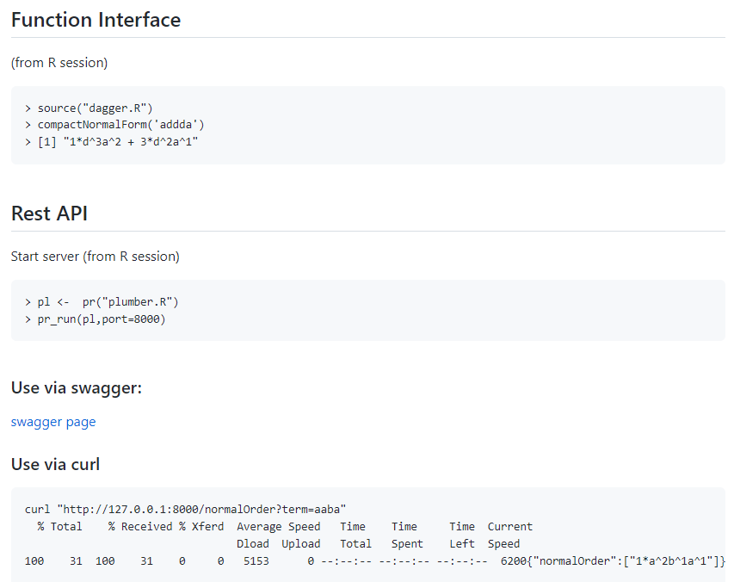
Usage
Prerequisites
CRAN R installed
R-packages plumber and stringr
http://127.0.0.1:8000/__docs__/)

Slide 8
Example
d = a^{ⴕ} (creation operator ‘a-dagger’)
a: annihilation operator
aa^{ⴕ}aa^{ⴕ}aa^{ⴕ}
adadad
1*d^3a^3 + 6*d^2a^2 + 7*d^1a^1 + 1*1^1
a^{ⴕ3}a³ + 6a^{ⴕ2}a² +7a^{ⴕ}a+ 1
Textbook input
API input
API Output
Output in Textbook notation

