Slide 1
Free my Financials

Slide 2
Team Members
Dennis Beaver
Jeffery Harmon
Pandora Roberts
William Withers
Grant Witty

Slide 3
Client
Nicolas Egierski

Slide 4
Use Cases
UC1 - Budget with Tags - People with a paycheck-to-paycheck mentality will customize the tool to meet their budgeting needs with tags. The user will create a new tag that can be used to categorize transactions and plan their budget - BR1 & BR2
UC2 - Budget over time - Treasurers for an organization will set a time frame for a budget so it can more closely match the schedule of the organization. As their plan changes over time, they will be able to update the budget to reflect the changes. BR1
UC3 - Financial Goals - A user will set a goal for a specific amount of money they want to save. The tool will then help them track their progress towards that goal. BR1

Slide 5
Requirements
FR01 - Users can create budgets - HIGH - BR1
FR02 - Users can view their budgets in a dashboard - HIGH - BR1
FR03 - The system organizes budgets based on user-defined categories - HIGH - BR1
FR08 - Users can set-up and track long-term financial goals that span across multiple time-bound budgets - MEDIUM - BR2
FR09 - Users can create groups who can access different budgets - MEDIUM - BR1
NR01 - Maintain AWS monthly costs under $15/month - HIGH

Slide 6
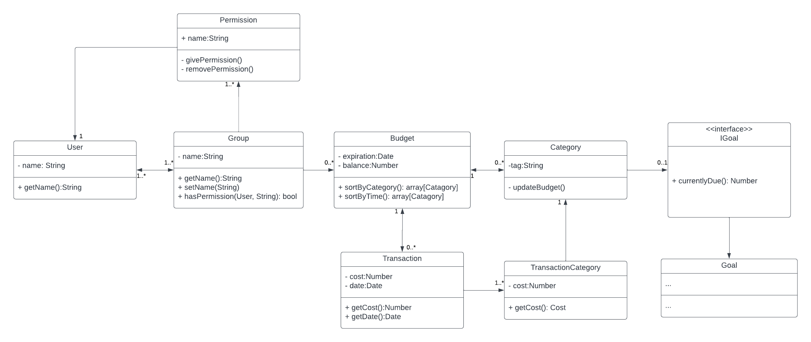
Domain Model

Slide 7
TechStack
Language: Typescript, HTML, SCSS
NUXT (Vue.js)
Database: POSTGRES
Hosting: AWS
Services: Google Identity Plaid API

Slide 8
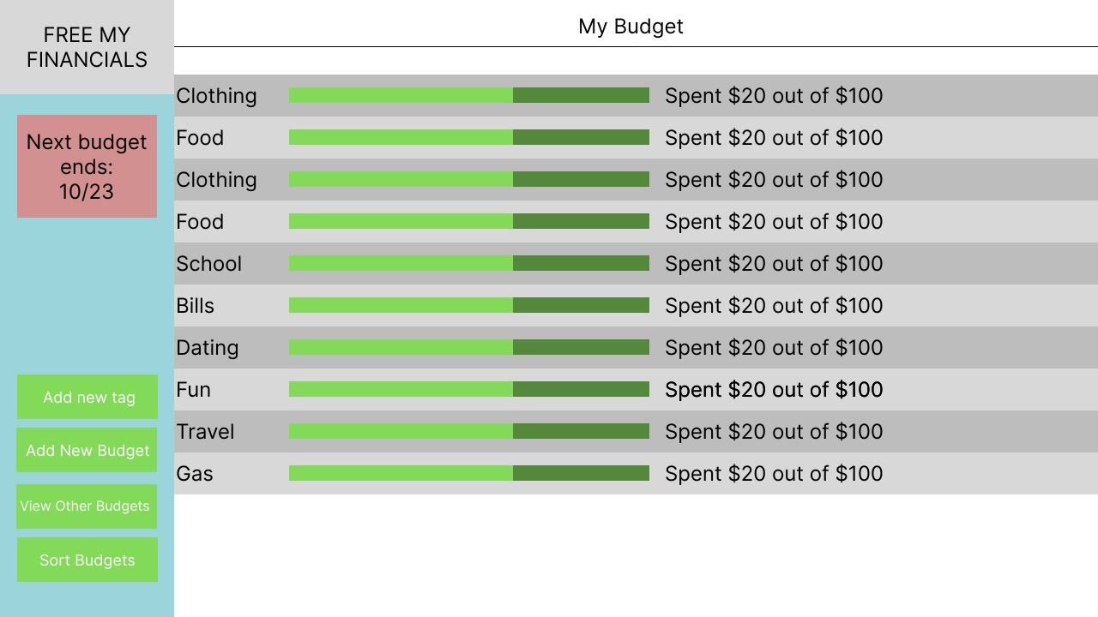
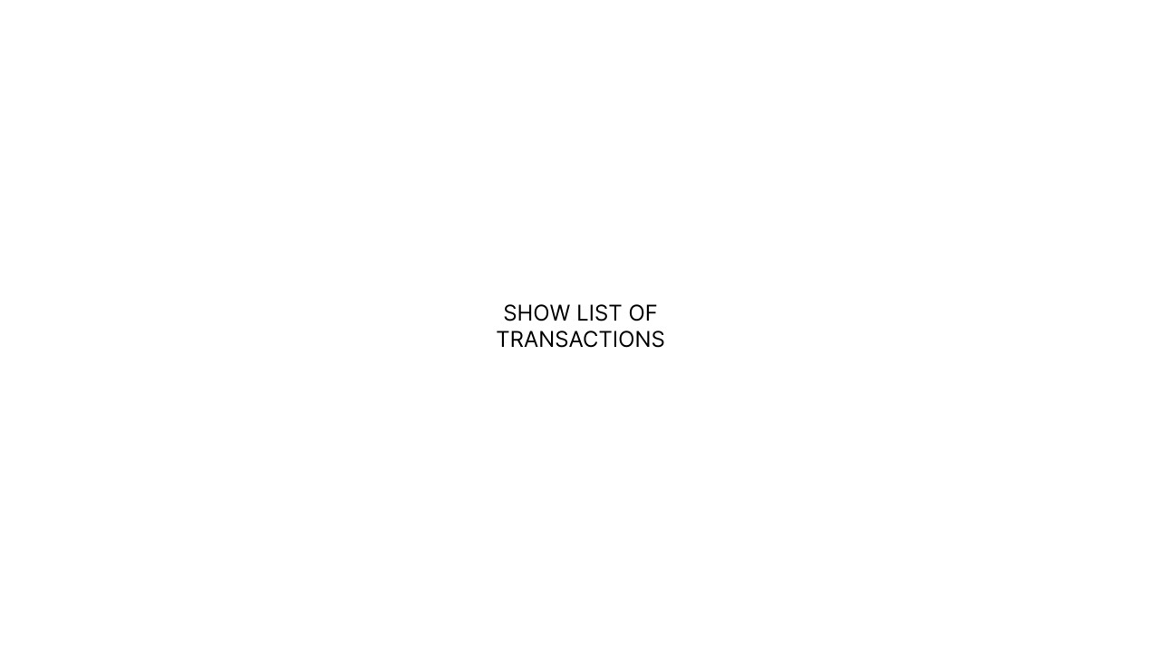
Prototype

Slide 9
First Iteration Features
User can create budgets

Slide 10
Mentor Feedback
Add registration and group permission functional requirements.
Add in missing services: Google Identity and Plaid API. Change formatting of Architecture documents.
Remove balance as a class, adding it under Budget.
Rephrase actors in use cases. Make use cases more detailed.
Change background color and finish up details in prototype.

Slide 11
Client Feedback
Client wants the program to be as close to serverless as possible
Client questioned the structure, responded that each group may have multiple people and budgets potentially with zero of both
Client asked if the GUI prototype we provided was an example of one budget, as of the moment that was correct
Client had no particular preference for task management tools

