Slide 1
Development of a General Minimal RESidual (GMRES) method alogrithm for Compressed Sparse Row (CSR) Matrices and implementation of ILU0 preconditioning in Fortran90
Alessandro Marcelli
A.A. 2022-2023

Slide 2
Compressed Sparse Row Matrices
A Matrix is called Sparse when most of its elements are zero.
Sparse data is more easily compressed and thus operations are much less resource intensive compared to Dense Matrices.
One possible format for storage of a Sparse Matrix is the
Compressed Sparse Row one, which employs three 1D vectors:
nzval: nonzero values of the matrix
colind: column indices of nonzero values
rowpnt: total number on nonzero values above row j
nzval = [ 5 8 3 6 ]
colind = [ 1 2 3 2 ]
rowpnt = [ 0 1 2 3 4]

Slide 3
Hessemberg Matrices
Special kind of square matrices that are “almost triangular” that either have null elements
above the first superdiagonal (Lower Hessemberg Matrix)
below the 1st subdiagonal (Upper Hessemberg Matrix)
If a Hessemberg Matrix has no null elements in said super/subsiagonal, is said to be unreduced.
Unreduced Upper Hessemberg Matrix
Unreduced Lower Hessemberg Matrix
Lower Hessemberg Matrix

Slide 4
Systems of linear equations and differential equations
A n-th equations linear system is defined as such
Partial Differential Equations (PDEs) and in particular Ordinary Differential Equations (ODEs) problems such as
Cauchy or Sturm-Liouville ones are examples for systems of equations.
ODEs of order greater than one can be rewritten as linear systems of 1st order differential equations.

Slide 5
General Minimum RESidue overview
Iterative method for the numerical solution of an indefinite nonsymmetric system of linear equations
The solution is approximated with a vector with minimal residual in a Krylov subspace defined as
Using the results from Arnoldi we can write the solution as
Is the initial error given by the Ansatz
This basis for Kn is at risk of linear dependency.
Using the Arnoldi iteration one can find a better one
The Arnoldi iteration yelds two matrices
Now we solve the linear least squares problem obtained, which gives us the yn needed for computing xn.
If rn is not small enough, we repeat the process using the last residue as r0.
(n+1)-by-n Hessember Matrix

Slide 6
Convergence
The residual does not increase.
For a m-by-m matrix A, at the m-th iteration the Km subspace is equal to R^{m} and thus the method converges to exact solution, but one can often get a “good enough” approximation before that.
Greenbaum, Pták and Strakoš theorem states the possibility of the method stalling for m-1 steps and suddendly converging to zero at the last step.
This is not a common occurrence though, and the method usually works well, expecially when the eigenvalues of A are clustered away from the origin and A is not too far from normality.

Slide 7
GMRES recap and computational costs
STEPS RECAP
Calculation of qn with Arnoldi
Minimization of rn
Computation of solution
Repeat if rn too big
Output generation
COMPUTATIONAL COSTS
2m² floating point operations for dense matrices, O(m) for CSR ones
O(nm) floating point operations at the n-th iteration

Slide 8
Least squares problem solution (1)
The decomposition is easily updatable by virtue of the following property of Hessenberg matrices
(n+1)-by-n dimension matrix, gives over-constrained linear system of n+1 equation for n variables
We compute the minimum using a QR decomposition
(n+1)-by-n upper triangular matrix
If we manage to set this to zero, we get a triangular matrix!
(n+1)-by-(n+1) orthogonal matrix
We need the Givens Rotation for this
The upper triangular matrix can be rewritten as
n-by-n upper triangular matrix

Slide 9
Least squares problem solution (2)
Using the Givens rotation we defined we can write
This is now a triangular matrix!
The minimization problem thus becomes
And the vector that minimizes the problem is given by

Slide 10
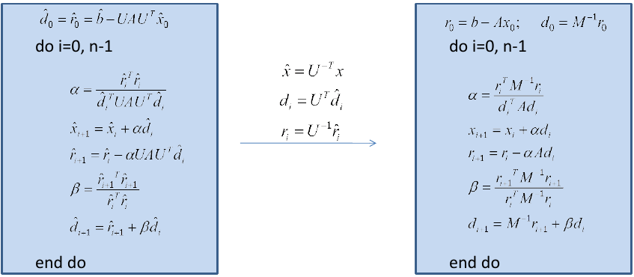
Preconditioning
Preconditioning is a procedure that helps iterative methods to converge faster.
It consists in applying a matrix, called preconditioner, to the original one, thus obtaining a matrix with a smaller condition number, which means it’s less sensible to error during solving.
We don’t need to form this explicitly

Slide 11
ILU Preconditioning
One kind of preconditioning the LU factorization (LU)
Upper Triangular matrix
Lower Unitriangular matrix
Sparsity Pattern
Graph of A
For sparse matrices the LU factorization is not ideal, since the LU factors can be much less sparse than the originl matrix, thus requiring more memory. Instead it’s better to implement the Incomplete LU factorization (ILU) since being an approximation it’s less memory intensive at the cost of a non-exact result.
This is not a problem, since we’re just using it as a preconditioner for an iterative method.

Slide 12
Fortran90 GMRES code structure
subroutine gmres(A_in, b_in, x_out, Iter_in, threshold_in, ip, error)
*VARIABLE DEFINITION, ALLOCATION AND INITIALIZATION*
*FIRST RESIDUAL CALCULATION*
*CHOOSE IF USE PRECONDITION OR NOT*
do while (error > threshold_in)
*ARNOLDI ITERATION FOR Iter_in STEPS*
*MINIMUM SQUARES PROBLEM SOLUTION*
*OUTPUT CALCULATION*
*RESIDUAL CROSS CHECK*
end do
*DEALLOCATIONS*
end subroutine
Slide 12
Checks if residual is small enough at the end of GMRES, if not the loop starts again
Slides 13 to 16
GMRES
Slide 17
GMRES code can be found at
https://github.com/comp-phys-uniroma2/cg/blob/master/gmres.f90

Slide 13
ILU0 Preconditioning
subroutine getULD_ilu0(A, U, L, D)
type(rCSR), intent(in) :: A
type(rCSR), intent(inout) :: U
type(rCSR), intent(inout) :: L
real(dp), intent(inout) :: D(:)
type(rMSR) :: LU
integer :: i, j, N, kl, ku, colindj
print*,'create LU'
call create(LU, A%nrow, A%nnz+1)
print*,'compute ilu0'
call ilu0(A, LU)
print*,'compute D'
N = A%nrow
do i = 1, N
D(i) = 1.0_dp/LU%nzval(i)
end do
print*,'create L,U'
call create(U, N, (A%nnz-N)/2 + N)
call create(L, N, (A%nnz-N)/2 + N)
print*,'compute L,U'
U%rowpnt(1) = 1
L%rowpnt(1) = 1
kl = 0; ku = 0;
do i = 1, N
do j = LU%colind(i), LU%colind(i+1) - 1
colindj = LU%colind(j)
if (colindj > i) then
ku = ku + 1
U%nzval(ku) = LU%nzval(j)
U%colind(ku) = colindj
end if
if (colindj < i) then
kl = kl + 1
L%nzval(kl) = LU%nzval(j)
L%colind(kl) = colindj
end if
end do
kl = kl + 1
L%nzval(kl) = D(i)
L%colind(kl) = i
L%rowpnt(i+1) = kl + 1
ku = ku + 1
U%nzval(ku) = D(i)
U%colind(ku) = i
U%rowpnt(i+1) = ku + 1
end do
end subroutine getULD_ilu0
select case(ip)
case('I')
call getULD_ilu0(A_in, U, L, D)
case('N')
end select

Slide 14
Arnoldi Iteration in Fortran90
Iterative eigenvalue algorithm. Starting from an arbitrary vector of norm 1, it finds an approximation of the eigenvalues and eigenvectors for a generic matrix A by constructing an orthonormal basis in the Krylov subspace using the Modified Gram-Schmidt process. Reported here is the k-th step of the iteration
mQ(:,1) = r/r_norm
beta(1) = r_norm
do k = 1, Iter_in-1
! operates on mH and mQ
select case(ip)
case('I')
call arnoldip(A_in, k, L, U, D)
case('N')
call arnoldi(A_in, k)
end select
! eliminate the last element in H ith row and update the rotation matrix
call apply_givens_rotation(cs, sn, k)
! Residual vector update
beta(k+1) = -sn(k)*beta(k)
beta(k) = cs(k)*beta(k)
error = abs(beta(k+1))/b_norm
print*,k, 'error:', error
if (error <= threshold_in) then
exit
end if
end do
1st vector for Arnoldi
K-th step of Arnoldi iteration
Givens rotation for QR decomposition.
For resource optimization, the matrix mH serves both the role of both H and R matrices, since it’s not necessary to keep the old values of either on following iterations.
ILU0 preconditioning case
No preconditioning case

Slide 15
K-th step of Arnoldi Iteration
subroutine arnoldi(A_in, k_in)
type(rCSR), intent(in) :: A_in
integer, intent(in) :: k_in
real(dp), dimension(:), allocatable :: q
real(dp) :: q_norm
integer :: i
integer :: Qsize
Qsize = size(mQ, 1)
allocate(q(Qsize))
! new Krylov vector
call matvec(A_in, mQ(:,k_in), q)
! Modified Gram-Schmidt, keeping the Hessenberg matrix
do i = 1, k_in
mH(i, k_in) = dot_product(q(:), mQ(:,i))
q(:) = q(:) - mH(i, k_in)*mQ(:,i)
end do
q_norm = norm2(q)
mH(k_in+1, k_in) = q_norm
mQ(:, k_in+1) = q(:) / q_norm
deallocate(q)
end subroutine arnoldi

Slide 16
Modified k-th step Arnoldi with ILU0
subroutine arnoldip(A_in, k_in, L, U, D)
type(rCSR), intent(in) :: A_in, L, U
integer, intent(in) :: k_in
real(dp), intent(in) :: D(:)
real(dp), dimension(:), allocatable :: q, z
real(dp) :: q_norm
integer :: i
integer :: Qsize
Qsize = size(mQ, 1)
allocate(q(Qsize))
allocate(z(Qsize))
call solveLDU(L,D,U,mQ(:,k_in),z)
! new Krylov vector
call matvec(A_in, z, q)
deallocate(z)
! Modified Gram-Schmidt, keeping the Hessenberg matrix
do i = 1, k_in
mH(i, k_in) = dot_product(q(:), mQ(:,i))
q(:) = q(:) - mH(i, k_in)*mQ(:,i)
end do
q_norm = norm2(q)
mH(k_in+1, k_in) = q_norm
mQ(:, k_in+1) = q(:) / q_norm
deallocate(q)
end subroutine arnoldip
ILU factorization every k-th step of the Arnoldi iteration
subroutine solveLDU(L,D,U,b,x)
type(rCSR), intent(in) :: L, U
real(dp), intent(in) :: D(:), b(:)
real(dp), intent(inout) :: x(:)
real(dp), allocatable :: s(:)
integer :: i
allocate(s(size(x)))
call solveL(L,b,s)
do i = 1, size(x)
s(i) = D(i)*s(i)
end do
call solveU(U,s,x)
deallocate(s)
end subroutine solveLDU
Subroutine for solving a lower triangular linear system by substitution
Subroutine for solving a upper triangular linear system by back-substitution

Slide 17
Givens Rotation
subroutine givens_rotation(v1,v2,cs_out,sn_out)
real(dp), intent(in) :: v1,v2
real(dp), intent(out) :: cs_out, sn_out
real(dp) :: t
t=sqrt(v1**2 + v2**2)
cs_out = v1/t
sn_out = v2/t
end subroutine
! ---------------------------------------------------------------------
subroutine apply_givens_rotation(cs, sn, k)
real(dp), dimension(:), intent(inout) :: cs, sn
integer, intent(in) :: k
real(dp) :: temp
integer :: i
!applied to i-th column
do i = 1, k-1
temp = cs(i)*mH(i,k) + sn(i)*mH(i+1,k)
mH(i+1,k) = -sn(i)*mH(i,k) + cs(i)*mH(i+1,k)
mH(i,k) = temp
end do
! update the next sin cos values for rotation
call givens_rotation(mH(k,k), mH(k+1,k), cs(k), sn(k))
! eliminate H(i,i-1)
mH(k,k) = cs(k)*mH(k,k) + sn(k)*mH(k+1,k)
mH(k+1,k) = 0.0_dp
end subroutine

Slide 18
Residual minimization, output and residual cross-check
call solveU(mH(1:k,1:k), beta(1:k), y_gmres)
select case(ip)
case('I')
do i = 1, size(x_out)
tmp_v(i)= dot_product(mQ(i,1:k), y_gmres(1:k))
end do
call solveLDU(L,D,U,tmp_v,r)
x_out = x_out + r
case('N')
do i = 1, size(x_out)
x_out(i)= x_out(i) + dot_product(mQ(i,1:k), y_gmres(1:k))
end do
end select
! cross check the residual:
call matvec(A_in,x_out,tmp_v)
r = b_in - tmp_v
r_norm = norm2(r)
error = r_norm / b_norm
ILU0 preconditioning case
No preconditioning case
The loop keeps on going while error > threshold_in

Slide 19
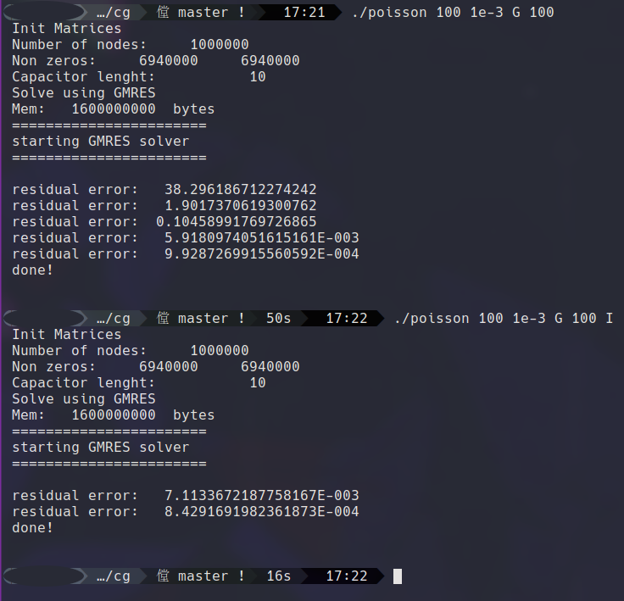
Solving the Poisson equation with and without ILU0 1
Program for solving a 3D Poisson equation, a famous example of Elliptical PDE using CSR sparse matrices.
3d gridle
NxNxN
Size of GMRES
subspace
(optional)
tolerance
Solver:
C= Conjugate Gradient
G= GMRES
Precond: (optional)
J=Jacobi
S=SSOR
I=ILU0
call gmres(A_csr, rhs, phi, maxiter, tol, PC, error)
Three runs presented:
100x100x100
150x150x150
200x200x200
… after that my machine crashed, unfortunately
The method converges sensibly faster (36 seconds less of runtime for N=100) when implementing ILU0

Slide 20
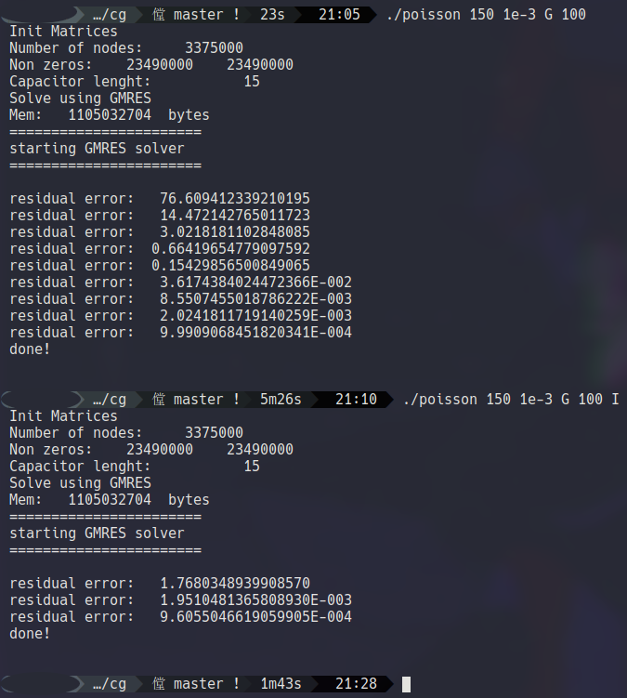
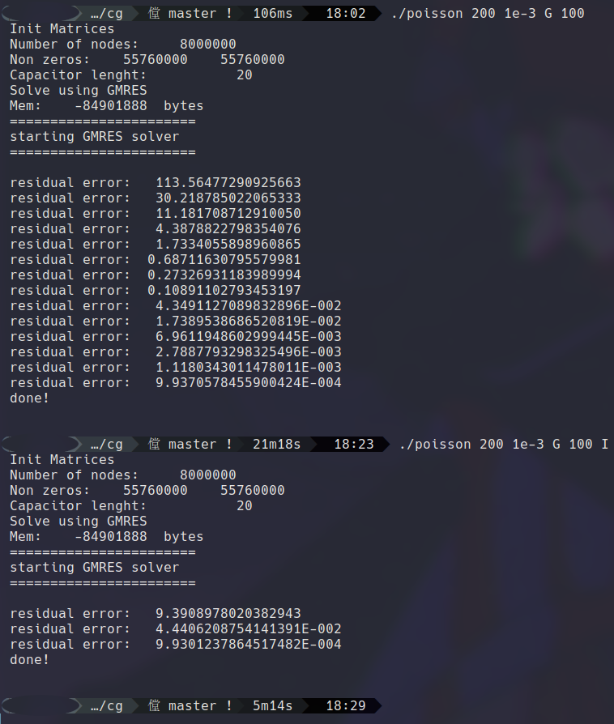
Solving the Poisson equation with and without ILU0 2
For bigger and bigger Matrices, the vantage become more and more obvious, as expected from theory!

