Slide 1
Google Play Store Apps Dataset
what is our project?:
Google Play Store Apps Dataset
speaker:
group: 5
Notes:
Hostel and classes…

Slide 2
data cleaning
googleplaystore.csv:
Correct misalignment (coding issues)
rating: convert NaN->0
app list: delete the repetition
size list: convert the unit into Kb and then delete the unit into value
installs list: delete the ‘+’
Last Update list: convert the form into M/D/Y
category list: replace the null with Other
price: delete the $, turn into the value
googleplay_user_reviews.csv
Correct misalignment
delete the null value reviews
delete the redundancy review record
reviews word segmentation

Slide 3

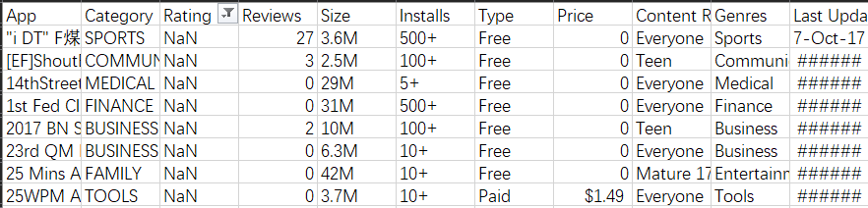
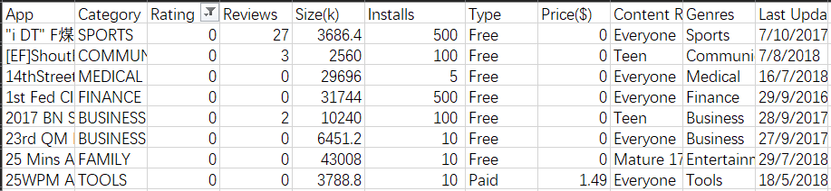
Data Cleaning
Dislocation
googleplaystore.csv:
Modify dislocation
Rating : NaN->0
app list : delete the repetition
size list : Convert Mb to Kb and delete the unit
installs list : delete the ‘+’
Last Update : Unified formula
category list : replace the null with Other
Price : delete the $
googleplay_user_reviews.csv
Modify dislocation
delete the null value reviews
delete the redundancy review record

Slide 4
how did we do the word segmentation
python numpy and pandas: combine the words into the alphabetic string
pick up the adj. and noun through the alphabetic string in keywords list
use excel statistics the frequency of occurrence of keywords
for example, in app FBReade, useful has occurred for 8 times
create word cloud through the frequency of occurence
Notes:
word cloud reflect the specific app, how people review the app through adj and noun.

Slide 5
data analysis
We want to create Rank formula through four steps:
rating of the apps is of the most significant, and the downloads and the number of comments are also important to rank the apps,
We use the rating and the number of installs to measure the measure the quality of Apps.
there are also some dimensions of the apps in the dataset we need to analysis whether we should add them to the Rank formula
such as the Size of the Apps, the Price of the Apps. In order to design the formula to rank Apps we post 4 sub questions.

Slide 6
data visualisation
our main question: recommendation list (10)of high quality experience APPs
sub-question:
whether installs and reviews will affect user experience
whether size will affect user experience
whether last update will affect user experience
whether price will affect user experience

Slide 7
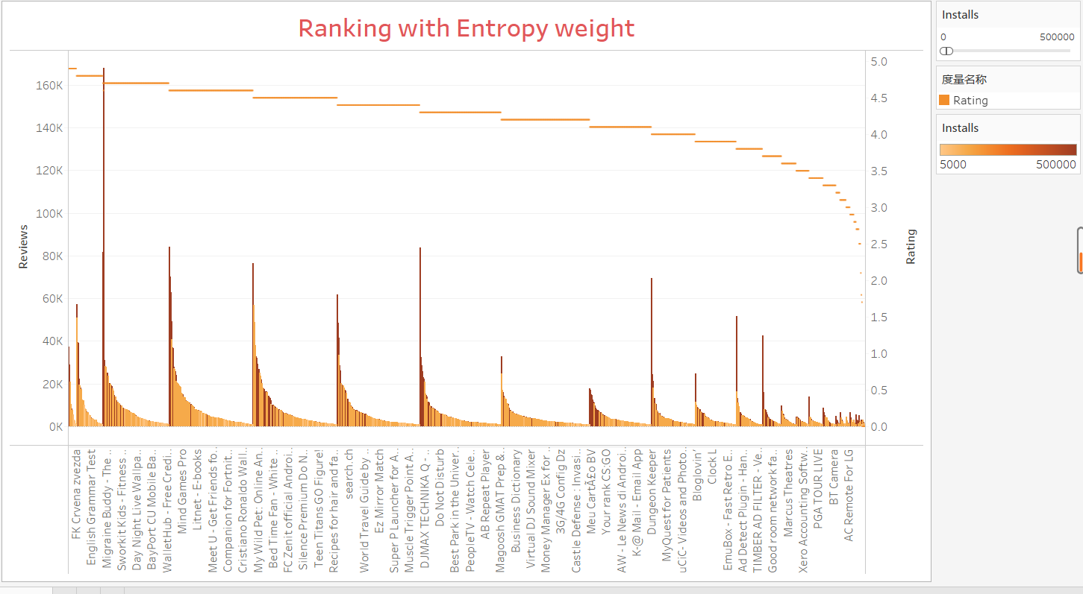
installs and reviews will affect user experience

Slide 8
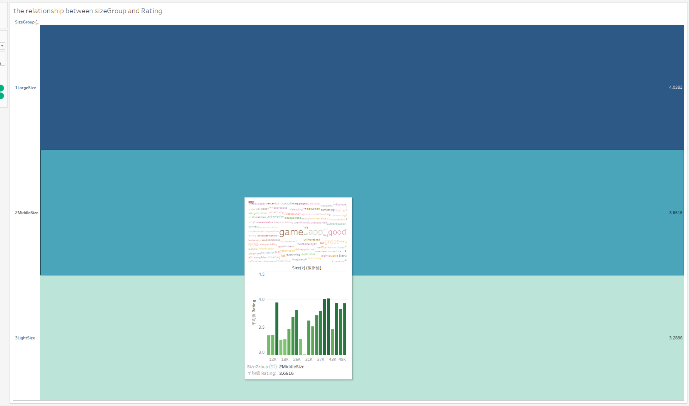
size will affect user experience
no size in formula since it has the great correlation with rating.
Notes:
The bar chart demonstrates that the size of app has no direct correlation with downloads. But, we can find a interesting condition that the size between 14k and 16k and the size between 76k and 80k have large downloads.
According to my data analysis, the rating of app increases as the size of app gets bigger. In other words, the bigger Apps may have the higher rating. So, if we have decided to add rating to measure the quality of the Apps, we need not to add the size of App to the ranking formula, Where the size of the apps has great correlation with the rating of the applications.

Slide 9
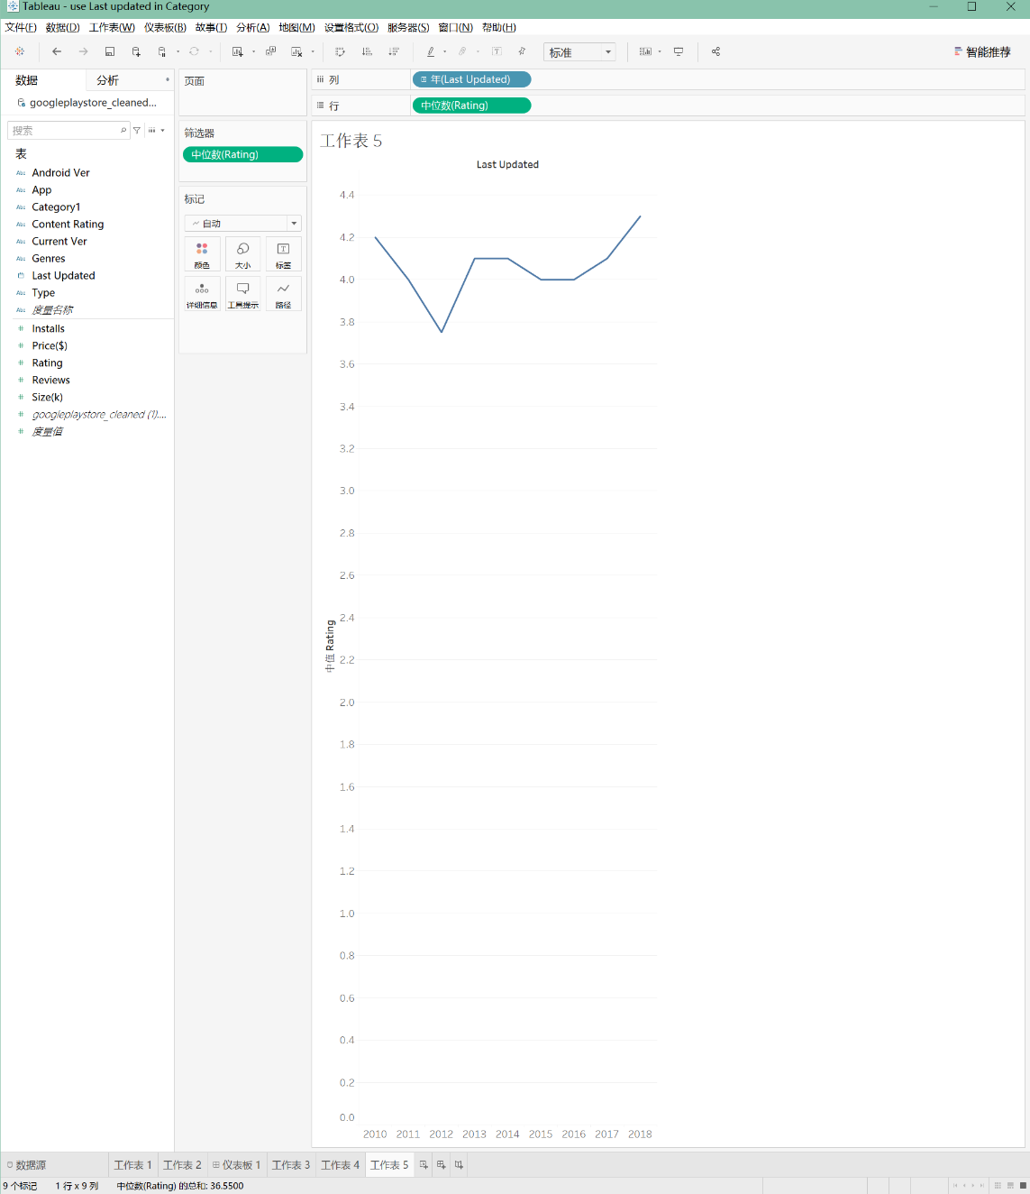
last update will affect user experience
there is no remarkable relationship with the last update and rating

Slide 10
price will affect user experience

Slide 11
recommendation list (10)of high quality experience APPs
we sort the APP into three part through installs effect
higher installs apps, more installs:
low installs apps because of diversity:
others:

Slide 12
higher installs apps

Slide 13
low installs apps

Slide 14
low installs apps

Slide 15
Thanks for your listening

