Slide 1
Google Play Store Apps Dataset
what is our project?:
Google Play Store Apps Dataset
speaker:
group: 5
Notes:
Hostel and classes…

Slide 2

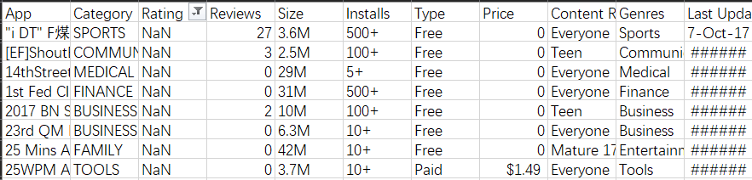
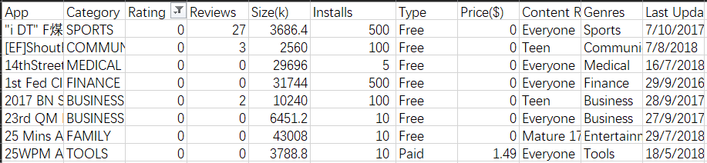
Data Cleaning
Dislocation
googleplaystore.csv:
Modify dislocation
Rating : NaN->0
app list : delete the repetition
size list : Convert Mb to Kb and delete the unit
installs list : delete the ‘+’
Last Update : Unified formula
category list : replace the null with Other
Price : delete the $
googleplay_user_reviews.csv
Modify dislocation
delete the null value reviews
delete the redundancy review record

Slide 3
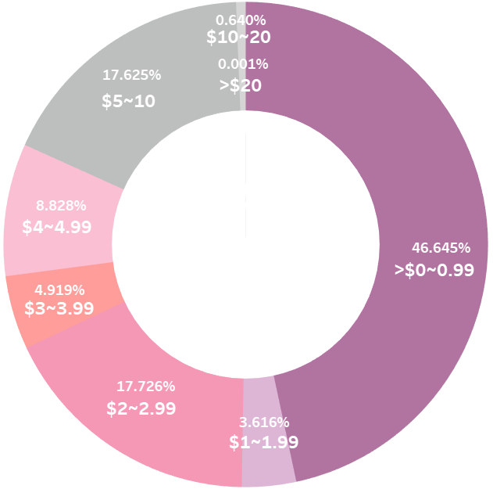
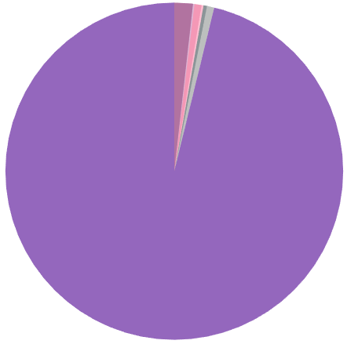
Users consider price too
Apps less than $5 will probably receive 81.7% of rest installations.(free apps exclusive)
Average installations of paid apps of different price ranges from top 3 most popular categories-Game, Communication and Tools.
We can conclude…
The cost of clicking on the install icon should be as less as possible.
Insert ads or introduce extra
paid-services …
People prefer cheaper apps
$0
96.2%
Most users download free apps

Slide 4
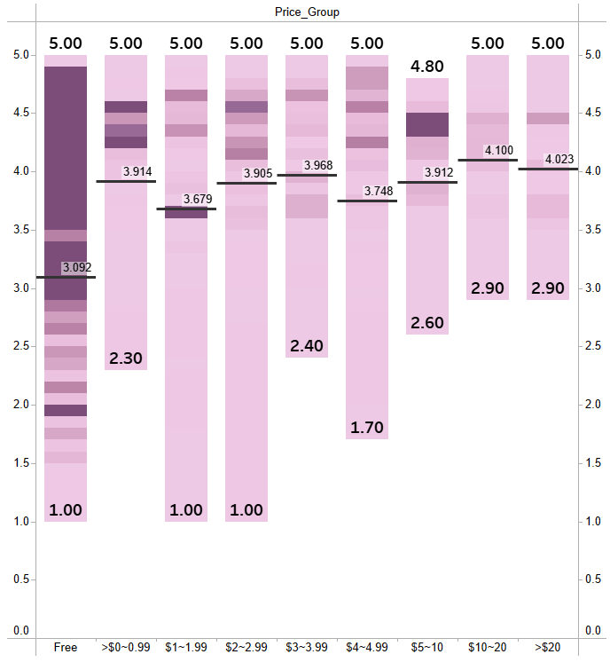
Distribution of rating in different price ranges
From all categories and both free and paid.
Maximum, minimum and the average…
Darker patterns denote more installations.
Conclusion
For users, PAID apps with numerous installations disappoint them least.
Paid apps with high installations are generally above the average.

