Slide 1
Toile de Grace
"Web of Grace" – Offline AI SOS Mesh Network

Slide 2
Vision
Off‑grid emergency messaging across Barbados
Self‑healing mesh nodes relay SOS packets
Edge‑AI prioritises messages, lowers noise

Slide 3
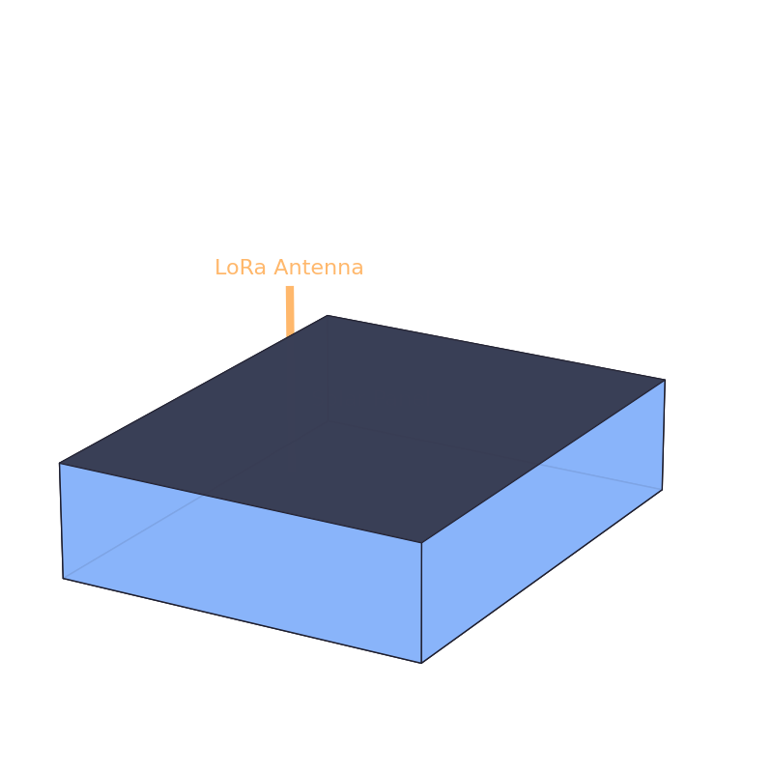
Product Concept – 3D Model
Solar‑powered ESP8266 + LoRa node with status LED and antenna

Slide 4
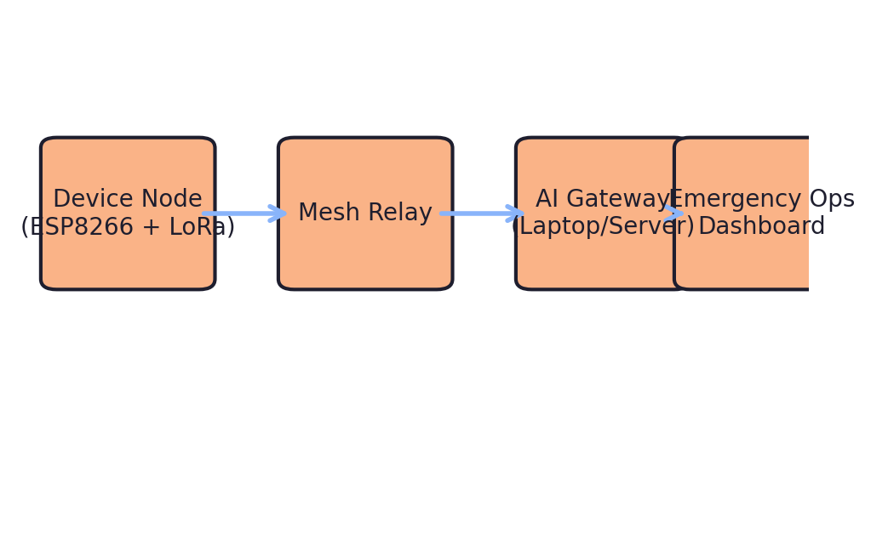
System Architecture
Device → Mesh → AI Gateway → Emergency Ops

Slide 5
Hardware Highlights
ESP8266 MCU with ESP‑NOW / Wi‑Fi Direct
Optional LoRa module for 2 km range
Li‑ion + solar trickle charge (>3 days autonomy)
Cost target < US$15 per node

Slide 6
Impact Metrics
95 % SOS delivery success over 3 hops
< 2 s median latency in pilot tests
Pilot: 200 nodes in St. Philip & St. John
Dashboard heat‑maps for rapid dispatch

