Slide 1
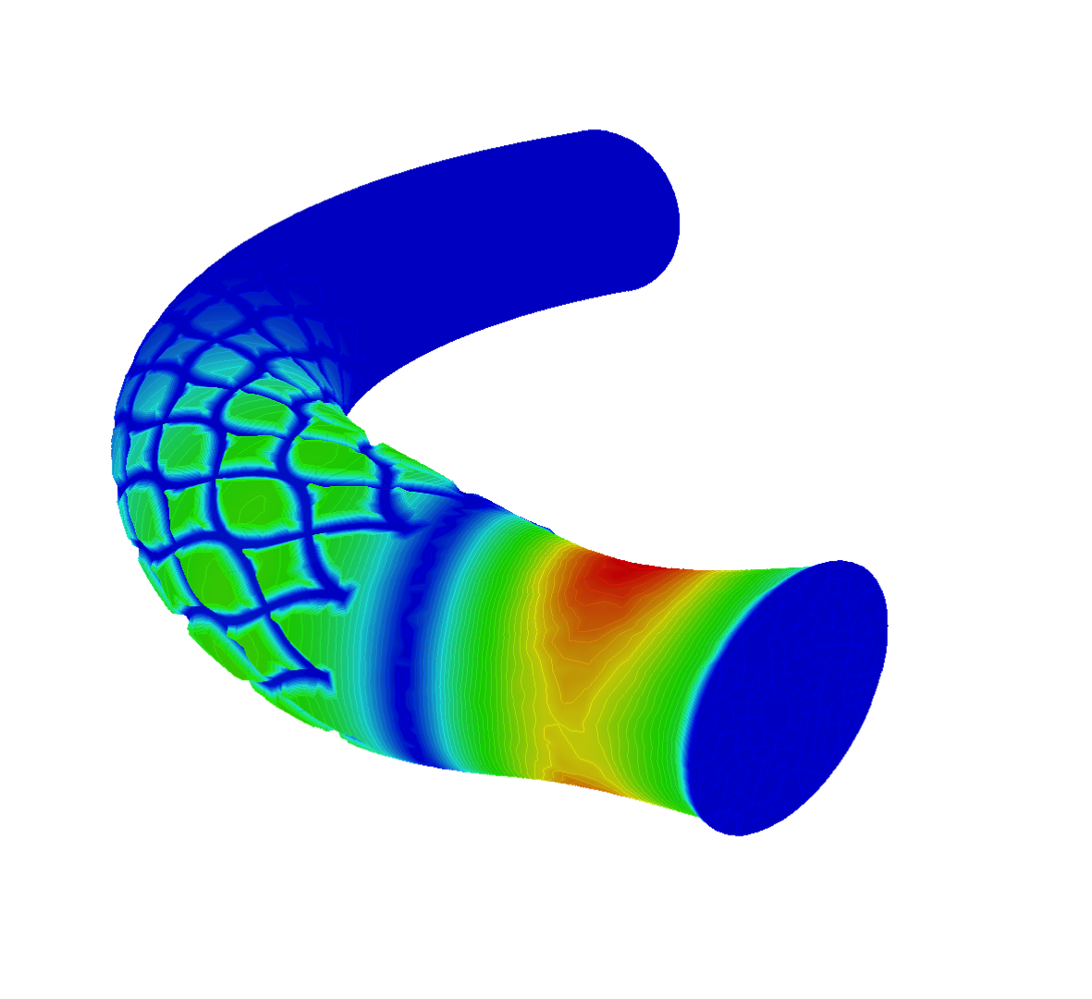
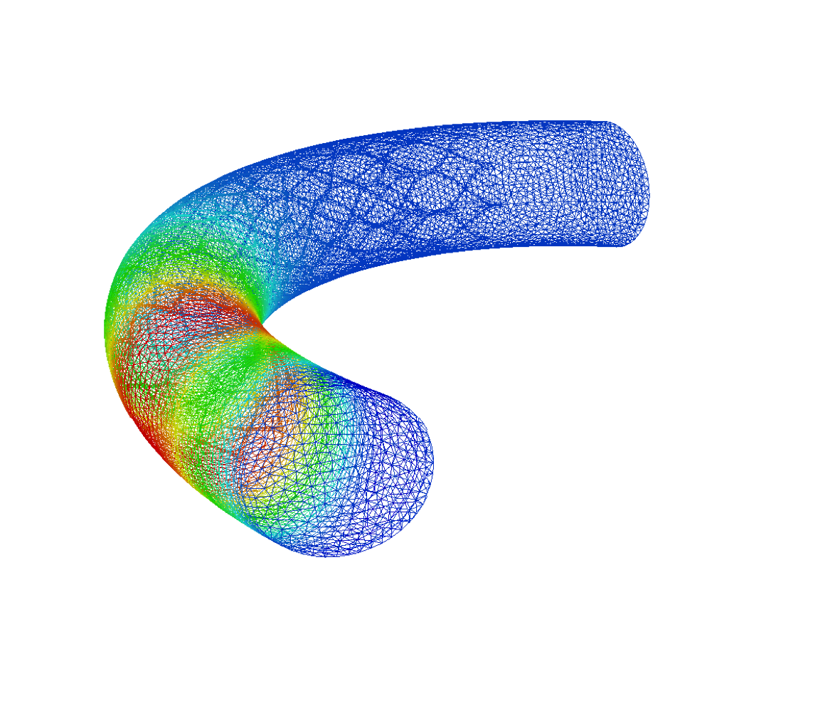
7th FreeFem++ days
An academic and industrial research conference,
A training session for beginner or advanced users. Laboratoire Jacques-Louis Lions Campus Jussieu, Université Pierre et Marie Curie
15-16 December , 2015
FreeFem++ is a teaching and research software for prototyping a PDE solver. The user comunity is continuously increasing and made of scientists from different areas of research, mathematics, physics, finance, mechanics, industry, etc.
Following the success of the previous FreeFem++ days, this new event will hopefuly reflect the latest new capabilities and applications of the software and it will be an opportunity to exchange information with other communities involved in the development of generic solvers for PDEs. The focus will be to
Highlight the most recent advances in developing generic solvers for PDEs,
Present the latest capabilities of FreeFem++ to solve PDEs using finite element methods,
Show how an academic solver could be used for ii ndustrial applications,
Help researchers to develop their own applications using FreeFem++.
Register at http://www.ljll.math.upmc.fr/FreeFem++/
More on FreeFem++ at http://www.freefem.org/ff++
Scientific committee: Local organizer
Grégoire Allaire, CMAP, Ecole polytechnique Frédéric Hecht, LJLL - UPMC
Frédéric Coquel, CMAP, Ecole polytechnique frederic.hecht@upmc.fr
Yvon Maday, LJLL, Université Pierre et Marie Curie
Ionut Danaila, LMRS, Université de Rouen
Bertrand Maury, Université Paris Sud-Orsay
Pascal Frey, LJLL, Université Pierre et Marie Curie
Olivier Pironneau, LJLL, Université Pierre et Marie Curie

