Slide 1


250th Independence Day Parade
July 4th, 2026
10:00 AM Show time
11:00 AM Parade

Slide 2
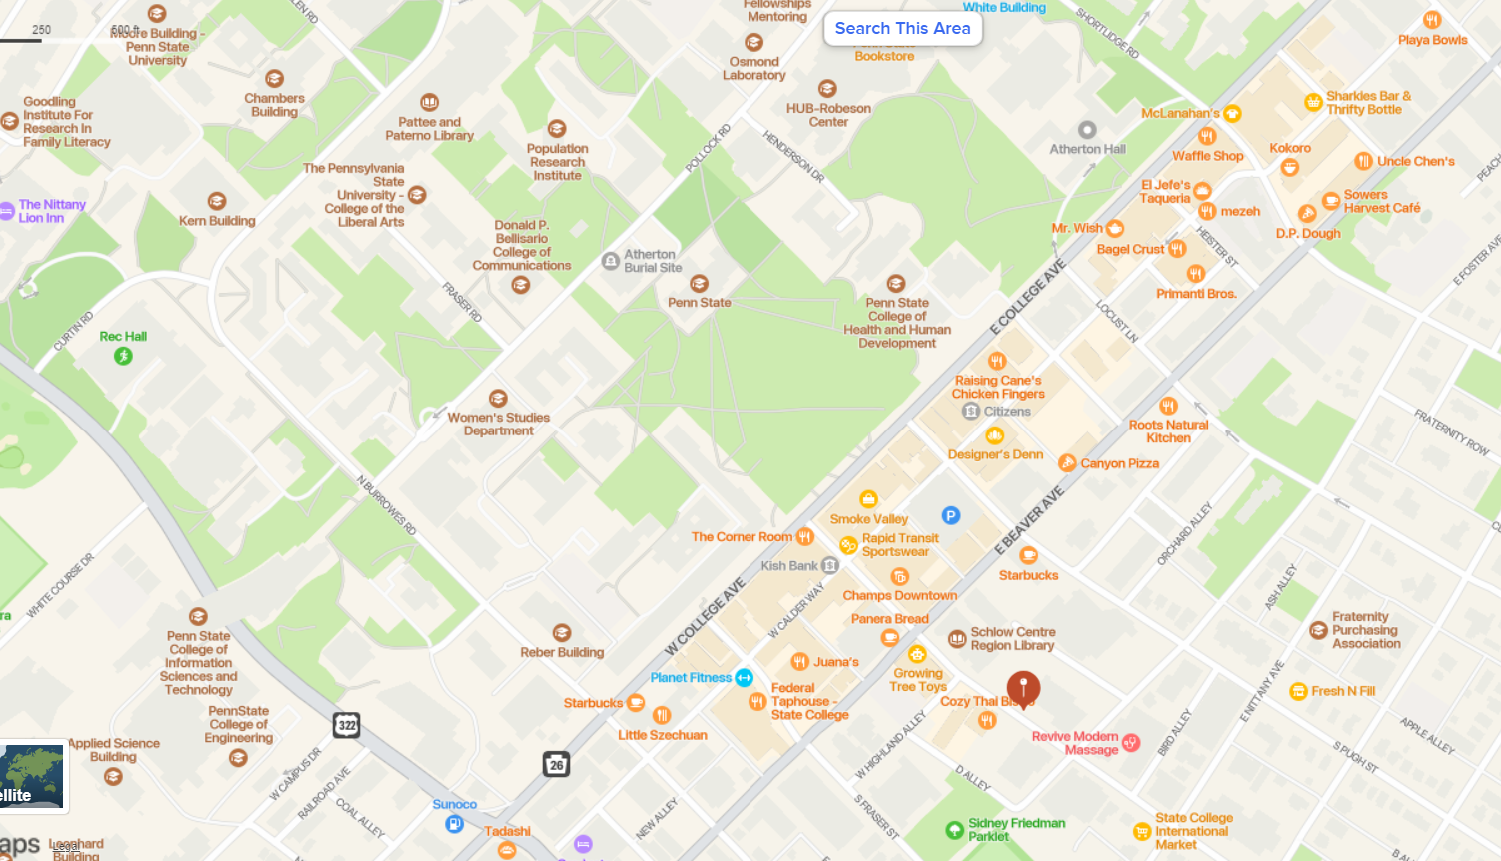


Vehicle Entrance from Atherton Street
To North Burrows via Curtin Road
Buses
Grandstand
Arrival and Staging
Staging Area A: Walking units: Park and walk to Area A on South
Burrows Street. Vehicles: enter Burrows Street from Beaver Ave.
Staging Area B: Enter Curtin Road
at light on Atherton. Stage
On North Burrows Street
Parade Route (College Ave)
Staging Area B
North Atherton Street
North Burrows St.
Free Parking
South
Burrows
St.
Staging Area A

Slide 3
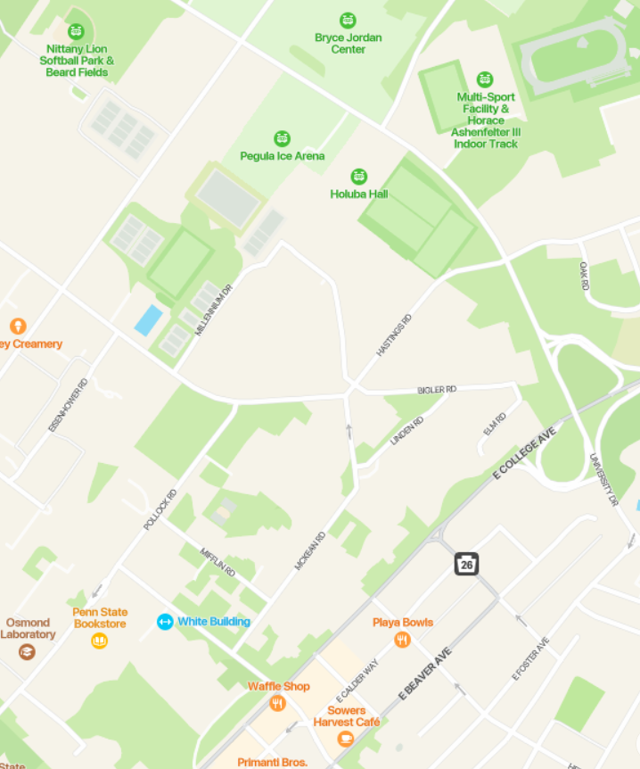
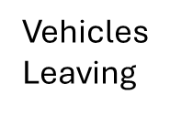

Post Parade Procedures
Vehicles to
Car Show
and 4thFest
Walkers: Get on buses or walk back to your vehicles.
Vehicles: All vehicles must turn left on Shortlidge Road,
go up the hill and take the first right on McKean Road.
Continue to follow McKean to the intersection of
McKean, Hastings and Bigler Roads.
At this point, vehicles attending 4thFest or the Car Show
turn slight right onto Hastings Road and follow it to the
traffic light at University Drive. At the light, turn left up
the hill toward the Bryce Jordan Center. Immediately
before the BJC, turn right onto Dauer Drive and parking
attendants will direct you from there.
Vehicles not attending 4thFest or the Car Show can turn
left at this intersection to exit through campus or they
can take a slight right onto Hastings Road to the light at
University Drive, where they can go left or right to
exit the area.
Vehicles
Leaving
All Vehicles
End of Parade/Buses

Slide 4
Notes:
Emergency Number: 911
Parade Director: DJ Watkins, (571) 257-6411 (Text Capable)
In the event of bad weather, the parade will be cancelled. This call will be made not later than 8:00 AM on July 4th. You will be notified using the email and phone number you provided at registration. If severe weather suddenly hits during the parade, shelter in vehicles or in the nearest parking structure (for walkers and animals).
Weather is predicted to be in the low to mid 80’s with sun, there is limited tree cover on the route, so sunscreen is recommended.
Ice water will be provided at the buses for the walkers at the end of the parade, but that’s six long blocks from the start line.
Toilet facilities are not available in the staging area. The nearest restroom is in the Fraser Street parking garage.
On street and garage parking in downtown State College is free on July 4th. Regular parking fees and regulations resume July 5th.

