Slide 1



Slide 2
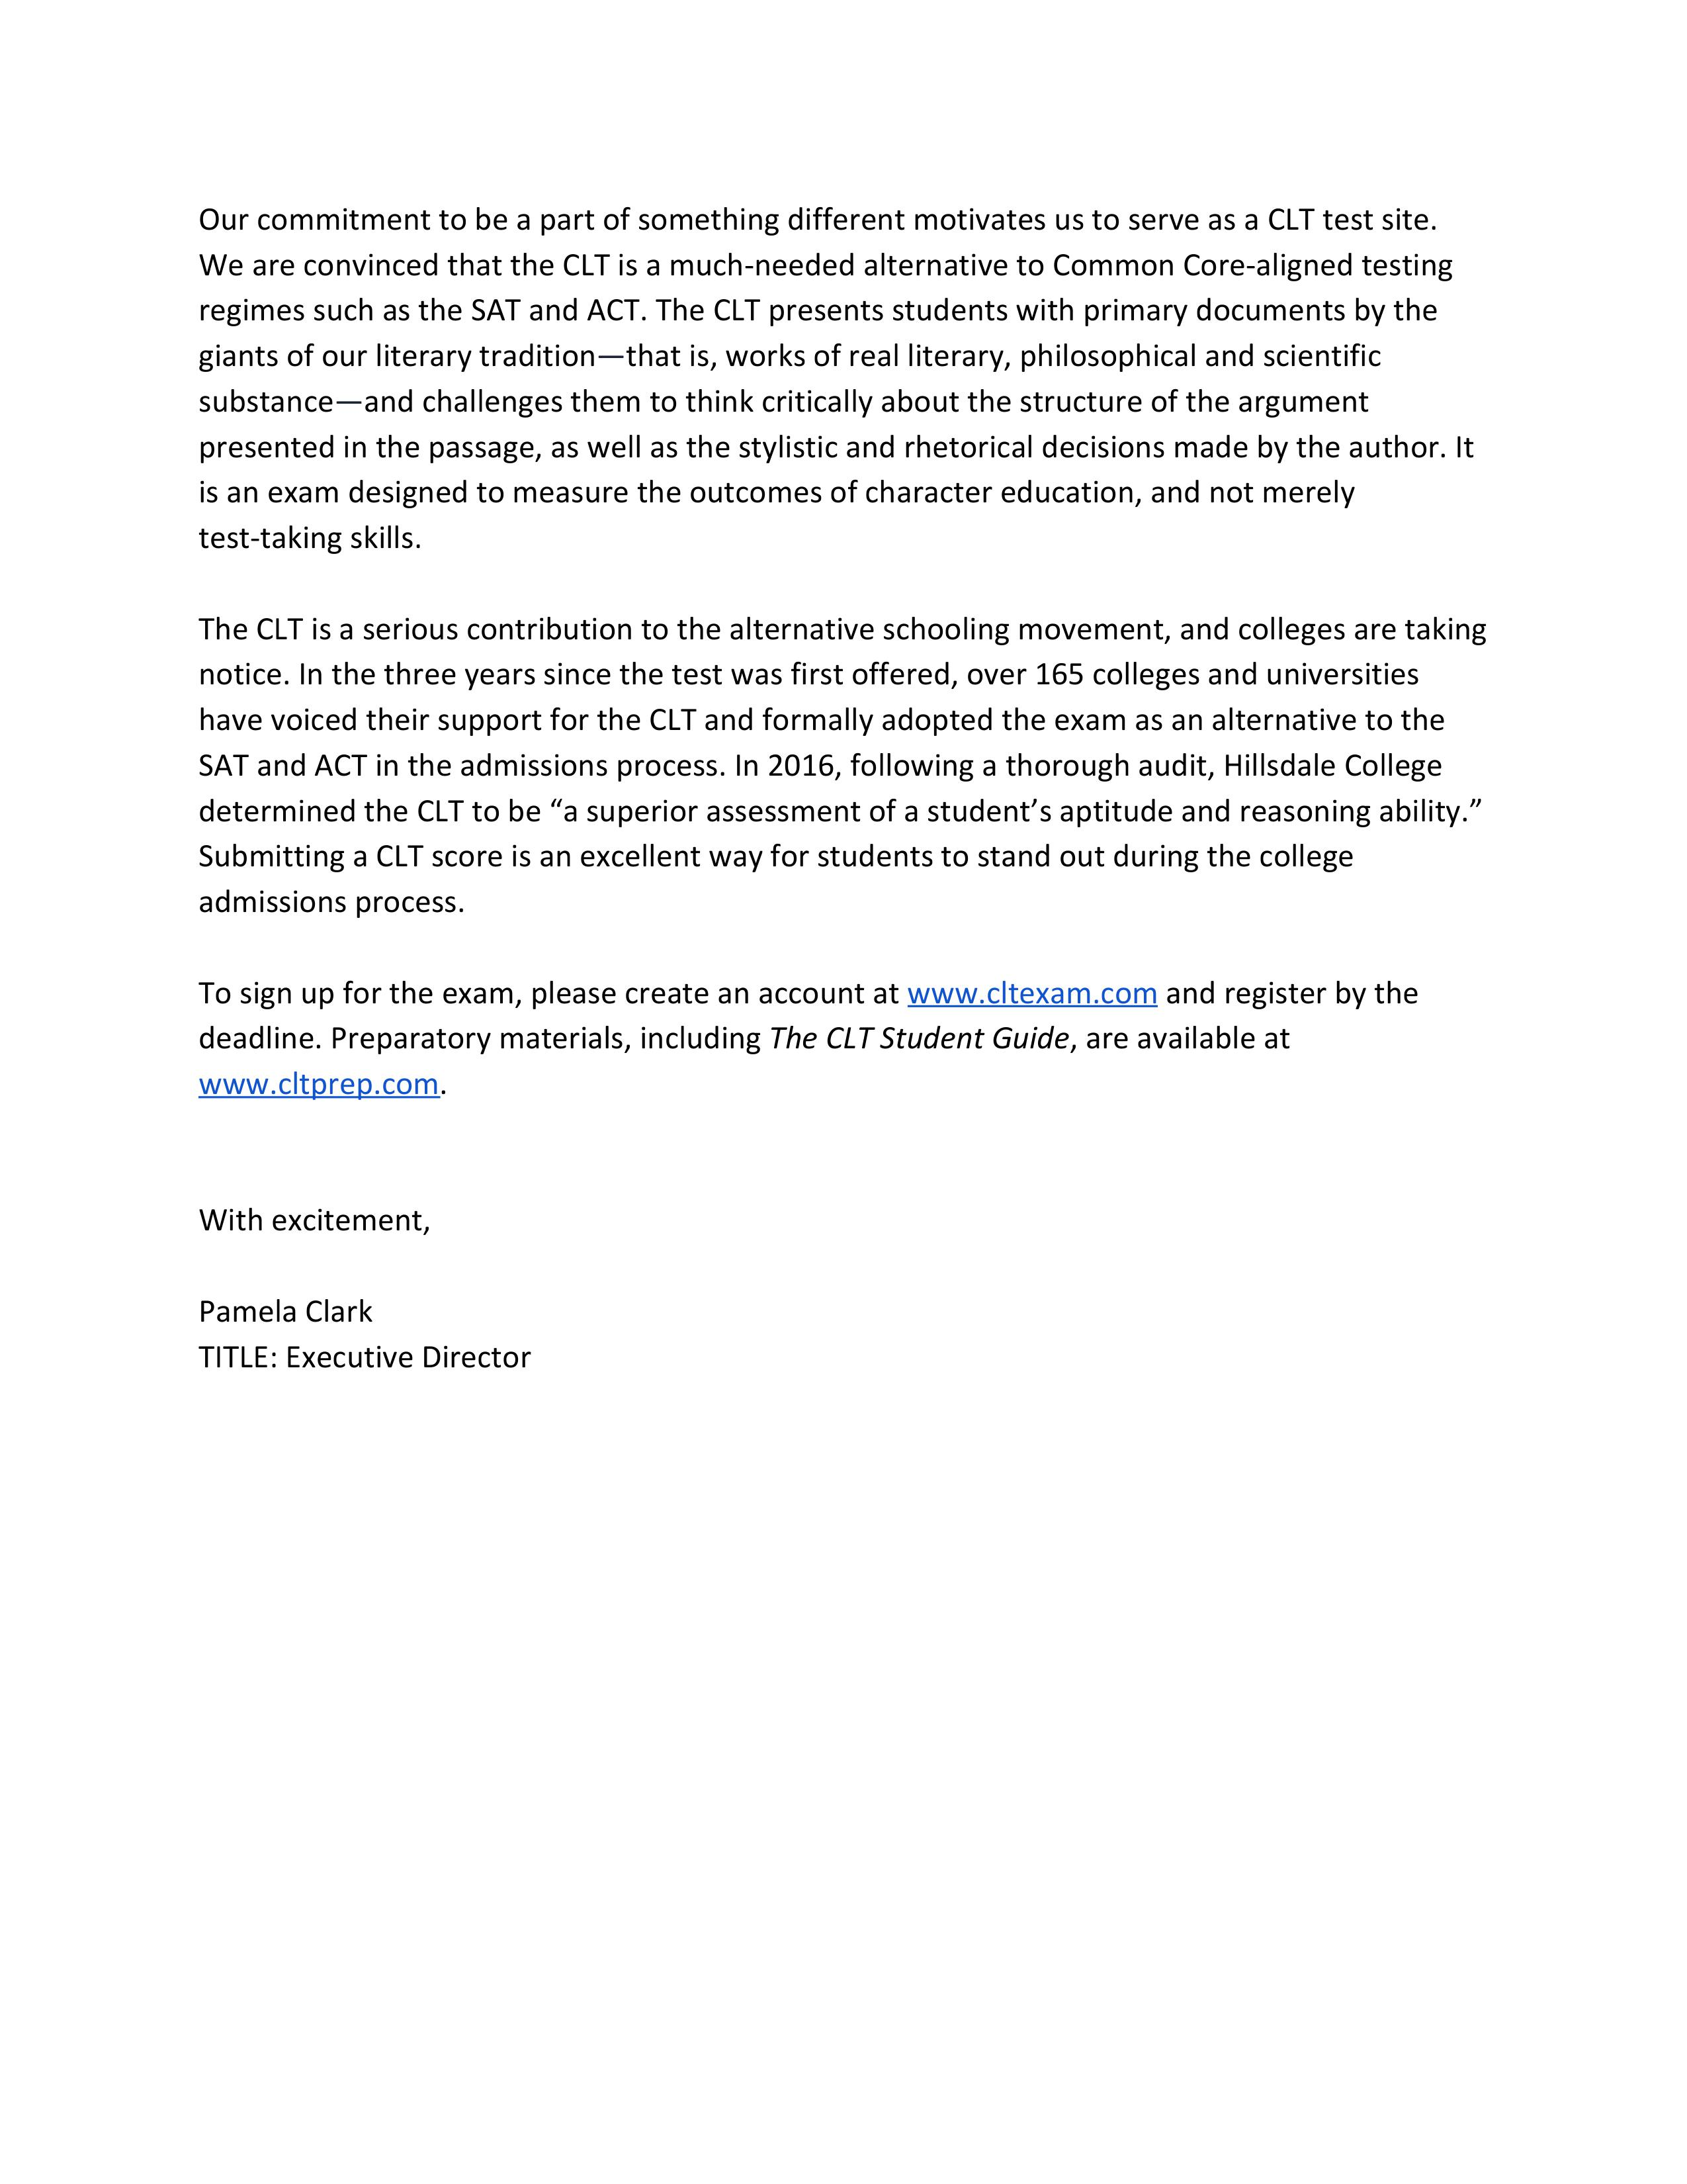

Executive Director

Slide 3



Slide 4


Slide 5


Slide 6
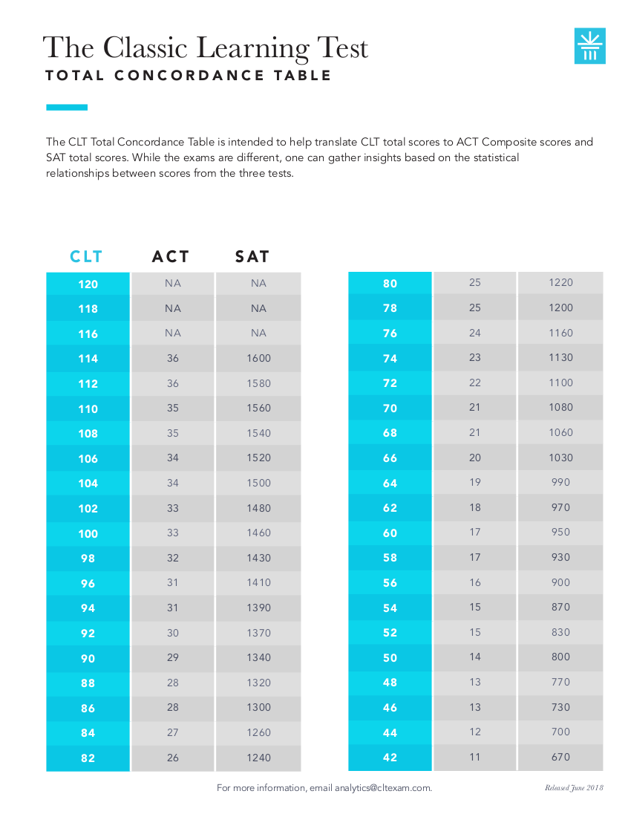

Slide 7
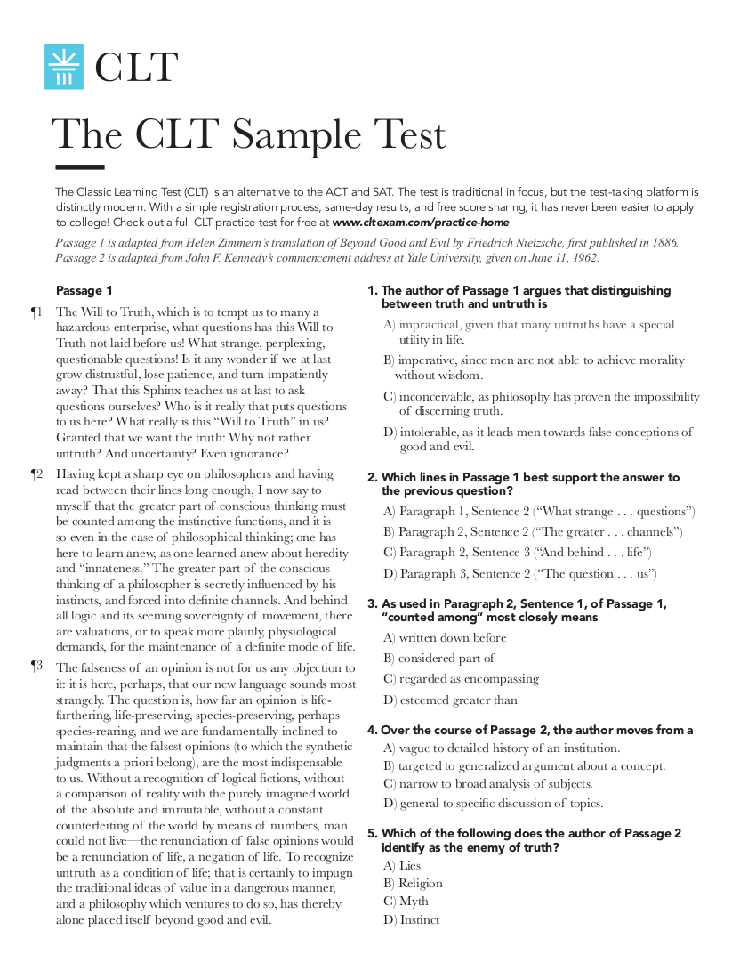

Slide 8
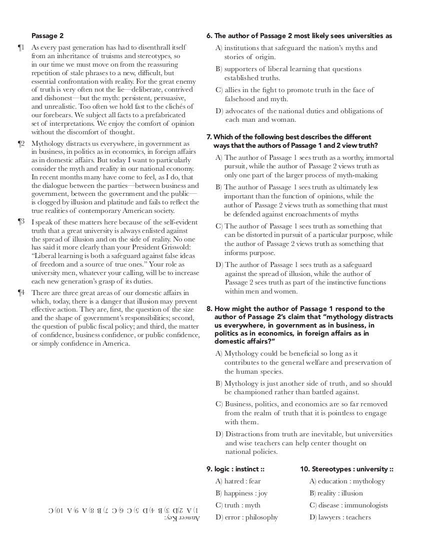

Slide 9
Top Podcast Covers the CLT
Base Camp Live has quickly become one of the top education podcasts. In this podcast, Jeremy Tate, CEO of the CLT, discusses the latest developments in college admissions and all things related to the SAT, ACT, and CLT.
https://basecamplive.com/latest-trends-of-college-entrance-tests-sat-act-and-clt-jeremy-tate/?utm_source=CLT+Exam&utm_campaign=a01e1ffb65-EMAIL_CAMPAIGN_2019_09_10_08_09_COPY_02&utm_medium=email&utm_term=0_4473d763ed-a01e1ffb65-174706629

