Slide 1
www.freemedforms.com
The FreeMedForms project :
structuring patient file,
sharing alerts.
Eric Maeker, MD (FR)
The FreeMedForms team
LSM / RMLL 2013, Brussels
Notes:
Hello,
Please, let me begin with a very special thanks and congratulations to the organizers of this event and for their work. I'm really impressed of what benevols have done for these days. I would also like to thank them for allowing me to present our work today.
I'm Eric Maeker, French physician and developer C + + / Qt I'm the creator and main developer of The FreeMedForms project. The project was started in 2008 from scratch and is now usable in day-to-day practice. The FreeMedForms is now in production in some medical offices.
You can find all information about the FreeMedForms project on our main web site: http://www.freemedforms.com/
I will present you today the patient file structuration and the alert manager.

Slide 2
The FreeMedForms project
The FreeMedForms project is a suite of medical applications (EMR, prescriber, drugs interaction checker, some other coding assistants…)
Driven by a benevol community of medical doctors and computer workers/scientists over the pulse of a french team.
Composed of about 50 members (10 actives members)
Supported by OpenSuse Medical, Debian Med, Fedora Medical, Arch Linux...
Collaboration with other medical teams: GNUmed, FreeMed, Care2X, SynapseEMR
Notes:
FreeMedForms is a suite of medical applications regrouping an Electronic Medical Record manager, a prescriber, some clinical coding assistants and many little utilities that are on the way.
The project is driven by a community of medical doctors and computer workers and was created on the pulse of a french team.
All applications of this project are free, open source and released under the GPLv3 licence.
The project is supported by the Debian Med team and also the FedoraMedical and OpenSuse Medical teams.

Slide 3
The FreeMedForms project
Linux, MacOsX, Win32, Win64, (FreeBSD)
C++ using Digia's Qt libs
Documented using Doxygen
Massive usage of MVC architecture
Builded using dynamic libraries with plugins architecture
Using SQLite and/or MySQL for database
Notes:
The project is coded in C++ with Qt libraries and a massive usage of the model/view/controller architecture. The code is documented using Doxygen.
Applications are builded with shared libraries and plugins. They are available for Linux, Mac, and Windows. The FreeBSD port should need some code adaptations.
The roadmap and the issue reporting are available on our wiki web site and Google Code.
We are using SQLite and/or MySQL (MariaDB) for the databases.

Slide 4
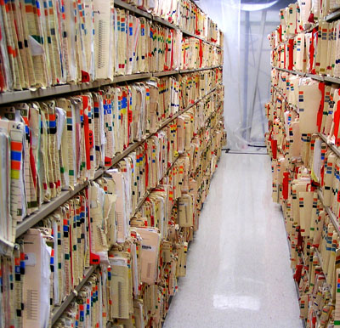
The FreeMedForms project
Structuring patient files
Notes:
Most medical care require a patient file adaptation.
Most users want the patient record to be easily and quickly changed.
With FreeMedForms, the patient file is fully editable.
It is built using sets of XML files that you can modify to best conform to your practice.
You can customize by-hand patient records by adding subforms to the central patient form.
FreeMedForms comes with an extensive list of subforms.

Slide 5
Main constation
Every patient is different,
Every medical specialty owns a different patient file.
→ Medical software should be adaptable in depth to each patient and to every practice.
FreeMedForms is build with this constraint in mind.
Each patient can have a different record's structuration, keeping a central common structure (identity...)
« on demand » patients' records.
PS: forms can be multilingual
Notes:
As I already said, all patients are different, their medical care too.
All medical specialties need a different patient file structuration and presentation.
So medical software should be massively adaptable.
FreeMedForms is built with this constraint in mind.
Each patient can have a different record's structuration keeping a common central structure like for identity, trusted person identity...
We are able to provide patients' record « on demand ». Forms can also be multilingual.

Slide 6
The form manager
Forms are grouped in « pages » and are stuctured in a tree model
Each page/branch can contain
  a part of the common central form
  a sub-form
Forms contains simple or complex widgets
Patient records are episode based
Forms and sub-forms are shareable
  Between users
  Using datapack servers
  (Future dev) Using your mail client
Notes:
Forms are grouped within « pages » and are structured as a tree model. Each page or tree branch can contain : a part of the common central form or a sub-form.
Forms can contain simple or complex widgets. We will see how to create new widgets.
Patient files are based on episodes. One episode correspond to one form record. Each episodes are independant but a linking system is on the way. Episode can be closed using a signing system.
As forms and sub-forms are just a set of files, they are shareable between users using the datapack server. A mail client based system is on the way.

Slide 7
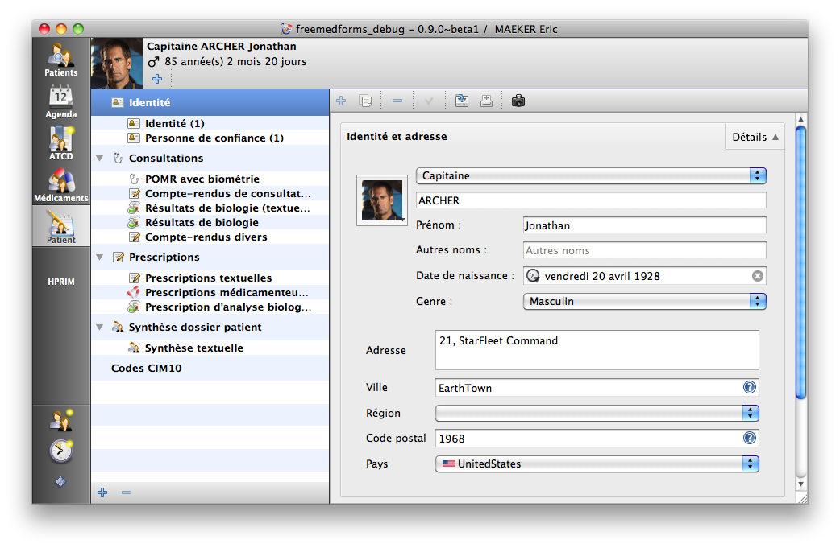
The form manager
PAGES
FORM CONTENT + EPISODE EDITING/VIEWING
FORM TREE MODEL
FORM EDITING

Slide 8
Simple diagram
Plugin: formmanagerplugin Namespace: Form
RAW DATA
IFormIO
FormCore
FormItem tree
EpisodeManager
FormManager
EpisodeModel
FormTreeModel
FormCollection
Notes:
Here is just a simple diagram showing the main form and episode objects.
Starting from the form raw source to the FormCollection and models.
Don't care, I'll present in the next diapositives all these objects.
All these objects are part of the formmanagerplugin using the Form namespace.

Slide 9
Form item widgets
FormItem
FormItem [IFormItemWidget, IFormItemData, FormItemSpec, FormItemValues, IFormItemScripts...]
Managed by the FormManager and internally mirrored
  One « collection » for the user interacting
  One « collection » for the internal computation and scripting
Can use the FreeMedForms episode database or their own database
IFormItemWidgetFactory allow you to create your own « set of widgets »
Notes:
Internaly forms are just a tree of FormItem objects. The FormItem object owns the specs, values, scripts, data manager, and widget.
Form Manager keeps two tree collections mirrored : one for the user interactions and one for internal computations and scripting.
FormItem can use the FreeMedForms database to store their values or use its own database system.
FormItems are created by the FormReaders but IFormItemWidgets are created by the IformItemWidgetFactories.

Slide 10
Form item factories
IFormItemWidgetFactory
Manage creation of IFormItemWidget
FreeMedForms « central » factory == BaseWidgetsPlugin
Must be coded in C++/Qt (QML is not yet supported)
Widgets can be
  Simple (one widget eg a combo)
  Complex (regrouping multiple widgets)
Are shared inside the plugins manager QObject poll (accessible from anywhere in the code)
Notes:
The factories are stored un the plugin manager object pool and can be accessed from anywhere in the code.
They are responsible of IformItemWidget creation.
They are currently coded in C++/Qt but a QML port is still possible.
Of course widgets can be as complex or simple as wanted.

Slide 11
Form reader
IFormIO
IFormIO (the reader), FormIODescription
Transform form's raw source (eg XML) to a tree of QObject/QWidget (Form::FormItem{Widget})
Register the new forms into the FormManager
Any kind of format can be handle (XML, JSON, CSV, pure text...)
Stores the form's raw source in a central database
Manages form's update checking
Are shared inside the plugins manager QObject poll (accessible from anywhere in the code)
Notes:
The form reader IformIO keeps all the forms' raw source in use in a part of the FreeMedForms database. It is responsible of form update checking.
The raw source of the forms can be anything you want (XML, TXT, JSON...), you just have to write your own IformIO.
The reader creates the FormItem trees ans also manages creation of the FormItemWidgets. All objects are registered in the Form Manager.

Slide 12
XML form reader
XmlForms::Internal::XmlFormIO
Currently only one reader is available: XmlForms::Internal::XmlFormIO
Architecture of the XML file is described in the documentation (the french one is always up to date)
Forms can be one unique monolytic XML file or many smaller XML files included
The central XML file (central.xml) contains the description of the form and the form itself (or included sub-forms)
Must avoid FormItem uuid collition and must keep uuid persistent in time (using uuid equivalence if required)
Notes:
Currently only an XML form reader is available.
The architecture of the XML files is described in the user manual (the french may be fresher than its english translation).
Forms can be monilytic XML files or a set of included files.
A central.xml contains the description of the form.
----
With any readers, you must avoid FormItem unique identifier collitions and keep them persistent in time. We are using namespaces.

Slide 13
XML form reader
Forms can handle
  Multiple XML form files (eg: definition of multiple pages)
  HTML files (eg: print mask ; exportation mask)
  PDF files (eg: PDF-FDF editing/saving/printing ; user manual ; help files)
  JavaScript files to make dynamic forms
  QtUi files for a better user experience
  Can « internally » manage multilingual configuration
Notes:
Forms can handle multiple different types of files.
- XML for the form inclusion
- HTML for the print/exportation mask
- JavaScript files for dynamic forms
- QtUi files for a better user experience

Slide 14
Storing data
EpisodeModel/EpisodeBase
FreeMedForms owns a general episode model/database : Form::EpisodeModel/EpisodeBase where items can store data (QVariant translated to strings and stored in a XML format using their uuid)
This is automatic, simple are safe (we have unit tests)
Form::IFormItemData allow you to interact with scripts, view, models and database.
Use the storableData() and setStorableData() to set/retrieving your data
Or you can use your own database (only using our database mecanisms)
Notes:
Episode are represented by a set of FormItems. They are a kind of « contact ». These items can store their internal data using the EpisodeModel and database automation.
All is fully automated, safe, simple and documented.
For very complex widgets, you can manage your own item database.

Slide 15
Script manager
Script::ScriptManager
Forms can handle scripts (ECMA scripts) with a full access to form/patient/user data
All form items can define different « timing » for their scripts
  OnLoad, PostLoad, OnDemand, OnValueChanged, OnValueRequiered
  OnDependentValueChanged, OnClicked
As all scripts are loaded in the same script manager instance, they must be protected inside namespaces to avoid collision
Allow you to interact with: FormItems, Patient/User core object, but also many usefull tools (FDF filler, image viewer...)
Notes:
Form builders can take advantages of the script engine which allow a full access to the patient/user and forms data.
There are many different timings for scripts (read diapo).
Read diapo.

Slide 16
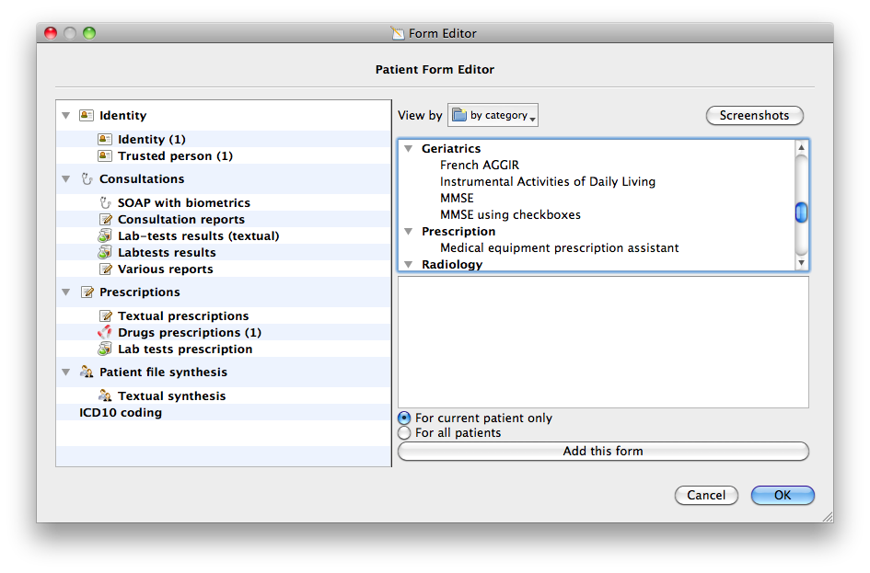

Slide 17
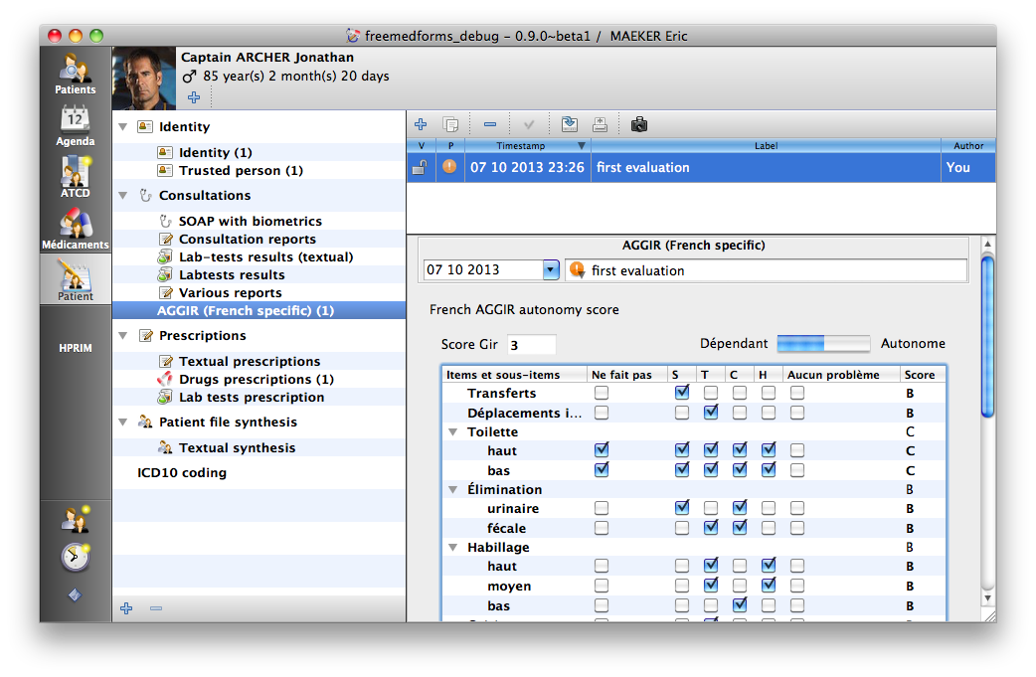

Slide 18
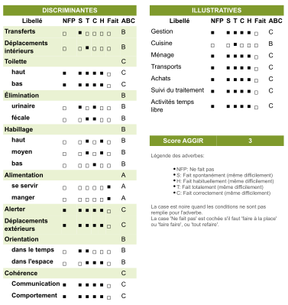

Slide 19
Alert management
Some philosophy ?
Notes:
It is always difficult to alert medical practitioners using a software.
Many alerts are overriden or totally ignored.
We tried to build a performant system, fully configurable to avoid this problematic

Slide 20
Alert philosophy [9]
Two kind of alerts: non-blocking and blocking alerts
  Non-blocking → icons and tooltips
  Blocking → blocking dialogs
Alert system provides three levels: low, medium, high;
And an infinite number of categories (DDI, PIM, drug duplication, dose checking, allergies, intolerances...)
Threshold of alerts can be adapted by the user for each type of alerts
Alerts can be dynamic (using scripting)
Try a maximum to avoid alert fatigue
[9]: J Am Med Inform Assoc. 2010 Sep-Oct;17(5):493-501.
Notes:
We defined two system of alert: one blocking and one non-blocking.
The non-blocking alert is represented by and icon and tooltips in views. While the blocking alerts are blocking dialogs that needs user validation to proceed. Both alerts present a minimal and suffisant information. At any time users can access to full alert information.
The alert system provides three levels of risk : low medium and high. And each alert can be classified in an inifinite umber of categories.
The threshold of each type of alert can be adapted by the user in the user preferences.

Slide 21
Alert philosophy
Can be related to
  One or all users
  Application (update notification, backup reminder...)
  One patient
  All patients (eg: for medical prevention, cancer screening...)
Can be « one shot alerts » or « cycling alerts »
Can have a defined validity period
Can be edited by user or not
Can be validated/overriden & commented by the user
Can be scripted
Notes:
Alerts can be related to different type of attendees.
They can be cycling or not, with a validity period defined or not.
The validation method can include a user comment in case of the user override the alert.
Alerts can be dynamic using their script system.

Slide 22
Alert packs
Alerts can be shared via alert packs
Alert packs are shared via the datapack manager
Alert packs must contains
  packdescription.xml (datapack description file)
  All XML alerts
When the user install an alert pack
  All alerts are saved
  All alerts are checked
  All alerts are executed (if required)
This is really useful to share medical prevention alerts
Notes:
Alerts can be shared between users or group of users using our datapack server. Alerts are then grouped into alert-packs.
A full documentation is about to be released on our main web site.

Slide 23
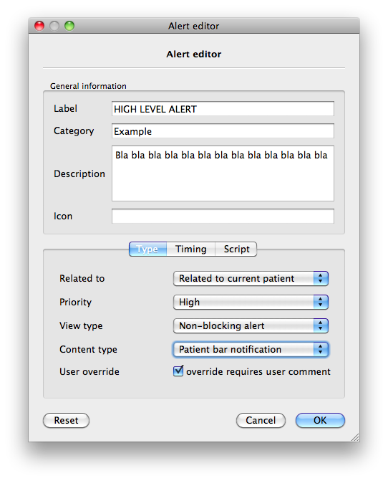
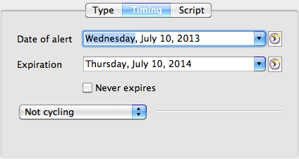
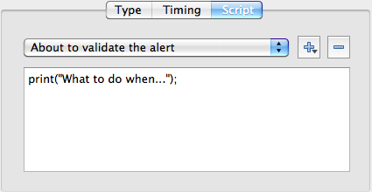

Slide 24
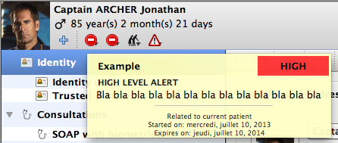
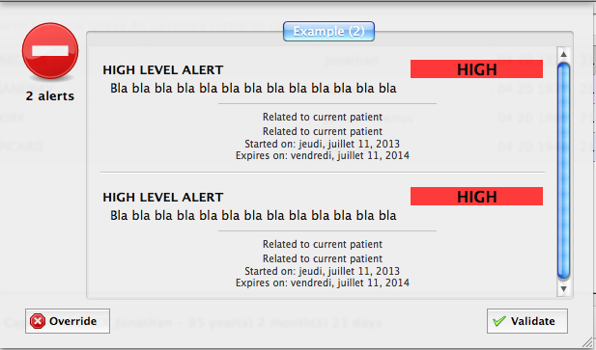

Slide 25
A word about the
Drug Interactions alert system
Drug 1
REAL TIME
ATC
Active substance 1.1
To ATC
Dynamic
Active substance 1.2
Active substance 1.3
DDI Engine
Drug Database
Active substance 2.1
Active substance 2.2
Static
Active substance 2.3
To ATC
Drug 2
!
ATC
Fatigue Alert
Notes:
The interaction engine analyzes all combinations of drugs per couple. Each molecular component is analyzed after being linked to an internationally recognized coding system and persistent over time called ATC (which means Anatomical Therapeutic Chemical). The ATC classification is owned by the World Health Organization.
The DDI engine calculates interactions in real time. Each time a drug is added or removed of the prescription, all interactions are recalculated. The process is done twice when prescribing a cure, I'll explain this later.
If the tool is effective in detecting interactions, it must signal them so that practitioners adhere to the warnings. Otherwise the tool is useless. The alert fatigue is well known effect of redondant or clinically irrelevant even non signifiant alerts. Practitioner suffering of this syndrome will override all alerts whatever is its content and level of risk.
So we had to define a strong alert philosophy.

Slide 26
Timing of the alert system
Drug selection
Dosage validation
Searching drugs
Dose processing
Time
Drugs allergies
Drugs intolerances
Processed
Noticed
* DDI & PIM not dose-related: processed
* DDI & PIM dose-related: noticed in some special cases or if prescription is only a selection of drugs (w/o dosing)
* Management of route
DDI & PIM dose-related
processed and noticed
Blocking alert
And Alert processing
Informative alerts
Notes:
The timing of the alert system is really important too.
Some interactions must be warned to practionners before he selectes drugs, some during the selection and some when the dosing of the drug is completed.
This short diagram shows the different phases of the alert computation and their emergence.

Slide 27
FreeMedForms
Needs you !
FreeMedForms is a great and big project
Actually unfunded
Need devs, testers, translators, MD, pharmacists... (and funds)
Code is available @SVN:http://code.google.com/p/freemedforms/source/checkout
Web site: http://www.freemedforms.com/
Mailing: freemedforms@googlegroups.com
Kisses to my wife and children (who support my devs...)
Thanks, The FreeMedForms Team

