Slide 1

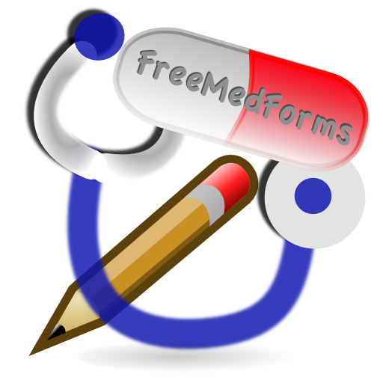

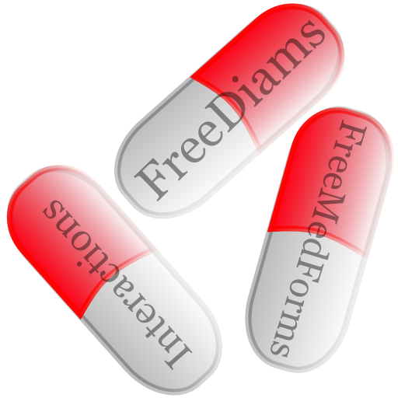


The FreeMedForms project:
managing drug-drug interactions,
an open source experimentation.
Eric Maeker MD, Christian A. Reiter MD
www.freemedforms.com
INTRODUCTION: Drug-drug interactions (DDI) can lead to severe health outcome and are all avoidable¹. Electronic medical record (EMR) managers can help to improve patient safety, as prescribers' and pharmacists' ability to recognize potentially interacting drug pairs is limited²⁻³. Unfortunately, many DDI software products are not optimal⁴⁻⁵.
THE PROJECT: The FreeMedForms project was started in October 2008 as a free and open source work. The main objective is to provide a full EMR and an open source DDI software for practitioners and pharmacists. The project is coded using C++ and the Qt framework⁶. The project is driven by a volunteer community of medical doctors, pharmacists and computer scientists. The code is released under the GPLv3 license. FreeMedForms is supported by open source medical teams like Debian Med⁷, OpenSuse Medical⁸ and Fedora Medical⁹.
DATA SOURCES: The drug databases are based on governmental free data, the DDI engine is based on a compilation of data sets mainly extracted from governmental web sites and scientific publications¹⁰⁻¹². The internationally recognized ATC classification¹⁹ is used to compute DDI and other patient-drug interactions. The main work consists of translating drugs components to their ATC equivalents. This is done using a specific application called FreeToolBox and has to be checked manually. There is no automated data-mining. Actually, the DDI engine can manage databases for the following countries: France, USA, Canada, South Africa and Belgium.
THE DDI ENGINE: As drugs can contain multiple components, the DDI engine analyzes prescriptions by pairs of components. Each component that can be translated to its ATC equivalent is analyzed. The DDI engine takes the route of administration into account, as some routes do not have any (or a weak) systemic passage. Two kinds of alerts are defined: non-blocking alerts are represented by an icon next to the drug inside the prescription view, and blocking alerts require a user validation to pass through. The threshold of each kind of alert can be defined separately to avoid alert fatigue. Alert fatigue is well known and defined as a phenomenon caused by excessive warnings including irrelevant, non-significant, or repetitious alerts¹³. The timing of the alert system is also clearly defined and the engine analyzes prescriptions during three different moments: when user searches for a drug (warn allergies), when a drug is selected and when the posology is defined.
INTEROPERABILITY: FreeDiams, the DDI software of the project, can be connected to any EMR that wishes to take advantage of its expertise using an interoperability interface. This interface uses simple XML files. The GNUmed and some other EMR projects have already implemented this interoperability.
CURRENT AND FUTURE DEVELOPMENT: Some development is actually started to implement more complex interactions like potentially inappropriate medication¹⁵⁻¹⁸, or renal failure detection. A scientific validation of the DDI engine is required and should be done by independent scientists (to avoid competing conflicts or any conflict of interest).
Bibliography
Repartition of interactions according to their level of risk
Contra-indication | 10880 | 2%
Unadvised | 25316 | 6%
Glycoprotein P interaction | 40936 | 10%
P450 cytochrome interaction | 25900 | 6%
Take into account | 216718 | 55%
Precaution for use | 79882 | 20%
Information | 1722 | < 1 %
Undefined | 398 | < 1 %
Total DDI per INN | 390376 | 100 %
1 : Committee on Identifying and Preventing Medication Errors. Preventing Medication Errors: Quality Chasm Series. Washington, DC: National Academies Press, 2007.
2. Ko Y, Malone DC, Skrepnek GH, et al. Prescribers’ knowledge of and sources of information for potential drugedrug interactions: a postal survey of US prescribers. Drug Saf 2008;31:525e36.
3. Weideman RA, Bernstein IH, McKinney WP. Pharmacist recognition of potential drug interactions. Am J Health Syst Pharm 1999;56:1524e9.
4. Saverno KR, Hines LE, Warholak TL, et al. Ability of pharmacy clinical decision-support software to alert users about clinically important drug-drug interactions. J Am Med Inform Assoc 2011;18:32e37
5. Rodríguez-Terol A, Caraballo MO, Palma D, et al. [Quality of interaction database management systems]. Farm Hosp 2009;33(3):134-46
6. The Qt project : http://qt-project.org
7. http://wiki.debian.org/DebianMed
8. http://en.opensuse.org/Portal:Medical
9. http://fedoraproject.org/wiki/SIGs/FedoraMedical
10. ANSM, France. Thésaurus des interactions médicamenteuses.
11. Flockhart DA. Indiana University School of Medicine. Drug Interactions: Cytochrome P450 Drug Interaction Table.
12. Oesterheld Jessica. P-glycoprotein Table - the Effect of Drugs and Foods.
13. Shobha Phansalkar, Judy Edworthy, Elizabeth Hellier, et al. A review of human factors principles for the design and implementation of medication safety alerts in clinical information systems. JAMIA 2010 17: 493-501
14. http://wiki.gnumed.de
15. Fick DM, Cooper JW, Wade WE, et al. Updating the Beers criteria for potentially inappropriate medication use in older adults: results of a US consensus panel of experts. Arch Intern Med. 2003 Dec 8-22;163(22):2716-24.
16. Holt S, Schmiedl S, Thürmann PA. Potentially inappropriate medications in the elderly: the PRISCUS list. Dtsch Arztebl Int. 2010 Aug;107(31-32):543-51
17. Laroche ML, Bouthier F, Merle L, Charmes JP. [Potentially inappropriate medications in the elderly: a list adapted to French medical practice]. Rev Med Interne. 2009 Jul;30(7):592-601.
18. McLeod PJ, Huang AR, Tamblyn RM, Gayton DC. Defining inappropriate practices in prescribing for elderly people: a national consensus panel. CMAJ. 1997 Feb 1;156(3):385-91.
19. Anatomical Therapeutic Chemical: http://www.whocc.no/atc
Med-e-Tel - The International eHealth, Telemedicine and Health
ICT Forum for Education, Networking and Business
Open source village, Luxembourg, April 10-12, 2013
Notes:
<numéro>

