Slide 1
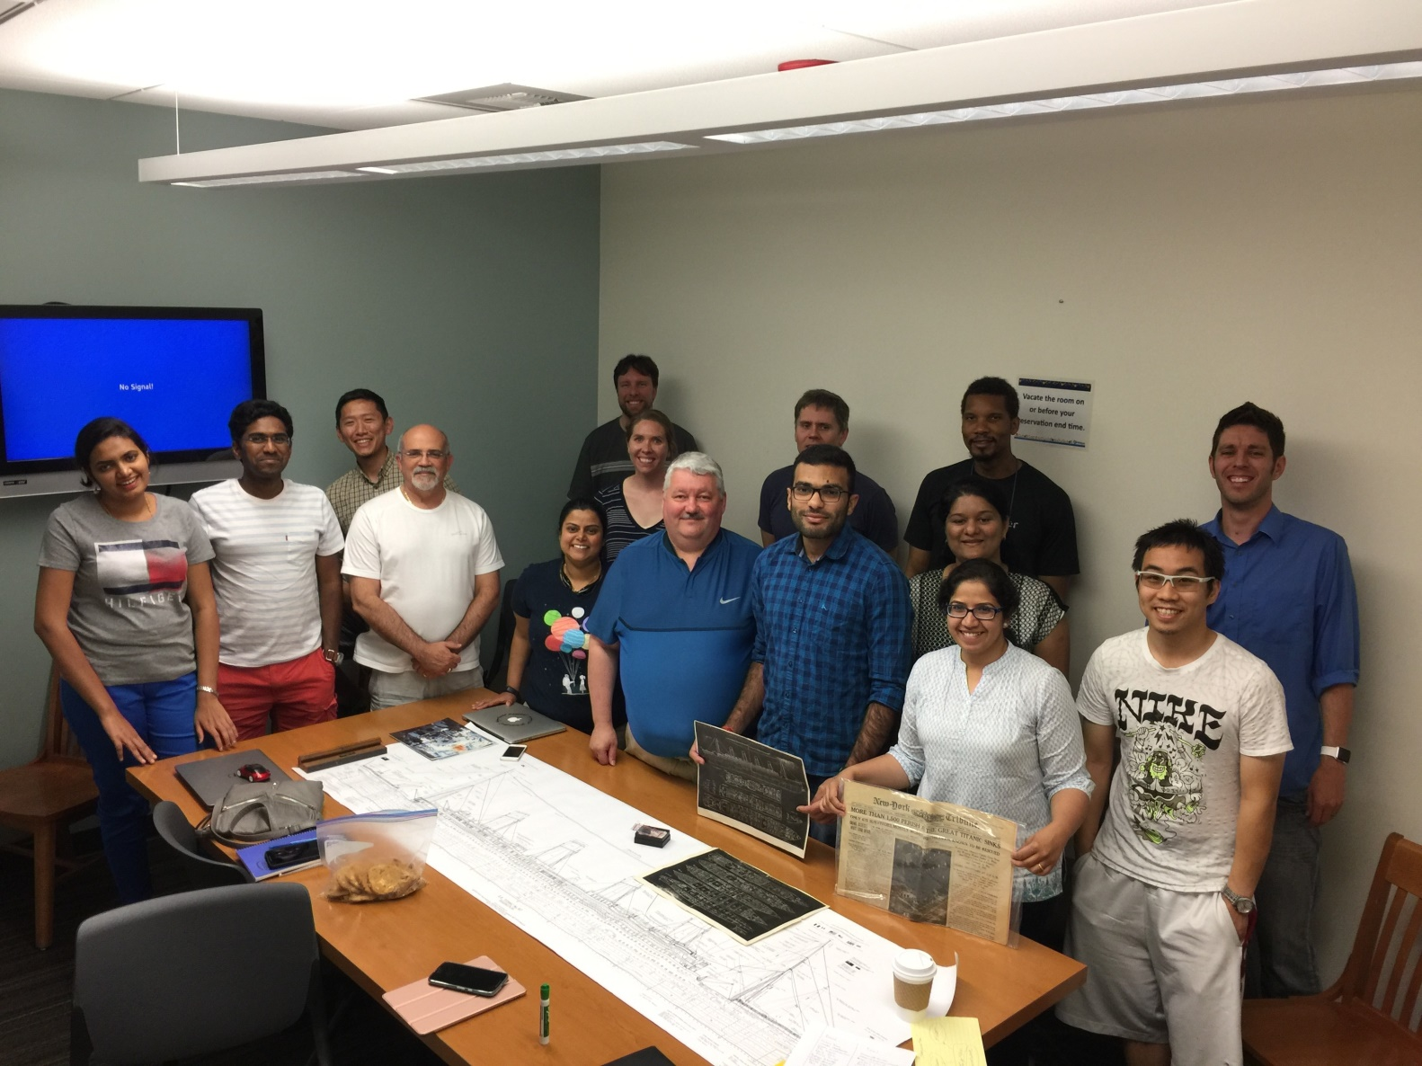

Sharing
Inspiring
Creative

