Slide 1
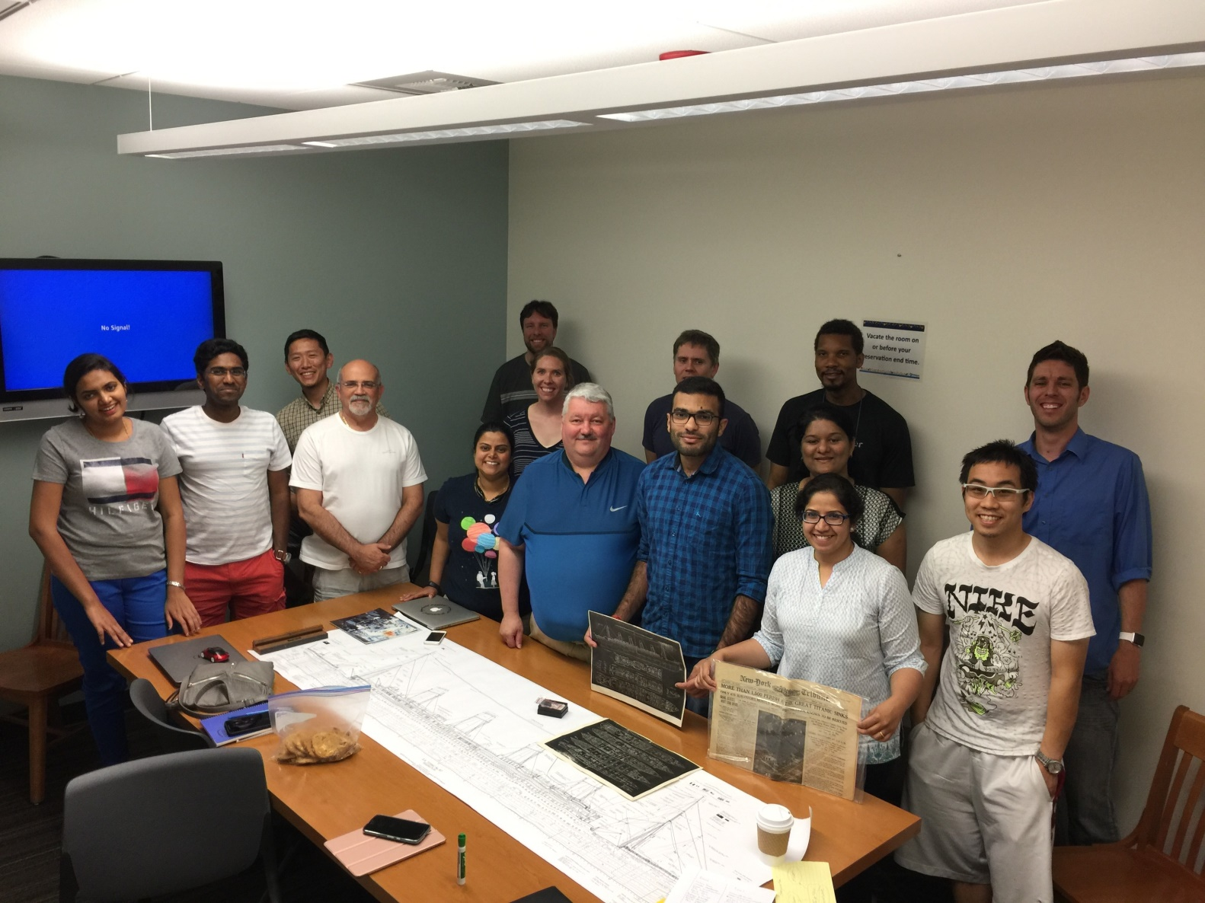

Sharing
Inspiring
Creativity

