Slide 1
Solvers for O(N) Electronic Structure in the Strong Scaling Limit with Charm++
Nicolas Bock
Matt Challacombe
Theoretical Division, Los Alamos National Laboratory
Laxmikant V. Kalé
University of Illinois at Urbana-Champaign
“Linear-Complexity Dense Linear Algebra, Parallelization and Applications“
SIAM CS&E 2015, Salt Lake
LA-UR-10-07458//LA-UR 11-06091//LA-UR-14-22050//LA-UR-14-20354//
Sponsored by: DOE LDRD-ER grant 20110230ER & TenBar Café

Slide 2
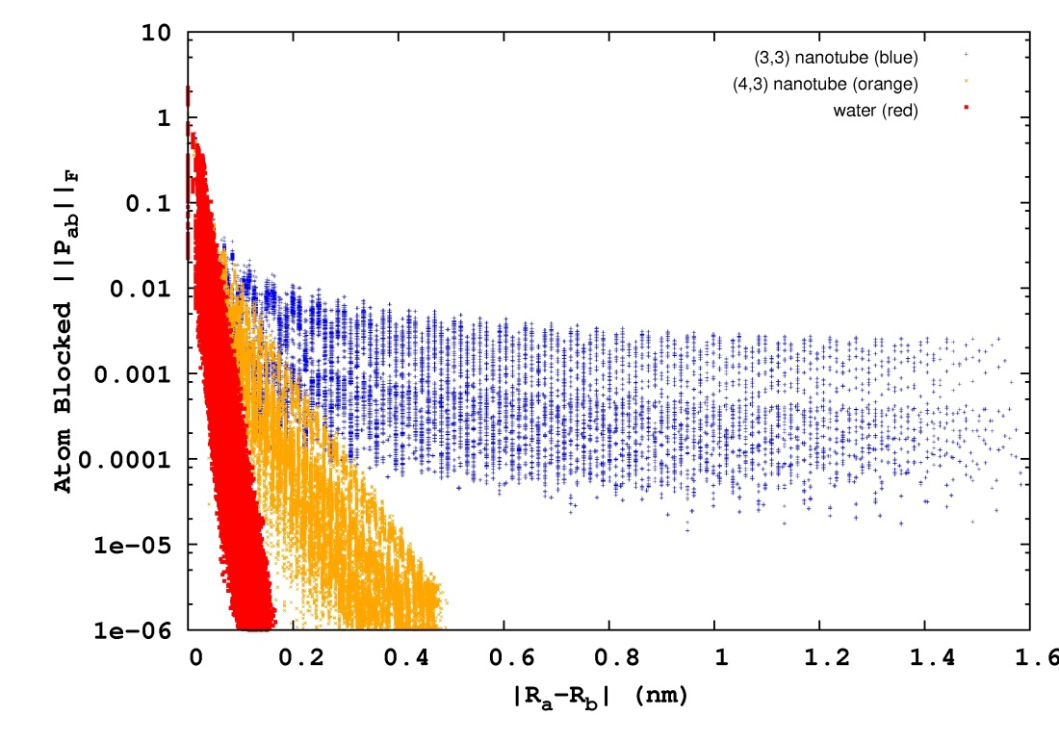
Quantum Locality & Kohn’s Nearsighted Principle
In a local, atom centered representation, quantum mechanical matrices possess decay properties. For non-metallic systems, matrix elements decay exponentially with atom-atom separation:
P_{ab} ~ exp(-β|R_{a}-R_{b}|)
water
semi-conducting nanotube
metallic nanotube
The rate of matrix decay is related to metric and gap ill-conditioning, with spatial extent increasing toward the metalic state (the Mott transition).
There are many ways to exploit this decay. The most conventional approach involves matrix truncation (sparsification). Only good for very rapid decay.

Slide 3
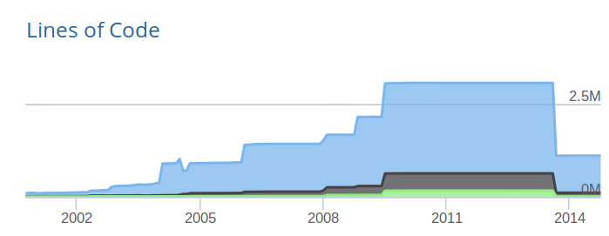

O (N ) Codes for HF/DFT are Complicated
Five solvers for basic HF/DFT. More complicated still for gradients, response & etc. Easily runs to millions of lines.
HDF & LAPACK
removed
freeon.org
Complexity in Solver Collectives:
Entangled & incompatible data structures
Mixed programming models
Layers of esoteric approximations
Disparate rates of error accumulation
Optimization of individual solvers inhibits evolution of the collective

Slide 4
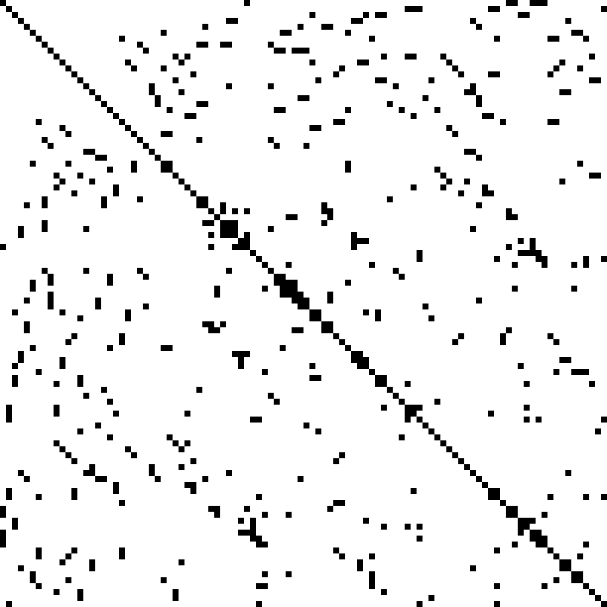
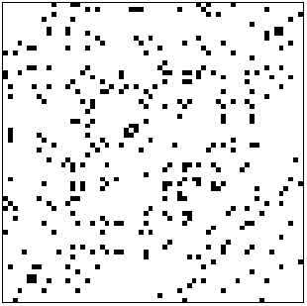
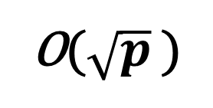
Case Study: Parallel Sparse Matrix-Matrix Multiply
Most optimal parallel SpMM is based on Bulloc’s method for work homogenization: DBCSR data structure, Hutter & co 2014.
p = 0
p = 1
Randomize
Decompose
p = 2
p = 3
Randomization leads to cost homogenization
Randomization  delocalization & data redistribution
O($\sqrt{p}$ )
Cannon’s algorithm for distribution throttled as
Cannot access strong scaling regime, p >> N
Fock Build
F  J[P] + a K_{F}[P] + b K_{xc}[P]
Solvers entangled with DBCSR require locality. Massive data redistribution on each SCF cycle ☹
Localize
Randomize
Spectral Projection
P  θ[ F - μI ]

Slide 5
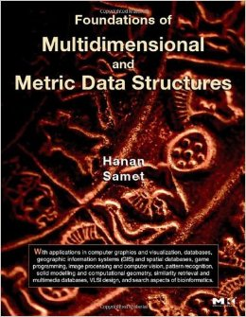
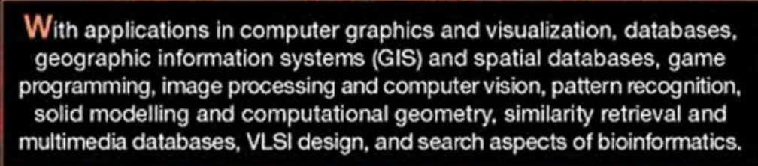
An N -body Framework for all Solvers
Potential for massive simplification with shared frameworks (stacks) supporting solvers collective
Kernel compression & optimal data operations
Multilevel approximation
Range, metric and overlap queries
Demonstrated for all HF/DFT solvers
Communication optimality
Runtimes for recursive task parallelism
Overlapping widely w/other disciplines

Slide 6
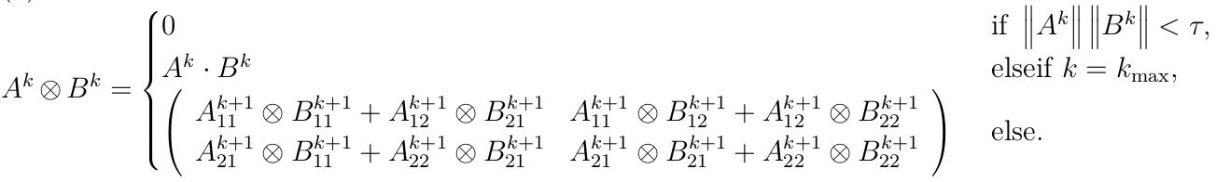
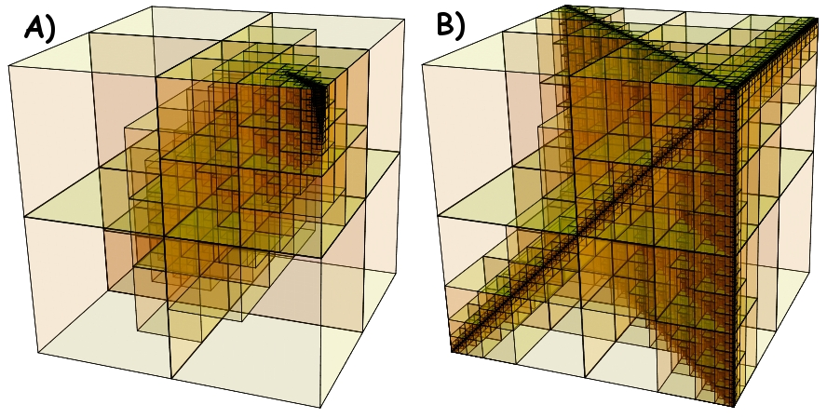
Matrix Multiplication as N-Body Solver
Challacombe & Bock, arXiv:1011.3534
SpAMM is a fast solver for multiplication of matrices with decay & locality. Employs matrix quadtrees, rigorous sub-multiplicative norms, recursive occlusion and culling of terms in the product space. O(N) for dense decay matrices.
Occlusion and culling in the recursive product space (idealized) for matrices with
A) exponential and B) algebraic decay

Slide 7
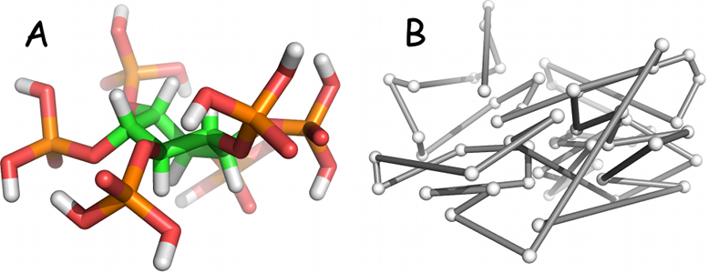
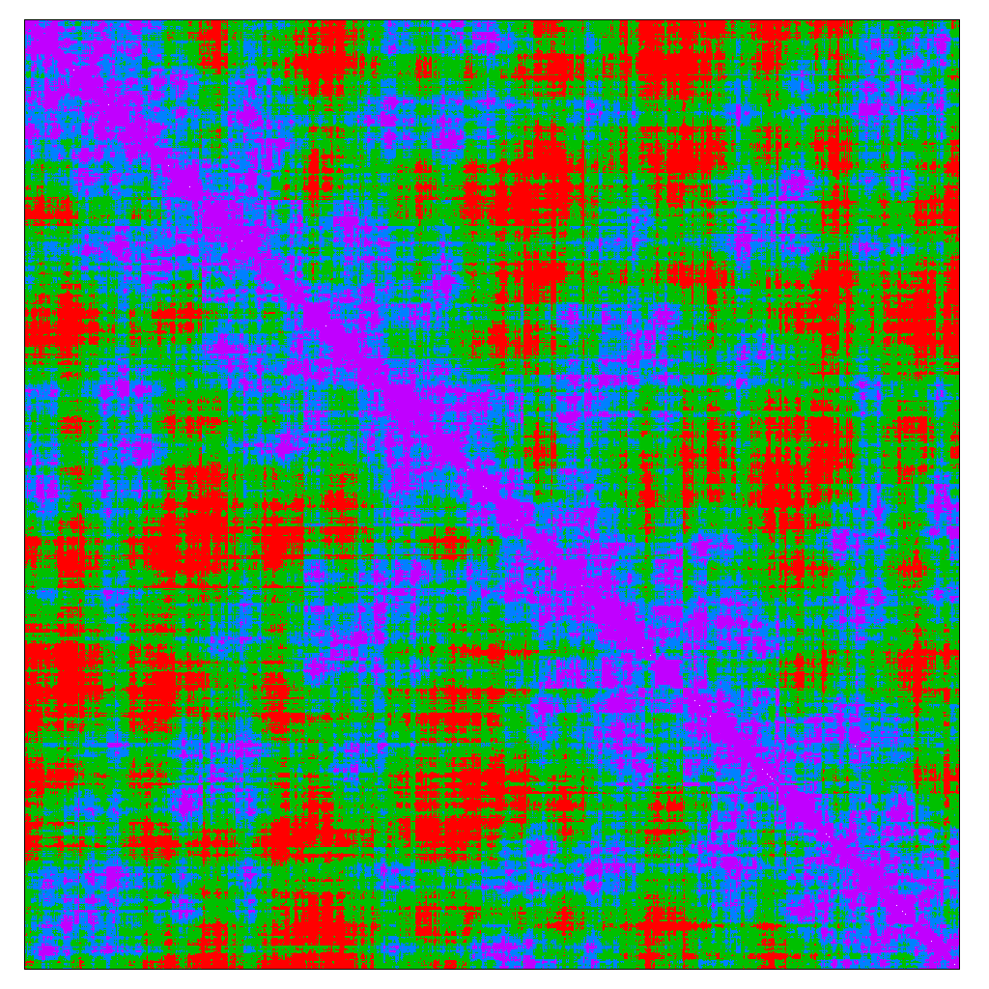
locality preserving
space filling curves
physics
locality
blocking
SpAMM: O(N), fine-grained recursive task parallelism
matrix as database (quadtree)
convolution
Notes:
Apply space-filling curve ordering to atoms → clustering of matrix elements in electron density matrix.
Hierarchical bisection of density matrix → quadtree.
Matrix elements exhibit exponential or algebraic decay with spatial separation, leading to sparse matrix trees, and sparse product space, as shown on right (A is exponential, B is algebraic).
Typically an O(N) method would threshold matrix elements by magnitude leading to sparse matrix which can be multiplied in O(N) with a CSR/Gustavson approach.
SpAMM applies a threshold in product space (i.e. on the fly during the multiplication), to achieve adjustable product approximation and speed.

Slide 8
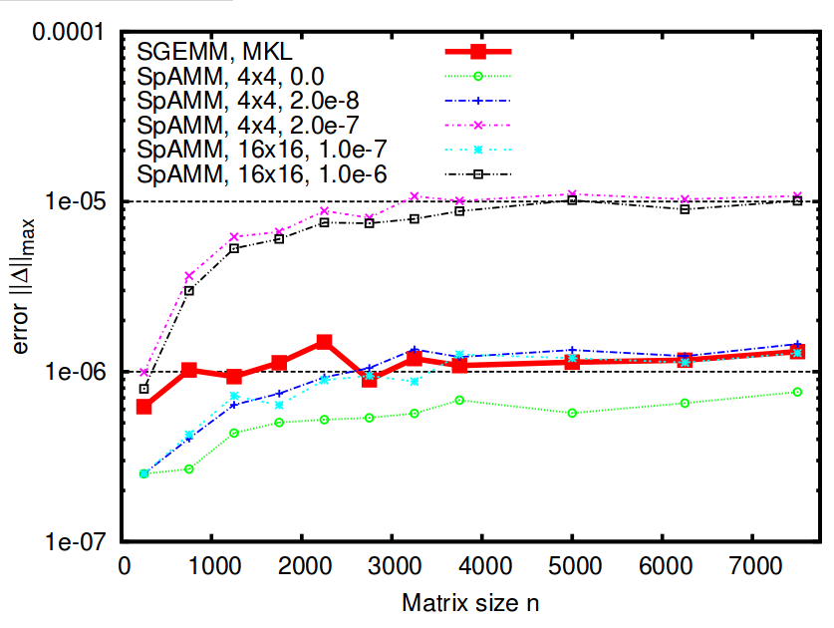
SpAMM For Dense Decay Matrices
Bock & Challacombe, SIAM J. Sci. Comput., 35(1), C72
Product matrix is asymptotically sparse, but only much, much later
Fill in of small blocks at negligible cost yields O (N ) scaling even for dense matrices
In single, SpAMM beats MKL SGEMM in error
Recursion w/locality more accurate than row-column

Slide 9
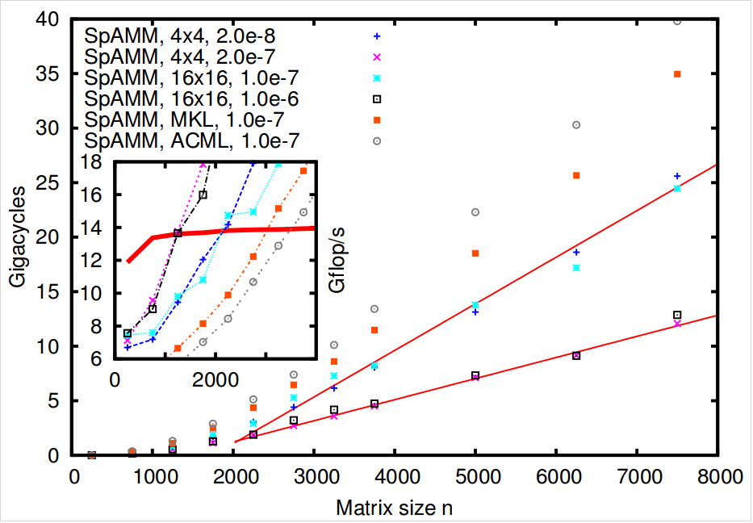
What About an Optimized SpAMM?
Bock & Challacombe, SIAM J. Sci. Comput., 35(1), C72
Assembly coded SpAMM in single. Don’t try this at home… Informs use of pragmas, OpenMP 4.0 directives & etc.
50% of peak with 4x4 blocking
Crossover with MKL/SGEMM at N=2000, same error
Can we do as well with directives (openmp 4)?
6-31G**, SpAMM of
Spectral Projector

Slide 10
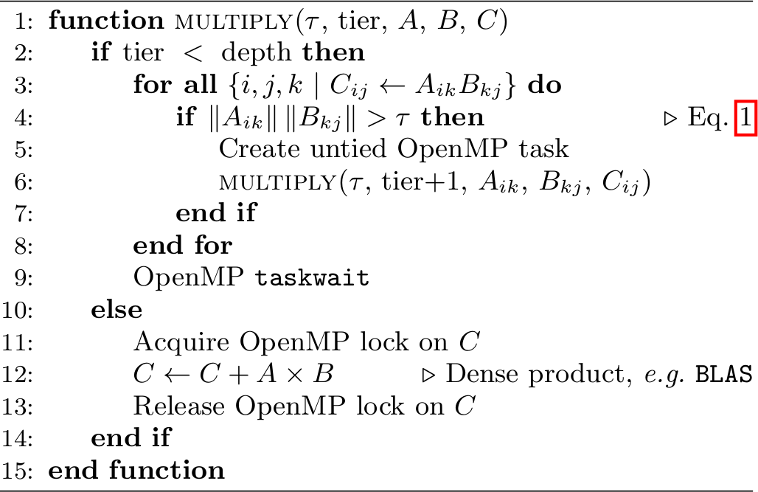
SpAMM – OpenMP 3.0
Notes:
Very simple programming model

Slide 11
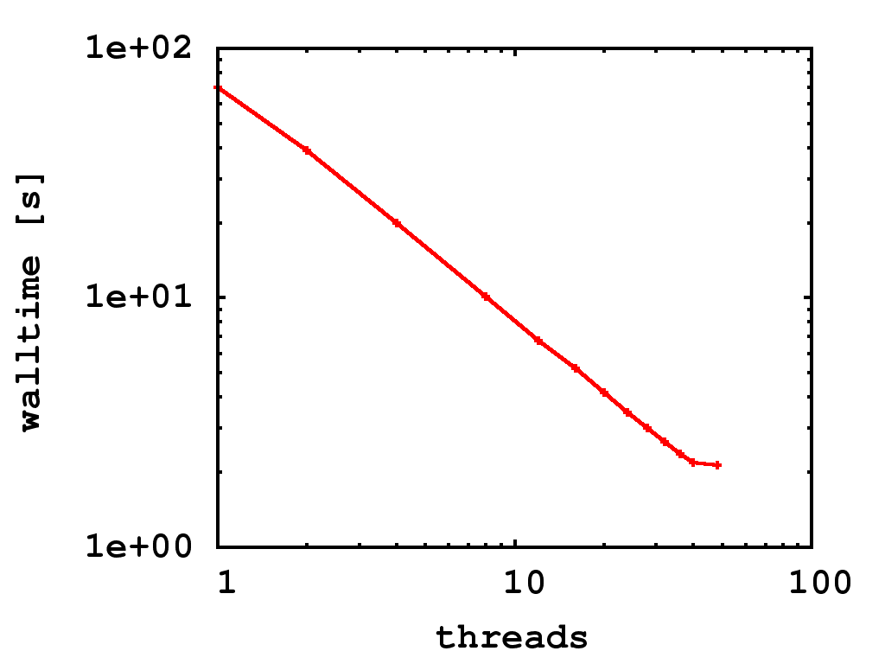
SpAMM – Parallel Efficiency on Magny Cours
Notes:
Parallel performance scales almost ideally on 4 socket AMD 12-core system, up to 48 cores.

Slide 12
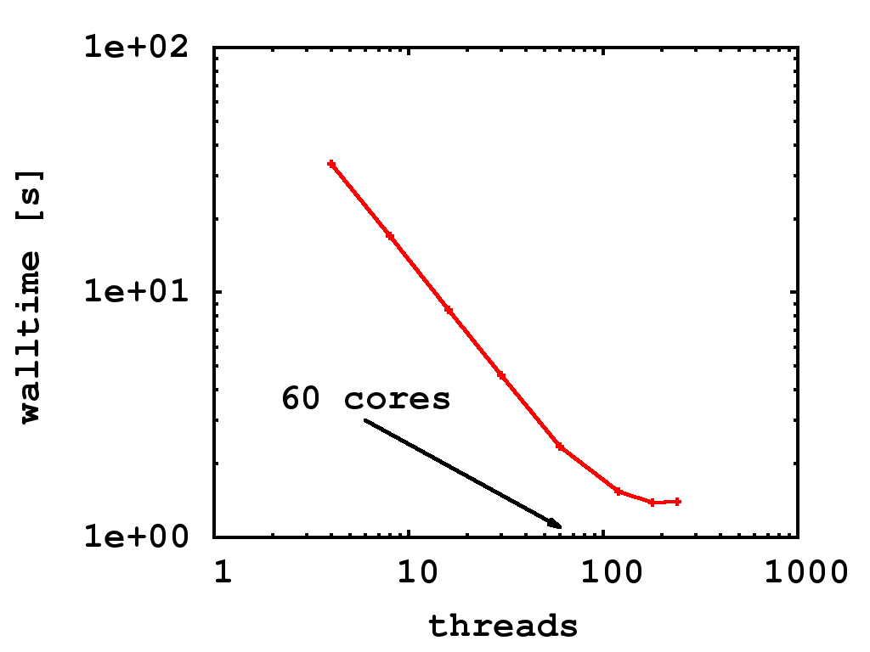
SpAMM – Parallel Efficiency on Xeon Phi
Notes:
Same almost ideal scaling on KNC up to 200 threads

Slide 13
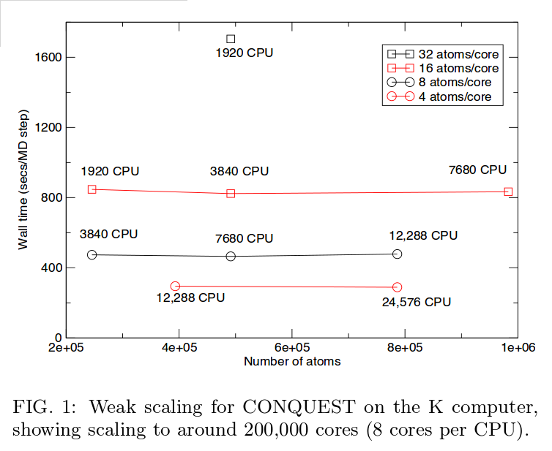
Weak Scaling and the Parallel SpMM
Bowler et. al, arXiv:1402.6828 ← very entertaining comment …
So far, no code has demonstrated a parallel SpMM beyond ~ 4 atoms/core (p < N/4). While enabling bigger systems, does not enable high throughput (timesteps!)
Best results to date involve work homogenization, precluding p >> N
Argue that no SpMM employing matrix decomposition can be O (N ) & access strong scaling limit

Slide 14
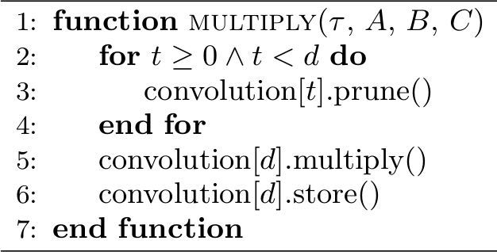
SpAMM - Charm++
Quadtree linked list → 2D chare array per tier
Recursive multiply → 3D chare array per tier
GreedyComm LB after each multiply
Notes:
LB only works with chare arrays
Still very simple programming model

Slide 15
SpAMM in the Strong Scaling Limit
Bock & Challacombe, SIAM J. Sci. Comput, Accepted w/ revs (2015)
n-body is communication optimal (recent Yellik & Demmel) & task parallelism supported by openmp3 & charmm++
Quantum locality → data locality via SFC heuristics
Decomposition in 3-D task space, not 2-D data space
Persistence load balancing and mixed openmp3/charm++ for iteration functional approximation. In this case, spectral projection of 6-31G** density matrices (sign/step)
Harder to scale with fast decay (bulk water has fast decay)

Slide 16
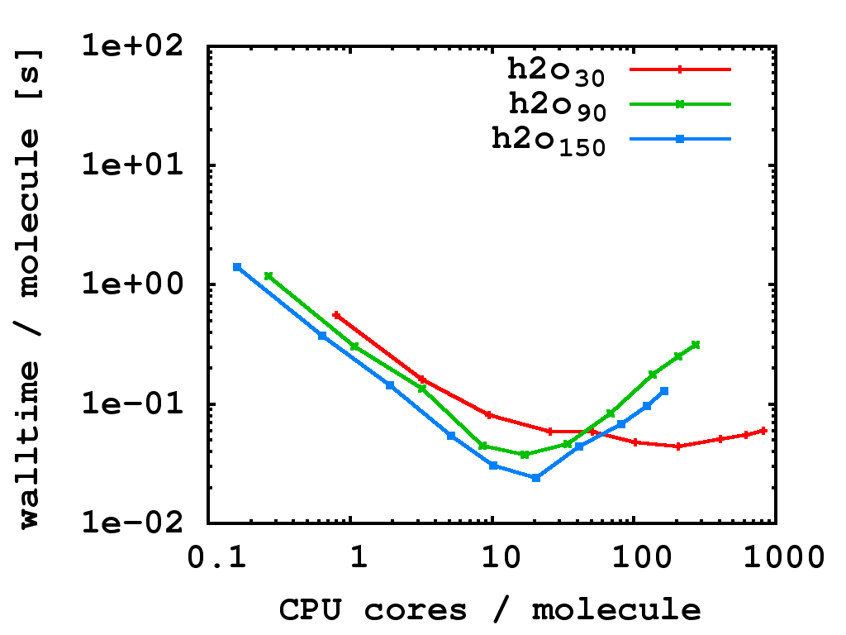
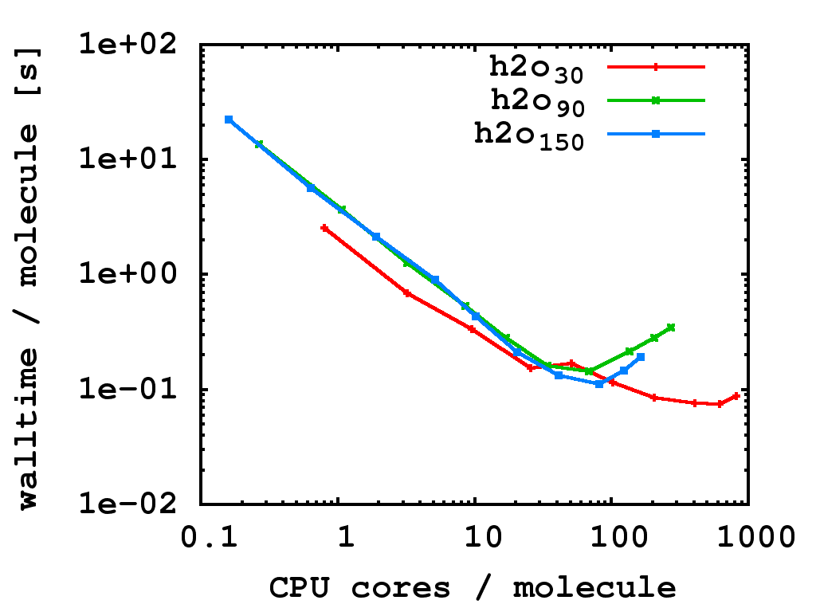
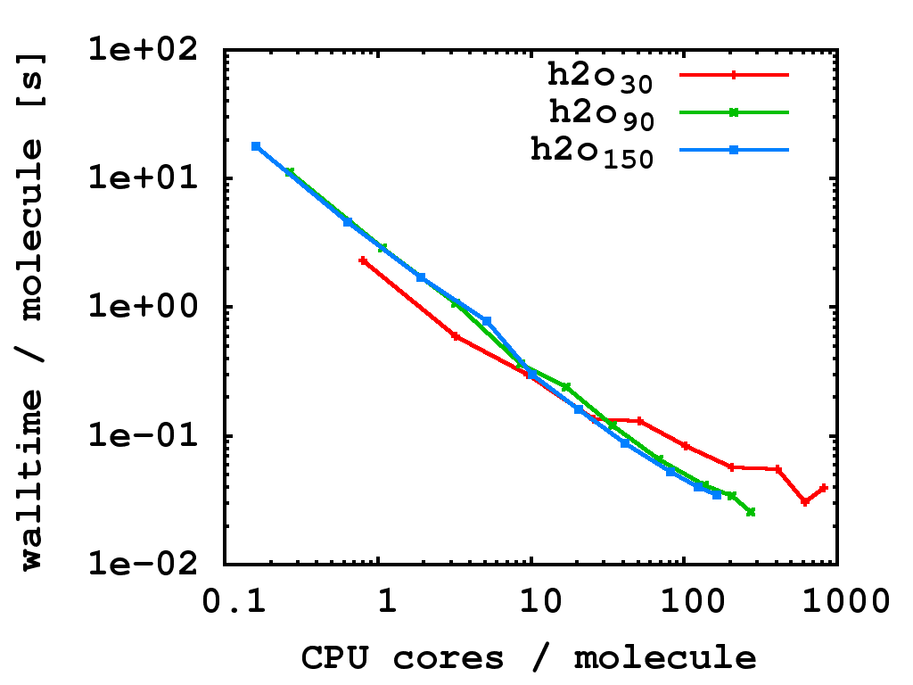
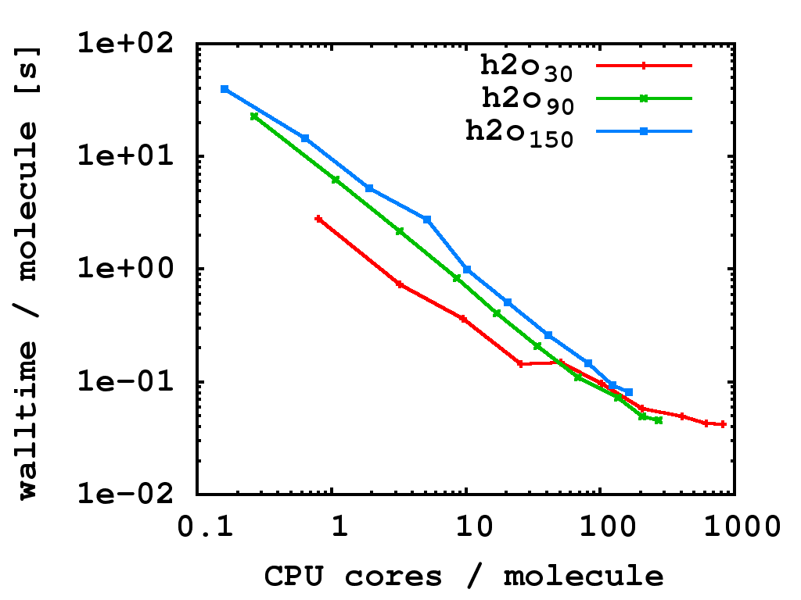


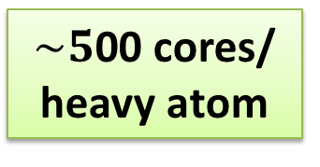


Persistence Load Balancing in SpAMM Spectral Projection (Sign/Step Function): Strong Scaling with Strong Decay (H2O_{n})
$$_{τ={10}^{−6} }$$
$$_{τ={10}^{−10} }$$
first step
first step
$$_{τ={10}^{−6} }$$
$$_{τ={10}^{−10} }$$
final step
final step
$\sim 5$00 cores/ heavy atom
Notes:
24 cores per node
Total of 1024 nodes = 24,576 cores
Biggest machine LANL has (outside classified)
LB is nicely balancing everything after only 2-3 iterations
A total of about 40 iterations is needed for convergence

