Slide 1
N-Body Algorithms for Matrices with Decay: Sparse Approximate Matrix Multiplication (SpAMM) and Inverse Factorization.
Matt Challacombe, Nicolas Bock & Terry Haut
Los Alamos National Laboratory
matt.challacombe@freeon.org
“Linear-Complexity Dense Linear Algebra, Parallelization and Applications “
SIAM CS&E 2015, Salt Lake
LA-UR-10-07458//LA-UR 11-06091//LA-UR-14-22050//LA-UR-14-20354//
Sponsored by: DOE LDRD-ER grant 20110230ER & TenBar Café

Slide 2
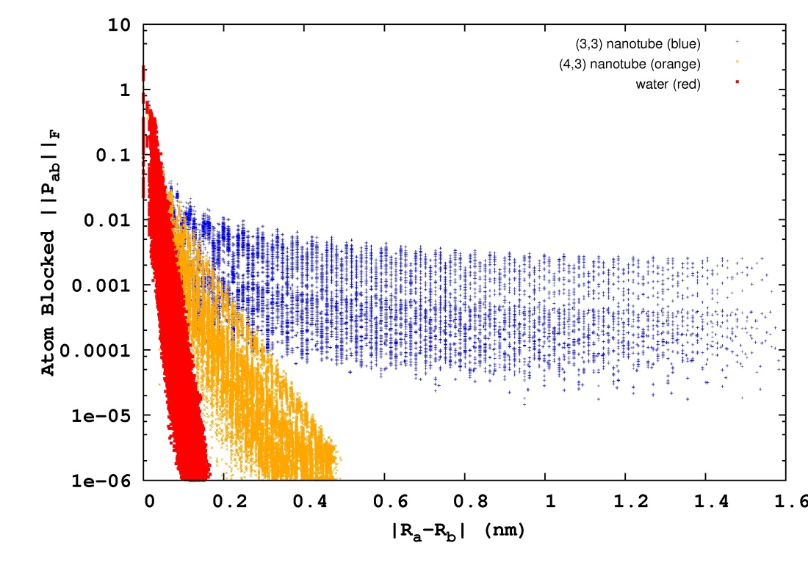
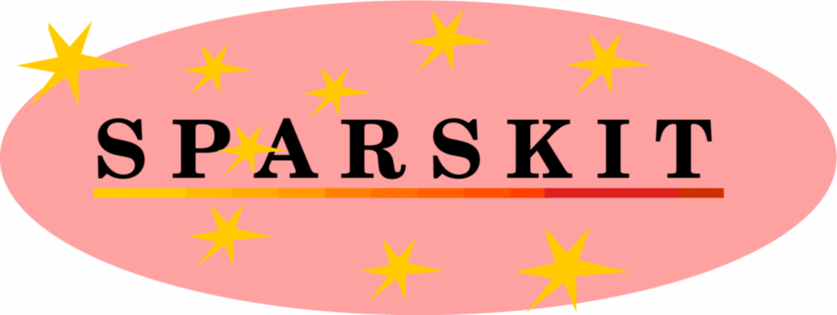


Quantum Locality & Kohn’s Nearsighted Principle
In a local, atom centered representation, quantum mechanical matrices possess decay properties. For non-metallic systems, matrix elements decay exponentially with atom-atom separation.
bulk water
semi-conducting nanotube
metallic nanotube
For physics poor models and uninteresting chemical problems, it is possible to achieve extreme locality leading to very sparse Hamiltonian matrices:
Use conventional, sparse linear algebra to achieve an O(n) cost with system size, n

Slide 3
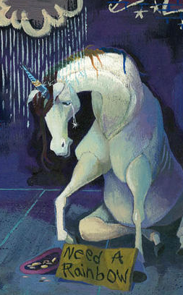
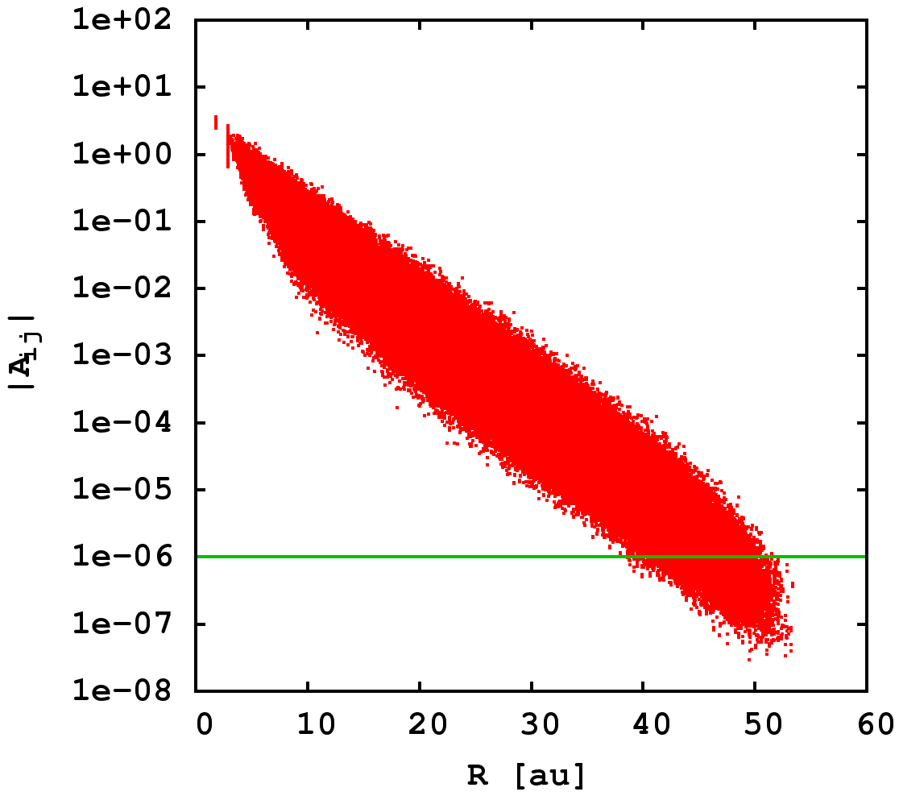
Dealing with a Real Basis; How Local?
“For extended basis sets such as TZV2P, the matrices in the DM-based methods become sufficiently sparse only for large systems containing ∼10 000 water molecules” – J. Hutter group
J. Chem. Theory Comput., 2013, 9 (10), pp 4421–4427
Whoa …
||S^{-1/2} ||_{ij}
Even for 6-311G** 350 waters and 1d-8 error in a matrix element of
S^{-1/2}, we don’t begin to truncate until past 25Å!

Slide 4
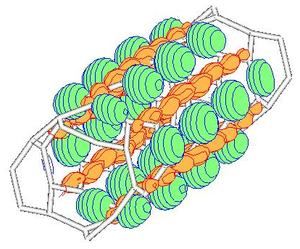
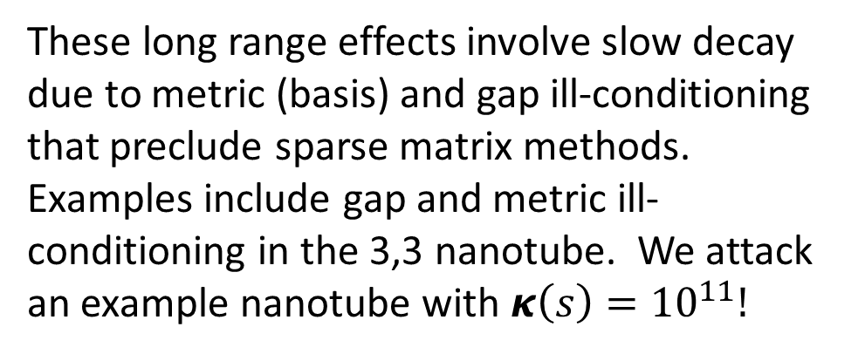
Real Wave-Functions Have Extent:
Ill-Conditioning in Electronic Structure
From bond-breaking to long-range entanglement, interesting chemistries and technologically important properties emerge from long-range, strong-correlation effects.
As an alternative to sparse matrix methods, we develop the linear algebra of matrices with decay as an n-body problem, targeting fast methods for problems with slow exponential or algebraic decay.
These long range effects involve slow decay due to metric (basis) and gap ill-conditioning that preclude sparse matrix methods. Examples include gap and metric ill-conditioning in the 3,3 nanotube. We attack an example nanotube with $κ\left(s\right)={10}^{11}!$

Slide 5
N-Body Solvers in the Information, Physical & Computer Sciences
N-Body solvers combine database operations (range & metric queries) with locality preserving heuristics, and a wide variety of mathematical approximations. Examples: the astrophysical Barnes-Hut tree-code, the Fast Gauss Transform and so on.
The generic n-body model has been extended to a vast number of fast, pairwise (kernel) summation techniques in the information sciences. Examples: see www.fast-lab.org.
In functional programming, the n-body problem may be developed with the formal properties of generacity, involving map, fold, reduce & etc. Examples: the parallel map skeleton, algorithmic skeleton frameworks and so on.

Slide 6
A Generalized Ecosytem of N-Body Solvers
PHYSICS: Strong Correlation
single determinant KSTs. Correlation on top of Fock exchange, eg. B13.
toward Mott transition, ill-conditioned matrix functions
MATH: Functional Approximation
nested approximate algebras and recursive preconditioning.
ill-conditioned matrix functions
N-BODY SOLVERS: Ecosystems & Stacks
N-Body Fock exchange (NoFX)
N-Body Linear Algebra (SpAMM)
others …
InfoSci: N-Body Learning
fast kernel summation, fast pairwise statistical problems, …
learning the metric: fast approaches to semi definite programming.
CompSci: Generic Programming
functional programming, skeletons, recursive task parallelism, openmp 4.
enterprise frameworks: scala/spark + neo/epiphany/phi.

Slide 7
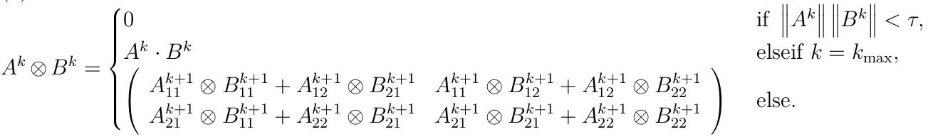
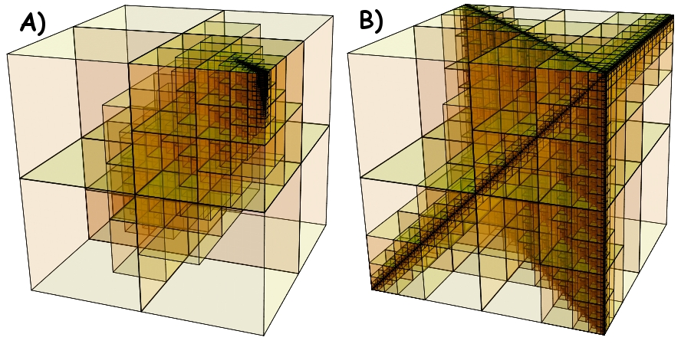
Matrix Multiplication as N-Body Solver
Challacombe & Bock, arXiv:1011.3534
SpAMM is a fast kernel for multiplication of matrices with decay & locality. Employs decorated quadtrees, rigorous sub-multiplicative norms, recursive occlusion and culling in the product space (an octree metric query on norms).
Fast occlusion and culling in the product space for matrices with:
A) exponential decay and B) algebraic decay
slower decay, still n-body

Slide 8
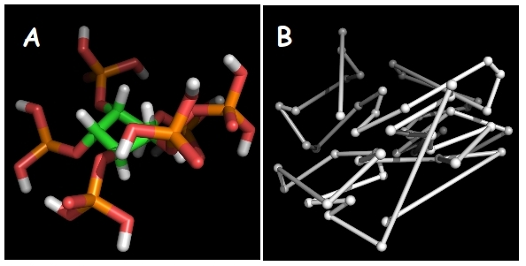
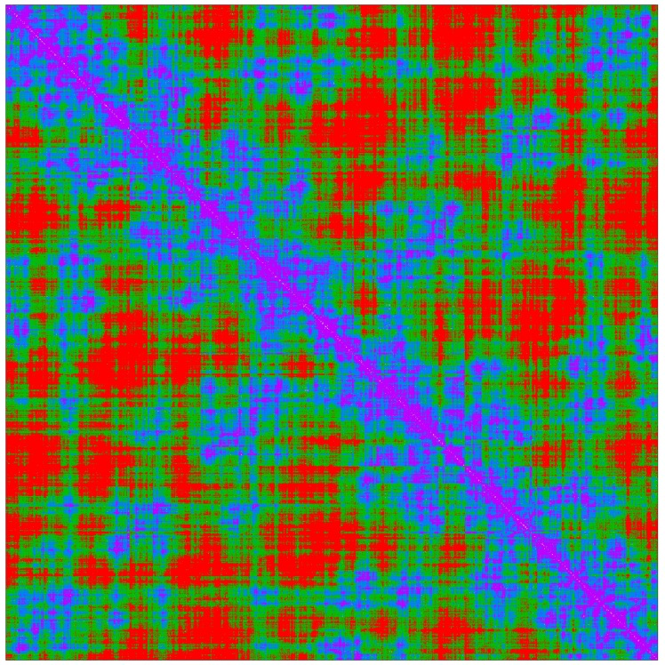
N-Body Methods Exploit Locality Heuristics
Space-filling-curve heuristics maximize locality, clustering (A-B)
With locality, database algorithms enable rapid distance, metric & overlap queries.
Clustering enhances multilevel approximation, occlusion & etc
Space-filling-curves (SFCs) map atoms close in space to an index where they are also close
This SFC ordering naturally blocks & structures corresponding matrices with decay
RB3LYP/6-31G** density matrix for [H₂O]₃₀₀. Purple is large, red is small.

Slide 9
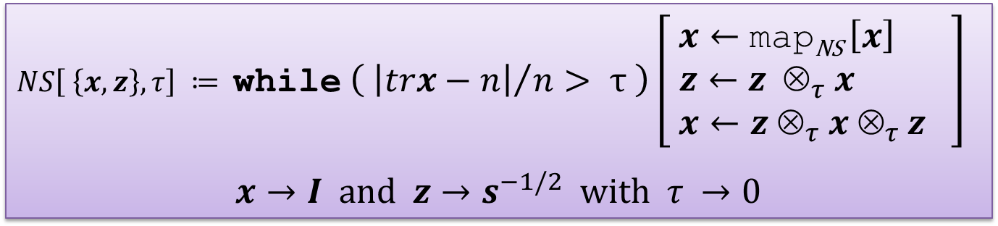
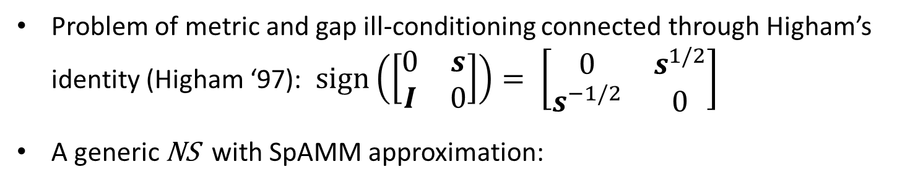
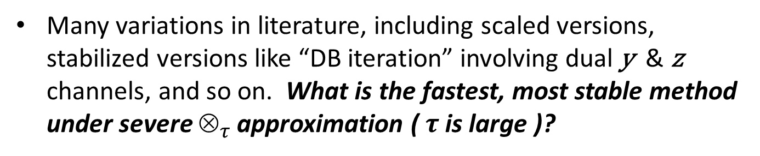

Newton Schulz for S ^{-1/2} (the Metric Problem)
Problem of metric and gap ill-conditioning connected through Higham’s identity (Higham ‘97): $sign\left(\left[\begin{matrix}0 & s \\ I & 0\end{matrix}\right]\right)= \left[\begin{matrix}0 & s^{1/2} \\ s^{−1/2} & 0\end{matrix}\right]$
A generic NS with SpAMM approximation:
$NS\left[ \left\{x, z\right\}, τ\right] ≔$while $\left( {\left|trx−n\right|}/n> τ \right)\left[ \begin{aligned}x←\text{map}\text{NS} \left[x\right] \\ z←z ⊗_{τ }x \\ x←z ⊗_{τ }x ⊗_{τ }z \end{aligned}\right]$
$x→I \text{and} z→s^{−1/2} \text{with} τ →0$
$$\text{return} \{x, z\}$$
Many variations in literature, including scaled versions, stabilized versions like “DB iteration” involving dual y & z channels, and so on. What is the fastest, most stable method under severe $_{τ }$approximation ($τ$ is large )?

Slide 10
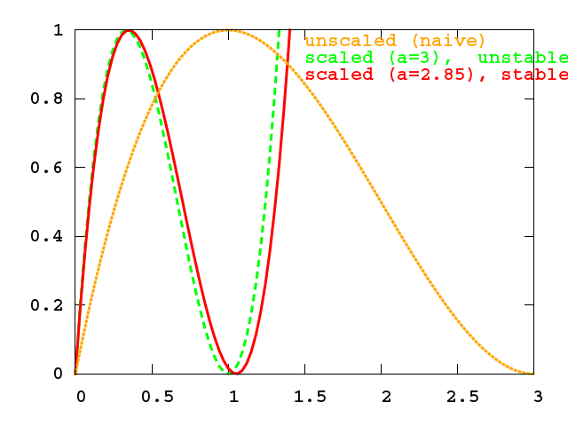


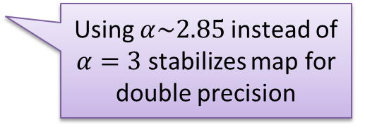
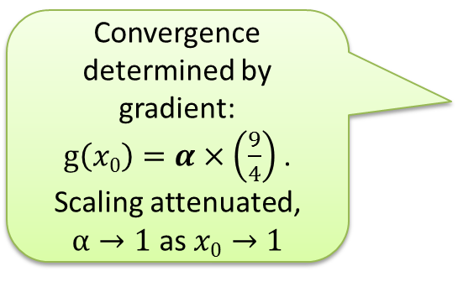
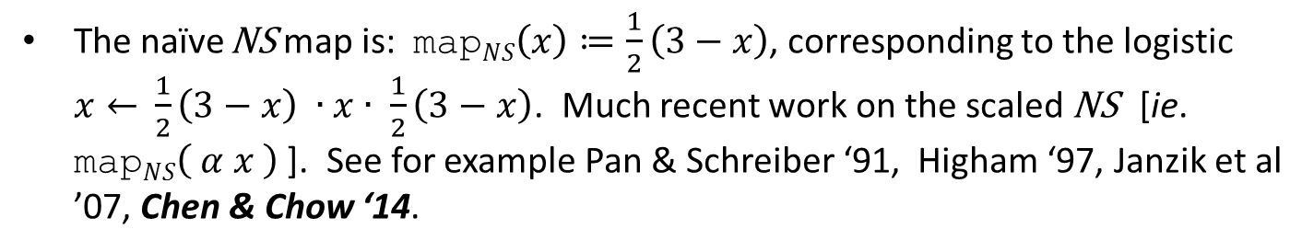
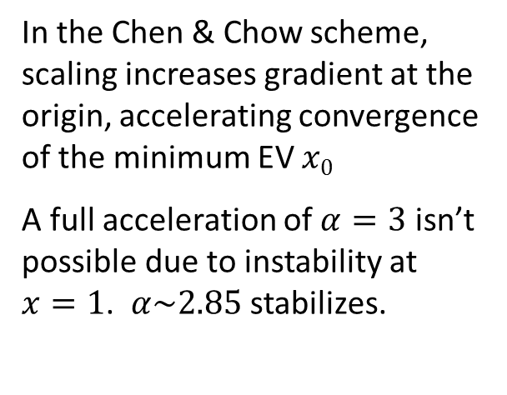
Scaled Newton Schulz
The naïve NS map is: $\text{map}NS\left(x\right)≔\frac{1}{2}\left(3−x\right)$, corresponding to the logistic $x←$ $\frac{1}{2}\left(3−x\right) ∙x∙ \frac{1}{2}\left(3−x\right)$. Much recent work on the scaled NS [ie. $\text{map}NS\left( α x \right)$ ]. See for example Pan & Schreiber ‘91, Higham ‘97, Janzik et al ’07, Chen & Chow ‘14.
In the Chen & Chow scheme, scaling increases gradient at the origin, accelerating convergence of the minimum EV $x0$
A full acceleration of $α=3$ isn’t possible due to instability at $x=1$. $α\sim 2.85$ stabilizes.
Convergence determined by gradient: $g\left(x0\right)=α×\left(\frac{9}{4}\right)$. Scaling attenuated, $α→1$ as$x0→1$
Using $α\sim 2.85$instead of $α=3$ stabilizes map for double precision

Slide 11
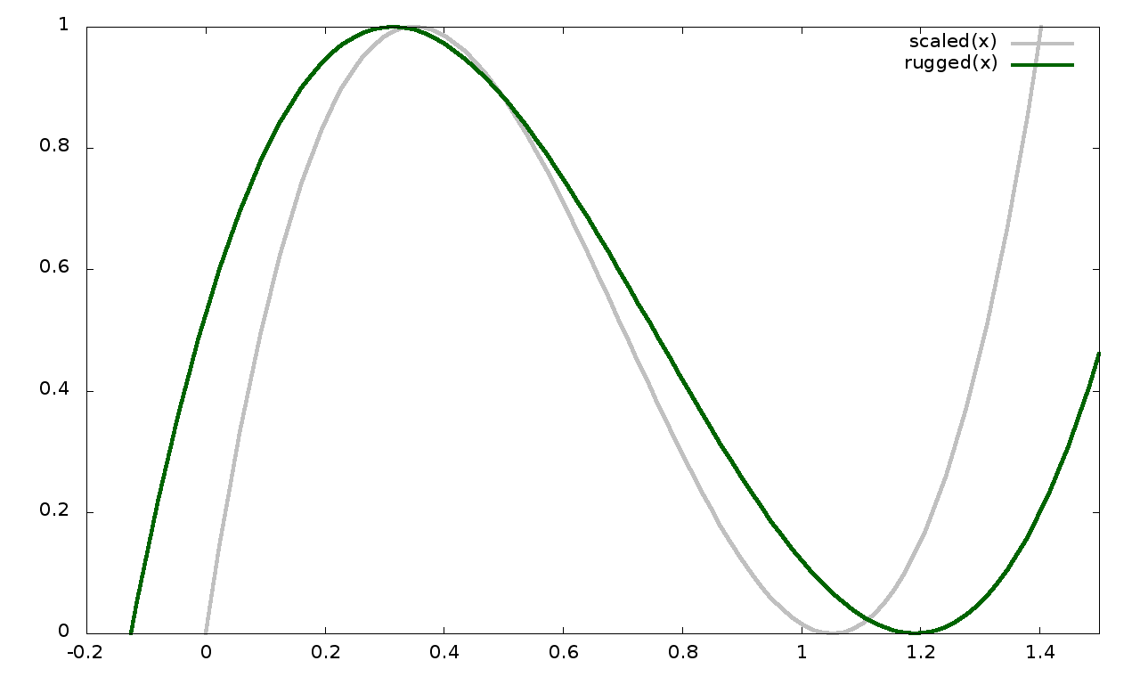


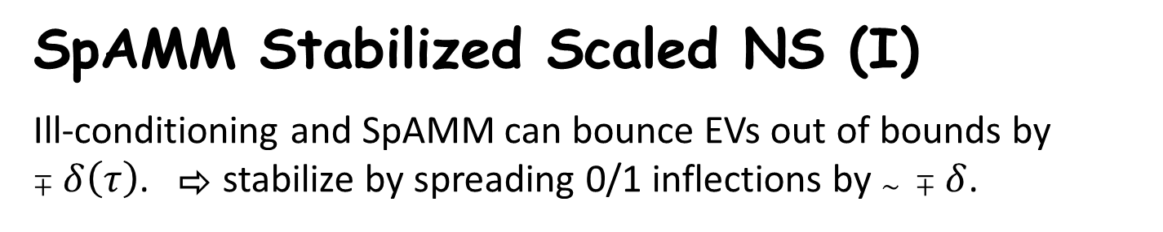
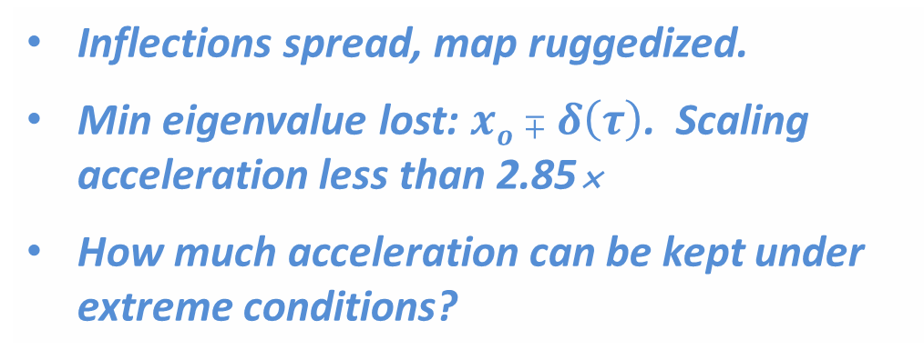
SpAMM Stabilized Scaled NS (I)
Ill-conditioning and SpAMM can bounce EVs out of bounds by $∓δ\left(τ\right)$. ⇨ stabilize by spreading 0/1 inflections by $\sim ∓δ$.
Inflections spread, map ruggedized.
Min eigenvalue lost: $xo∓δ\left(τ\right)$. Scaling acceleration less than 2.85
How much acceleration can be kept under extreme conditions?

Slide 12
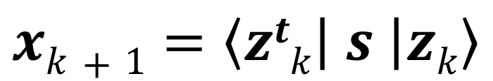
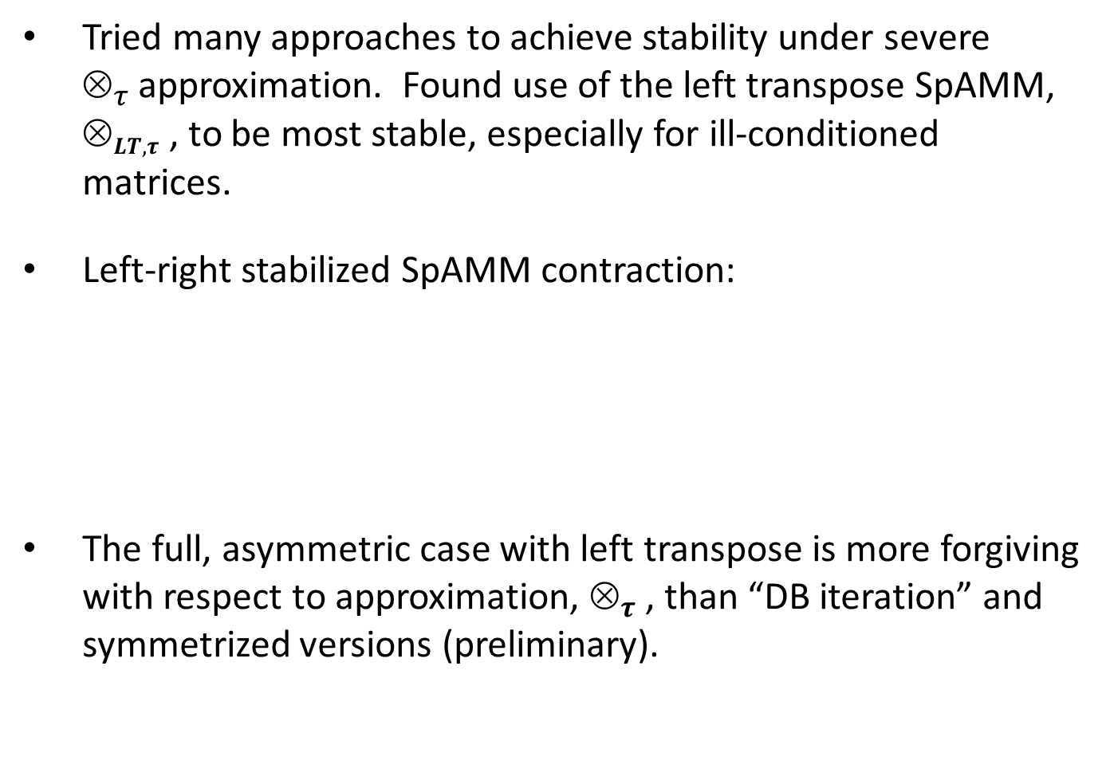
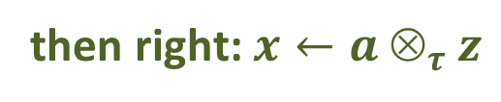
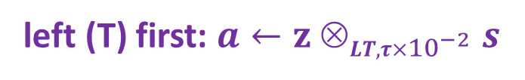
SpAMM Stabilized Scaled NS (II)
Tried many approaches to achieve stability under severe $_{τ }$approximation. Found use of the left transpose SpAMM, $_{LT, τ }$, to be most stable, especially for ill-conditioned matrices.
Left-right stabilized SpAMM contraction:
The full, asymmetric case with left transpose is more forgiving with respect to approximation, $_{τ }$, than “DB iteration” and symmetrized versions (preliminary).
$$xk+1=\left\langle ztk | s | zk\right\rangle$$
then right: $x←a _{τ }z$
left (T) first: $a←z _{LT, τ×{10}^{−2} }s$

Slide 13
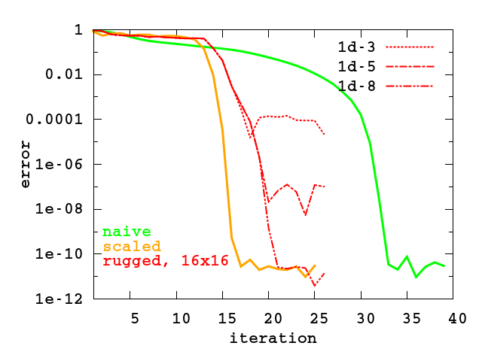
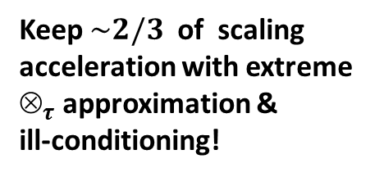
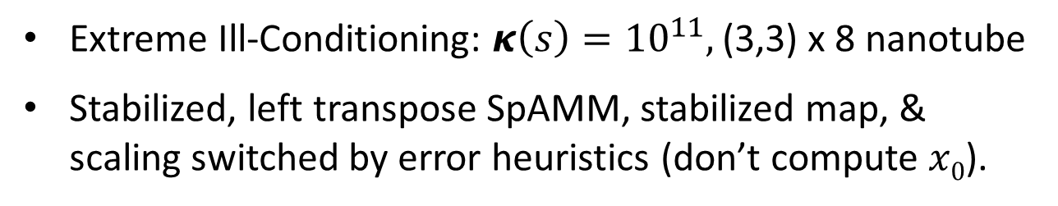
SpAMM Stabilized Scaled NS (III)
Extreme Ill-Conditioning: $κ\left(s\right)={10}^{11},$ (3,3) x 8 nanotube
Stabilized, left transpose SpAMM, stabilized map, & scaling switched by error heuristics (don’t compute $x0$).
Keep $\sim 2/3$ of scaling
acceleration with extreme $_{τ }$approximation & ill-conditioning!

Slide 14
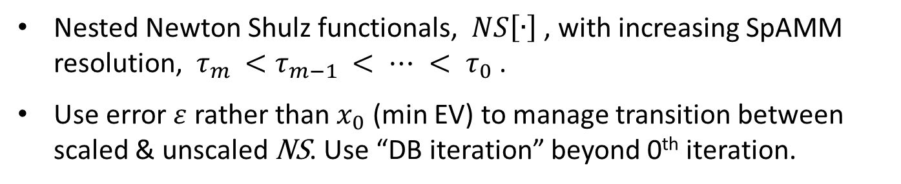
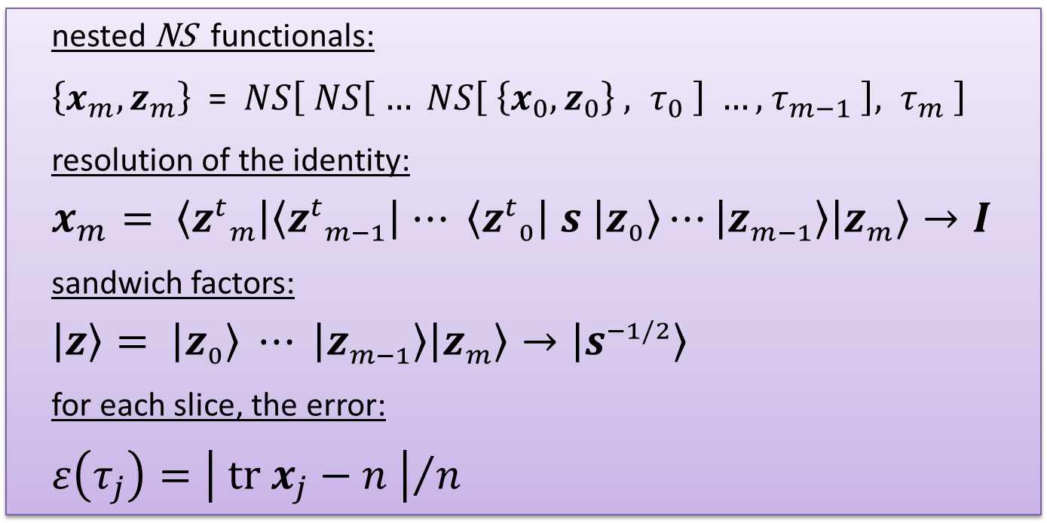
Recursive Preconditioning: The SpAMM Sandwich
Nested Newton Shulz functionals, $NS\left[∙\right]$, with increasing SpAMM resolution, $τ_{m }<τ_{m−1 }< ⋯ < τ_{0}$ .
Use error $ε$ rather than $x_{0}$ (min EV) to manage transition between scaled & unscaled NS. Use “DB iteration” beyond 0th iteration.
nested NS functionals:
$\left\{x_{m}, z_{m}\right\}$ =$NS\left[ NS\left[ … NS\left[ \left\{x_{0},z_{0}\right\} , τ_{0} \right] …, { τ}_{m−1} \right]{, τ}_{m} \right]$
resolution of the identity:
$$x_{m}= \left\langle {z^{t}}_{m} | \left\langle {z^{t}}_{m−1} | ⋯ \left\langle {z^{t}}_{0} | s | z_{0}\right\rangle ⋯ | z_{m−1}\right\rangle | z_{m}\right\rangle →I$$
sandwich factors:
$$\left|\left.z\right\rangle \right.= \left|\left.z_{0}\right\rangle \right.⋯ \left|\left.z_{m−1}\right\rangle \right.\left|\left.z_{m}\right\rangle \right.→\left|\left.s^{−1/2}\right\rangle \right.$$
for each slice, the error:
$ε\left(τ_{j}\right)={\left| tr{ x}_{j}−n \right|}/n$

Slide 15
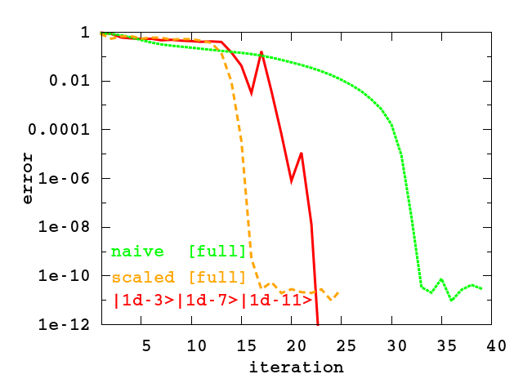



Ill-Conditioning: $κ\left(s\right)={10}^{11},$ (3,3)x8 nanotube
$$NS\left[ \left\{x_{0},z_{0}\right\}, { τ}_{0}={10}^{−3} \right]$$
$$NS\left[ \left\{x_{1},z_{1}\right\}, { τ}_{1}={10}^{−7} \right]$$
$$NS\left[ \left\{x_{2},z_{2}\right\}, { τ}_{2}={10}^{−11} \right]$$

Slide 16
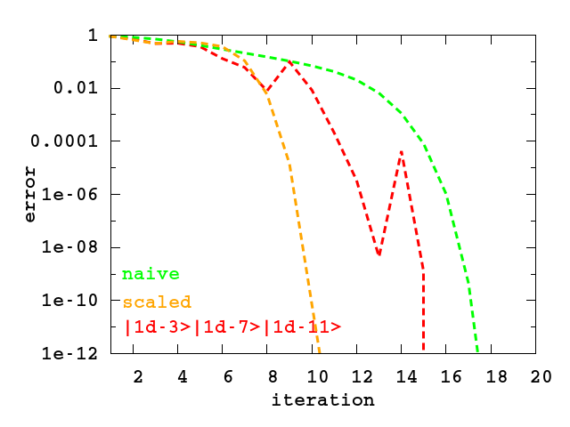
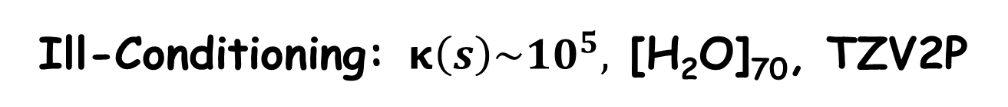
Ill-Conditioning: $κ\left(s\right)\sim {10}^{5},$ [H₂O]₇₀, TZV2P
With recursive preconditioning, one resolutions accuracy is another’s error!

Slide 17
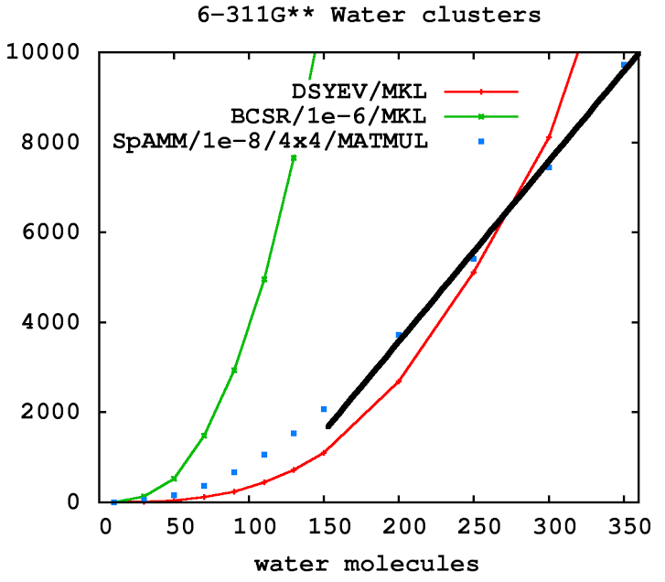
Inverse Factors of an Ill-conditioned S
Recall, that for large, triple-zeta + polarization basis sets: “sufficiently sparse only for … ∼10 000 water molecules”
For 6-311G** basis, decay in S^{-1/2} is exponential but very, very slow
Naïve Newton Schulz iterations [J. Chem. Phys. 126 (2007) p. 124104]. Target error 1e-8 in matrix elements.
Substantiates BCSR results of Hutter group [~10⁴ waters]
Unoptimized SpAMM 4x4 vs max optimized MKL/DSYEV crossover @ 250 waters.
O (N ) & dense!

Slide 18
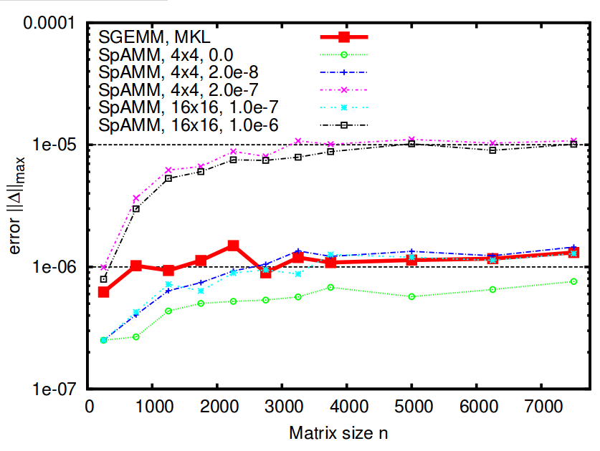
SpAMM For Dense Matrices w/Decay
Bock & Challacombe, SIAM J. Sci. Comput., 35(1), C72
Product matrix is asymptotically sparse, but only much, much later
Fill in of small blocks at negligible cost yields O (N ) cost even for dense matrices
S.P. SpAMM beats MKL SGEMM in error & is O (N )
Recursion w/locality more accurate than row-column

Slide 19
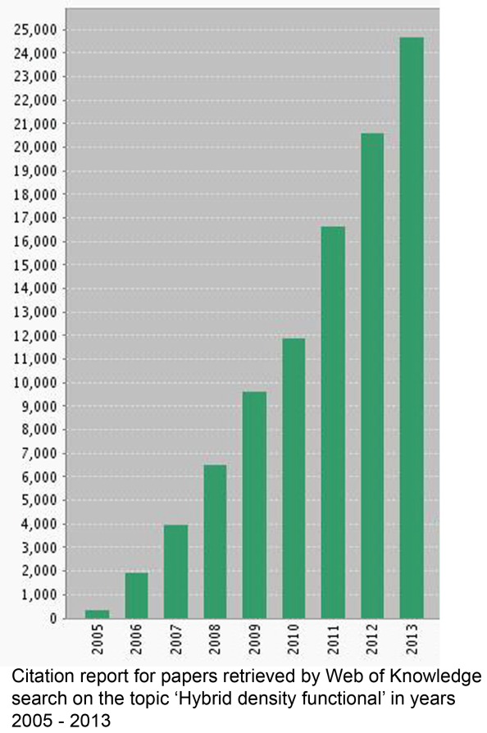

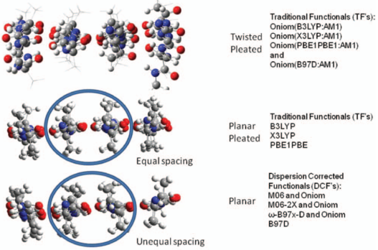
Accuracy Demands Less Local Models
Often, accurate results require Fock exchange and large basis sets, leading to negligible sparsity and five+ entangled solvers
The electronic properties of metal oxides, like the perovskites, require HF/DFT models
Comp. Mat. Sci. 29 (2004) p.165
Structural motifs and reaction profiles in biochemical applications also require hybrid HF/DFT models for even a qualitatively correct result
J. Chem. Phys. 137 (2012) p. 044109

Slide 20
