Slide 1
O (N ) Quantum Chemistry Made Simple
In N ⁴→ N, do not accumulate, eliminate
- Bruce Lee
Matt Challacombe, Nicolas Bock & Terry Haut
Los Alamos National Laboratory
matt.challacombe@freeon.org
Spooky Stuff: LA-UR-10-07458//LA-UR 11-06091//LA-UR-14-22050//LA-UR-14-20354
Sponsored by: DOE LDRD-ER grant 20110230ER & TenBar Café

Slide 2
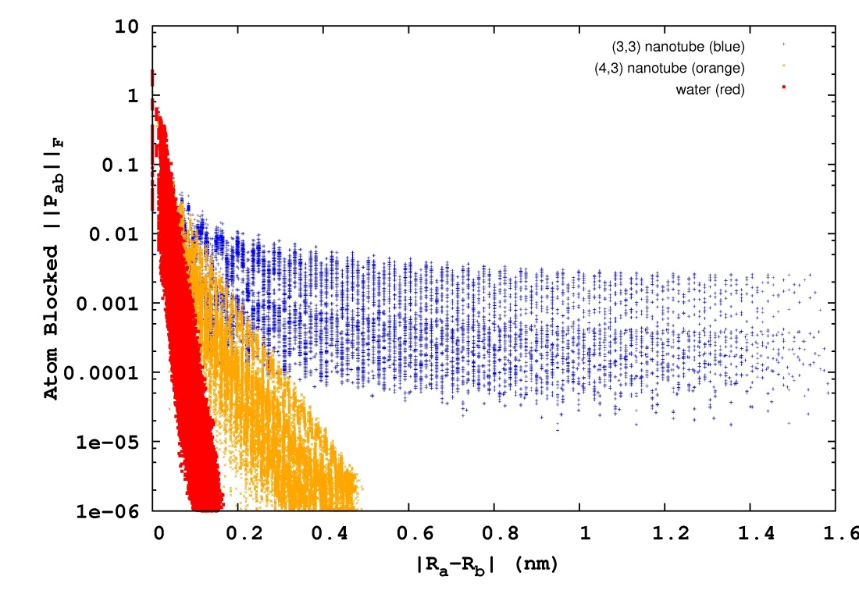
Quantum Locality & Kohn’s Nearsighted Principle
In a local, atom centered representation, quantum mechanical matrices possess decay properties. For non-metallic systems, matrix elements decay exponentially with atom-atom separation:
P_{ab} ~ exp(-β|R_{a}-R_{b}|)
bulk water
semi-conducting nanotube
metallic nanotube
The rate of matrix decay is controlled by:
The HOMO-LUMO or band gap
Non-orthogonality of the basis (metric ill-conditioning)
These effects may be intertwined

Slide 3




Matrix Sparsity and O (N ) Quantum Chemistry
For extremely localized methods, like tight binding and pure DFT, the resulting Hamiltonian matrix can be very sparse:
Use conventional, sparse linear algebra to achieve an O (N ) cost with size, N
Two ways to achieve sparsity:
Zero elements w/separation greater than radial cutoff
Zero elements smaller than numerical threshold
Numerical Threshold
Radial Cutoff

Slide 4
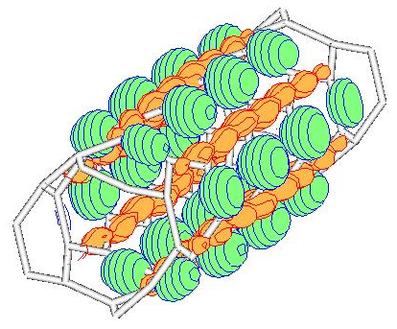
Real Wave-Functions Have Extent:
Ill-Conditioning in Electronic Structure
From bond-breaking to long-range entanglement, a host of technologically important properties emerge from long-range, strong-correlation effects.
These long range effects involve slow decay due to metric (basis) and gap ill-conditioning.
Most interesting and technologically important problems involve strong electron correlation, which is a long-range, delocalized quantum effect.
Vacancy defects control insulator-to-metal transition in Perovskites:
Field induced switching of conductance
Self-healing of induced vacancy defects
Resistance Change Memory
Exchange & correlation holes control onset of metallization:
Vacancies create strong, static correlations delocalized over many centers
Only now, functionals based on long-ranged Fock exchange (range separated & B13strong) can start to explain
Towards the metallic edge, fast
N-Body solvers for slow decay:
SpAMM solver for insulator/metal
transition in CNTs by LDA/Fock mixing
Kernel compression for metallic
problems with oscillatory/algebraic decay

Slide 5
N-Body Solvers in the Information, Physical & Computer Sciences
N-Body solvers combine database operations (range & metric queries) with locality preserving heuristics, and a wide variety of mathematical approximations. Examples: the astrophysical Barnes-Hut tree-code, the Fast Gauss Transform and so on.
The generic N-Body model has been extended to a vast number of fast, pairwise (kernel) summation techniques in the information sciences. Examples: see www.fast-lab.org.
In functional programming, the N-Body problem may be developed with the formal properties of generacity, involving map, fold, reduce & etc. Examples: the parallel map skeleton, algorithmic skeleton frameworks and so on.

Slide 6
Generalized Solver Ecosytems for Physics and Inference
PHYSICS: Strong Correlation
single determinant KSTs. Correlation on top of Fock exchange, eg. B13.
toward Mott transition, ill-conditioned matrix functions
MATH: Functional Approximation
nested approximate algebras and recursive preconditioning.
ill-conditioned matrix functions
N-BODY SOLVERS: Ecosystems & Stacks
N-Body Fock exchange (NoFX)
N-Body Linear Algebra (SpAMM)
others …
InfoSci: N-Body Learning
fast kernel summation, fast pairwise statistical problems, …
learning the metric: fast approaches to semi definite programming.
CompSci: Generic Programming
functional programming, skeletons, recursive task parallelism, openmp 4.
enterprise frameworks: scala/spark + neo/epiphany/phi.

Slide 7
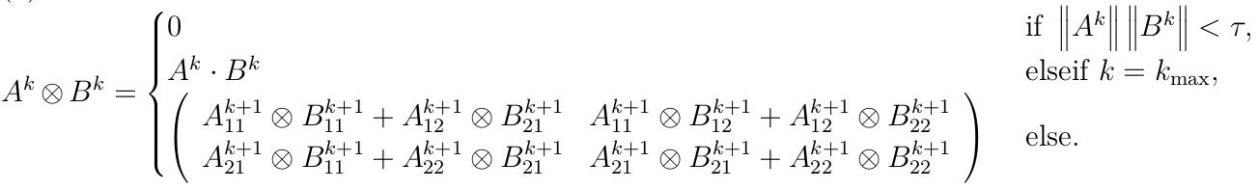
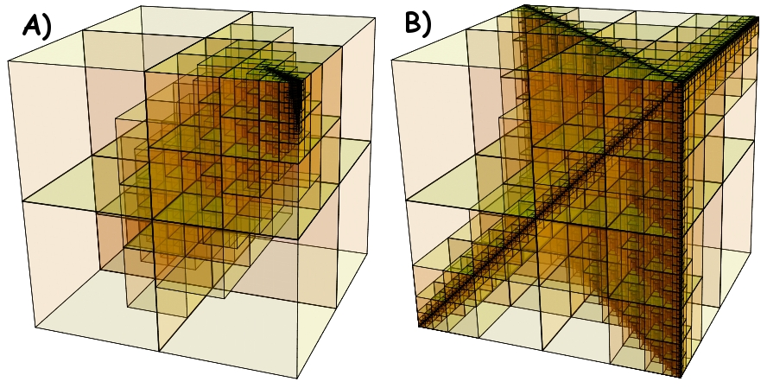
Matrix Multiplication as N-Body Solver
Challacombe & Bock, arXiv:1011.3534
SpAMM is a fast kernel for multiplication of matrices with decay & locality. Employs decorated quadtrees, rigorous sub-multiplicative norms, recursive occlusion and culling in the product space (octree metric query).
Fast occlusion and culling in the product space for matrices with
A) exponential and B) algebraic decay

Slide 8
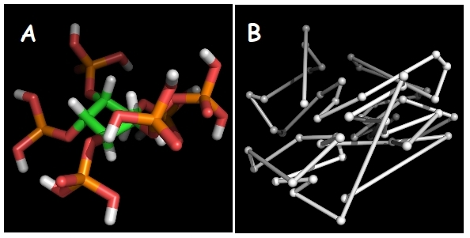
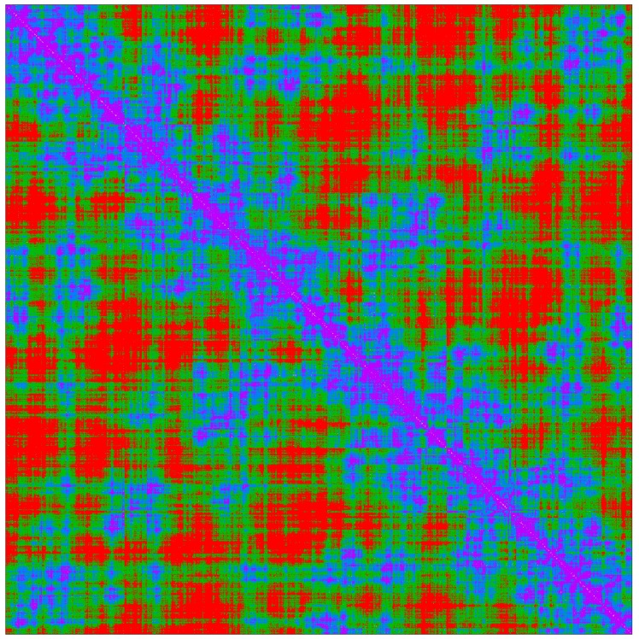
N-Body Methods Exploit Locality Heuristics
Space-filling-curve heuristics maximize locality, clustering (A-B)
With locality, database algorithms enable rapid distance, metric & overlap queries.
Clustering enhances multilevel approximation, occlusion & etc
Space-filling-curves (SFCs) map atoms close in space to an index where they are also close
This SFC ordering naturally blocks & structures corresponding matrices with decay
RB3LYP/6-31G** density matrix for [H₂O]₃₀₀. Purple is large, red is small.

Slide 9
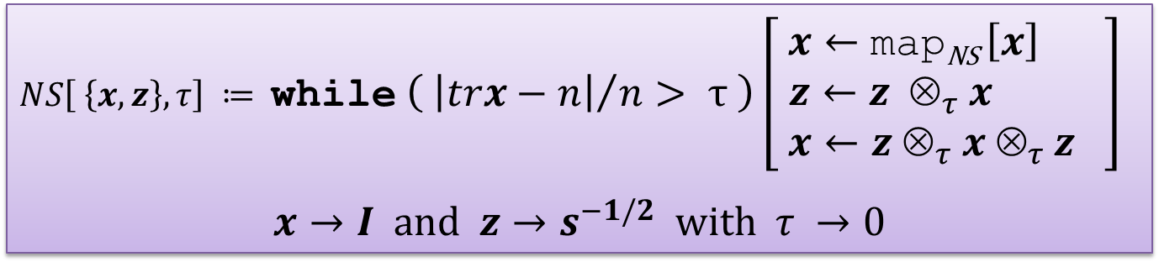
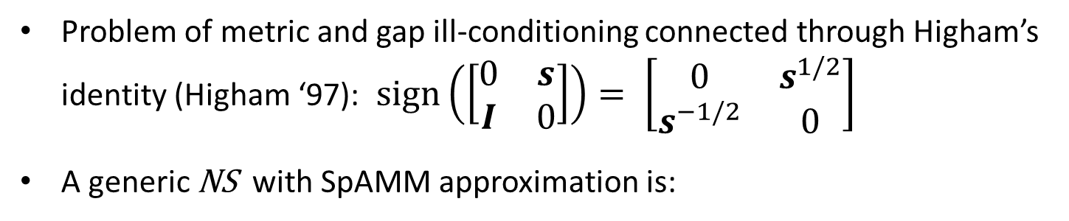
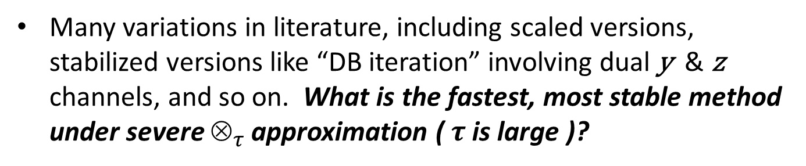

Newton Schulz for S ^{-1/2} (the Metric Problem)
Problem of metric and gap ill-conditioning connected through Higham’s identity (Higham ‘97): $sign\left(\left[\begin{matrix}0 & s \\ I & 0\end{matrix}\right]\right)= \left[\begin{matrix}0 & s^{1/2} \\ s^{−1/2} & 0\end{matrix}\right]$
A generic NS with SpAMM approximation is:
$NS\left[ \left\{x, z\right\}, τ\right] ≔$while $\left( {\left|trx−n\right|}/n> τ \right)\left[ \begin{aligned}x←\text{map}\text{NS} \left[x\right] \\ z←z ⊗_{τ }x \\ x←z ⊗_{τ }x ⊗_{τ }z \end{aligned}\right]$
$x→I \text{and} z→s^{−1/2} \text{with} τ →0$
$$\text{return} \{x, z\}$$
Many variations in literature, including scaled versions, stabilized versions like “DB iteration” involving dual y & z channels, and so on. What is the fastest, most stable method under severe $_{τ }$approximation ($τ$ is large )?

Slide 10
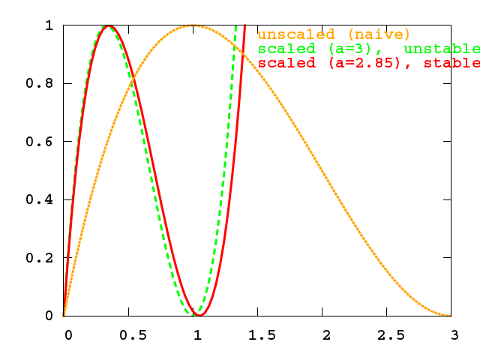


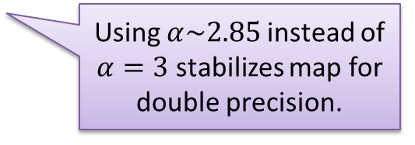
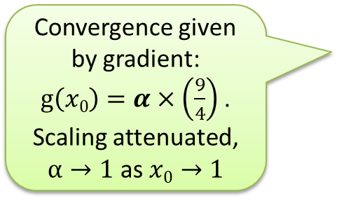
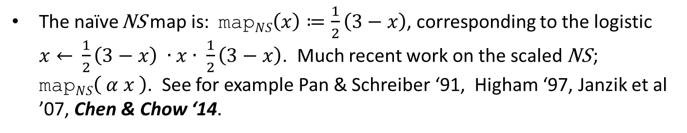
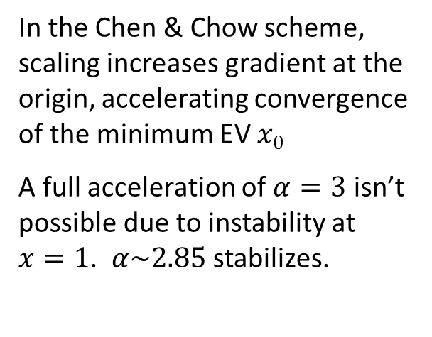
Scaled Newton Schulz (Chen & Chow ’14)
The naïve NS map is: $\text{map}NS\left(x\right)≔\frac{1}{2}\left(3−x\right)$, corresponding to the logistic $x←$ $\frac{1}{2}\left(3−x\right) ∙x∙ \frac{1}{2}\left(3−x\right)$. Much recent work on the scaled NS ; $\text{map}NS\left( α x \right)$. See for example Pan & Schreiber ‘91, Higham ‘97, Janzik et al ’07, Chen & Chow ‘14.
In the Chen & Chow scheme, scaling increases gradient at the origin, accelerating convergence of the minimum EV $x0$
A full acceleration of $α=3$ isn’t possible due to instability at $x=1$. $α\sim 2.85$ stabilizes.
Convergence given by gradient: $g\left(x0\right)=α×\left(\frac{9}{4}\right)$. Scaling attenuated, $α→1$ as$x0→1$
Using $α\sim 2.85$instead of $α=3$ stabilizes map for double precision.

Slide 11
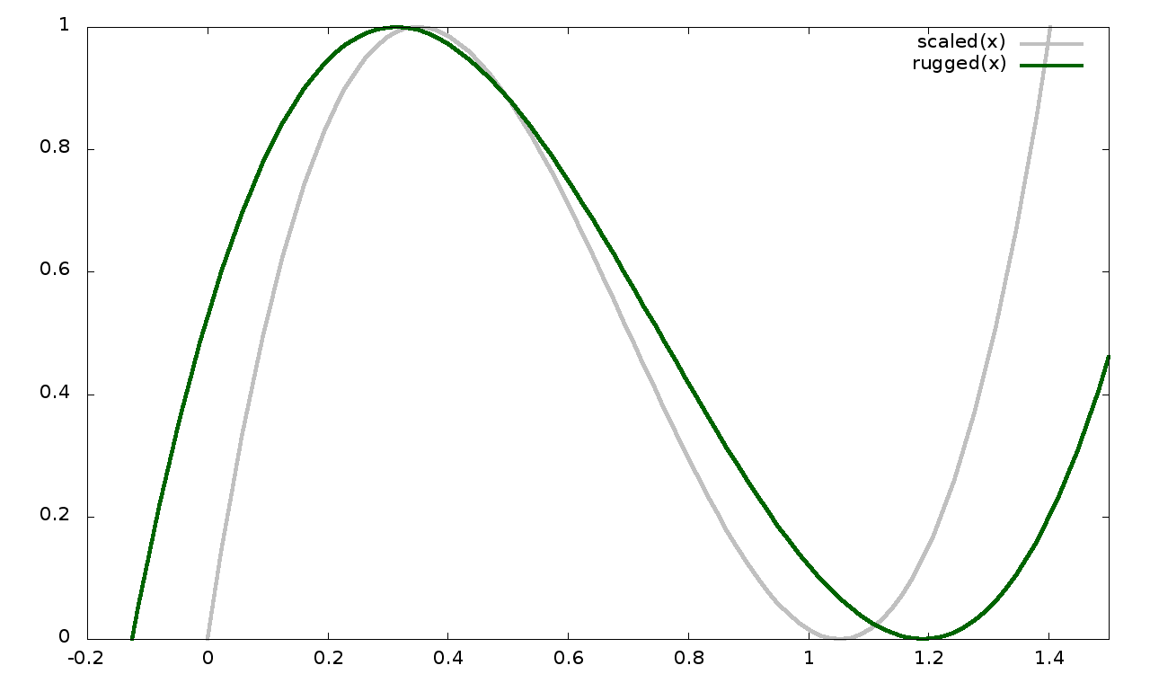


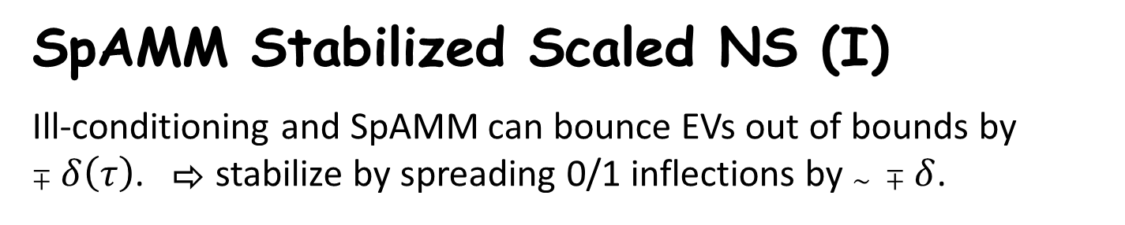
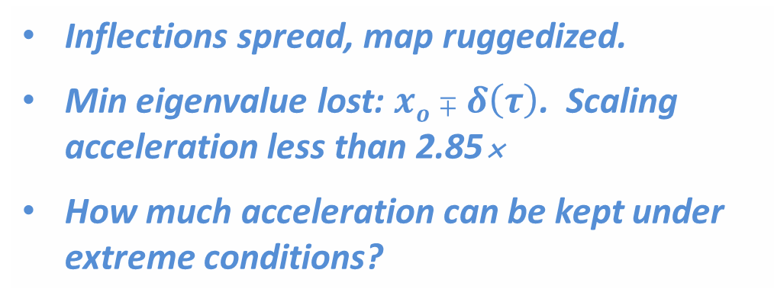
SpAMM Stabilized Scaled NS (I)
Ill-conditioning and SpAMM can bounce EVs out of bounds by $∓δ\left(τ\right)$. ⇨ stabilize by spreading 0/1 inflections by $\sim ∓δ$.
Inflections spread, map ruggedized.
Min eigenvalue lost: $xo∓δ\left(τ\right)$. Scaling acceleration less than 2.85
How much acceleration can be kept under extreme conditions?

Slide 12
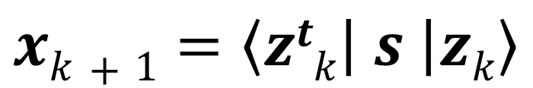
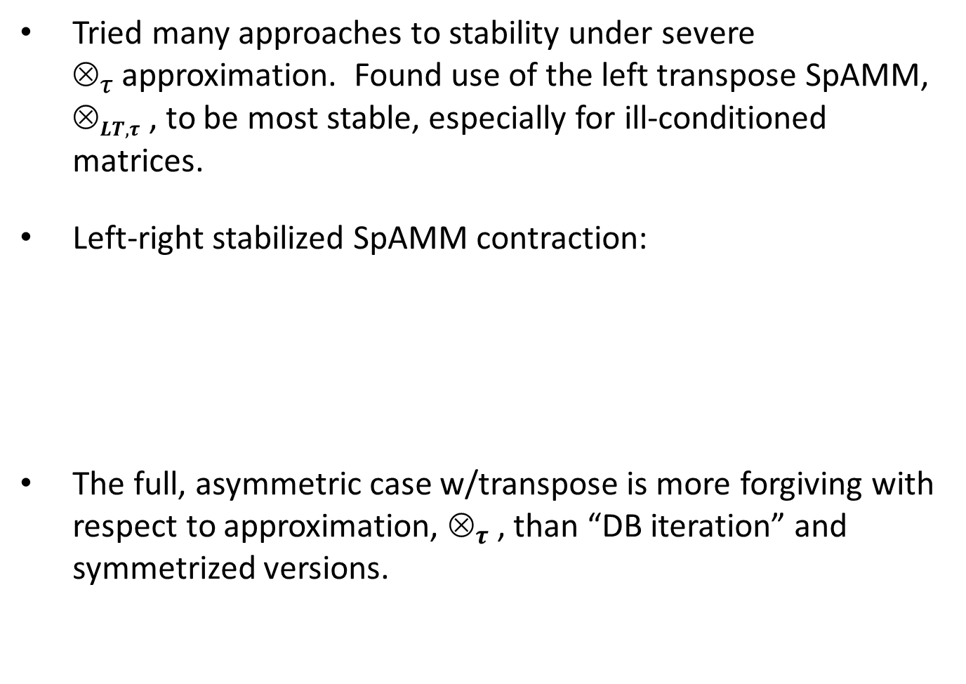
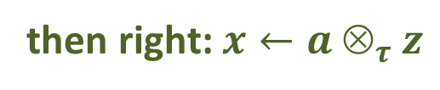
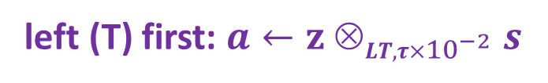
SpAMM Stabilized Scaled NS (II)
Tried many approaches to stability under severe $_{τ }$approximation. Found use of the left transpose SpAMM, $_{LT, τ }$, to be most stable, especially for ill-conditioned matrices.
Left-right stabilized SpAMM contraction:
The full, asymmetric case w/transpose is more forgiving with respect to approximation, $_{τ }$, than “DB iteration” and symmetrized versions.
$$xk+1=\left\langle ztk | s | zk\right\rangle$$
then right: $x←a _{τ }z$
left (T) first: $a←z _{LT, τ×{10}^{−2} }s$

Slide 13
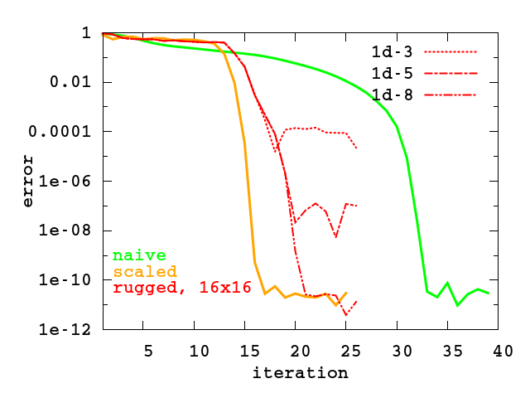
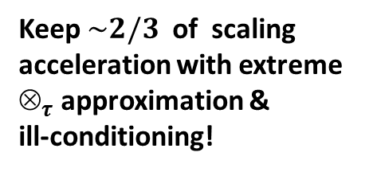
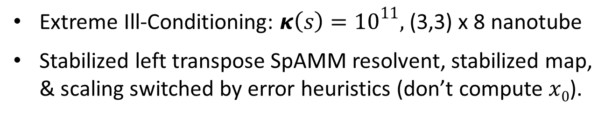
SpAMM Stabilized Scaled NS (III)
Extreme Ill-Conditioning: $κ\left(s\right)={10}^{11},$ (3,3) x 8 nanotube
Stabilized left transpose SpAMM resolvent, stabilized map, & scaling switched by error heuristics (don’t compute $x0$).
Keep $\sim 2/3$ of scaling
acceleration with extreme $_{τ }$approximation & ill-conditioning!

Slide 14
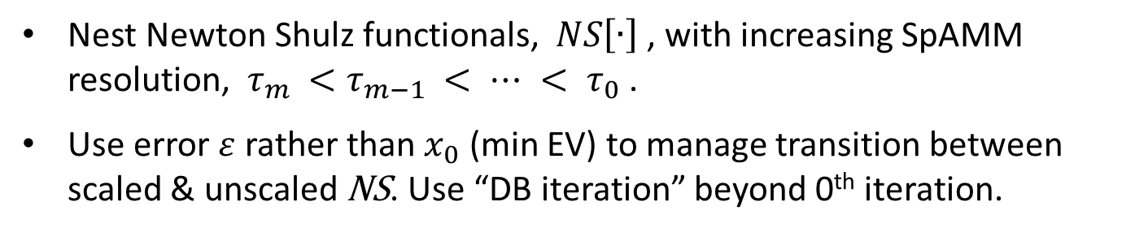
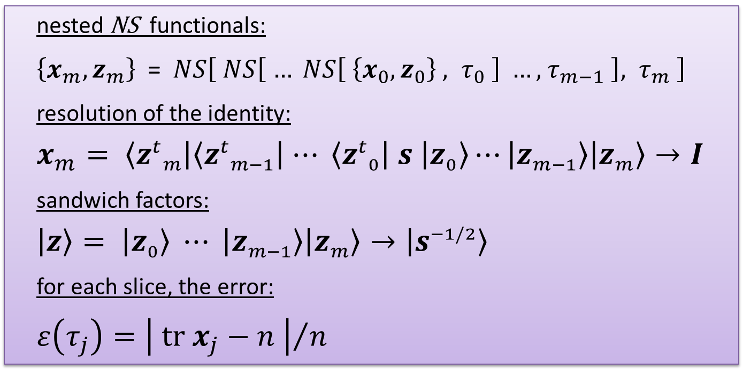
Recursive Preconditioning: The SpAMM Sandwich
Nest Newton Shulz functionals, $NS\left[∙\right]$, with increasing SpAMM resolution, $τ_{m }<τ_{m−1 }< ⋯ < τ_{0}$ .
Use error $ε$ rather than $x_{0}$ (min EV) to manage transition between scaled & unscaled NS. Use “DB iteration” beyond 0th iteration.
nested NS functionals:
$\left\{x_{m}, z_{m}\right\}$ =$NS\left[ NS\left[ … NS\left[ \left\{x_{0},z_{0}\right\} , τ_{0} \right] …, { τ}_{m−1} \right]{, τ}_{m} \right]$
resolution of the identity:
$$x_{m}= \left\langle {z^{t}}_{m} | \left\langle {z^{t}}_{m−1} | ⋯ \left\langle {z^{t}}_{0} | s | z_{0}\right\rangle ⋯ | z_{m−1}\right\rangle | z_{m}\right\rangle →I$$
sandwich factors:
$$\left|\left.z\right\rangle \right.= \left|\left.z_{0}\right\rangle \right.⋯ \left|\left.z_{m−1}\right\rangle \right.\left|\left.z_{m}\right\rangle \right.→\left|\left.s^{−1/2}\right\rangle \right.$$
for each slice, the error:
$ε\left(τ_{j}\right)={\left| tr{ x}_{j}−n \right|}/n$

Slide 15
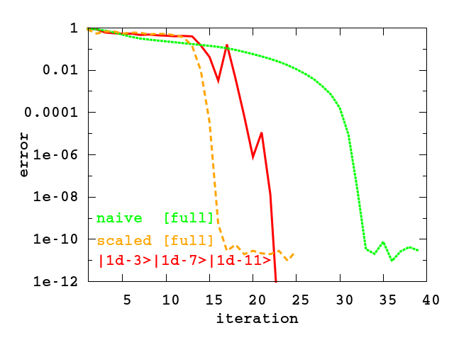



Ill-Conditioning: $κ\left(s\right)={10}^{11},$ (3,3)x8 nanotube
$$NS\left[ \left\{x_{0},z_{0}\right\}, { τ}_{0}={10}^{−3} \right]$$
$$NS\left[ \left\{x_{1},z_{1}\right\}, { τ}_{1}={10}^{−7} \right]$$
$$NS\left[ \left\{x_{2},z_{2}\right\}, { τ}_{2}={10}^{−11} \right]$$

Slide 16
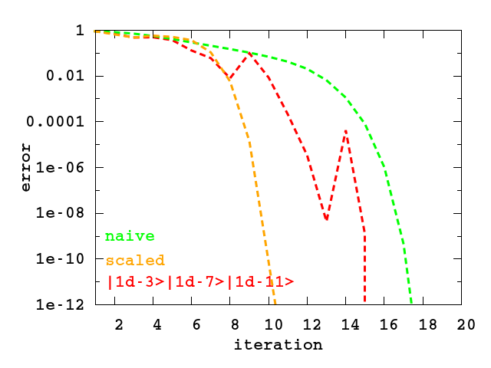
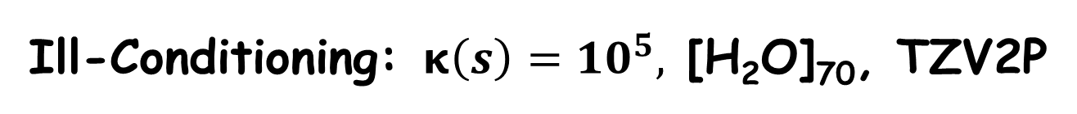
Ill-Conditioning: $κ\left(s\right)={10}^{5},$ [H₂O]₇₀, TZV2P
With recursive preconditioning, one resolutions accuracy is another’s error!

Slide 18
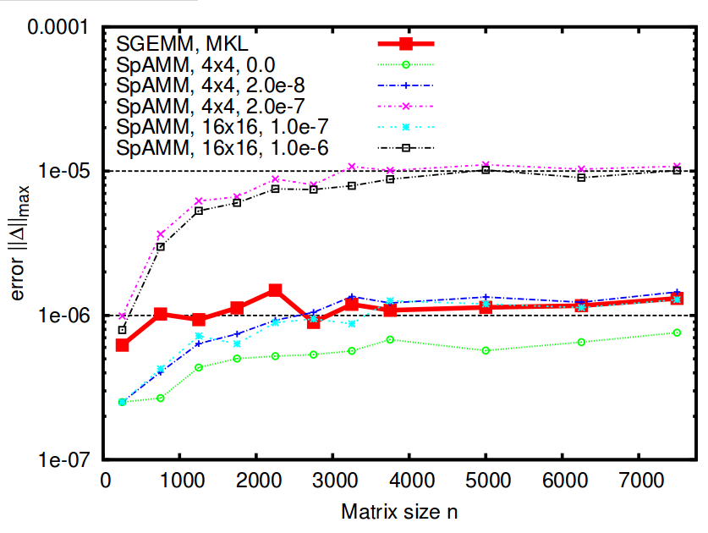
SpAMM For Dense Matrices w/Decay
Bock & Challacombe, SIAM J. Sci. Comput., 35(1), C72
Product matrix is asymptotically sparse, but only much, much later
Fill in of small blocks at negligible cost yields O (N ) cost even for dense matrices
S.P. SpAMM beats MKL SGEMM in error & is O (N )
Recursion w/locality more accurate than row-column

Slide 19
Ill-Conditioning in Electronic Structure
Most interesting and technologically important problems involve strong electron correlation, which is a long-range, delocalized quantum effect.
Vacancy defects control insulator-to-metal transition in Perovskites:
Field induced switching of conductance
Self-healing of induced vacancy defects
Resistance Change Memory
Exchange & correlation holes control onset of metallization:
Vacancies create strong, static correlations delocalized over many centers
Only now, functionals based on long-ranged Fock exchange (range separated & B13strong) can start to explain
Towards the metallic edge, fast
N-Body solvers for slow decay:
SpAMM solver for insulator/metal
transition in CNTs by LDA/Fock mixing
Kernel compression for metallic
problems with oscillatory/algebraic decay

Slide 20
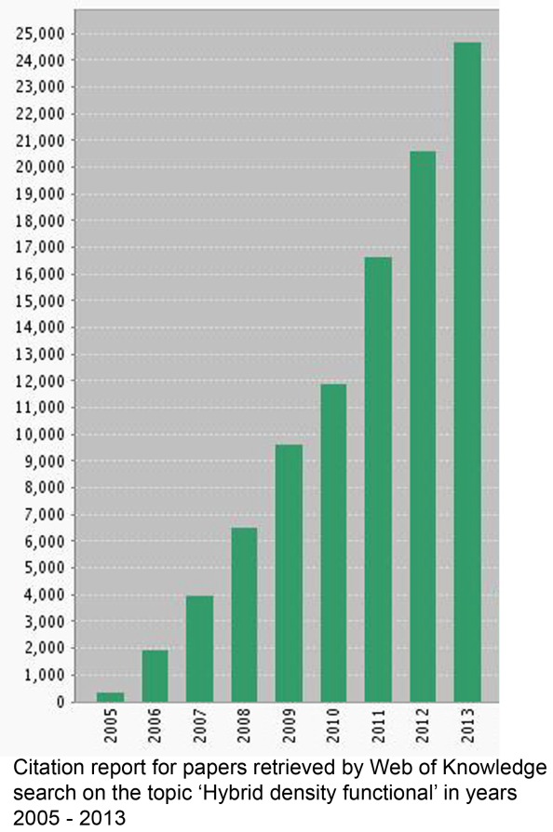

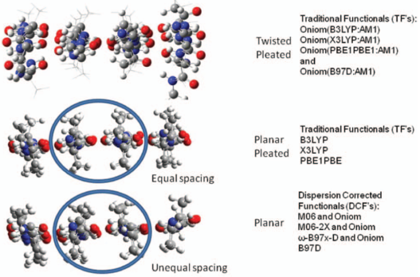
Accuracy Demands Less Local Models
Often, accurate results require Fock exchange and large basis sets, leading to negligible sparsity and five+ entangled solvers
The electronic properties of metal oxides, like the perovskites, require HF/DFT models
Comp. Mat. Sci. 29 (2004) p.165
Structural motifs and reaction profiles in biochemical applications also require hybrid HF/DFT models for even a qualitatively correct result
J. Chem. Phys. 137 (2012) p. 044109

Slide 21
