Slide 1


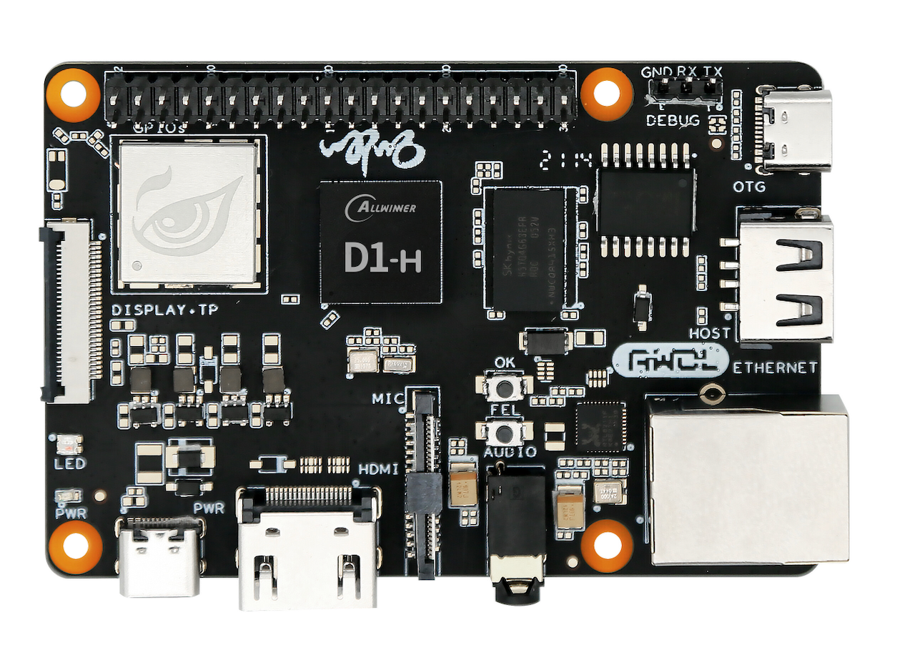
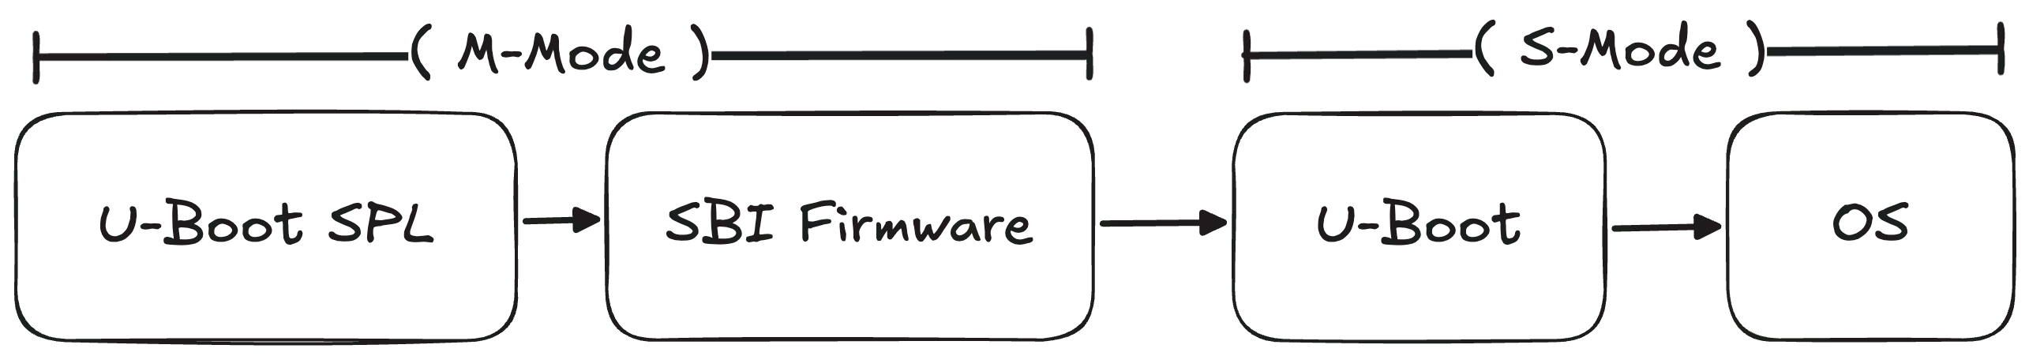
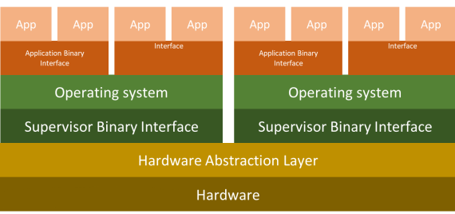
Improving Privilege Levels and Memory Protection for Teaching in Embedded Xinu
Contact Us!
Contact Us!
Spencer Christensen and Spencer O’Brien, Marquette University
The Bootloader
Results
Prior work was left with some issues:
Modified U-Boot image caused:
Mid initialization crash
Incorrect launch of the kernel in M-mode
Un-maintainable version dependency
Default U-Boot utilized unnecessary hardware features that bloated the image and booting process
To address these issues, we:
Rebuilt U-Boot image from scratch
Implemented custom U-Boot SPL assembly code
With the changes made during research, RISC-V Xinu matches specification with improved booting. This provides:
A simpler control flow between privilege modes
Allowing students an easier conception of this complicated topic
A stable bootloader configuration with:
Reduced boot times (~20 sec)
Stable & hardcoded MAC addresses
Reduced need for firmware maintenance
Kernel works to RISC-V specification
Kernel independent of M-mode
Eliminated most timer skew
Figure 1: Allwinner Nezha D1 Board [1]
Introduction & Background
Xinu is an Educational/Research operating system (OS)
It runs on bare-metal platforms as opposed to virtual systems
It is taught in many Universities across the world
Bare-metal teaching had advantages that can deepen student understanding
As architecture and operating systems evolve it is important to keep our educational tools up to date with ports and expansions aimed at improving educational outcomes.
Future Work
The Problem
Figure 2: U-Boot Boot Process on RISC-V
Completing this work opens the door for research and course assignments in the following areas:
Atomic operations & locking
Messaging & system buffers
Timekeeping & preemption
Asynchronous operations
Projects students could get hands on experience with:
Asynchronous serial port drivers
Using buffers, semaphores & interrupt control
The Xinu shell
Using Async serial ports and processes
Pseudo Filesystem I/O
Using 2nd serial port & above additions
Changes are currently live in Marquette’s Operating Systems Course, with 70 students. Differences in academic performance will be measured at the end of Spring Semester 2026.
Motivations to switch to RISC-V architecture:
Easy memory protection
Simplified privilege scheme
Highly intentional interrupt schemes
Top-down design
Problems with current implementation:
The security of RISC-V’s new protection model was thwarted
The modified bootloader was left in a fragile state, easily broken by future updates
Memory protection dysfunctional
The Kernel
With the bootloader working to specification, the following changes were made to the kernel:
Assembly commands utilized S-mode counterparts
M-mode control flow now nestled entirely in S-mode
Interrupt control preserves configuration
Timer interrupts changed to be cyclic
References
[1] AWOL. "D1-H Development Board — Nezha." AWOL Documentation. https://docs.aw-ol.com/d1/en/d1_dev/
[2] Pillai, Vysakh P. "Exploring Virtualization in RISC-V Machines." embeddedinn. May 30, 2021. https://www.embeddedinn.com/articles/tutorial/exploring_virtualization_in_riscv_machines/.
Figure 3: RISC-V Privilege Level Scheme Diagram [2]

