Slide 1
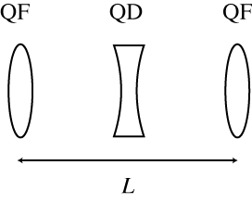
RadTrack – Elegant Use Case #1
Objective 1 : Build a simple FODO lattice
L=2m
Lengths of quads .5m
Hint: Start from middle of first quad
Objective 2 : Generate an electron beam distribution
Initial beam parameters:
Energy = 65 MeV
Normalized emittance = 2 mm-mrad
Transverse spot size = 200 µm rms (Gaussian, round)
Objective 3 : Run beam through FODO lattice, analyze output
Compare initial and final transverse distributions
Display evolution of beta functions through lattice
Objective 4 : Repeat above for 10 FODO lattices

Slide 2
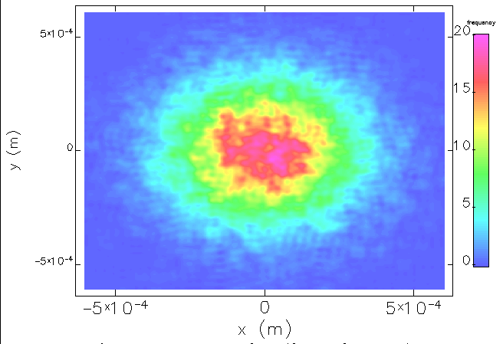
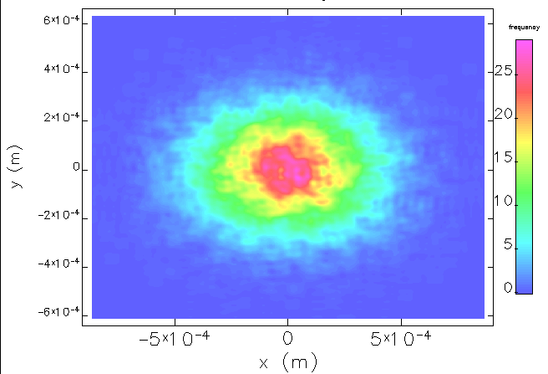

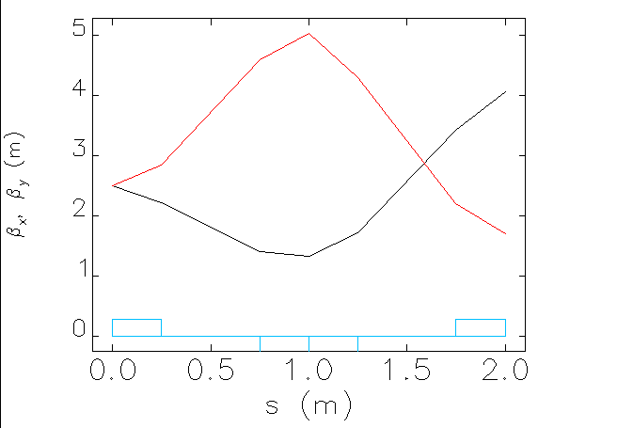
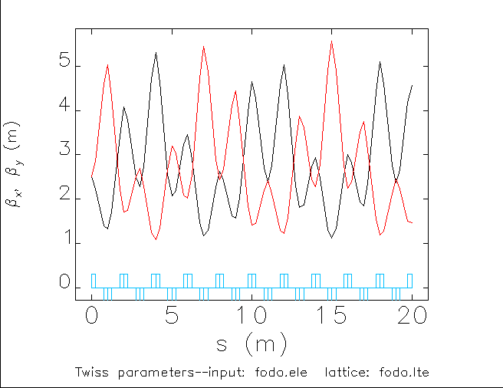
Elegant Use Case #1 – info to verify correct execution
Final beam distribution
and beta function evolution
through FODO
Final beam distribution
and beta function evolution
Through 10x FODO
Initial beam distribution

