Slide 1
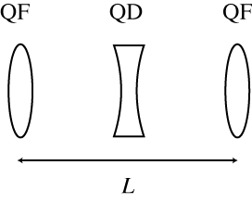
RadTrack – Elegant Use Case #1
Objective 1 : Build a simple FODO lattice
L = 2.0 m
Quads: l =0.5 m, k1 = +/- 2
Hint: start from middle of first quad
Objective 2 : Generate an electron beam distribution
Initial beam parameters:
energy = 65 MeV
normalized RMS emittance = 2 micron
Twiss beta (x,y) = 2.5 m
verify: transverse spot size = 200 µm rms (Gaussian, round)
Objective 3 : Run beam through FODO lattice, analyze output
Compare initial and final transverse distributions
Display evolution of beta functions through lattice
Objective 4 : Create a new beamline, consisting of 10 FODO cells
simulate and repeat tasks of Objective 3

Slide 2
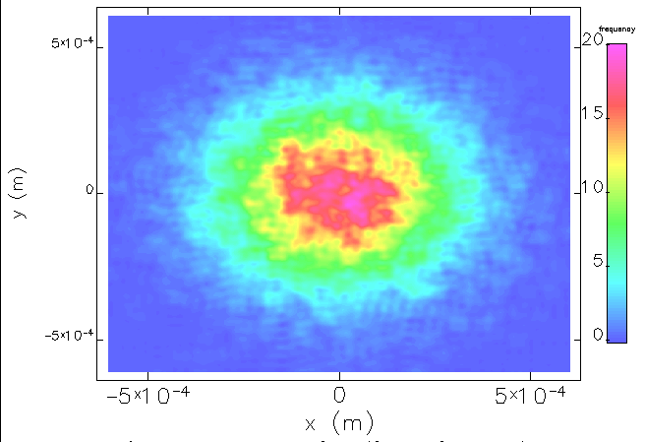
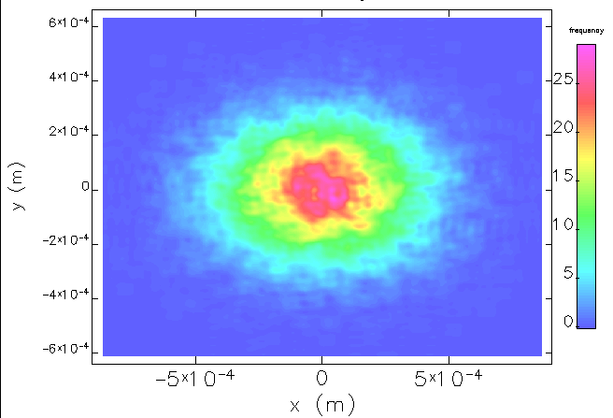

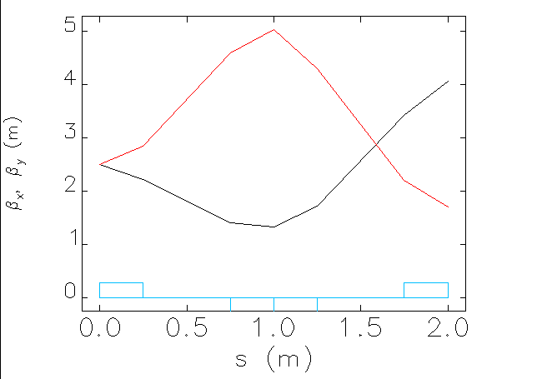
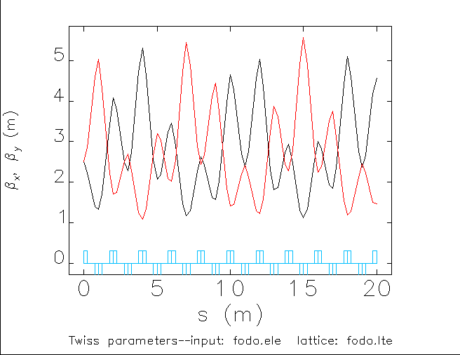
Elegant Use Case #1 – info to verify correct execution
Final beam distribution
and beta function evolution
through FODO
Final beam distribution
and beta function evolution
Through 10x FODO
Initial beam distribution

