Slide 1
RC4 and WEP
By:
Anthony Gervasi &
Adam Dickinson

Slide 2
Overview
Discussion of RC4 Algorithm
Breaking RC4 as used in WEP (Wired Equivalent Privacy) protocol
Response from RSA labs

Slide 3
RC4 Algorithm
Developed by RSA labs
Symmetric
Stream Cipher
  Block Cipher that uses a different key for each block of plaintext in a stream.
  WEP generally uses a counter to change the key.

Slide 4
RC4 Description
Two main parts:
  KSA (Key Scheduling Algorithm)
  PRGA (Pseudo Random Generation Algorithm)
Notation:
  S = {0, 1, 2, … N-1} is the initial permutation
  l = length of key

Slide 5
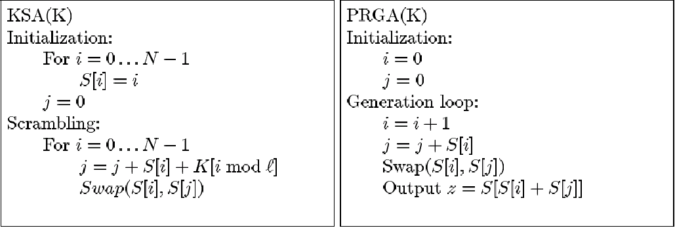
RC4 Description

Slide 6
RC4 Example
Simple 4-byte example
S = {0, 1, 2, 3}
K = {1, 7, 1, 7}
Set i = j = 0

Slide 7
KSA
First Iteration (i = 0, j = 0, S = {0, 1, 2, 3}):
j = (j + S[ i ] + K[ i ]) = (0 + 0 + 1) = 1
Swap S[ i ] with S[ j ]: S = {1, 0, 2, 3}
Second Iteration (i = 1, j = 1, S = {1, 0, 2, 3}):
j = (j + S[ i ] + K[ i ]) = (1 + 0 + 7) = 0 (mod 4)
Swap S[ i ] with S[ j ]: S = {0, 1, 2, 3}

Slide 8
KSA
Third Iteration (i = 2, j = 0, S = {0, 1, 2, 3}):
j = (j + S[ i ] + K[ i ]) = (0 + 2 + 1) = 3
Swap S[ i ] with S[ j ]: S = {0, 1, 3, 2}
Fourth Iteration (i = 3, j = 3, S = {0, 1, 3, 2}):
j = (j + S[ i ] + K[ i ]) = (3 + 2 + 7) = 0 (mod 4)
Swap S[ i ] with S[ j ]: S = {2, 1, 3, 0}

Slide 9
PRGA
Reset i = j = 0, Recall S = {2, 1, 3, 0}
i = i + 1 = 1
j = j + S[ i ] = 0 + 1 = 1
Swap S[ i ] and S[ j ]: S = {2, 1, 3, 0}
Output z = S[ S[ i ] + S[ j ] ] = S[2] = 3

Slide 10
Analysis of RC4
Advantages
  Faster than DES
  Enormous key space (average of 1700 bits)
Disadvantages
  Large number of “weak” keys 1 of 256
  “Weak” keys can be detected and exploited with a high probability

Slide 11
Weaknesses of RC4
Almost all weaknesses are in the KSA since attacking the PRGA is fairly infeasible due to the huge effective key. The fastest known method requires 2⁷⁰⁰ time.
The KSA can be attacked with several methods mainly because of the simple initialization permutation used.
Invariance Weakness is the most devastating attack.

Slide 12
The Invariance Method
Many devices that use RC4 use a Initialization Vector (IV) either before or after the key.
This IV is often a simple counter.
Certain patterns in the IV lead to a case where the S vector is basically unchanged all the way through a round.
This gives you about a 5% chance of guessing one or more bytes of the key.

Slide 13
The Invariance Method
If you collect many samples of these instances you can make a good guess at the key. For example, if you have 60 instances you can guess one or more key bytes with about 50% certainty.
Since this attack is done on each byte independently it has a linear complexity instead of exponential complexity. So larger key values don’t help much.

Slide 14
Applying the Invariance Method to WEP
In WEP the first part of the RC4 key is transmitted along with the message.
We also know a portion of the plaintext since WEP has predefined headers such as the SNAP designation 0xAA in the first byte. ARP and IP also have predictable packet structures.

Slide 15
Applying the Invariance Method to WEP
First, we must capture raw encrypted data packets from the network. This can be achieved using inexpensive off the shelf hardware and open source software.
Once about 6 million packets are collected, we look for resolved cases where the permutation matrix is essentially unchanged and use them to predict the key bytes. We determine which packets are interesting based on the IV.
We will now either have the key or be close enough that an exhaustive search will give us the key in seconds.

Slide 16
Invariance Method and SSL
SSL is the main secure communication link used by websites.
The Invariance Method does not apply to SSL since it uses hashing functions (SHA1 and MD5) on the key from the KSA, and because it does not re-key RC4 for each packet but rather uses the previous state for the next packet.

Slide 17
Response from RSA Labs
WEP should be considered broken. Other cryptography is necessary to secure wireless communications.
Algorithms such as SSL that use RSA’s recommendations and either hash the KSA output, or disregard the first 256 bits of the PRGA output, should still be completely secure.

Slide 18
Resources
Fluhrer, Mantin, Shamir - Weakness in the Key Scheduling Algorithm of RC4.
http://www.drizzle.com/~aboba/IEEE/rc4_ksaproc.pdf
Stubblefield, Loannidis, Rubin – Using the Fluhrer, Mantin, and Shamir Attack to Break WEP.
http://www.cs.rice.edu/~astubble/wep/wep_attack.pdf
Rivest – RSA Security Response to Weakness in the Key Scheduling Algorithm of RC4.
http://www.rsasecurity.com/rsalabs/technotes/wep.html
RC4 Encryption Algorithm.
http://www.ncat.edu/~grogans/algorithm_breakdown.htm

