Slide 1
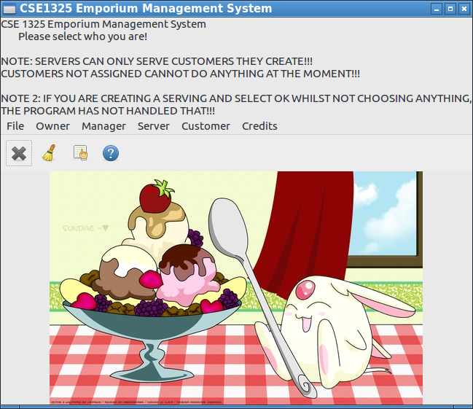
Brandon’s Emporium
The program uses many texts files and has them completely organizes for loading and saving. It uses an efficient loading and saving method so it all comes up instantly!
This project should be chosen because its implementation simply works. It uses common business practices such as the Model View Controller. It keeps things separate with different files and uses a vertically integrated approach to display the contents.
The program implements many bonus features and the program is made to be completely user friendly. Its ease of use should make this project an easy consideration of presentation.

