Slide 1
Attention
4.CBAM –ECCV;
5.Non-local Neural Network –CVPR
1.Spatial Transformer Networks -nips
6.GCNet -CVPR
2015
2018
2019
2017
2.Squeeze-and-Excitation Networks –CVPR;
3.Residual Attention Network -CVPR

Slide 2
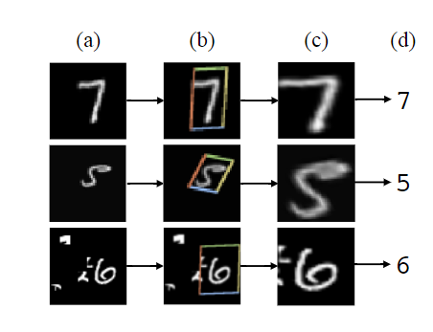
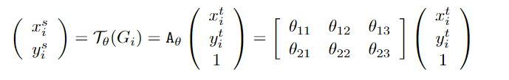
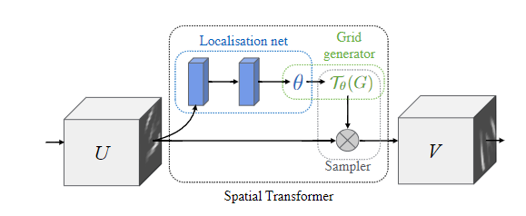
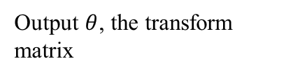
Spatial Transformer Networks
Image Transform:
Transform image by transform matrix
Output $θ$, the transform matrix
Compute pixel position
Notes:
Spatial Transformer Networks由三个模块组成: 1.Localisation net: 负责学习和输出变换矩阵; 2.Grid generator: 对图像进行变换; 3.Sampler: 对图像对应位置的像素点进行采样, 并计算变换前后对应像素点位置.

Slide 3
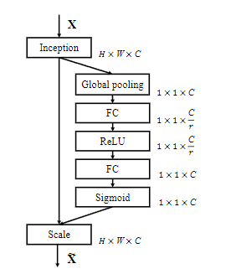
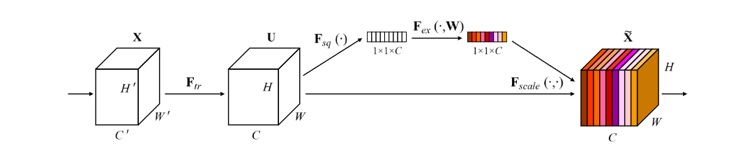


Squeeze-and-Excitation Networks
$$F_{sq}$$
$$F_{ex}$$
Global pooling by channel
Convolution operation
FC layer to excitation
Notes:
在F_sq中采用global avg pooling来将WxHxC的feature map转换成1x1xC的feature map

Slide 4
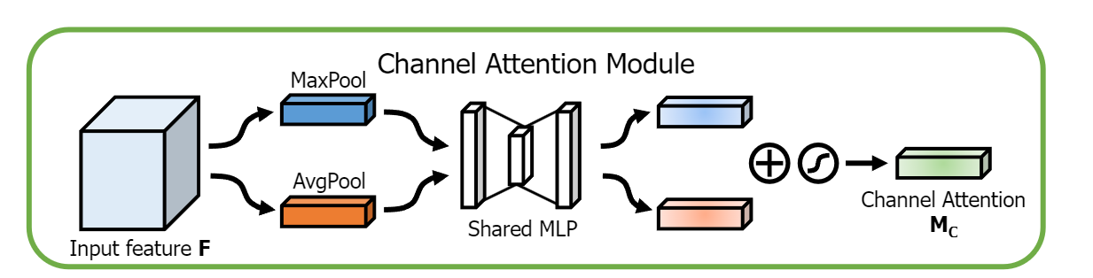
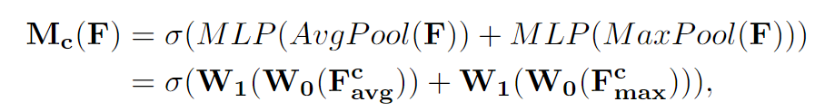
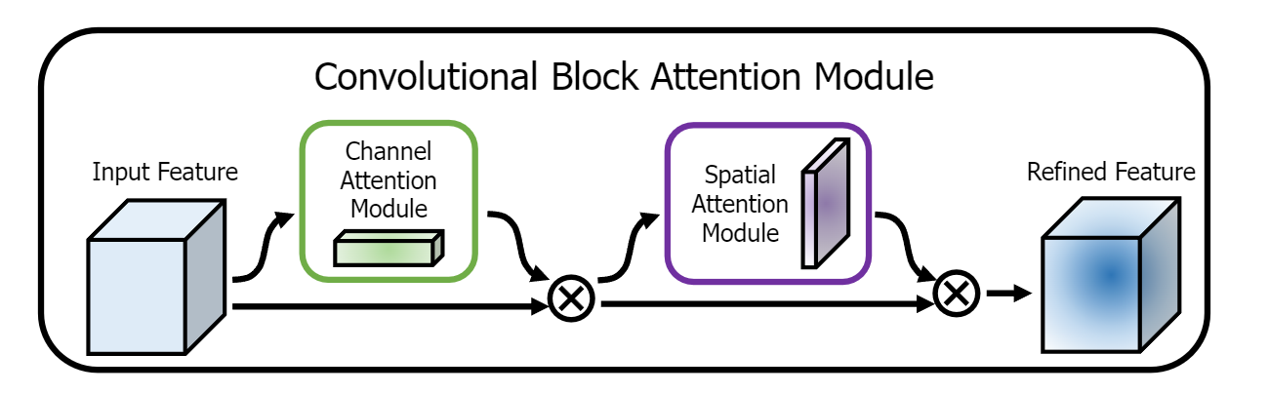
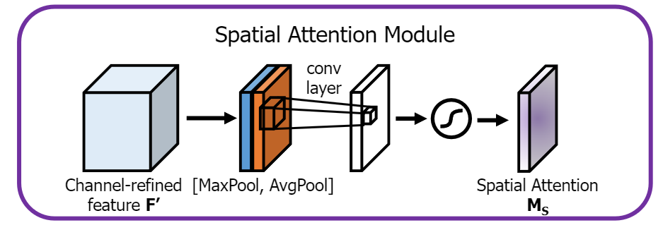
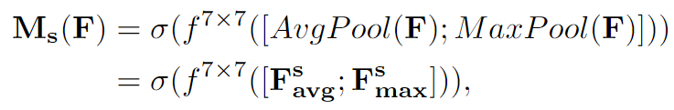
CBAM
Notes:
在Channel Attention Module中，使用global pooling沿channel进行池化；在Spatial Attention Module中，对channel进行Max和Avg池化

Slide 5
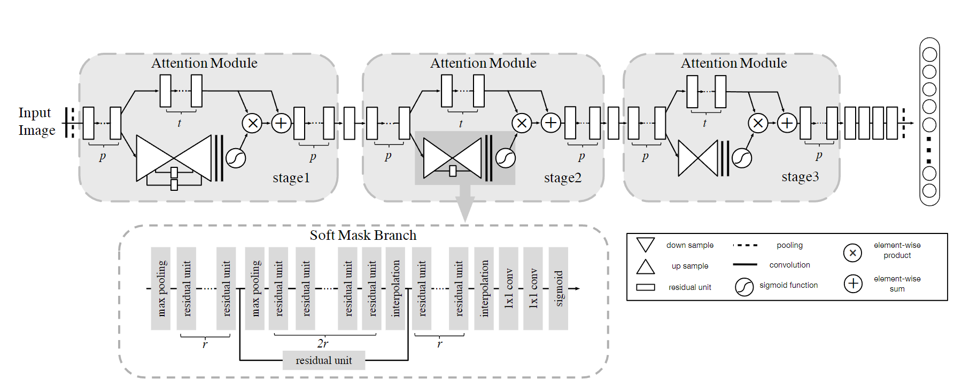
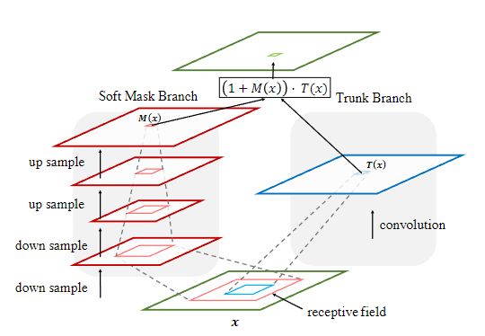
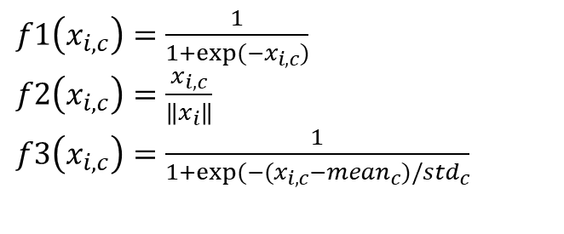
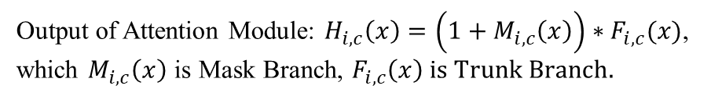
Residual Attention Network
Trunk Branch
Output of Attention Module: $H_{i,c}\left(x\right)=\left(1+M_{i,c}\left(x\right)\right)∗F_{i,c}(x)$, which $M_{i,c}\left(x\right)$ is Mask Branch, $F_{i,c}\left(x\right) is Trunk Branch.$
For different Attention Scope, Attention Model can deploy different function:
$f1\left(x_{i,c}\right)=\frac{1}{1+exp⁡(−x_{i,c})}$
$f2\left(x_{i,c}\right)=\frac{x_{i,c}}{\left\|x_{i}\right\|}$
$f3\left(x_{i,c}\right)=\frac{1}{1+exp⁡(−(x_{i,c}−{mean}_{c})/{std}_{c}}$

Slide 6
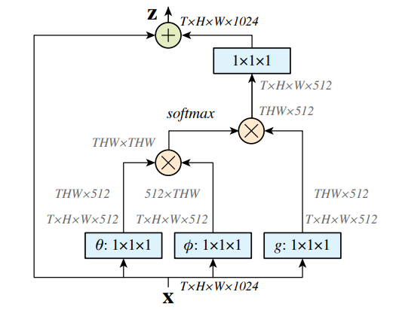
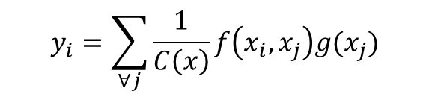
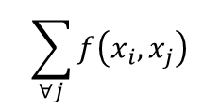
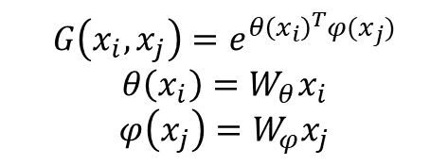
Non-local Neural Network
Compute relation weight between blocks
Representation function
$$y_{i}=\sum_{∀j}{\frac{1}{C\left(x\right)}f\left(x_{i},x_{j}\right)g(x_{j})}$$
$$y=softmax\left(x^{T}W_{θ}^{T}W_{φ}x\right)g(x)$$
$$\sum_{∀j}{f\left(x_{i},x_{j}\right)}$$
Relation computing function, can be Gaussian or Embedded Gaussian(default):
$$G\left(x_{i},x_{j}\right)=e^{θ{\left(x_{i}\right)}^{T}φ(x_{j})}$$
$$θ\left(x_{i}\right)=W_{θ}x_{i}$$
$$φ\left(x_{j}\right)=W_{φ}x_{j}$$

Slide 7
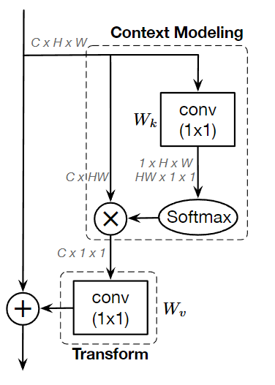
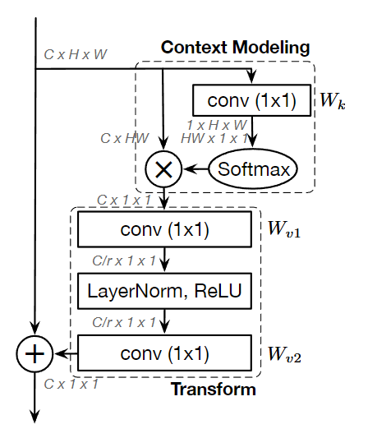
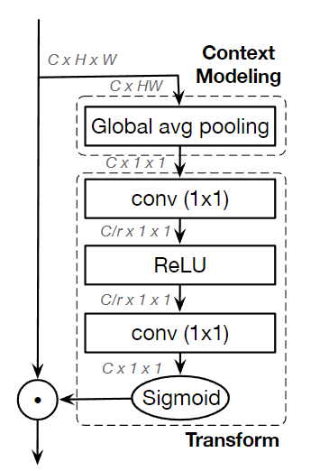
GCNet
Global context block reduce the computation size of non-local block by simplify NL block, and it’s fusion by SE block.
Simplified non-local block
Global context block
SE block

