Slide 1
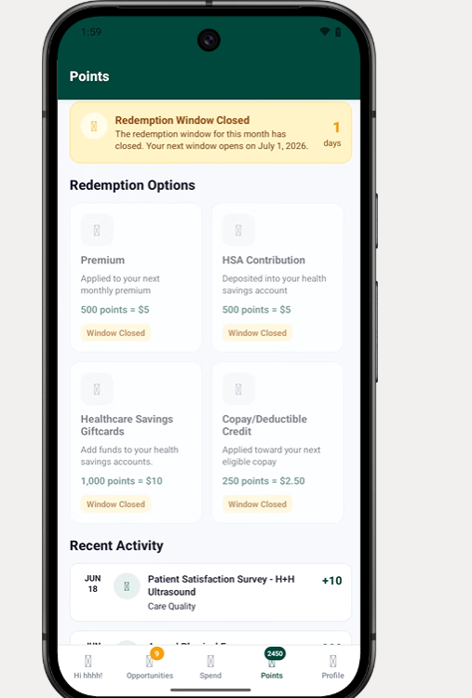
Redeem Points

Slide 2
Premium Allocation
Monthly Premium: $400
Point Available: 2450
Point To Allocate to Premium:
% ____ or
Points: _1200___
OK
Allow allocation based on percentage or points system. After allocation is done, show the reminder of the points. The remainder can now be allocated to any of the four options

Slide 3
HSA Allocation
2026 HSA Contribution Limit: $4400
YTD HSA Contribution Limit: $3600
Point Available: 1250
Point To Allocate to HSA:
% ____ or
Points: _800___
Error Message if the amount allocated exceed the thresholds
OK
Allow allocation based on percentage or points system. After allocation is done, show the reminder of the points. The remainder can now be allocated to any of the four options

Slide 4
Health Savings Gift Cards
Point Available: 450
Point To Allocate to HSA:
% ____ or
Points: _250___
OK
https://www.amazon.com/b/?node=122265875011
Allow allocation based on percentage or points system. After allocation is done, allow the customer to proceed to the website to use the points

Slide 5
Co Pay and Deductible
Point Available: 200
Point To Allocate to CoPays:
% ____ or
Points: _200___
Error Message if the amount allocated exceed the thresholds
OK
Allow allocation based on percentage or points system. After allocation is done, show the reminder of the points. The remainder can now be allocated to any of the four options

