Slide 1
Bike Rental Analysis
Sam Skinner, 3 December, 2016

Slide 2
Setup of Problem
Capital BikeSource rents bikes in Washington, DC.
Rentals to both registered & casual users.
Automated system captures rental data.
Rentals vary by season and weather.
“What are the effects of each on the rentals on a given day?”

Slide 3
Data Source
— original rental data are from Capital BikeSource in Washington, D. C., captured by an automated system.
— weather data are from http://freemeteo.com
— combined dataset is from UC, Irvine Machine Learning Repository.
— consists of 17, 379 records from 2011 & 2012, aggregated into 731 days (day.csv file).

Slide 4
Description of Attributes
instances: Record id number
date: Date (Factor w/ 731 levels "1/1/11","1/1/12",...)
season: Season (1:spring, 2:summer, 3:fall, 4:winter)
year: Year (0:2011, 1:2012)
month: Month (1 to 12)
holiday: Holiday? (0:no, 1:yes)
weekday: Day of Week. Numbered 1-7, beginning with Sunday.
workingday: WorkingDay? (0:no, 1:yes)
conditions: Weather Conditions: (1: Clear or Partly cloudy, 2: Mist with Few Clouds up to Cloudy, 3: Light Snow or Light Rain with Scattered Clouds/Cloudy/Thunderstorm, 4: Heavy Rain, Hail or Thunderstorm or Mist or Snow + Fog)
temp: Normalized temperature in Celsius. The values are divided to 41 (max)
felt_temp: Normalized feeling temperature in Celsius. The values are divided to 50 (max)
hum: Normalized humidity. The values are divided to 100 (max)
windspeed: Normalized wind speed. The values are divided to 67 (max)
casual: Count of casual users
registered: Count of registered users
count: Count of total bike rentals including both casual and registered

Slide 5
Viewing the Data
Frequencies for both Continuous and Categorical Data
Check for Normality of Distributions
Identify Outliers

Slide 6
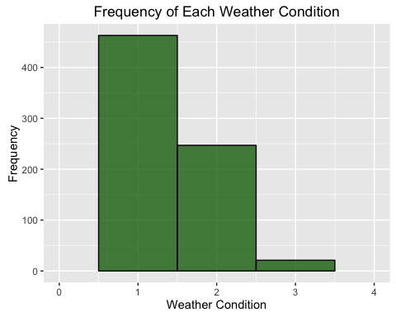
Frequency of Each Weather Condition
Notice the absence of condition “4”, and only 21 data points for “3”.

Slide 7
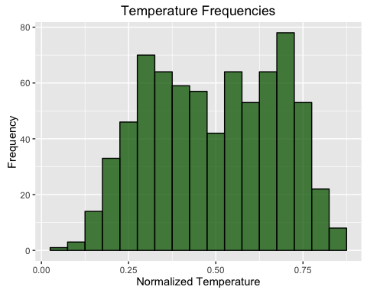
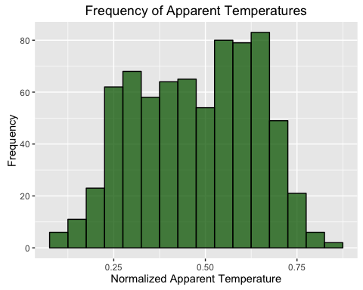
Distribution of Temperatures and Apparent Temperatures
Both are fairly platykurtic.

Slide 8
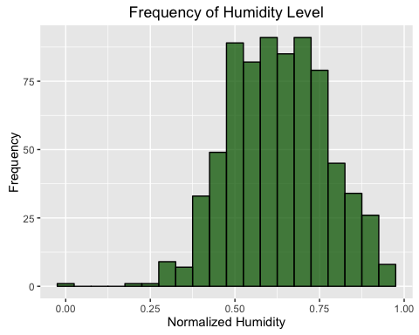
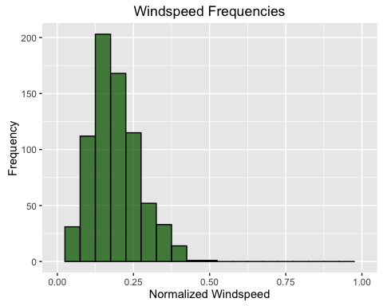
Distribution of Humidities and Windspeeds
Both are slightly skewed.
The “zero” datum for humidity
is probably an error.

Slide 9
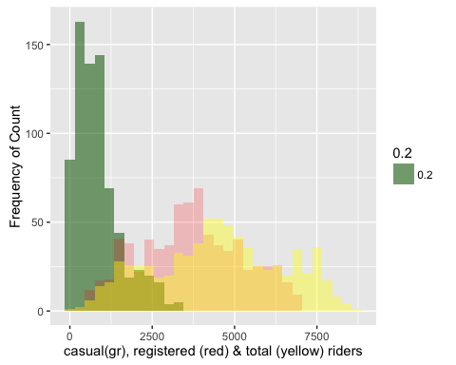
Counts of Bikers

Slide 10
Reducing the Dataset
Un-useful Variables:
Instance, Date (day) - unneeded
Felt_temperature - redundant (actual temp)
Conditions - redundant (humidity)

Slide 11
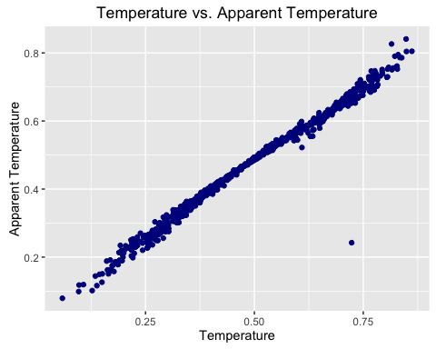
Actual vs. Apparent Temperatures
Pearson
product-moment
coefficient = 0.99

Slide 12
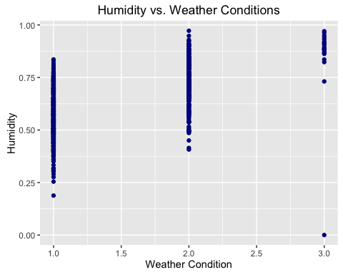
Humidity vs. Weather Condition
p-value < 2.2e-16, Spearman’s rho = 0.597

Slide 13
Reduced Set of Variables
Season
Month
Year
Weekday
Workday
Holiday
Temperature
Humidity
Windspeed
Casual
Registered
Total

Slide 14
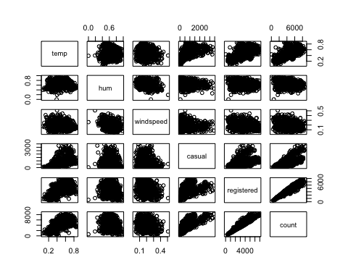
Pairs (reduced # variables, continuous only)

Slide 15
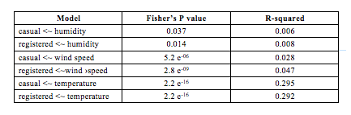
Univariate Models Effect of Weather on Riders
Only temperature shows a meaningful relationship.

Slide 16
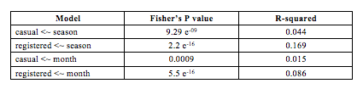
Univariate Models Effect of Season, Month
The month relationship is humped for both
casual and registered riders with a peak in the fall.

Slide 17
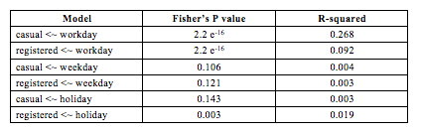
Univariate Models Effect of Workday, Weekday & Holiday
The weekday relationship is U-shaped for casual riders,
but slightly humped for registered.

Slide 18
Multivariate Models
Based on the Univariate results, I tested various multivariate models. Here is the best (so far):
casual ~ workday + temp + hum + windspeed
registered ~ workday + temp + hum + windspeed
count = casual + registered

Slide 19
Final Working Model
Specifically:
Casual = - 806.6(wkday) + 2149.5(temp) – 812.7(hum) – 1145.3(wind) + 1063.6
Registered = 932.4(wkday) + 4460.2(temp) – 2294.1(hum) – 3656.4(wind) + 2945.8
Notice opposite sign for wkday and different intercept.

Slide 20
Statistical Significance
Model p-value Adj. R-squared
casual 2.2 e⁻¹⁶ 0.6271
registered 2.2 e⁻¹⁶ 0.4225

Slide 21
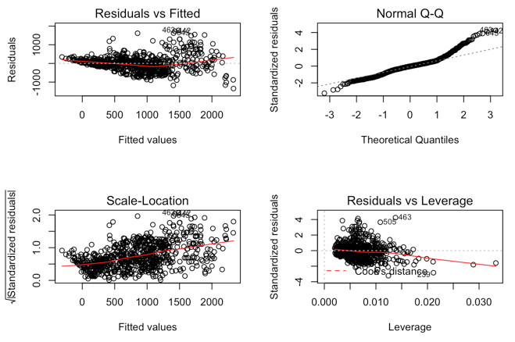
Tests of ANOVA Assumptions: Casual

Slide 22
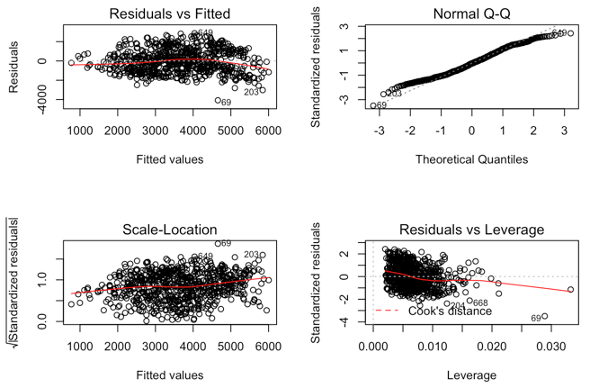
Tests of ANOVA Assumptions: Registered

