Slide 1
Data Visualization for Pattern Discovery
Which plots I reach for first, what they revealed in the Seaborn tips and iris datasets, and how they shaped feature selection and model design
Seaborn · Matplotlib · pandas · scikit-learn
Notes:
Hi everyone. In this video I'm answering the discussion prompt: which plots do I find most effective when exploring a new dataset, and how do they guide feature selection and model design?
I'll keep it practical. I used two Seaborn sample datasets, tips and iris, and built boxplots, violin plots, a scatter plot with a regression line, a histogram, a pairplot and a correlation heatmap, plus one combined grid of subplots. For each one I'll show what pattern or anomaly it exposed, and what I decided because of it. At the end I test those decisions with quick cross-validated models, so the visuals aren't just pretty pictures; they actually change the analysis.

Slide 2




Four plot families answer four first questions
Distribution
Histogram · KDE · boxplot
What does one variable look like? Skew, gaps, outliers, rounding.
Comparison
Boxplot · violin by group
Do groups differ in centre, spread or shape, and are the groups even balanced?
Relationship
Scatter · regplot · pairplot
How do two variables move together? Linear, curved, clustered by class?
Correlation
Heatmap
Which features carry the same information and which are redundant?
My default order: distributions first, then comparisons, then relationships and correlations, so every later model choice rests on something I have actually seen.
Notes:
So, my answer to the prompt in one slide. I think of exploratory plots as four families, each answering a different first question.
Distribution plots, like histograms, KDEs and boxplots, tell me what a single variable looks like: is it skewed, are there outliers, are values rounded.
Comparison plots, boxplots or violins split by a category, tell me whether groups really differ, and whether the groups are balanced.
Relationship plots, scatter plots, regression plots and pairplots, show how variables move together and whether classes form clusters.
And a correlation heatmap tells me which features are redundant.
I go through them roughly in that order, so every modelling decision rests on something I've actually looked at.

Slide 3
Two sample datasets, one repeatable workflow
244 × 7
sns.load_dataset("tips")
150 × 5
sns.load_dataset("iris")
Restaurant bills: total_bill, tip, sex, smoker, day, time, size. I added tip_pct = tip ÷ bill.
Four flower measurements (sepal and petal length and width) and the species label.
1
2
3
4
5
Load
Seaborn sample data, 0 missing values
Plot
Distributions, groups, pairs, correlations
Spot
Outliers, skew, confounds, redundancy
Decide
Features, transforms, model family
Validate
5-fold cross-validation
Notes:
The two datasets come straight from Seaborn with load_dataset. Tips has 244 restaurant bills with seven columns: total bill, tip, sex, smoker, day, meal time and party size. I added one derived column, tip percentage, because a tip only means something relative to the bill. Iris has 150 flowers, four measurements each, plus the species. Neither dataset has missing values.
The workflow is the same for both: load, plot, spot patterns, decide what to do about them, and then validate the decision with a quick cross-validated model. All the code is in one script, data_viz_pattern_discovery.py, which regenerates every figure in this deck.

Slide 4
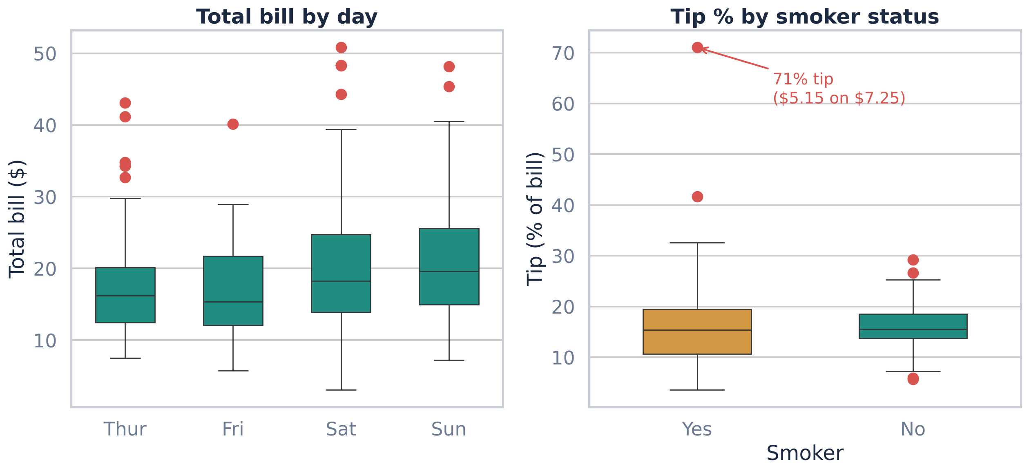
Boxplots flag the extremes worth a second look
1
9 bills above the $40.30 fence
Every day has high outliers, and they sit on the long right tail rather than looking like typos.
2
One 71% tip
$5.15 on a $7.25 bill, from a smoker table. A single row like this can drag a mean.
3
Same median, double the spread
Smokers and non-smokers both tip about 15.5%, but the SD is 8.5 vs 4.0 points.
DECISION Keep the large bills (real parties, not errors), flag the 71% tip, and use medians or robust scaling instead of means.
Notes:
First statistical visual: boxplots. On the left is total bill by day, on the right tip percentage by smoker status, side by side using Matplotlib subplots.
Three things jump out. One: there are nine bills above the upper fence of about forty dollars. They show up on every day and sit on a smooth tail, so I read them as genuinely large parties, not data-entry errors.
Two: one table tipped seventy-one percent, five fifteen on a seven twenty-five bill. That's the kind of row that quietly distorts a mean.
Three: the medians for smokers and non-smokers are basically the same, about fifteen and a half percent, but the smokers' box and whiskers are far wider, a standard deviation of 8.5 points versus 4.
Decision: I keep the big bills, I flag the 71% tip rather than delete it, and I summarise with medians or robust scaling instead of means.

Slide 5
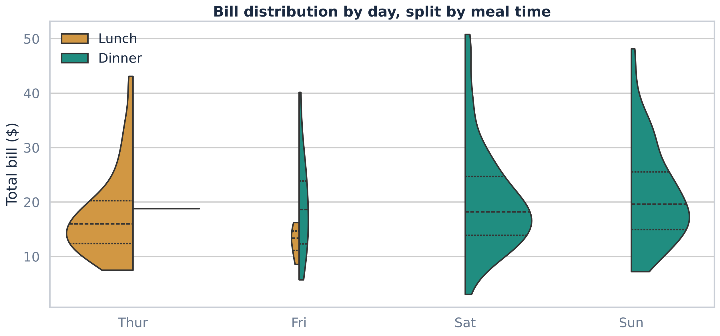
Violins expose a day and meal-time confound
1
Thursday is lunch; weekends are dinner
61 of 62 Thursday tables are lunch. Saturday and Sunday have no lunch at all.
2
Dinner bills have a longer tail
Weekend violins stretch up to $50; Thursday lunch bunches around $12-$20.
3
Friday is thin
Only 19 tables, so the Friday shape is too noisy to trust on its own.
DECISION Don't feed both day and time to a model as if they were independent. Use one, or a weekday-lunch vs weekend-dinner flag.
Notes:
Second statistical visual: a split violin plot. Each violin shows the full distribution of the bill for one day, and the two halves are lunch in amber and dinner in teal.
A boxplot would have hidden what this shows. Thursday is almost entirely lunch, 61 of 62 tables, while Saturday and Sunday have no lunch at all. So day and meal time are confounded: if I see higher bills on weekends, I can't tell whether that's the day or the fact that it's dinner.
The violins also show shape. Dinner bills have a long upper tail reaching fifty dollars, while Thursday lunch bunches between about twelve and twenty. And Friday only has nineteen tables, so its violin is too thin to read much into.
Decision: I won't put day and time into a model as if they carried independent information. I'd use one of them, or a single weekday-lunch versus weekend-dinner flag.

Slide 6
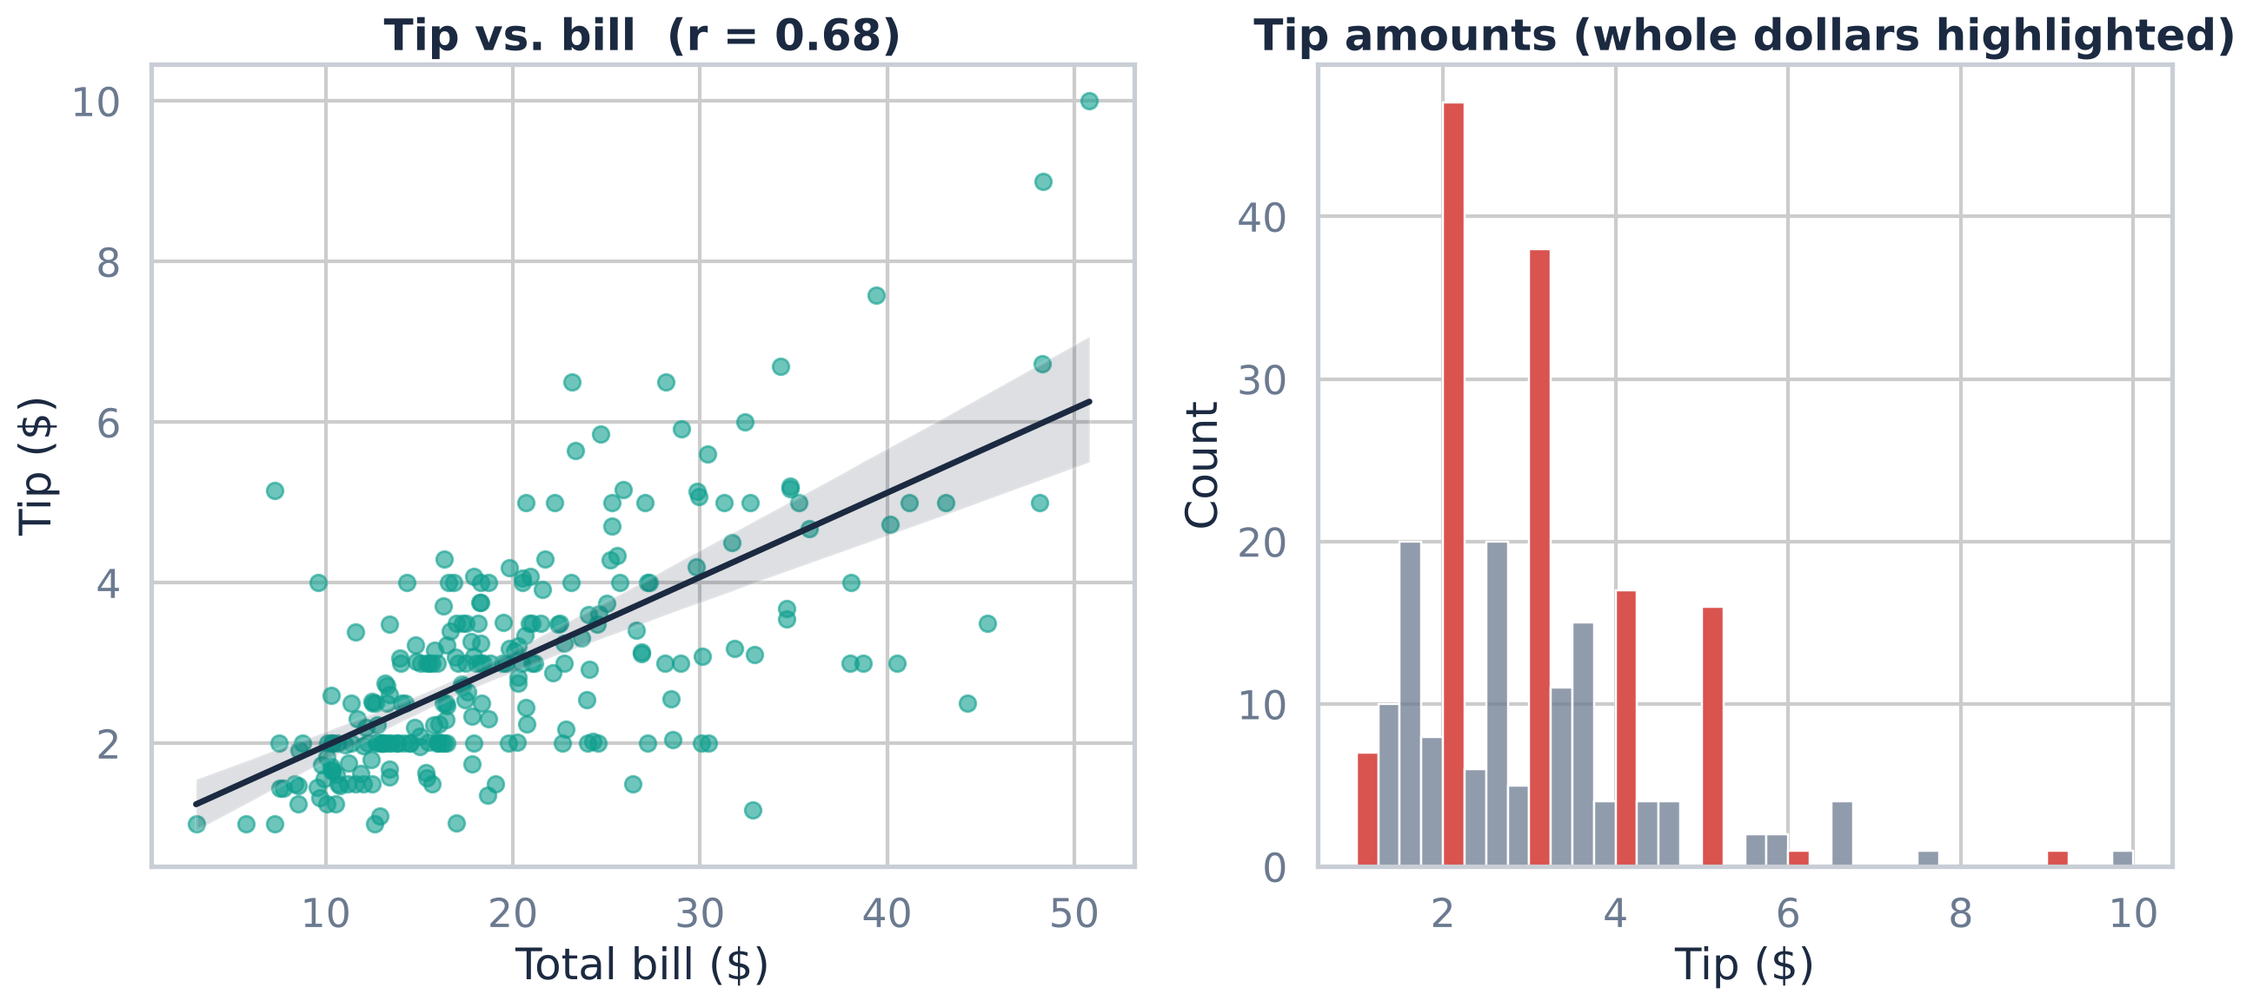
Scatter and histogram: trend plus rounding
Linear, r = 0.68
Each extra $1 of bill adds about 10.5¢ of tip. A straight line is a fair first model.
35% are whole dollars
Red bars at $2, $3, $4, $5: people round. That caps how precisely any model can predict a tip.
Tip % falls as bills grow
r = −0.34 between bill and tip %, so a flat-percentage rule would overpredict big tables.
Notes:
Next, a relationship plot and a distribution plot on one figure. On the left, Seaborn's regplot of tip against total bill. The correlation is 0.68 and the fitted slope says each extra dollar on the bill adds about ten and a half cents of tip, so a linear model is a sensible baseline.
On the right is a histogram of tip amounts with quarter-dollar bins, and I coloured the bars that sit exactly on whole dollars in red. Those spikes are an anomaly you'd never see in summary statistics: about 35 percent of all tips are round dollar amounts. People round. That puts a ceiling on how precisely any model can predict a tip.
And if you plot tip percentage instead, it actually falls as the bill grows, a correlation of minus 0.34. So a fixed-percentage rule would overpredict for large tables.

Slide 7
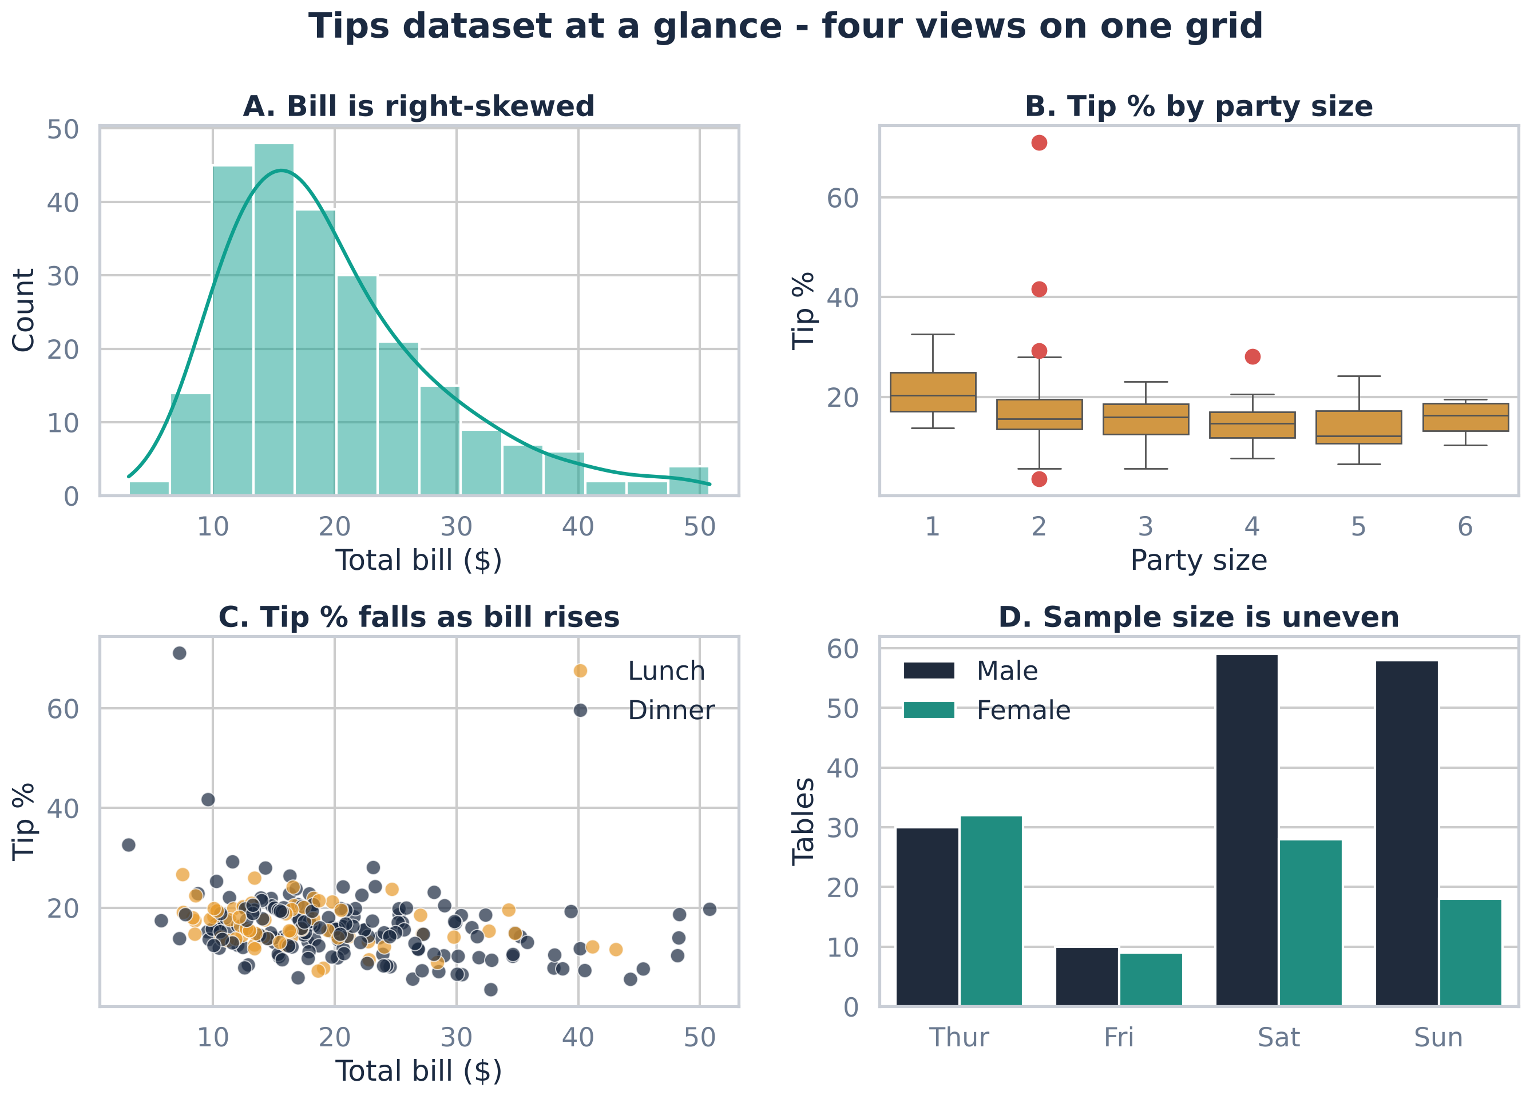
One grid, four views: combining subplots
A
Bill is right-skewed
Skew 1.13 drops to −0.12 after a log transform.
B
Tip % barely moves with party size
Medians 12-20%; sizes 1, 5 and 6 have only 4-5 tables each.
C
Tip % shrinks on bigger bills
Same pattern at lunch and dinner.
D
Uneven samples
Weekend tables are mostly men (59 vs 28 on Saturday).
plt.figure() + fig.add_gridspec(2, 2), then one Seaborn call per axis
Notes:
The tips for this assignment suggested combining plots in a grid, so here's a two-by-two dashboard built with Matplotlib's GridSpec, with one Seaborn call drawing into each axis. Seeing four views at once is the fastest way I know to get a feel for a dataset.
Panel A: the bill is right-skewed, skewness 1.13, and a log transform brings that down to about zero, which matters for linear models.
Panel B: tip percentage barely changes with party size, but sizes one, five and six only have four or five tables each, so I wouldn't trust those boxes.
Panel C: tip percentage drops as the bill rises, for both lunch and dinner.
Panel D is a simple countplot, and it's a reminder to check sample sizes: weekend tables are dominated by male payers, 59 versus 28 on Saturday. Any comparison by sex is partly a comparison by day.

Slide 8
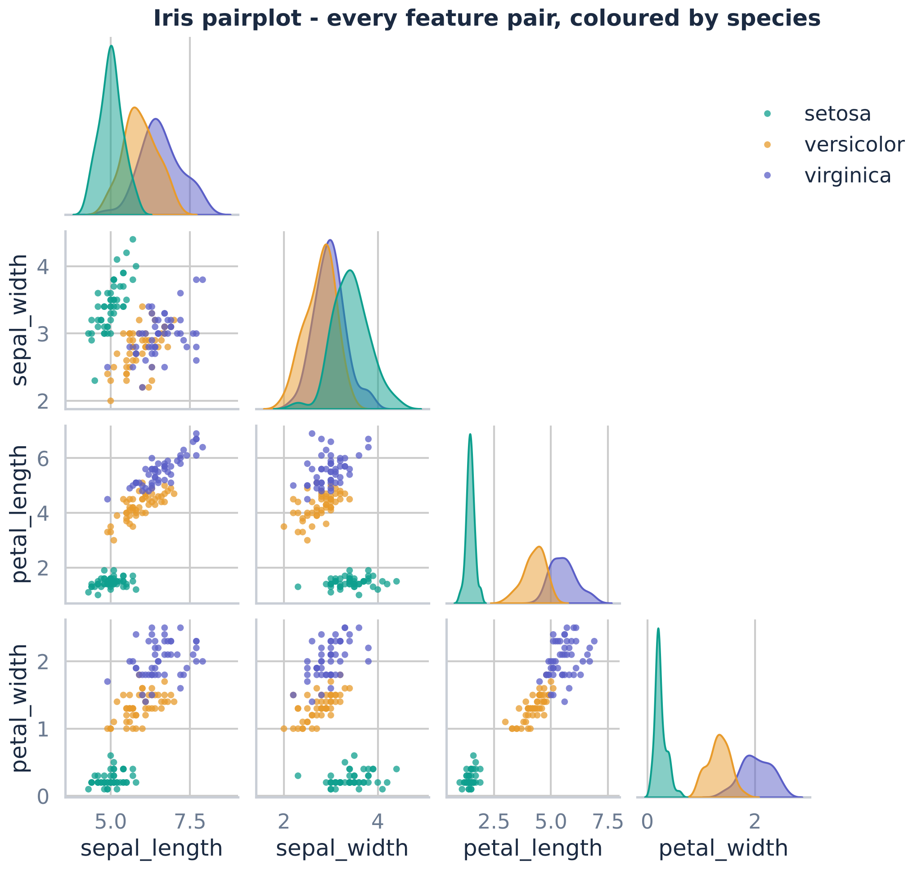
A pairplot shows which features separate the species
1
Petal features split the classes
In every panel that uses petal length or width, the three colours form separate bands.
2
Setosa is perfectly separable
Setosa petals are 1.0-1.9 cm long; the other species start at 3.0 cm. One threshold does it.
3
Sepal pairs are tangled
Versicolor and virginica overlap heavily on sepal length and width.
DECISION Lead with petal features, and start with a simple linear classifier: the classes already look linearly separable.
Notes:
Now iris, and my favourite first plot for a small labelled dataset: the pairplot. Every pair of features gets a scatter plot, the diagonal shows each feature's distribution, and the points are coloured by species. I used corner equals True to drop the duplicate upper triangle.
The pattern is immediate. Wherever petal length or petal width is involved, the three species form separate bands. Setosa in particular is perfectly separable: its petals are one to 1.9 centimetres long, and the other species start at three. A single threshold would classify it.
The sepal panels are the opposite: versicolor and virginica overlap heavily.
So before fitting anything I already know which features matter most, and that a simple linear classifier should be enough. I don't need to jump to something complex like a neural network.

Slide 9
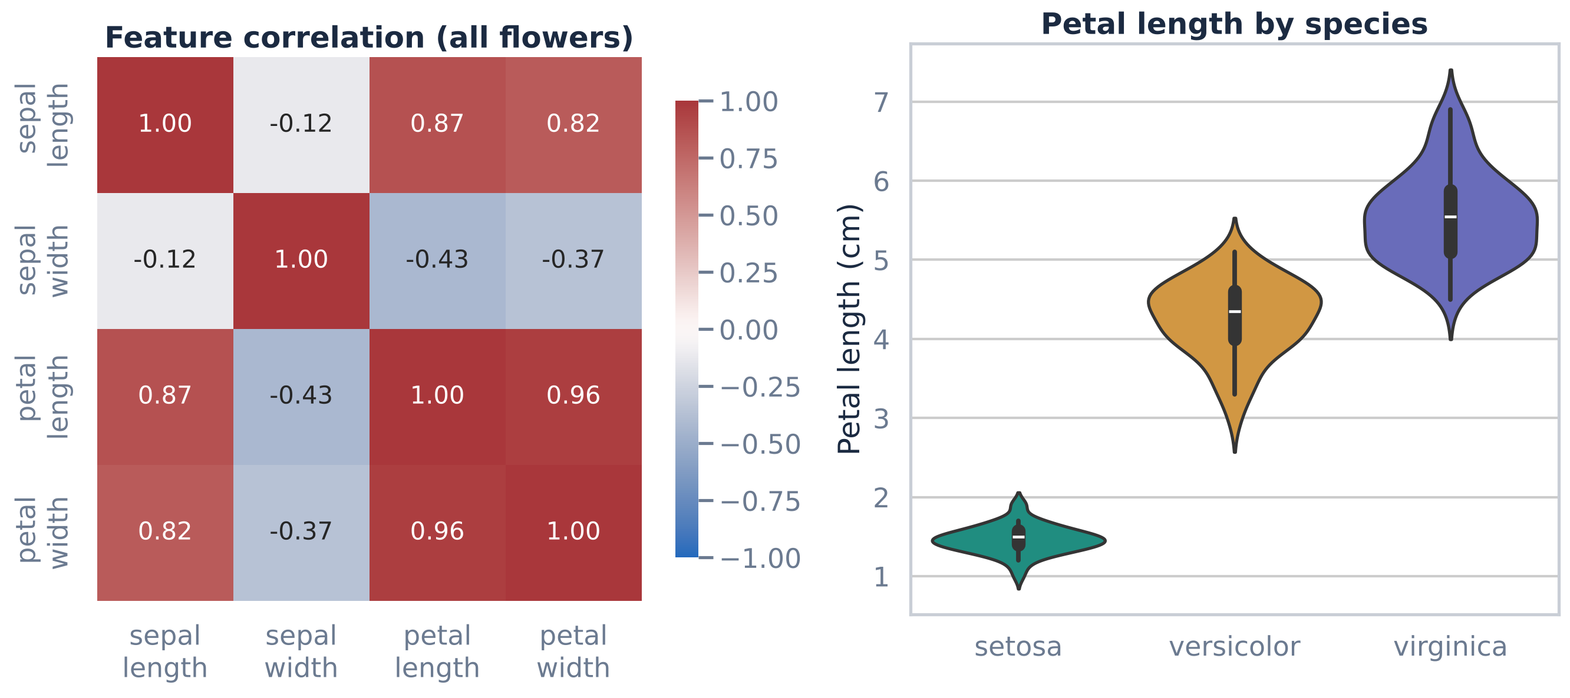
Heatmap and violin: redundancy and a hidden paradox
0.96
Petal length vs petal width
Almost the same information. One of them is redundant for most models.
−0.12 → +0.74
Sepal length vs width
Weakly negative overall, but positive inside every species: Simpson's paradox.
Notes:
On the left is a correlation heatmap. Petal length and petal width correlate at 0.96, so they carry almost the same information. For many models one of them is redundant, and keeping both can make coefficients unstable.
The anomaly is in the sepals. Overall, sepal length and sepal width have a correlation of minus 0.12, which looks like "no relationship". But if I compute it inside each species, it's plus 0.74 for setosa, 0.53 for versicolor and 0.46 for virginica. That's Simpson's paradox: mixing the groups hides the real within-group relationship. I only noticed because the pairplot showed separate clusters, so the heatmap alone would have misled me.
On the right, a violin plot of petal length by species confirms the separation and shows that setosa is also much less variable than the other two.

Slide 10
Testing the visual hunches with cross-validation
Tips: linear regression R² for predicting the tip
0.457
total_bill only
0.421
all 6 features
Both results match what the plots predicted: petal features carry nearly all the signal, and in tips the bill does the work while sex, smoker, day, time and size only add noise.
Notes:
A visual hunch is only useful if it holds up, so I tested two of them with five-fold cross-validation.
For iris, a standardised logistic regression with all four features scores 96 percent accuracy. With just the two petal features: also 96 percent. Petal length on its own: 95.3. And the two sepal features only reach 81 percent. That's exactly what the pairplot and heatmap suggested: the petals carry nearly all the signal, and one petal feature almost does the whole job.
For tips, a linear regression that predicts the tip from total bill alone gets an R-squared of 0.457. Adding sex, smoker, day, time and party size actually lowers it to 0.421 out of sample. Again, consistent with the plots: the bill drives the tip, and the categorical features, which the violins showed are confounded and unbalanced, mostly add noise.

Slide 11
From pattern to decision
Visual | Pattern or anomaly | Decision
Boxplot | 9 bills above $40.30, one 71% tip, smokers' tip % twice as spread | Keep real extremes, flag the 71% tip, use medians and robust scaling
Split violin | Thursday = lunch, weekend = dinner; Friday has 19 tables | Use day or time, not both; merge thin categories
Scatter + histogram | Linear bill-tip trend (r 0.68); 35% of tips are whole dollars | Linear baseline on the bill; expect a rounding noise floor
Grid of subplots | Bill skew 1.13; tiny party-size groups; unbalanced sex by day | Log-transform the bill; don't over-read small groups
Pairplot | Petal features separate species; setosa trivially | Select petal features; a linear classifier is enough
Heatmap | Petal length/width r 0.96; sepal Simpson's paradox | Drop a redundant feature; analyse within species
Notes:
Here's everything in one table, which is really the answer to the third checklist question: how did the visuals influence my decisions?
Boxplots told me which extremes to keep, which to flag, and to prefer robust statistics. The split violin exposed the day and meal-time confound, so I wouldn't use both. The scatter plot justified a linear baseline, and the histogram explained why predictions will never be very precise. The grid of subplots led to a log transform of the bill and a warning about tiny groups. For iris, the pairplot selected the petal features and the model family, and the heatmap flagged redundancy and the Simpson's paradox in the sepals.
Every row is a decision I'd have made differently, or not at all, without looking at the plot first.

Slide 12



Plot first, model second
Summary stats hide shape
Rounded tips, a confounded day/time split and Simpson's paradox were all invisible in describe().
Visuals pick the features
The pairplot and heatmap chose petal features before any model ran, and CV agreed.
Then test the hunch
A quick cross-validated model turns a visual impression into evidence.
Question for the class: which plot has most often changed your mind about a dataset?
Notes:
To wrap up. First, summary statistics hide shape. The rounded tips, the day and meal-time confound and the Simpson's paradox in iris were all invisible in a describe() table and obvious in a plot.
Second, visuals pick the features. The pairplot and heatmap pointed to the petal measurements before I trained anything, and cross-validation agreed.
Third, treat a plot as a hypothesis and test it, even with a quick five-fold model.
So my short answer to the prompt: boxplots and violins for distributions and groups, pairplots and heatmaps for relationships and redundancy, all on a grid so I see them together. Plot first, model second.
I'd love to hear from the rest of you: which plot has most often changed your mind about a dataset? Thanks for watching.

