Slide 1
Interview tool

Slide 2
Log in
Interview tool
logo
Log in to your account
New here?
Email
Sign up
Password
Sign in

Slide 3
Sign up
Interview tool
logo
Create your new account
Name
Surname
Email
Password
Join in

Slide 4
Homepage 1/2
logo
+
Settings
New Candidate
Candidates overview
Business Pipeline
Name Surname
Grade
Rec
Starting date
Requestor name
Needed by (date)
Project
Intern assigned
Grade from 1 to 10 and linked with the final grade in the evaluation sheet
Recommendation (Rec) = offer, not offer, second interview
Starting date as per the candidate availability
Name Surname
Grade
Rec
Starting date
Requestor name
Needed by (date)
Project
Intern assigned
Name Surname
Grade
Rec
Starting date
Requestor name
Needed by (date)
Project
Intern assigned
Name Surname
Grade
Rec
Starting date
Requestor name
Needed by (date)
Project
Intern assigned
Name Surname
Grade
Rec
Starting date
Name Surname
Grade
Rec
Starting date
Name Surname
Grade
Rec
Starting date
Name Surname
Grade
Rec
Starting date

Slide 5
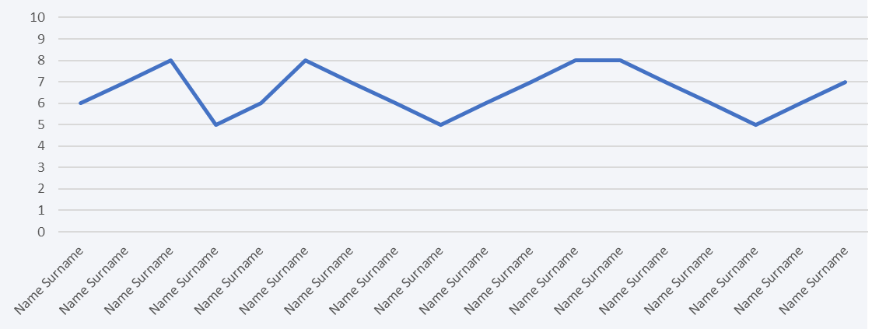
Homepage 2/2
logo
+
Settings
New Candidate
Candidates' metrics
Grade from 1 to 10 and linked with the final grade in the evaluation sheet
Recommendation (Rec) = offer, not offer, second interview
Starting date as per the candidate availability

Slide 6
Single candidate overview (1/2)
+
New Candidate
logo
Workday Profile
Download CV
[name & surname of candidate] evaluation sheet
Name Surname
Grade
Rec
Starting date
Interviewer
API with workday for the candidate profile
The grade is a WA
Elevator pitch interviewee
Grade
What did you achieve in this experience?
Grade
What have you precisely done in this experience?
Grade
What is your favorite experience?
Grade
Why consulting?
Grade
Why Accenture?
Grade
Working under stress?
Grade
Experience failures? How did you handle it?
Grade

Slide 7
Single candidate overview (2/2)
+
New Candidate
logo
Workday Profile
Download CV
[name & surname of candidate] evaluation sheet
Name Surname
Grade
Rec
Starting date
Interviewer
API with workday for the candidate profile
The grade is a WA
What motivates you / what demotivates you?
Grade
What does a consultant do?
Grade
3 most important skills of consultant and why?
Grade
Tell me about a time where you had a leading role / managed people
Grade
What are the current trends and dynamics in the financial services industry?
Grade
Tell me about your understanding of a current new technology and the impact / role in the FS industry?
Grade
What is the future of banks in your perspective?
Grade
Business Case
Grade

Slide 8
Interviewer working page (questions)
+
New Candidate
logo
Workday Profile
Download CV
[name & surname of candidate] Questions
Why consulting?
[ text space for interviewer comments]
All questions and comments are then saved in the candidate profile – it can be access anytime after the interview is complete
1
2
3
4
5
6
7
8
9
10
Previous
question
Why Accenture?
Next
question
Experience failures? How did you handle it?

Slide 9
Interviewer working page (Business Case)
+
New Candidate
logo
Workday Profile
Download CV
[name & surname of candidate] Questions
Business Case
Context
[ text space for interviewer comments]
Approach
All questions and comments are then saved in the candidate profile – it can be access anytime after the interview is complete
Expected Results
1
2
3
4
5
6
7
8
9
10
Previous
question
What is the future of banks in your perspective?

Slide 10
Evaluation sheet
logo
+
+
New Candidate
Add question
Elevator pitch interviewee | 10%
What did you achieve in this experience? | 1%
What have you precisely done in this experience? | 1%
What is your favorite experience? | 1%
Why consulting? | 1%
Why Accenture? | 1%
Working under stress? | 1%
Experience failures? How did you handle it? | 10%
What motivates you / what demotivates you? | 10%
What does a consultant do? | 5%
3 most important skills of consultant and why? | 5%
Tell me about a time where you had a leading role / managed people | 1%
What are the current trends and dynamics in the financial services industry? | 1%
Tell me about your understanding of a current new technology and the impact / role in the FS industry? | 1%
What is the future of banks in your perspective? | 1%
Business case | 50%
Empty evaluation sheet
Here it is possible to change the questions and list the questions in a different order
It is also possible to assign a different weighting to the questions – however this should only work for new interviews and new questions otherwise it will be more difficult to compare candidate – hence the team should decide together a common weighting at the beginning
The business case should be selected prior the interview and from the library

Slide 11
Business case library & Settings
logo
+
Settings
Add Business case
BC Title
Type
Difficulty
Expected time to solve
Context
BC Title
Type
Difficulty
Expected time to solve
Business case library with expected results and process/framework to solve it
Type = Market sizing, teaser etc etc
Difficulty = low, medium, high
Expected time to solve = depending on the interview from 10 to 30 mins
BC Title
Type
Difficulty
Expected time to solve
BC Title
Type
Difficulty
Expected time to solve
Approach / Framework
BC Title
Type
Difficulty
Expected time to solve
BC Title
Type
Difficulty
Expected time to solve
BC Title
Type
Difficulty
Expected time to solve
Expected results
BC Title
Type
Difficulty
Expected time to solve

Slide 12
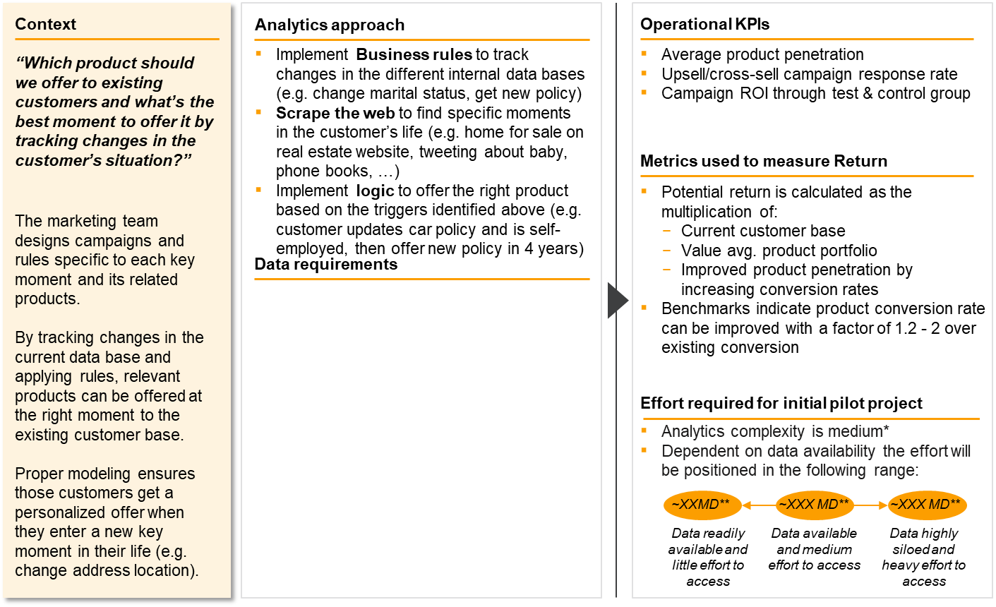
New Business case
logo
Settings
Save
Submit
Business case library with expected results and process/framework to solve it

Slide 13
Things needed
Cloud to store all data
Metrics and KPIs analysis of all candidates
API capabilities

