Slide 1

Requirements:
An application to display the optimum selling price of coal for particular grade of coal, on particular date and port.
Selling price will quoted based on model or rules engine built over historical data of raw price, demand, supply, selling price of AEL and competitor respectively.

Slide 2
Example:
Let say AEL and competitor stock S1 and S2 , dispatch quantity D1 and D2 and intransit quantity I1 and I2 and previous selling price SP1 and SP2.
Now analysing the above parameters we have to quote the new selling price SP.
It may be SP+x% or SP-x%.

Slide 3
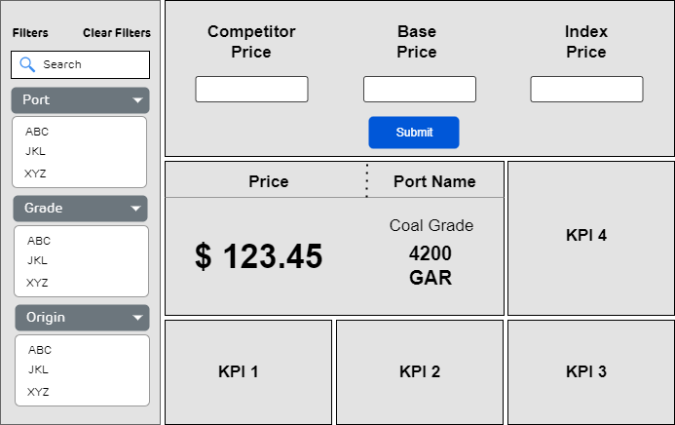
Wireframe:

