Slide 1

6

Slide 2





PRESENTED BY:
Ameer hamza
PRESENTED TO:
SHAHZAD ALI RANA
CLASS/SEMESTER
BSCS/7st Semester
Roll Number : 49410 Registration Number :2019-GCUf-080876

Slide 3
TOPIC
Streaming computing

Slide 4
CONTENTS
INTRODUCTION
LITERATURE REVIEW
NEED OF RESEARCH
BACKGROUND STUDY
OBJECTIVES
PROPOSED SOLUTION
PREDECTIVE RESULT
FUTURE SCOPE
REFERANCES

Slide 5
INTRODCTION
Distributed Computing
In distributed computing, we have multiple autonomous computers which seem to the user as a single system. In distributed systems, there is no shared memory and computers communicate with each other through message passing. In distributed computing, a single task is divided among different computers.

Slide 6
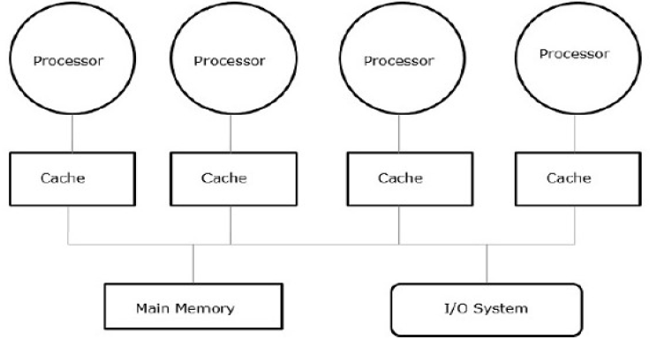
INTRODCTION
Distributed Computing

Slide 7
INTRODCTION
Smart City definition
we define a smart city as a high-performance urban context, where citizens are interconnected to each others and to the city itself, which provides a constant flow of information, personalized to the user’s needs and preferences. Citizens are more independent, more aware of the surrounding opportunities, and benefit from the integrated services that the city offers.

Slide 8
INTRODCTION
The ICT infrastructure is the brain of the city, governs its body and reacts to the circumstances intelligently. A smart city allows new ideas to prosper and new, more efficient approaches to be developed in economy, politics, governance, mobility, environment and all the other aspects of city life

Slide 9
INTRODCTION
Smart cities today
Smart cities are close to becoming a common reality. Recently, many experiments and pioneering projects have been successfully run. Some of these works cover specific applications and services suitable for smart cities (often involving mobile devices), while other are integrated plans for an entire city, both theoretical or actually implemented.

Slide 10
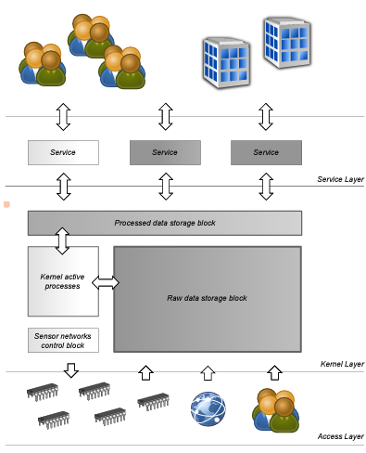
Distributed Smart City Services for Urban Ecosystems
INTRODCTION

Slide 11
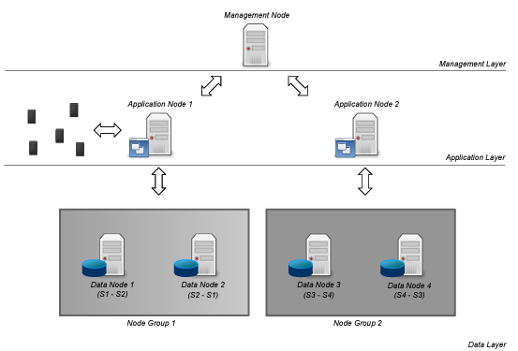
Distributed infrastructure
INTRODCTION

Slide 12

Literature Review

Slide 13
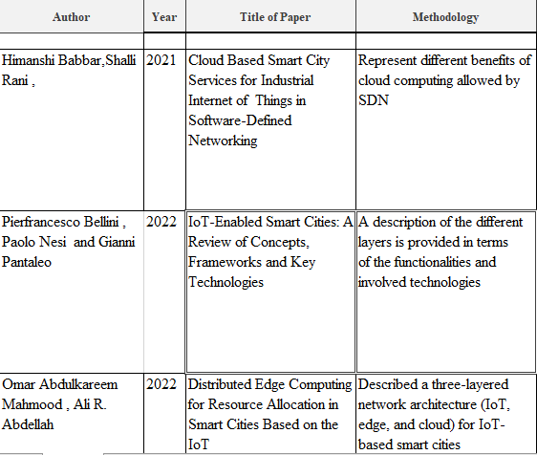
Literature Review

Slide 14
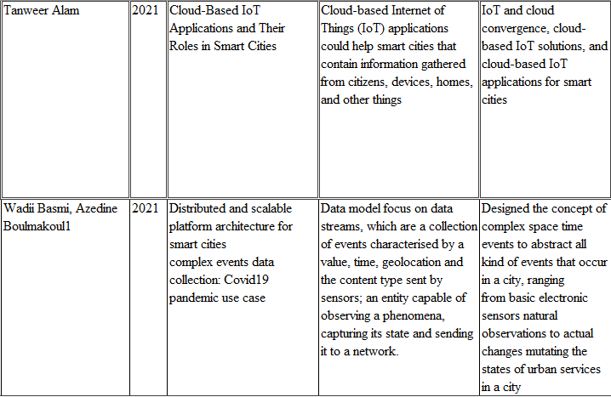
Literature Review

Slide 15
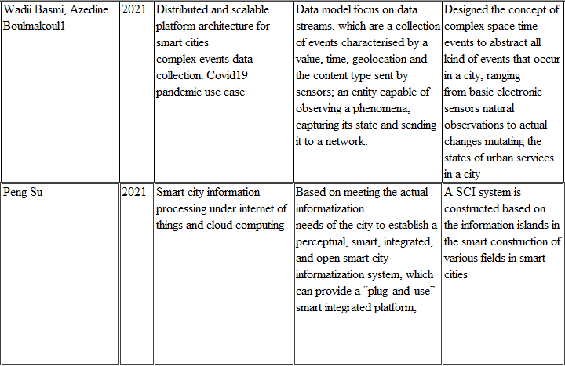
Literature Review

Slide 16
NEED OF RESEARCH
The main Scope of the research is:
Smart cities generally aim at efficiently organizing and managing city resources through a digital layer on top of the legacy infrastructure. As the digitalization trend goes on with an increasing pace and with the involvement of a diverse set of actors, proper management of this digital layer as well as the services deployed over it becomes ever more crucial. This article presents our methodology of transforming the complex smart city concept and its digital layer into a structured model for creating a dynamic and adaptive service ecosystem in the digital cities of future.

Slide 17
BACKGROUND STUDY
While the notion of an ontology has many different deﬁni-
tions, the most consensus on an ontology is ‘‘being a formal,
explicit speciﬁcation of a shared conceptualization .’’
Main components of ontologies are the domain-relevant enti-
ties, organized as concepts, and their (unary and binary)
relations, formulated in a logical language. A taxonomy,
which deﬁnes generalization and specialization relations on
the individual concepts forms the basis of the ontology . In the so-called Semantic Web, ontologies have become pop-ular due to the possibility to share knowledge that can be parsed by software agents, integrated into their knowledge base to reason about the gathered information and com-
bine different facts to obtain new knowledge .

Slide 18
BACKGROUND STUDY
In recent years, some authors have claimed sensitivity
higher than 95% [51, 54, 84, 85, 90, 109].
However, these methods were unable to overcome the false positive rate. 100% sensitivity, but their results are on a dataset containing only large nodules of size greater than 5mm.

Slide 19
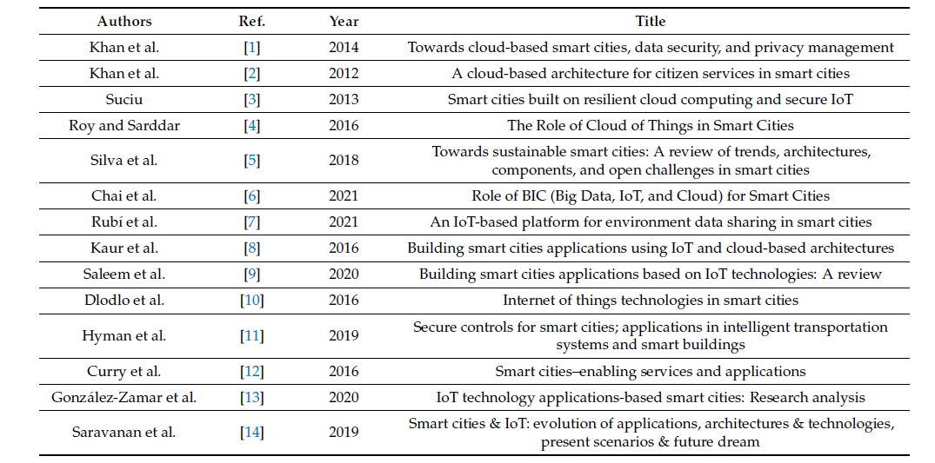
BACKGROUND STUDY

Slide 20
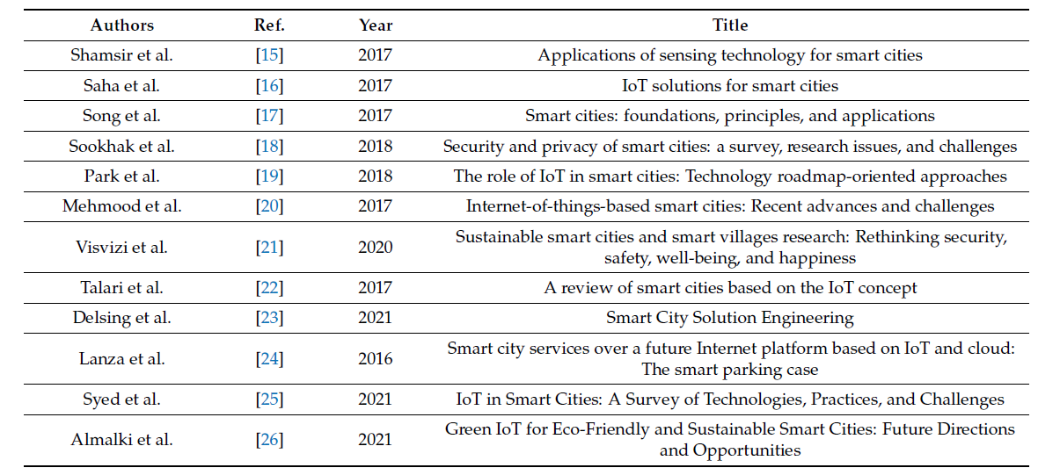
BACKGROUND STUDY

Slide 21
OBJECTIVE
The main objective is to develop
algorithms/techniques:
The three major enablers that are identified in this direction are
(i) a semantic functional description of city objects, representing physical devices or abstract services
(ii) a distributed service directory that embodies available city services for service lookup and discovery
(iii) planning tools for selecting and chaining basic services to compose new complex services.

Slide 22
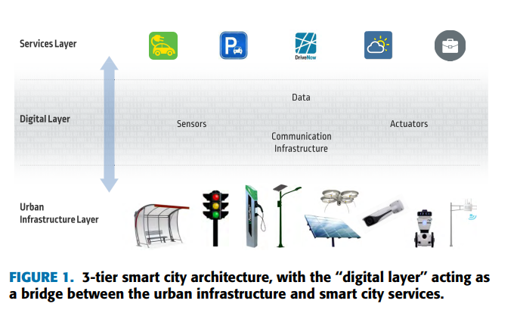
PROPOSED SOLUTION

Slide 23
PREDECTIVE RESULT
Present our methodology of transforming the complex smart city concept and its digital layer into a common structured model for creating a dynamic, adaptive and unied service ecosystem. This is
achieved by encapsulating both ICT-capable physical devices
and virtual online services into a common model, referred to as Smart City Objects (SCO). A smart city object can be as simple as a temperature sensor providing data to the cloud or as complex as a trip assistance service that stems from a well-crafted composition of many other SCOs from transportation and energy domains.

Slide 24
PREDECTIVE RESULT
Internet of Smart City Objects which aims at the design, creation and holistic interconnection of smart city objects from different domains through its open and extensible platform and its supporting tools. With this objective, we move away from fragmented
Internet of Things (IoT) solutions and isolated data silos in cities towards a more integrated, scalable and harmonized smart city ecosystem

Slide 25
FUTURE SCOPE
The ISCO project focused on the initial design and proof-
of-concept implementation of a smart city framework that
eases the implementation and deployment of dynamic and
self-adaptive software. Towards this objective, the general
concept and main components of our solution were presented
in this article, which consists of a Smart City Object API,
an ICN-based distributed service directory, and an adaptive
planning component for dynamic service composition. The
framework, protocols, and tools developed in our solution
can be exploited by various city stakeholders for the efﬁcient
creation, discovery, and execution of harmonious services in
the smart city service ecosystem.

Slide 26
REFERANCES
[1] Bab bar, H.; Rani, S.; Singh,A.; Abd-Elnaby, M.; Choi, B.J. Cloud Based Smart City Services for Industrial Internet of Things in Software-Defined Networking
2021, 13, 8910. https://doi.org/10.3390/su13168910
[2] Bellini, P.; Nesi, P.; Pantaleo, G. IoT-Enabled Smart Cities: A Review of Concepts, Frameworks and Key Technologies. Appl. Sci.
Appl. Sci. 2022, 12, 1607. https://doi.org/10.3390/app12031607
[3] Mahmood, O.A.; Abdellah, A.R.; Muthanna, A.; Koucheryavy, A. Distributed Edge Computing for Resource Allocation in Smart Cities Based on the IoT. Information 2022, 13, 328. https://doi.org/10.3390/ info13070328
[4] Alam, T. Cloud-Based IoT Applications and Their Roles in Smart Cities. Smart Cities 2021, 4, 1196–1219. https://doi.org/10.3390/smartcities4030064

Slide 27
REFERANCES
[5] Basmi W, Boulmakoul A, Karim L, Lbath A (2020) Modern approach to design a distributed and scalable platform architecture for smart cities complex events data collection. Procedia Comput Sci 170:43–50. https ://doi.org/10.1016/j.procs .2020.03.008. http://www.scien cedir ect.com/scien ce/artic le/pii/S1877 05092 0304300
[6]Peng Su, Smart city information processing under internet of things and cloud computing (2022)78:3676–3695 https://doi.org/10.1007/s11227-021-03972-5

Slide 28
THANKS
ANY QUESTIONS

