Slide 1
Datamining and Foundations of AI: Assessment 2
100568617

Slide 2
Disclaimer
Jypter Notebooks might not be fully representative of the content in this PowerPoint, as reruns were made to make sure it was suitable for upload.
However, efforts have been made to make the process as reproducible as possible (seeding, function construction).

Slide 3
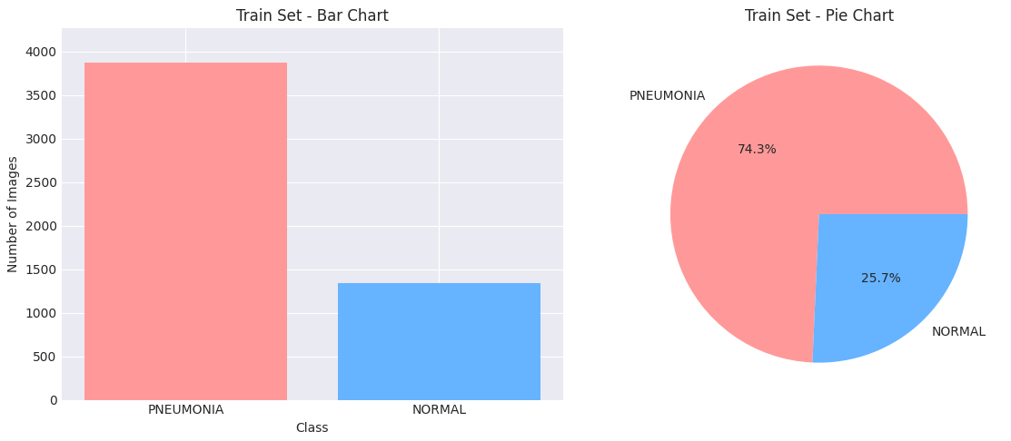
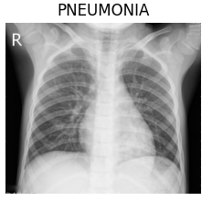
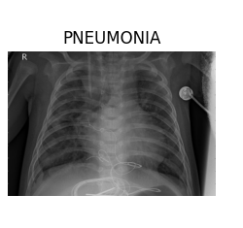
Solution Development
Followed keras transfer learning to make the experiment fair and reproducible - https://keras.io/guides/transfer_learning/
Loaded the from directory (tensor objects)
Augmented training set as there was concern of overfitting.
Cropped images to aspect ration (150, 125) as I was worried about external features influencing model training, and the images are narrow.
Reproducible functions (base_model, train_top_layers, fine_tune, build_cnn) to ensure others could implement it the same way.

Slide 4
Using Pretrained Models for Solutions
Why These Models?
Diverse range of models with variable architectures, parameters sizes and existing usage
Focus: Training and Performance, comparison
ResNet50
Many layers, including batch normalisation, relu activations.
Residual blocks contain convolutional layers that create paths to add the input to the output facilitating gradient flow.
InceptionV3
Improved version of GoogLeNet.
Parallel convolutional layers with different filter sizes from 1x1, to, 3x3 with pooling layers.
Each module is stacked to form a deep network.
EfficientNetB0
MBConv Layers, batch normalisation and squeeze blocks.
Starts with simple stem, followed by many conv blocks increasing depth and width, with a fully connected layer.

Slide 5
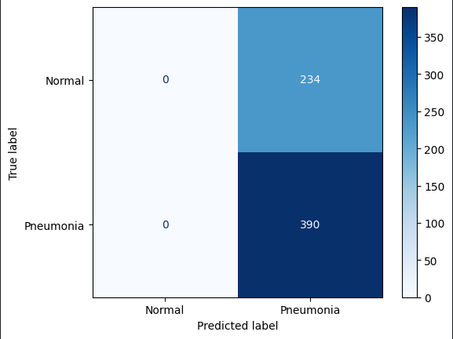


ResNet50, EfficientNetB0, InceptionV3 Results
ResNet50
EfficientNetB0
InceptionV3

Slide 6
Findings ResNet50, EfficientNetB0, InceptionV3
ResNet50 Moderate accuracy
Struggles with 'Normal' case predictions
EfficientNetB0
Lowest accuracy,
Highest validation loss
Fails to predict 'Normal' cases correctly
InceptionV3
Highest accuracy
Best balance in predictions, needs improvement on false negatives

Slide 7
Custom CNN Architecture
First Conv Layer – Uses Conv2D, BatchNormalization, and MaxPooling2D to extract low-level features, stabilize training, and reduce spatial dimensions. – Low Level features
Residual Block - Incorporates Conv2D layers, BatchNormalization, and residual connections inspired by ResNet50 to prevent vanishing gradients and allow deeper networks. – Deeper Networks
Inception Block - Implements parallel Conv2D layers with different filter sizes and MaxPooling2D, inspired by InceptionV3, to capture multi-scale features and complex patterns. – Multi Scale Features
Efficient Scaling Block - Uses Conv2D layers, BatchNormalization, residual connections, and GlobalAveragePooling2D, inspired by EfficientNetB0, to balance network depth, width, and resolution, and prevent overfitting. – Data augmentation
This architecture efficiently combines techniques from ResNet50, InceptionV3, and EfficientNetB0 for robust performance and effective training. - robustness

Slide 8
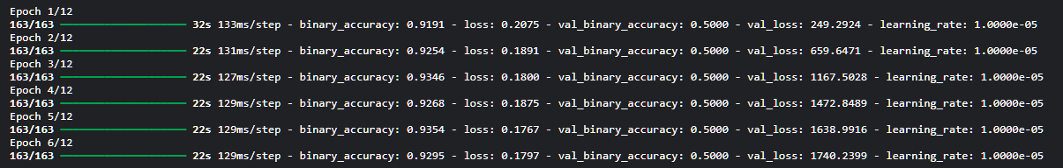
Evaluations – Custom CNN Soution
Other models required 3 color channels which was redundant considering the images were grayscale
Using single colour channel was far better for generating higher performance.
Using RGB channels resulted in high validation loss which effected the model's ability to predict true outcomes
RGB
Grayscale

Slide 9
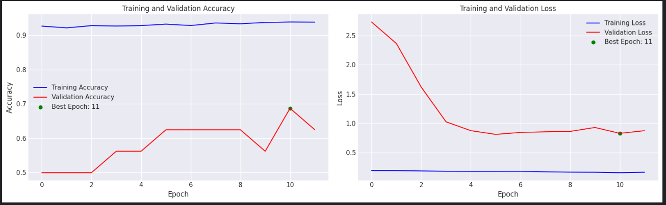
Evaluation – Custom CNN
Consitently high training Accuracy ~95%
Constant training Loss
Training very low, constant across epochs
Validation loss starts high but decreases significantly.
Suggests overfitting because of the high training accuracy and low rate of loss, with the fluctuating validation accuracy and higher validation loss.

Slide 10
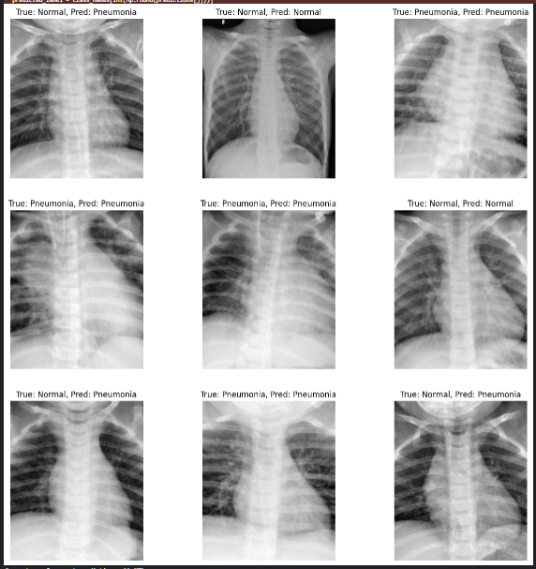
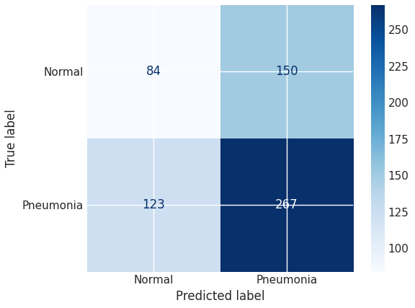
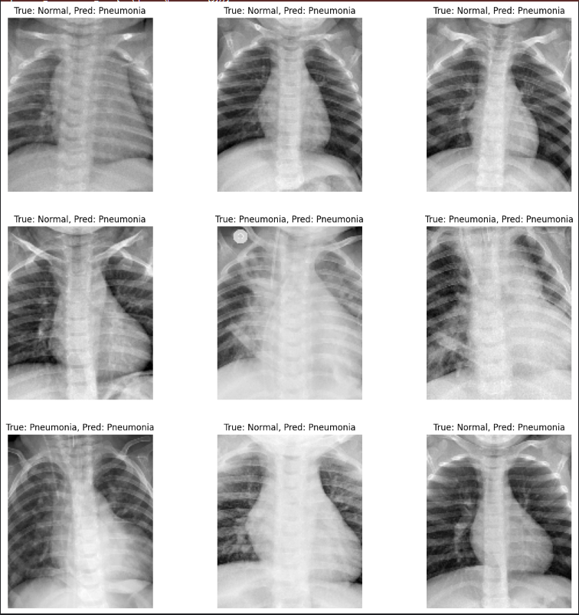
Evaluations – Custom CNN Model
The model performs well in predicting pneumonia cases
Overall, the model is great at detecting pneumonia, but very poor rate at classifying normal cases. This suggests a bias prediction bias towards pneumonic imagery. It also has a high rate of misclassification for normal cases.
High prediction rate for pneumonic images.
4 / 7 that were pneumonic were correct.
All predictions in this sample were pneumonic.
6/9 were normal.
Bias towards pneumonic, poor at identifying normal cases.

Slide 11
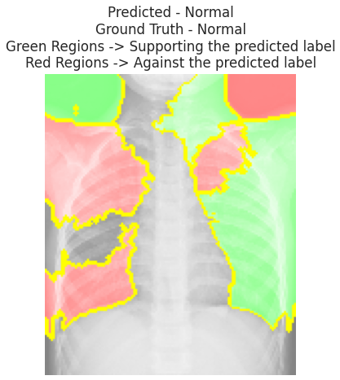
Evaluation with XAI (LIME)
Implemented LIME (Local Interpretable Model-Agnostic Explanations)
Green regions support the model's prediction of normal, whereas the red areas contain features such as abnormalities, which the model has learned to associate with non-normal cases.
Some areas still suggest further image preprocessing could have been performed and further model tuning.

Slide 12
Conclusion
A fair and balanced test using the same hyper parameters and building technique.
This may have impeded the model's ability to produce high quality results, which was evident with the consistent overfitting across models.
However, I used some preprocessing techniques that I believe enhance data models trustworthiness, as I didn’t allow outside features to influence the model's decision making.
The custom CNN model had outperformed the other models using the same base hyperparameters and was modelled from their architecture.
Overall, I believe that with the custom CNN models high accuracy, rate with detecting pneumonic patients and with the similar disadvantage of over fitting of the other models. The custom CNN model would be suitable for classifying patients with pneumonia with further extensive optimization and finetuning, because of its high validation accuracy and its high true positives.

