Slide 1
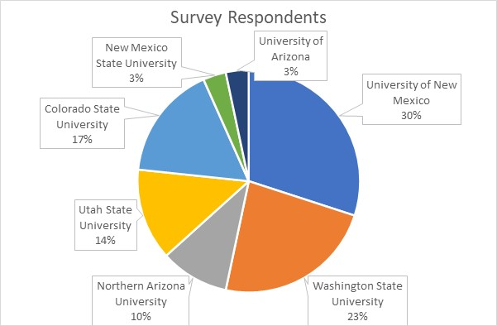
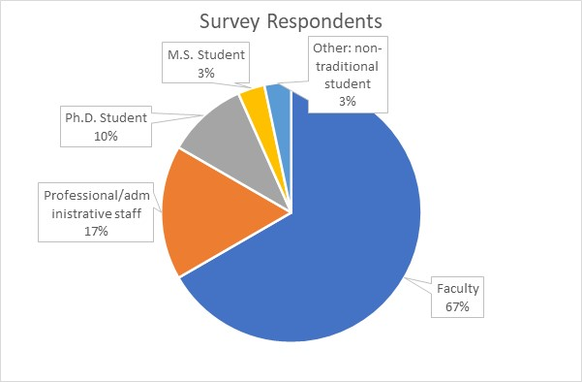
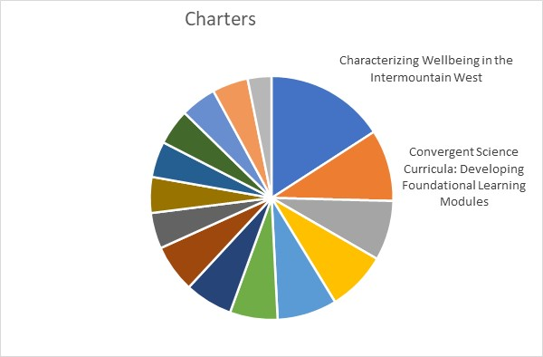
Survey respondents: 30
7 out of the 8 Universities (missing NM Tech)
Mostly faculty, though some students and some staff
All approved charters in our Google drive represented

Slide 2
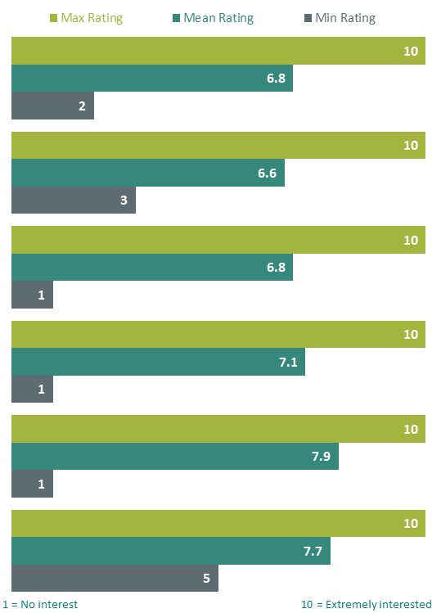
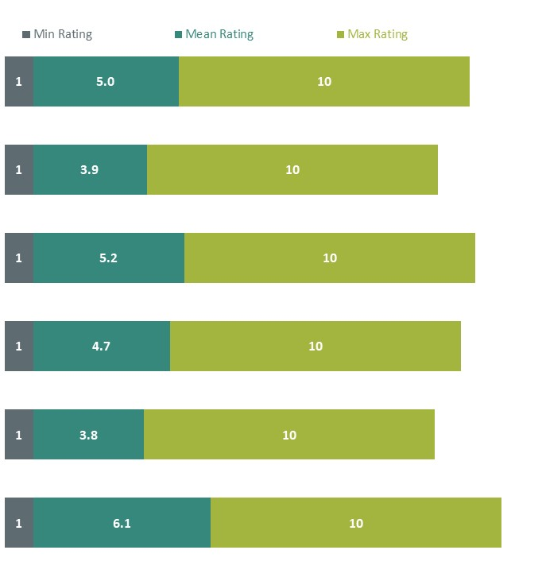
INTEREST
EXPERIENCE
CORPORATE/NGO
POLICY
AGENCIES
EXTENSION
INDIGENOUS
COMMUNITY

Slide 3
ALL STAKEHOLDER GROUPS
Interest weighed to high values for all groups – mostly above 5.
A significant proportion of respondents have low experience, especially with Indigenous communities…
… and significant proportions of respondents have high experience, especially with communities and agencies.

Slide 4
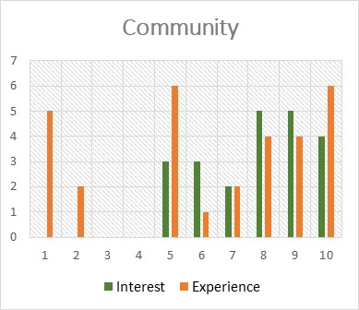
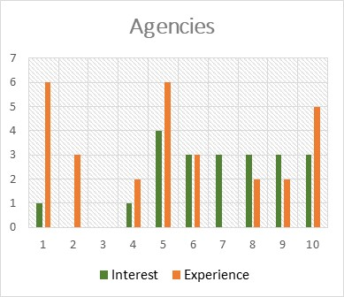
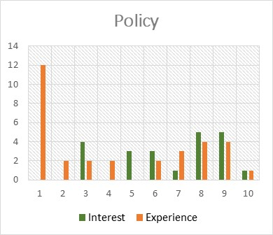
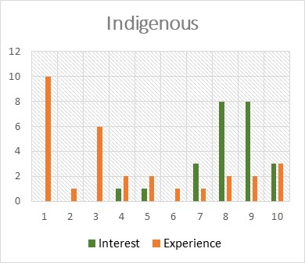
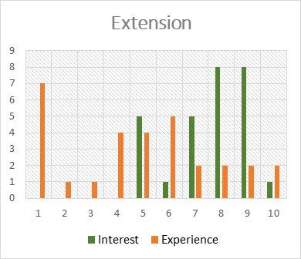
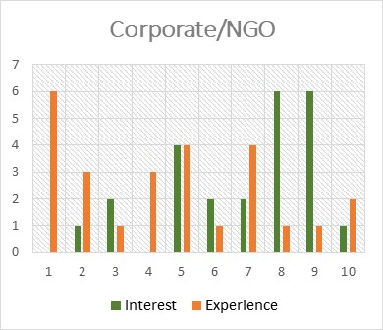
Subgroup 1
Interest matched with expertise at high values
New people with little expertise
Can we help each other, pair experts with new people?
Subgroup 2
Interest outpaces expertise at high values
New people with little expertise
Are these priorities for TN-wide resources and training?

Slide 5
Which of aspects of community engagement are you most interested in or have the most need in learning about through the TN?
Aspects
Best practices, including objectives of engagement, tools, and effectiveness metrics
How to increase impact
Science communications (including data visualization)
Stakeholders’ pressing questions
Integrating partners into research plans
Stakeholders
Tribal
Policy
Agencies
Extension
NGOs
Communities
International collaborators
K-12
Underrepresented groups
Topics
Water management
Food security
Food sovereignty
Equity
Other interesting comments
Connecting with other TN members
Addressing power imbalances
How to post-colonize science
Black: 4-5 comments Dark gray: 2-3 comments Light gray: 1 comment Light blue: additional groups not in survey

Slide 6
Please use the space below to list any other projects within the TN or future Project Charter(s) that you are working on
Watershed organizations in the Intermountain West – Courtney Flint
Energy transition/biofuels - Renia Ehrenfeucht
Considering settlement/resettlement/development patterns - Renia Ehrenfeucht (part of previous one?)
Small-scale sustainable off-grid FEW systems - Kelly Simmons-Potter (already submitted, waiting for response)
Regenerative agriculture – Jan Boll
Effects of conversion from semi-arid rangeland to urban low impact development on streamflow and watershed topography in Parker, CO - Aditi Bhaskar
History of how water resources engineering further settler colonialism in CO - Aditi Bhaskar
Economic issues related to resilience in the West – Dale Manning
Using co-production of knowledge to build regenerative food systems – Philip Moffatt

