Slide 1
Freeseer: Video Studio in a backpack
Introduction to Freeseer
March, 2010

Slide 2
Freeseer is...
A light weight recording studio
Optimized for recording presentations
Open source, licensed under the GPLv3 license
Features
Very easy to use interface
  click Record to start, Stop to end recording
  GUI form for entering the talk title, speaker, etc.
Freeseer mixes video & audio input to produce a video
Records locally, no network access needed
Supports free & open video and audio codecs
Supports a selection of input sources including firewire, X desktop capture, usb webcam, vga capture devices
Works on Linux: Fedora, Ubuntu, Arch, Gentoo
Windows support & live streaming planned for the future

Slide 3
Why does Freeseer exist?

Slide 4
Freeseer work flow
Set up
Record
Talk
Repeat until all talks captured
Publish
Talk(s)
Tear
Down

Slide 5
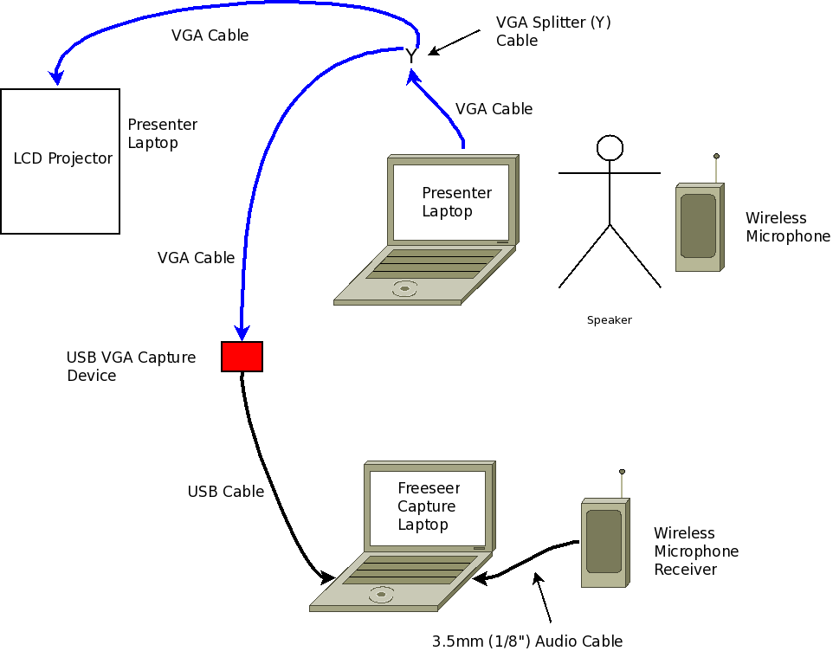
VGA Capture

Slide 6
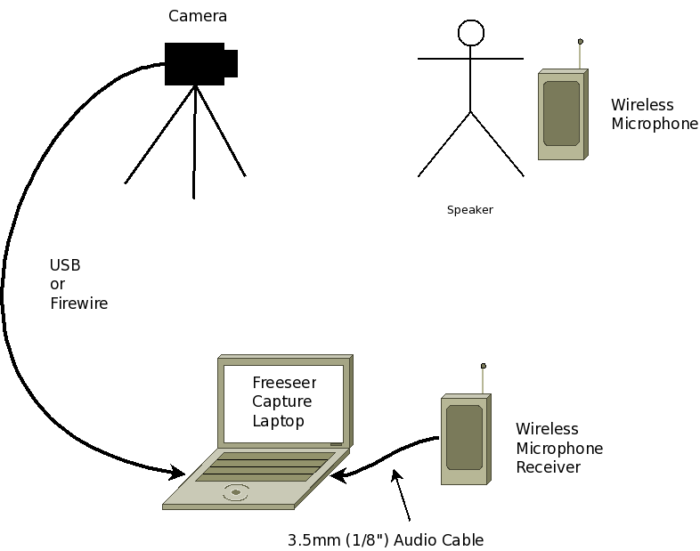
Camera Capture

Slide 7




Freeseer architecture
Choice of GUI implementations
Freeseer Engine with API

Slide 8
How to get involved....
Mailing list for discussion
IRC channel #freeseer on freenode
Code repository: git, hosted at github
Bug tracker: hosted at github
Wiki: hosted at github
Twitter, identi.ca: @freeseer

Slide 9
Thank you!

