Slide 1

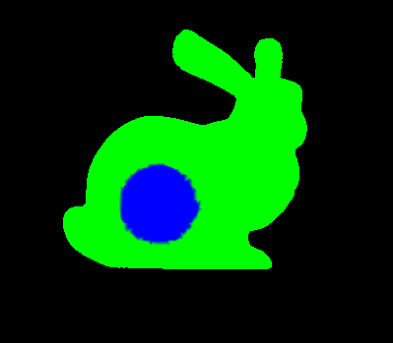
RAM
Space Ship
RAM
Space Ship
CPU
GPU
OpenGL

Slide 2
RAM
Space Ship
RAM
Space Ship
CPU
GPU
OpenGL

Slide 3
RAM
Space Ship
CPU
GPU
???????

Slide 4
“X” = x2-x1
“Y” = y2-y1
“Z” = z2-Z1
C^2 = X^2+Y^2+Z^2
sqrt(X^2 + y^2)
C^2 = A^2 + B^2

Slide 5
Shader program : 99
Vertex : 17
Fragment: 19

Slide 6
2nd buffer
Backbuffer
FrontBuffer

Slide 7
VRAM
Space Ship
RAM
Space Ship
Some file
code
OpenGL
“Back buffer”
CPU
C/C++ App.
GPU
GLSL
(Shaders)

Slide 8
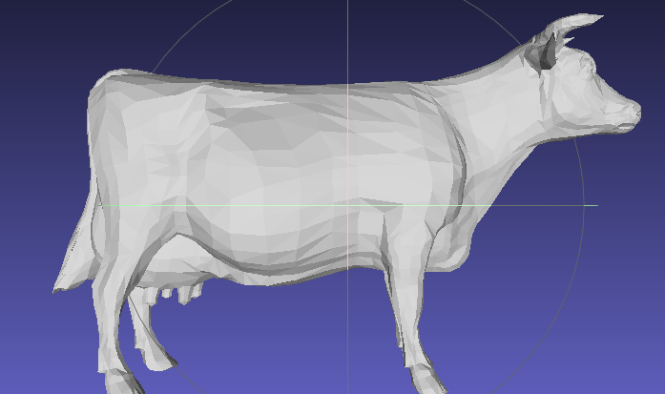
VRAM
Space Ship
RAM
Space Ship
Some file
Space Ship
code
Space Ship
OpenGL
“Back buffer”
CPU
C/C++ App.
GPU
GLSL
(Shaders)
Some file

